Slide 1


Year 1 Phonics
ear
ere

Slide 2
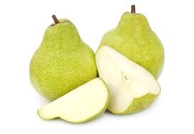
The sound ‘air’ is sometimes written with the letters ‘ear’.
pear

Slide 3

The sound ‘air’ is sometimes written with the letters ‘ere’.
where

Slide 4
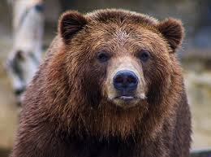
bear

Slide 5
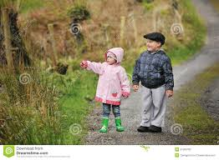
there

Slide 6
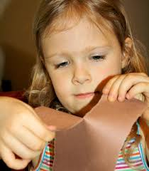
tear

Slide 7

everywhere

Slide 8
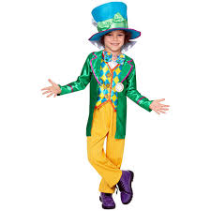
wearing

Slide 9
air
are
ear
ere

Slide 10
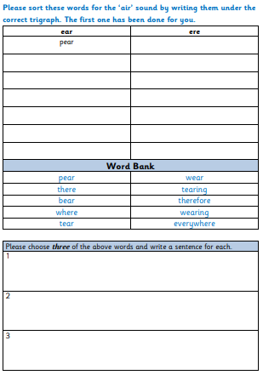
Task 1
Read the words in the word bank and sort them by writing them into the correct columns.
Choose three words and write a sentence for each word.

Slide 11
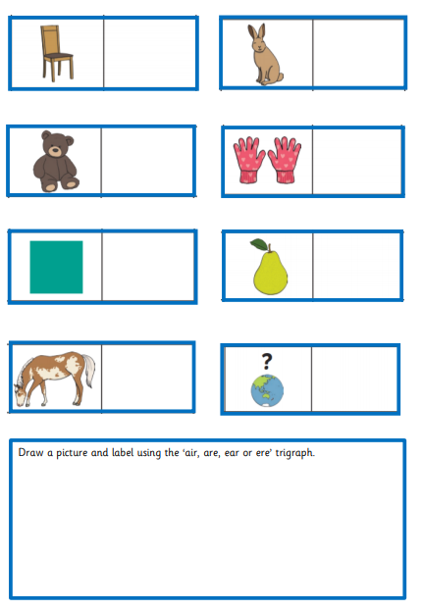
Task 2
Look at each picture and write the word using the correct trigraph.
Draw a picture and write the word using the correct trigraph.

