Slide 1

Thursday
4th March 2021

Slide 2
L.O: To fill the shopping basket with a certain weight.

Slide 3

Balance Scales
If the scales are level it means that both objects weigh the same
We use these to compare the weight of objects.

Slide 4
Balance Scales
It means it has the heavier object on that side.

Slide 5

Balance Scales
It means it has the lighter object on that side.

Slide 6

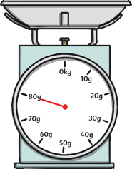

How Many?
How many grams does this currant bun weigh?
2 buns weighs 20g.
This currant bun weighs 10g.

Slide 7
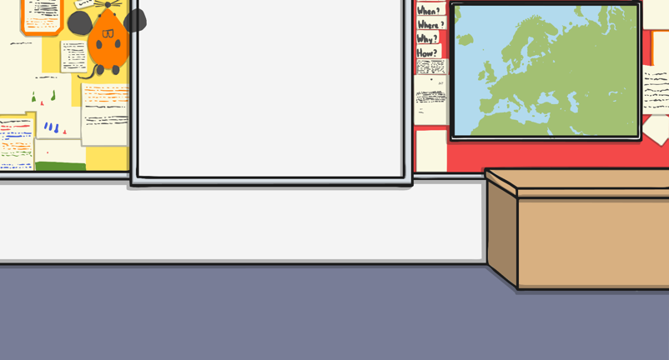
How Many?
This currant bun weighs 10g.
The bun and the apple weigh 15g

Slide 8
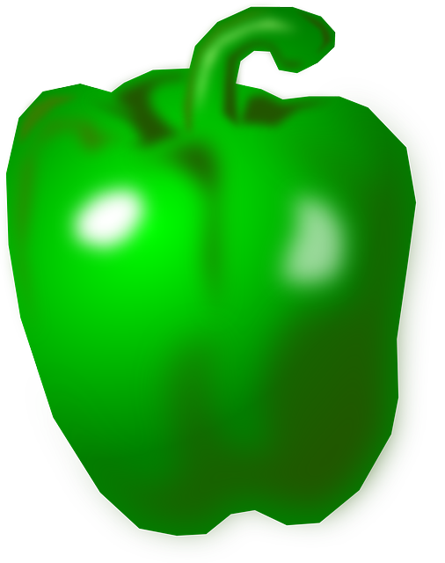

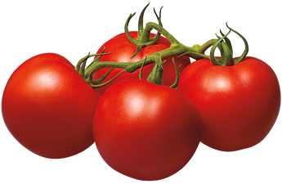
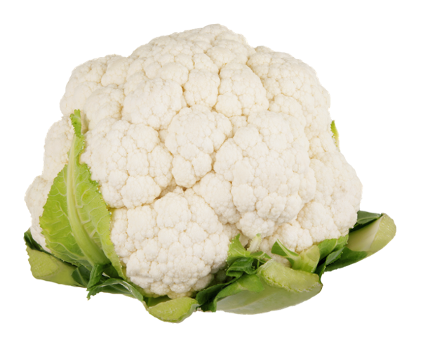
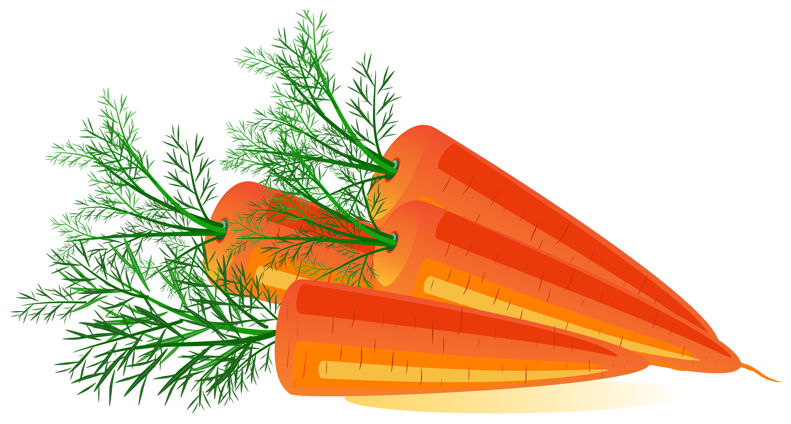
Let’s go shopping!
1g
2g
3g
10g
5g
5g
4g

Slide 9
+
5g
5g
= 10g

Slide 10
Let’s go shopping!
1g
1g
2g
2g
3g
3g
5g
5g
5g
4g

Slide 11
+
2g
3g
= 5g

Slide 12
Let’s go shopping!
1g
1g
2g
2g
3g
3g
6g
5g
5g
4g

Slide 13
Let’s go shopping!
1g
1g
2g
2g
3g
3g
8g
5g
5g
4g

Slide 14
.
Task

