Slide 1
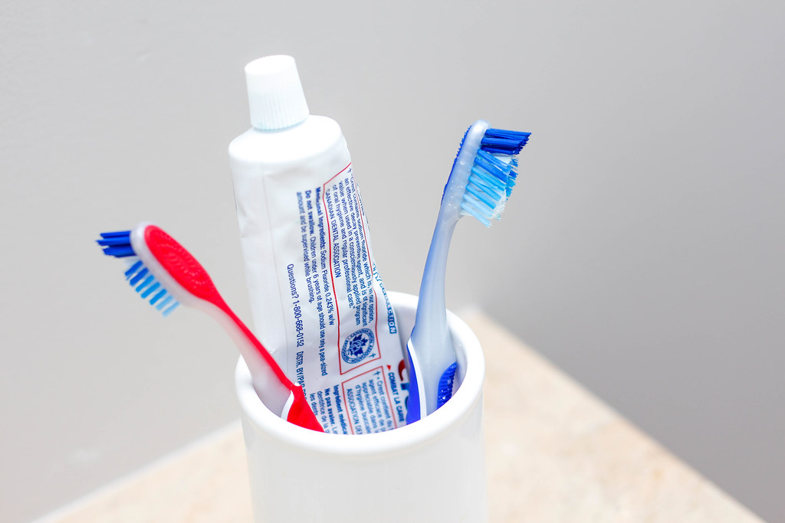
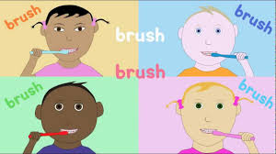

Teeth

Slide 2
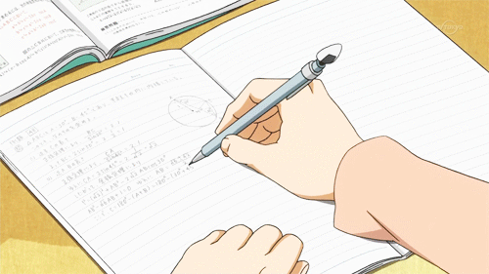
How can you keep your teeth healthy?
Write a list of ways in which you can look after your teeth. Keep the list safe and in tomorrow’s lesson see if you have included some of my ideas…

Slide 3
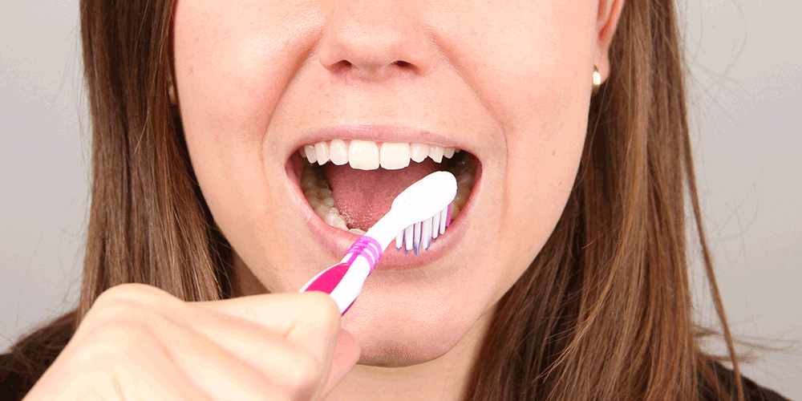
One of the most important ways to keep your teeth healthy is to brush them every day, twice a day.

Slide 4
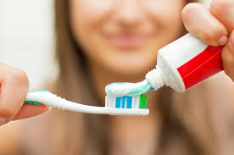
Learning Objective:
To write a set of instructions using time connectives.

Slide 5
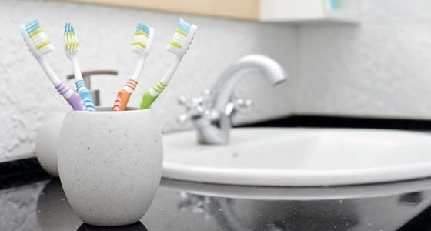
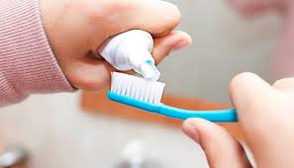
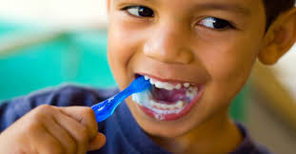
What are time connectives?
Time connectives are words that help us to know when something is happening.

Slide 6

What words can you use?
Time connectives are:
First
Next
Then
After that
Last or Finally
Before

Slide 7
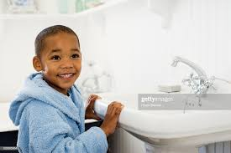
First I go into the bathroom.

Slide 8
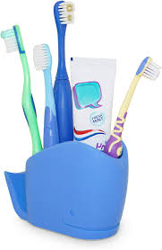
Next I get my toothbrush and some toothpaste.

Slide 9
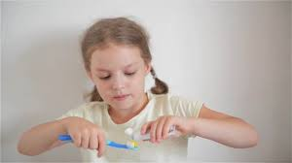
After that I put toothpaste on my toothbrush.

Slide 10
Then I brush my teeth.

Slide 11
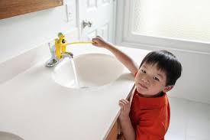
Before that I turn the tap on.

Slide 12
I brush my teeth for 2 minutes.

Slide 13
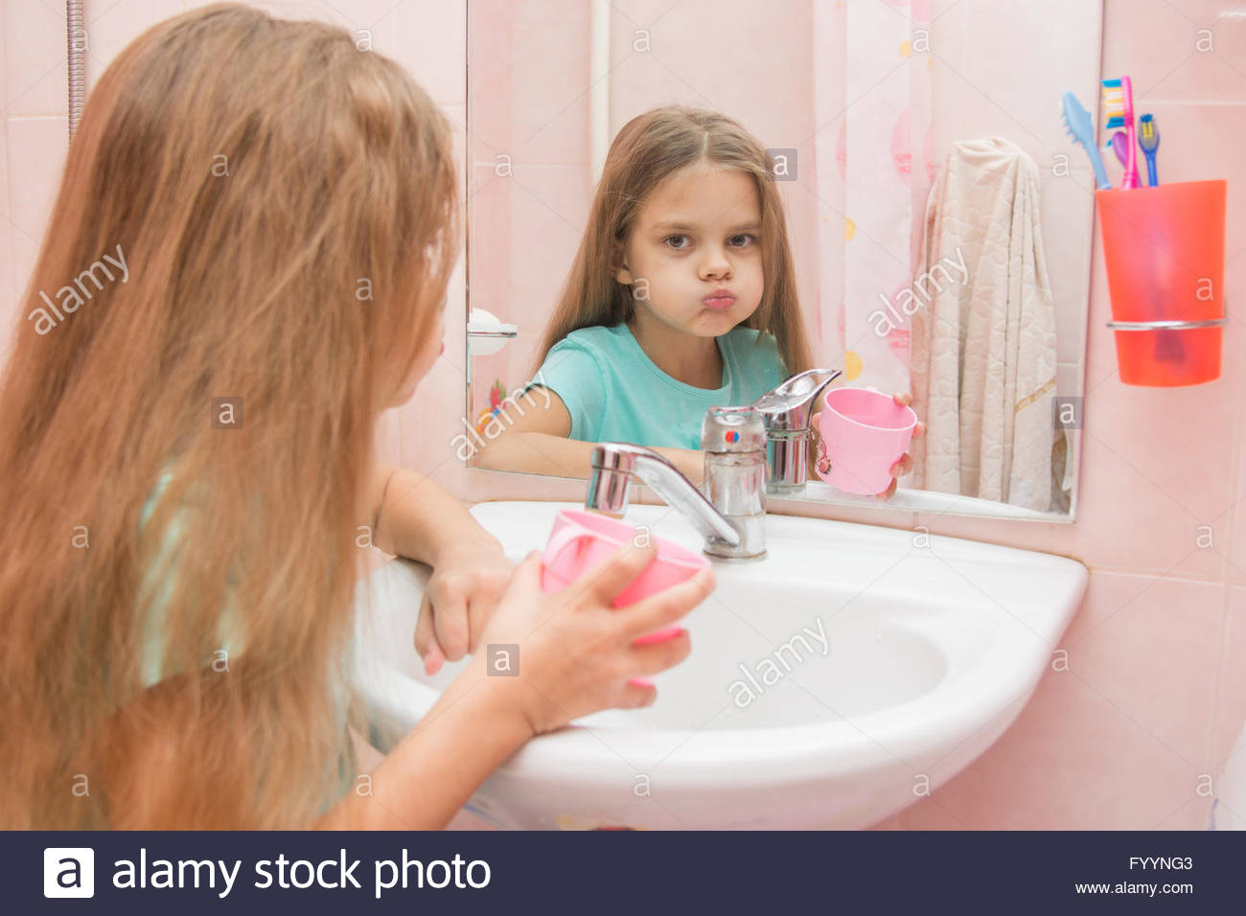
Next I rinse my mouth with water.

Slide 14
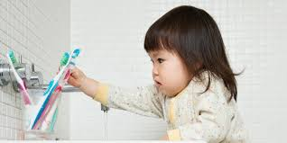
Finally I rinse my toothbrush and put it back where it is kept.

Slide 15



Time to smile!

Slide 16
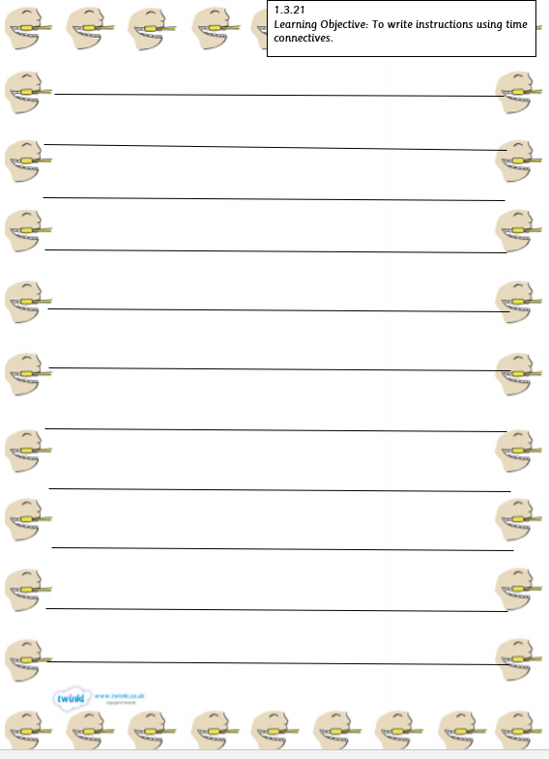
Write a set of instructions for brushing your teeth.
Try to use time connectives.
Remember to use capital letters, full stops and finger spaces.

Slide 17
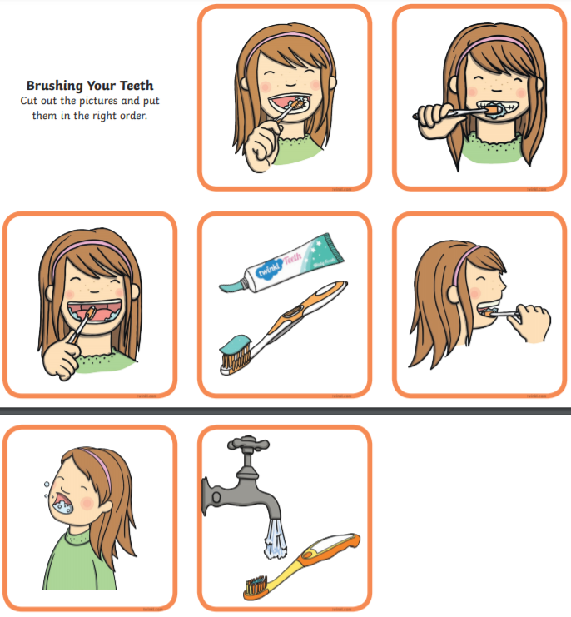
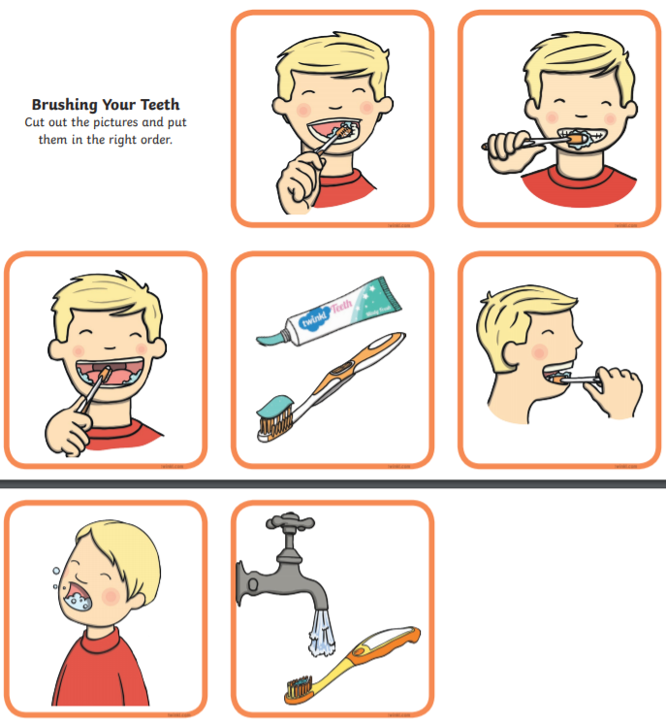
You can use the sequencing pictures to help if you wish.

