Slide 1

Monday
1st March 2021

Slide 2
L.O: To measure in centimeters using a ruler.

Slide 3

Starter
https://www.youtube.com/watch?v=2wUsdsae0ro

Slide 4

How many cubes long is the pencil?
8
The pencil is ________ cubes long.

Slide 5
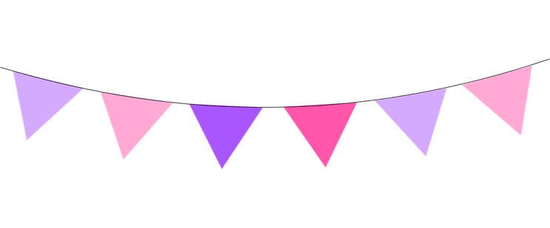
How many cubes long are the flags?
10
The flags are ________ cubes long.

Slide 6
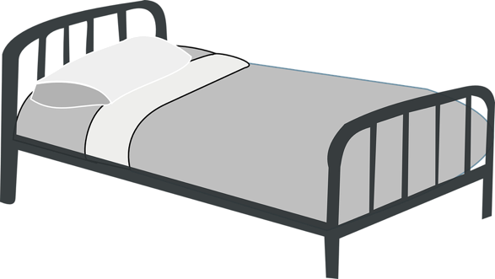

You could measure using hands.
7
The bed is ________ hands long.

Slide 7

You could measure using hands.
4
The bed is ________ hands long.

Slide 8

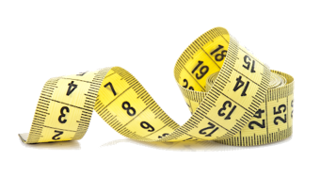
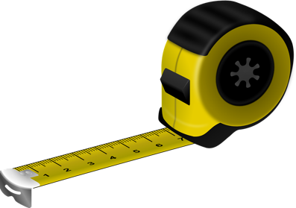
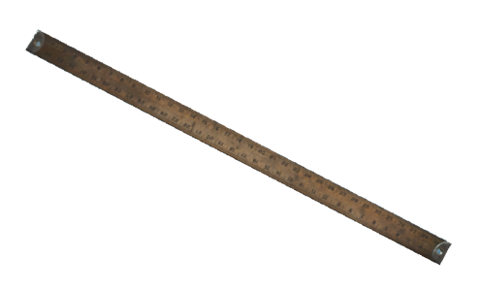
We use a centimetres as a standard unit of measure
This Photo by Unknown Author is licensed under CC BY-SA

Slide 9

Remember to line up the item at 0 when measuring.
Each mark is 1cm

Slide 10

How long is the pencil?
7
The pencil is _______ cm long.

Slide 11

How long is the pencil?
5
The pencil is _______ cm long.

Slide 12

How long is the pencil?
10
The pencil is ____ cm long.

Slide 13
6
The yellow straw is _______cm.
The pink straw is _______cm.
The green straw is _______cm.
4
9
green
The _________ straw is the tallest.
The _________ straw is the shortest.
pink

Slide 14
ÇÇÇ
3
The blue straw is _______cm.
The red straw is _______cm.
The purple straw is _______cm.
10
9
red
The _________ straw is the tallest.
The _________ straw is the shortest.
blue

Slide 15

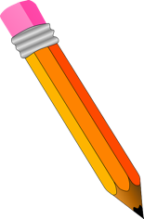
The pencil is 6cm long.
What mistake has Sue made? Explain your answer
Sue has measured from 1cm instead of lining it up at 0.
5cm
How long is the pencil?

Slide 16

Drawing lines to the correct measurement
4cm

Slide 17
Drawing lines to the correct measurement
8
cm

Slide 18
.
Task 1

Slide 19
.
Task 2

Slide 20
.
Extension Task
1.Measure everyone in your family. Who is the tallest? Who is the shortest? 2. Measure how tall you are and mark your height with masking tape on the floor. Place objects side by side next to your height. Can you find a combination of objects that measures the same length as your height? 3. With someone’s help, measure the distance from fingertip to fingertip when you stretch your arms wide. Compare the distances to other members of your family- do you notice anything?

