Slide 1
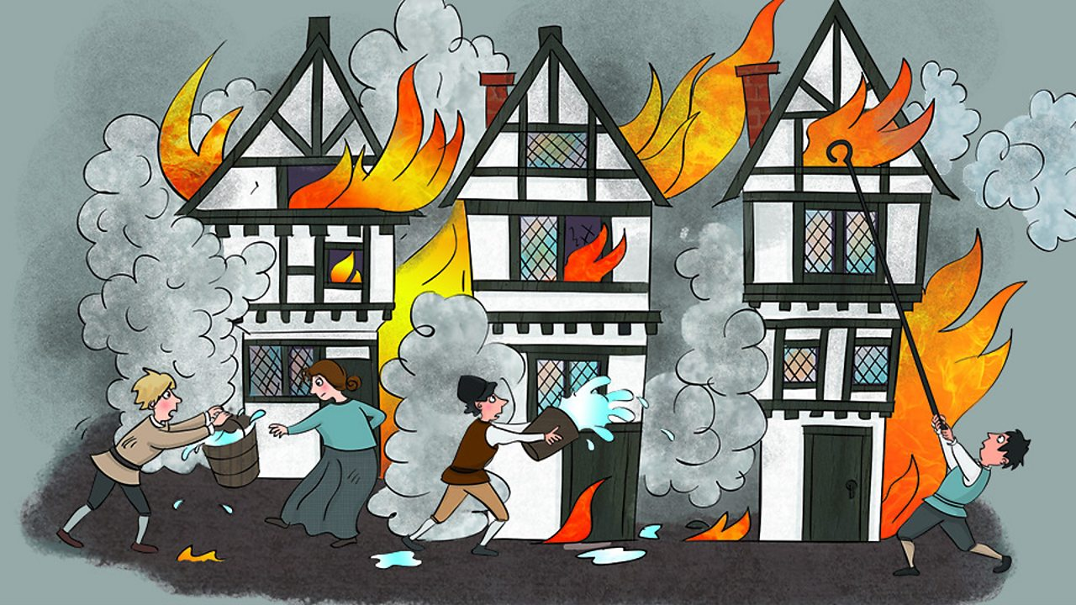

The Great Fire of London

Slide 2
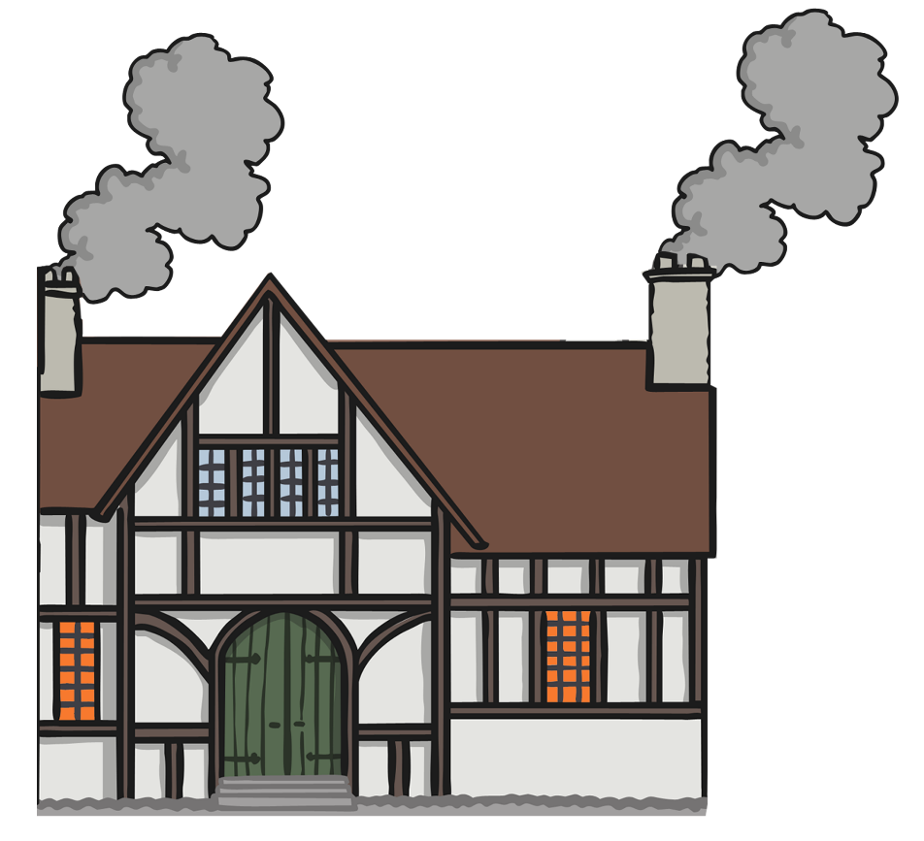
1st Day - Sunday 2nd September 1666
It is believed that a spark from the bakers oven started the fire.
The family jumped for safety from the upstairs window. It is reported that the maid died because she was too scared to jump.
The fire starts at Thomas Farriner’s bakery on Pudding lane.

Slide 3
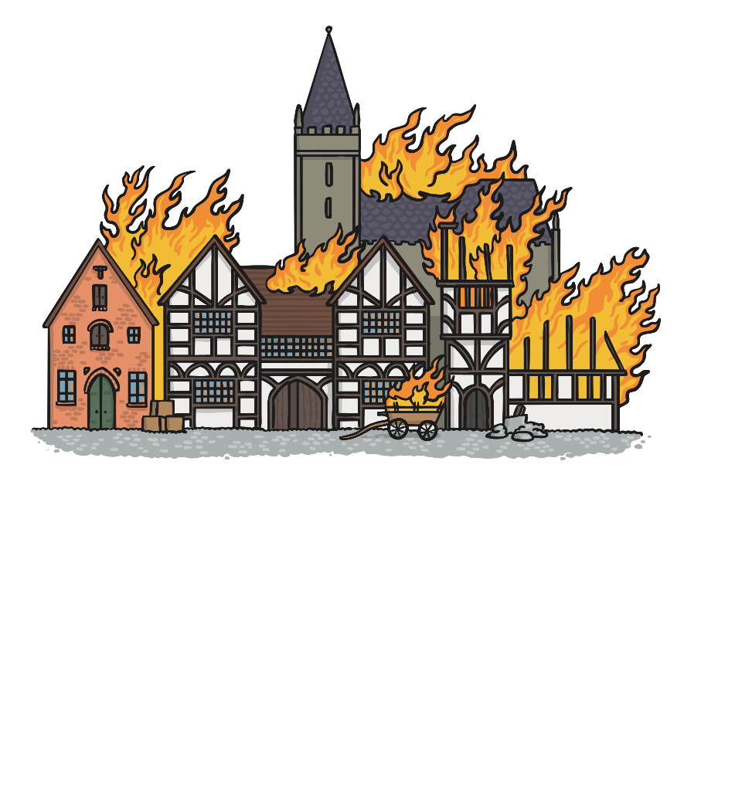
1st Day - Sunday 2nd September 1666
Within 30 minutes the fire had spread to the neighbours house.
There had been a drought so everything was very dry causing the fire to spread quickly.

Slide 4
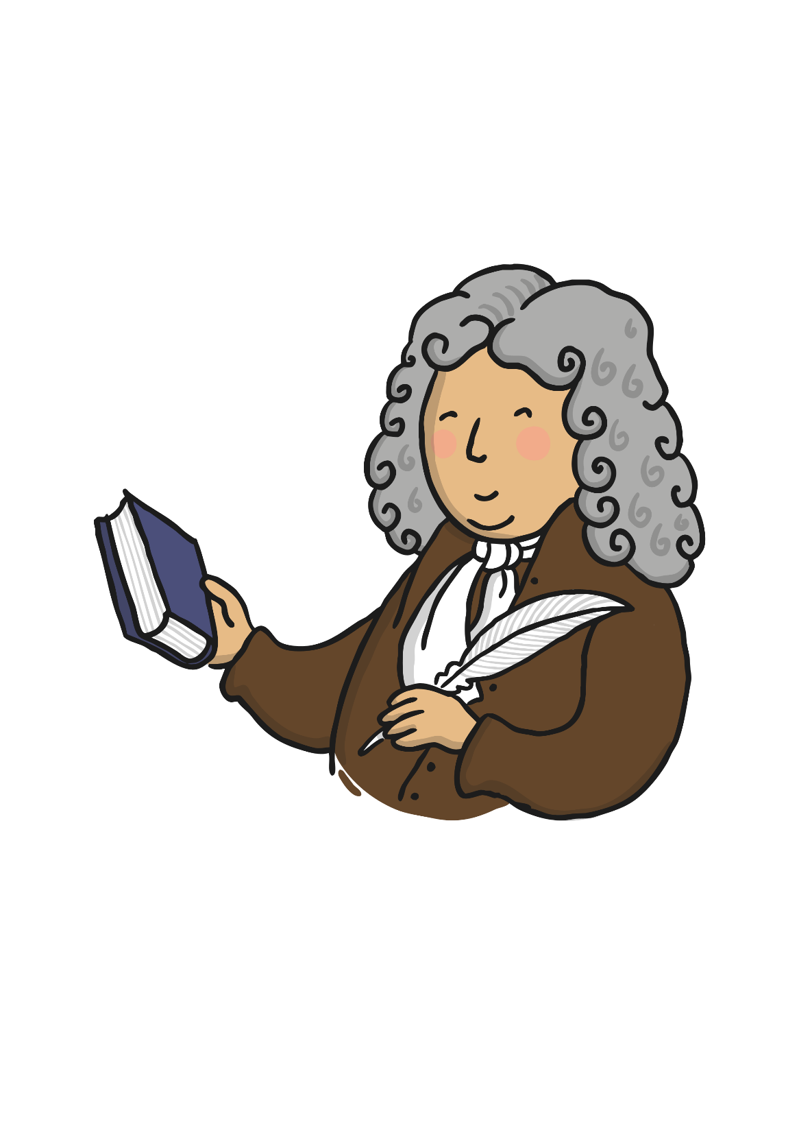
Sunday morning
3am in the morning Samuel Pepys was woken by his maid to report the fire.
He saw it was far away in so went back to sleep.
7am Samuel Pepys wakes up to hear that over 300 hundred homes had been destroyed.

Slide 5

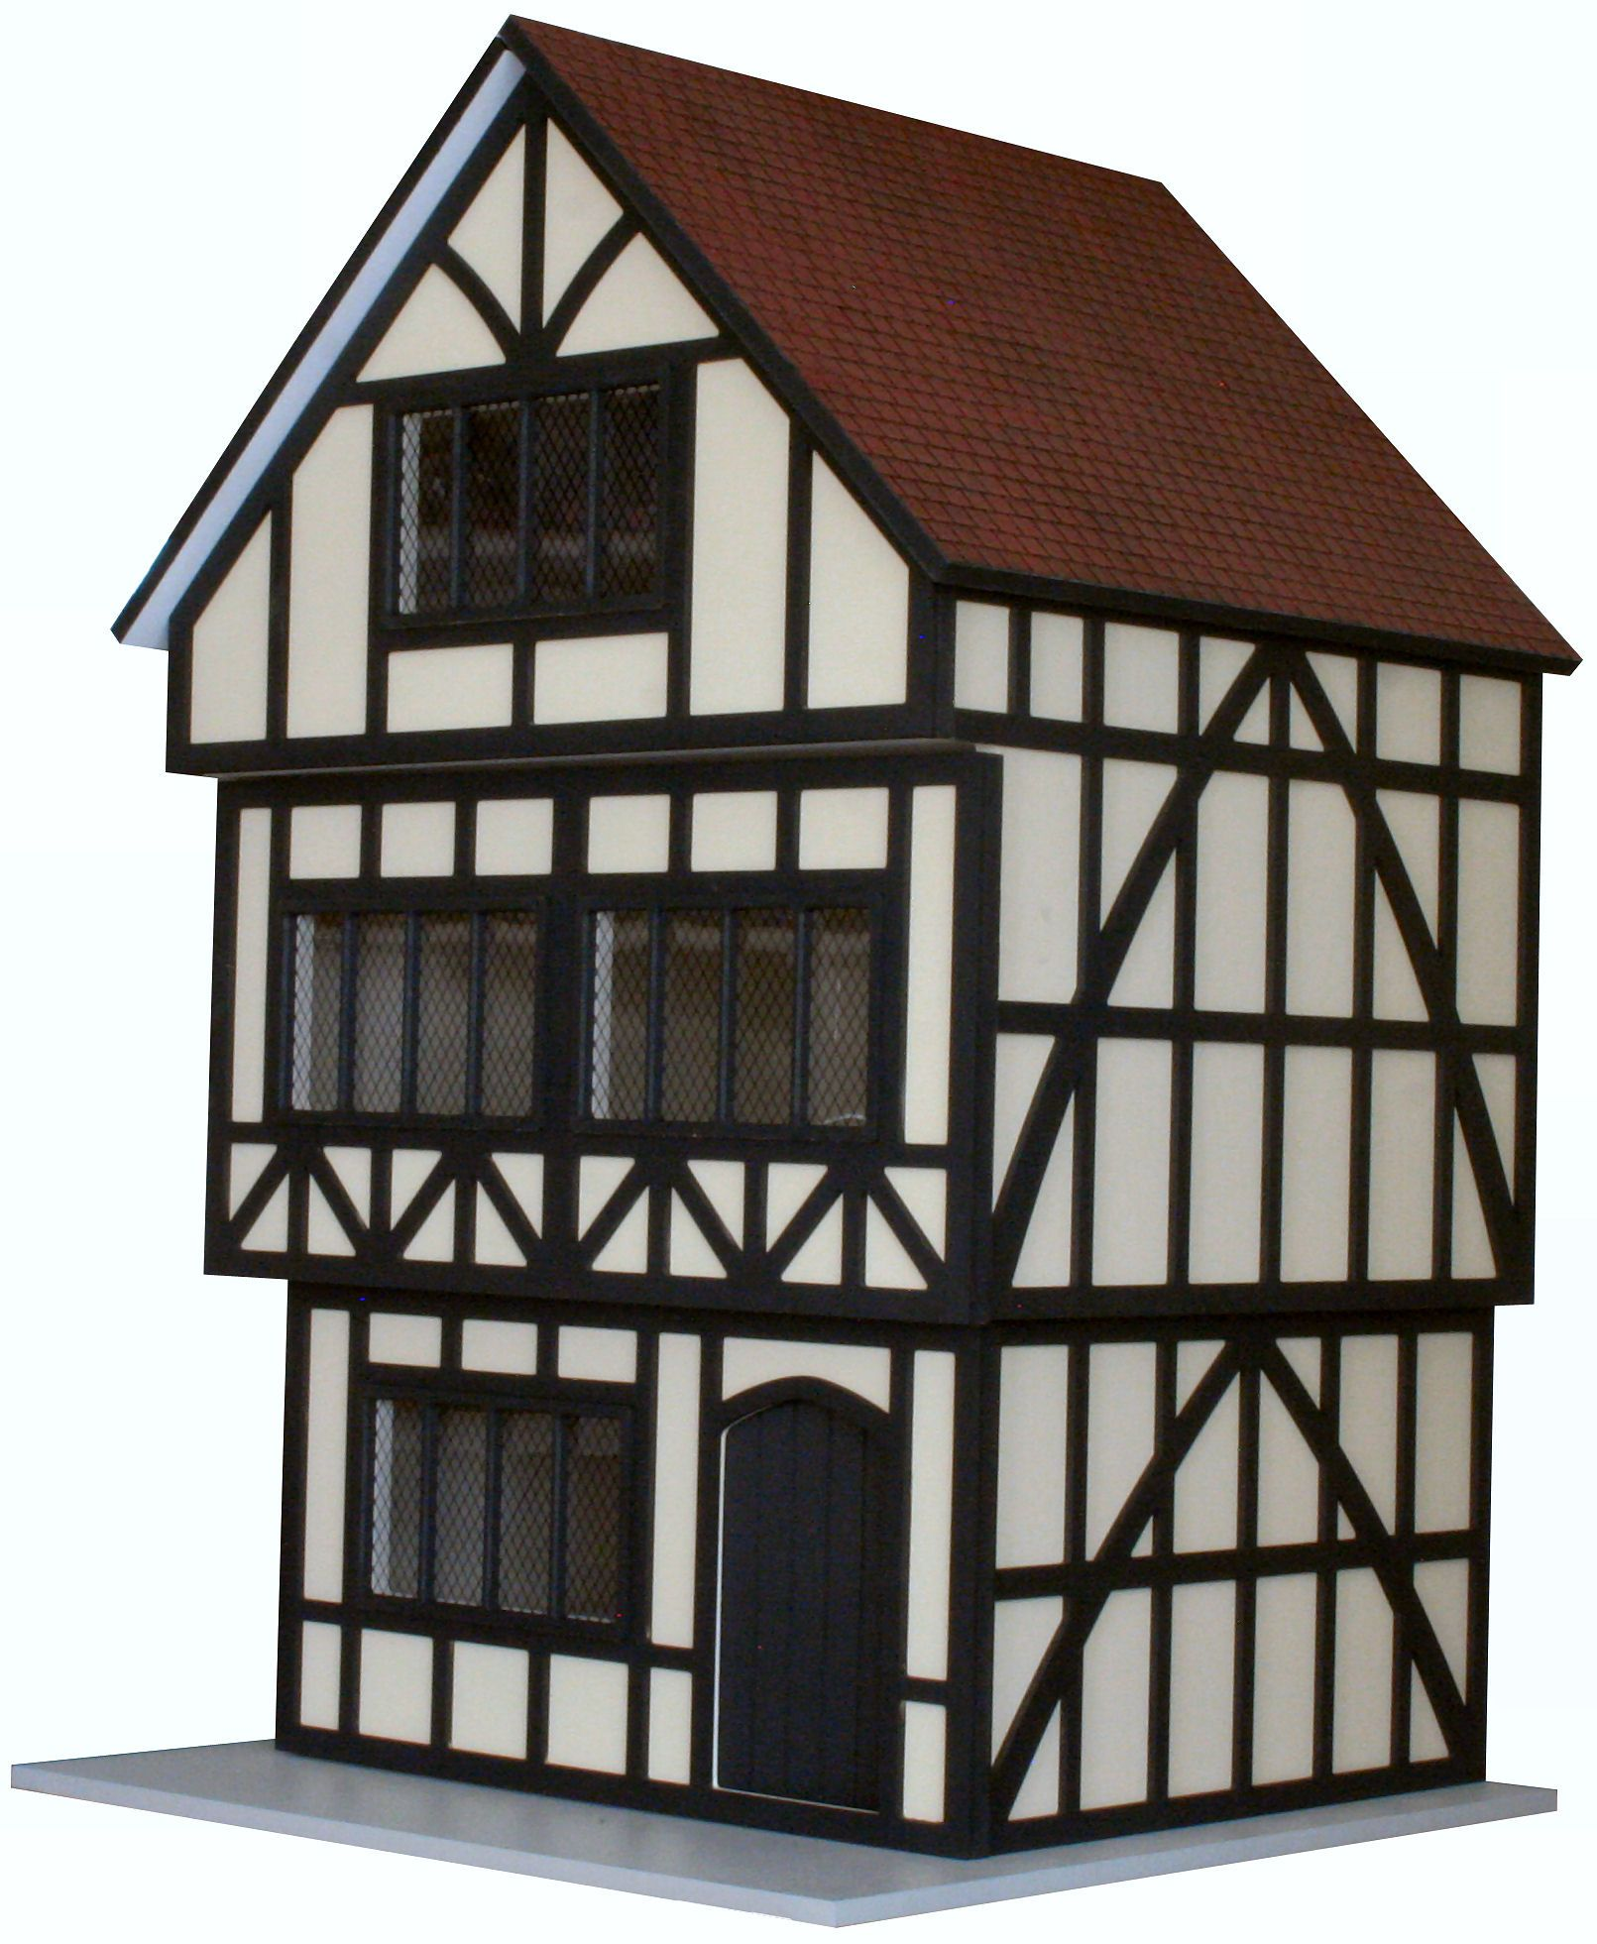
2nd Day – Monday 3rd September 1666
The houses were made from wood.
Why did the fire spread so quickly?
They were build very close to each other.
A lot of the houses were tiered which saved room on the streets but meant they were close to the houses on the opposite side of the street.

Slide 6
2nd Day – Monday 3rd September 1666
People were scared, unsure what had caused the fire.
The noise and the cracking and thunder of the impetuous flames, the shrieking of women and children, the hurry of people, the fall of towers, houses, and churches, was like a hideous storm; and the air all about so hot and inflamed.
– Samuel Pepys.

Slide 7
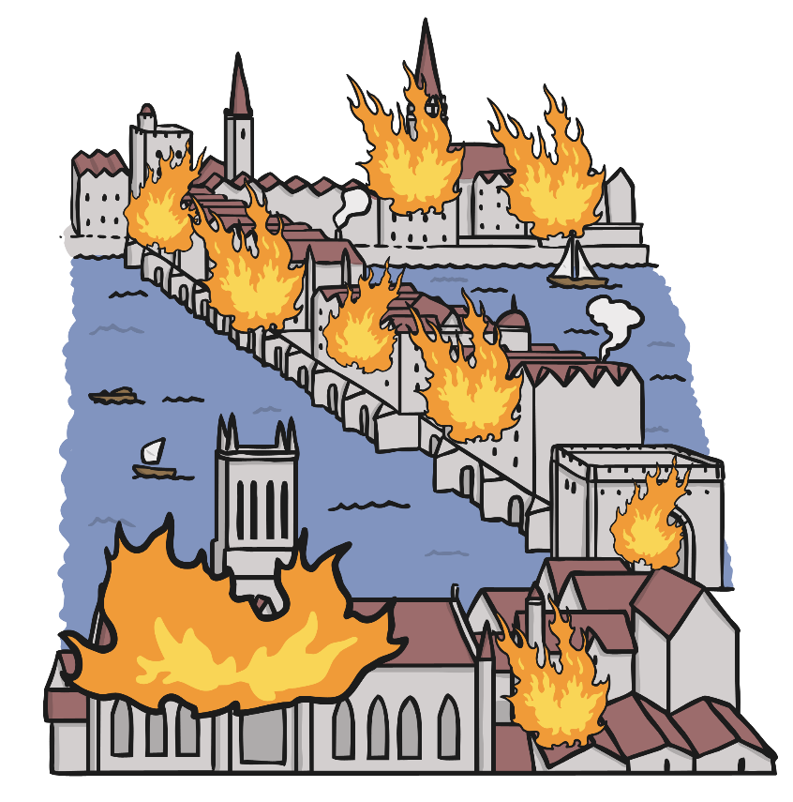
2nd Day – Monday 3rd September 1666
People tried to escape by boat on the River Thames

Slide 8
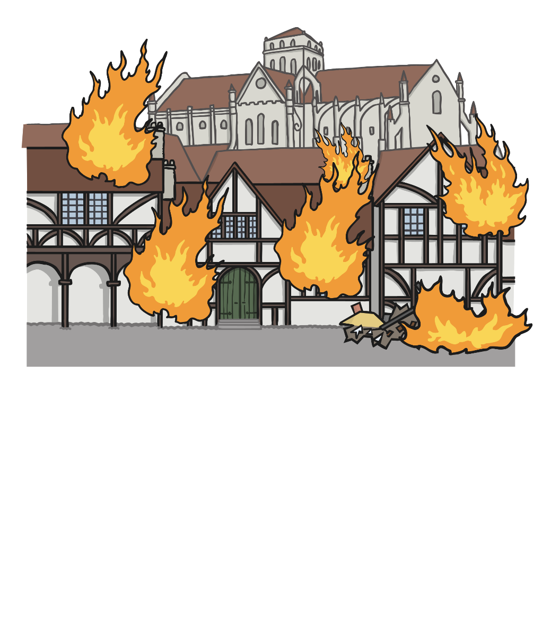
3rd Day – Tuesday 4th September 1666
This was the worst day of the fire.
Scrapes of burning silk spread as far as Beaconsfield!

Slide 9
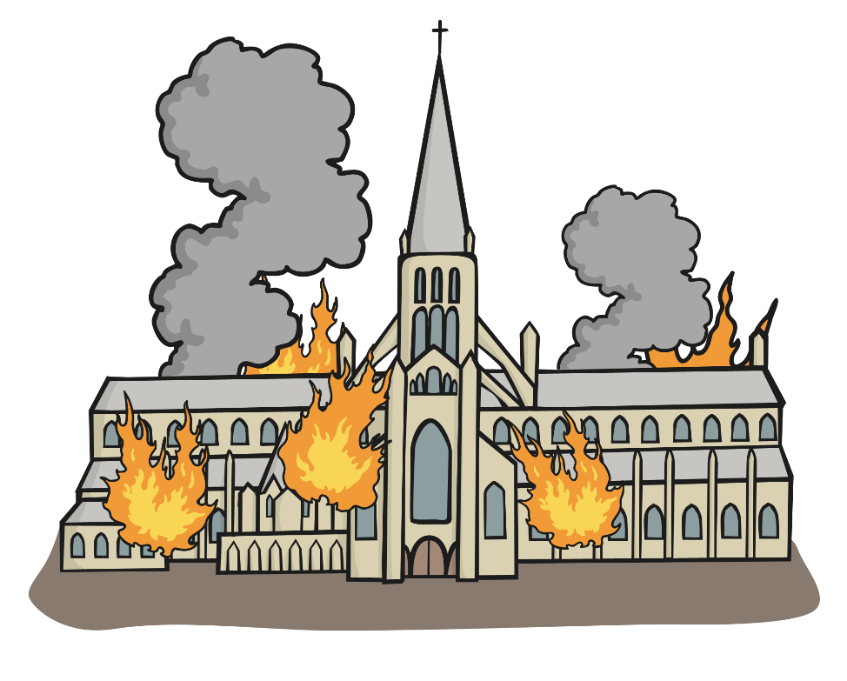
3rd Day – Tuesday 4th September 1666
Over 13,000 houses were destroyed and 87 churches burnt by the fire including St Paul’s Cathedral.

Slide 10
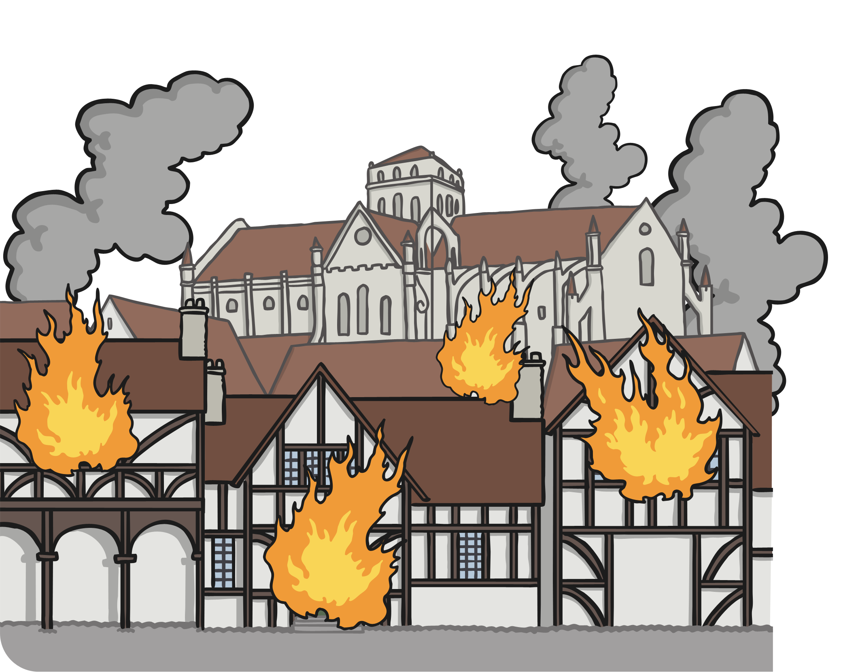
4th Day – Wednesday 5th September 1666
The Duke of York (the future King James II) ordered that houses be destroyed using gunpowder ahead of the fire to stop the fire from spreading even further.

Slide 11
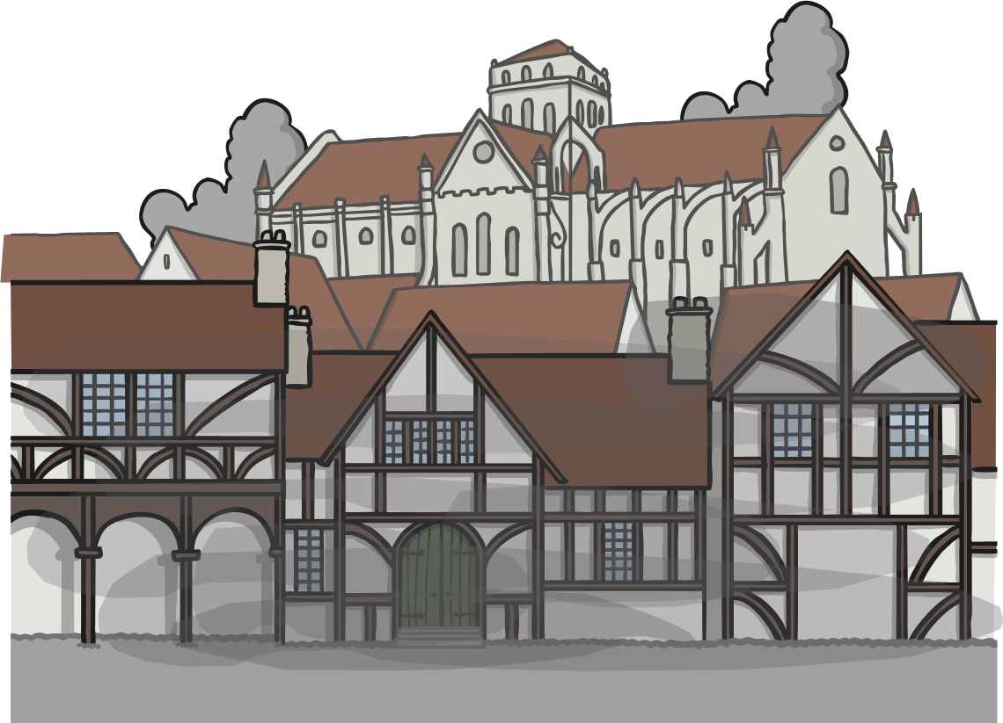
5th Day – Thursday 6th September 1666
The fire is finally put out. London is devasted and needs to be rebuilt.

Slide 12
The rebuild
The disaster made London a better and safer city.
Streets were widened and buildings were made stronger, more fireproof and out of brick instead of wood.

Slide 13

Task

