Slide 1
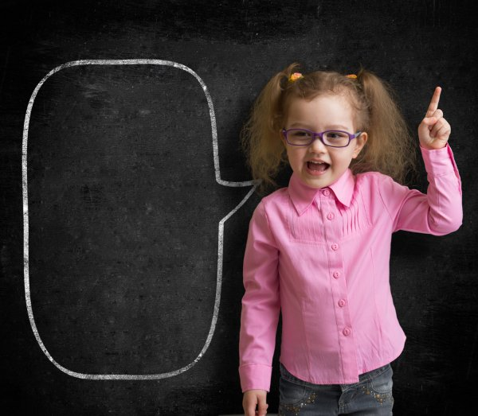

Year 1 Phonics
n or kn?
n or gn?

Slide 2



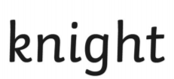

Alternative choice for the sound ‘n’.
Let’s Think about Silent Letters…

Slide 3
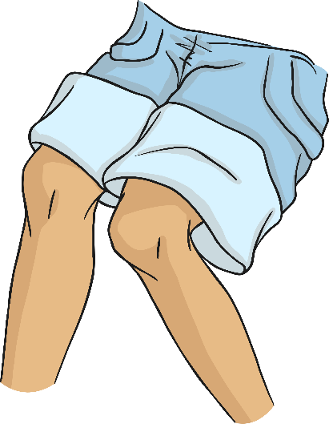
Words that start with the sound ‘n’ are
sometimes spelt with the digraph ‘kn’.
knee

Slide 4
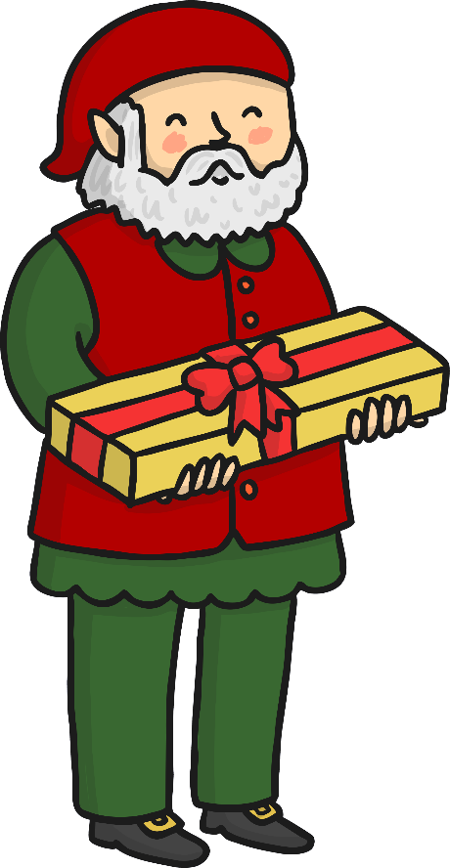
Words that start with the sound ‘n’ are
sometimes spelt with the digraph ‘gn’.
gnome

Slide 5
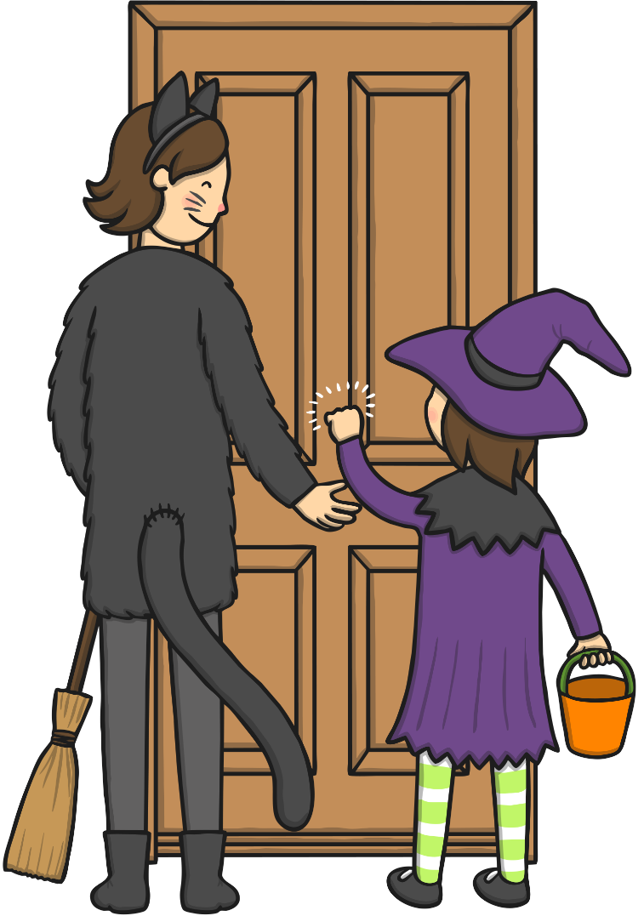
knock - to hit something to make a noise

Slide 6
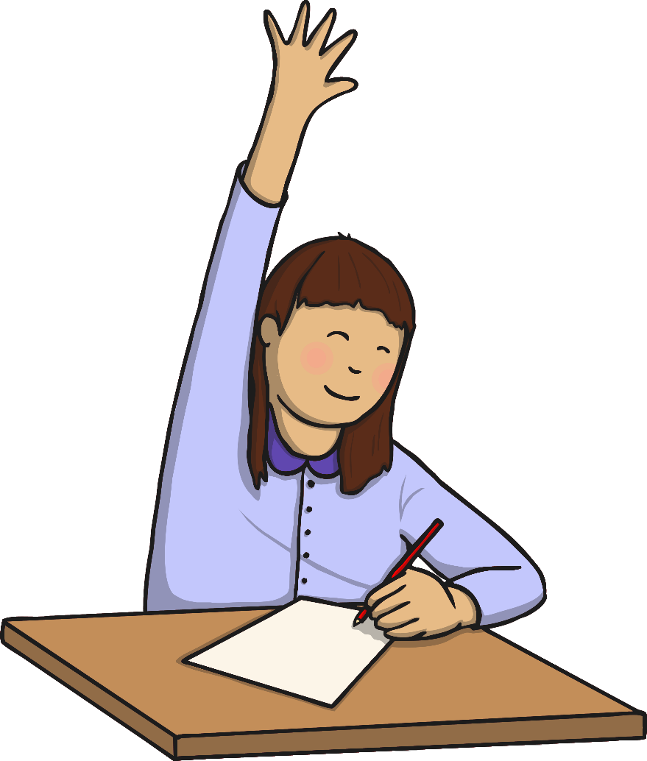
know - to have information in your mind

Slide 7

knee - the middle part of your leg that lets it bend

Slide 8
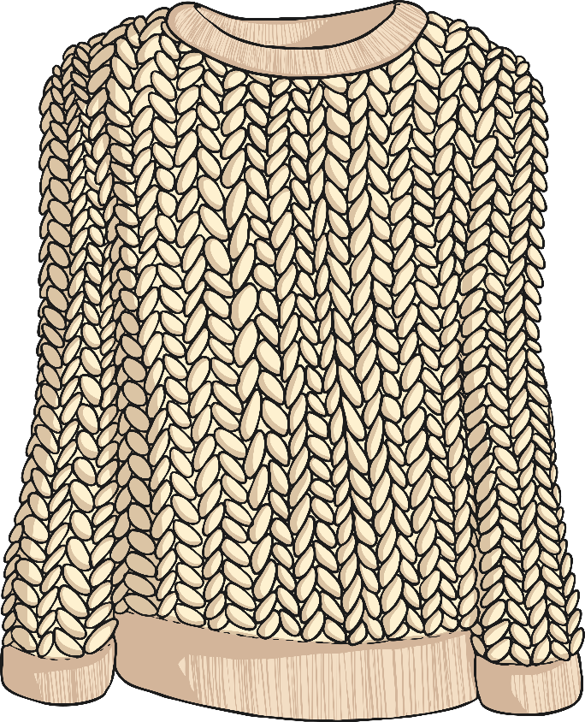
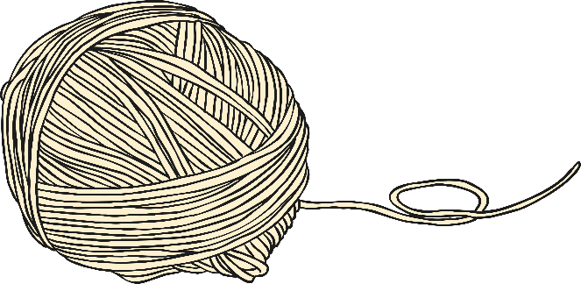
knitting - making something with 2 long needles and wool

Slide 9
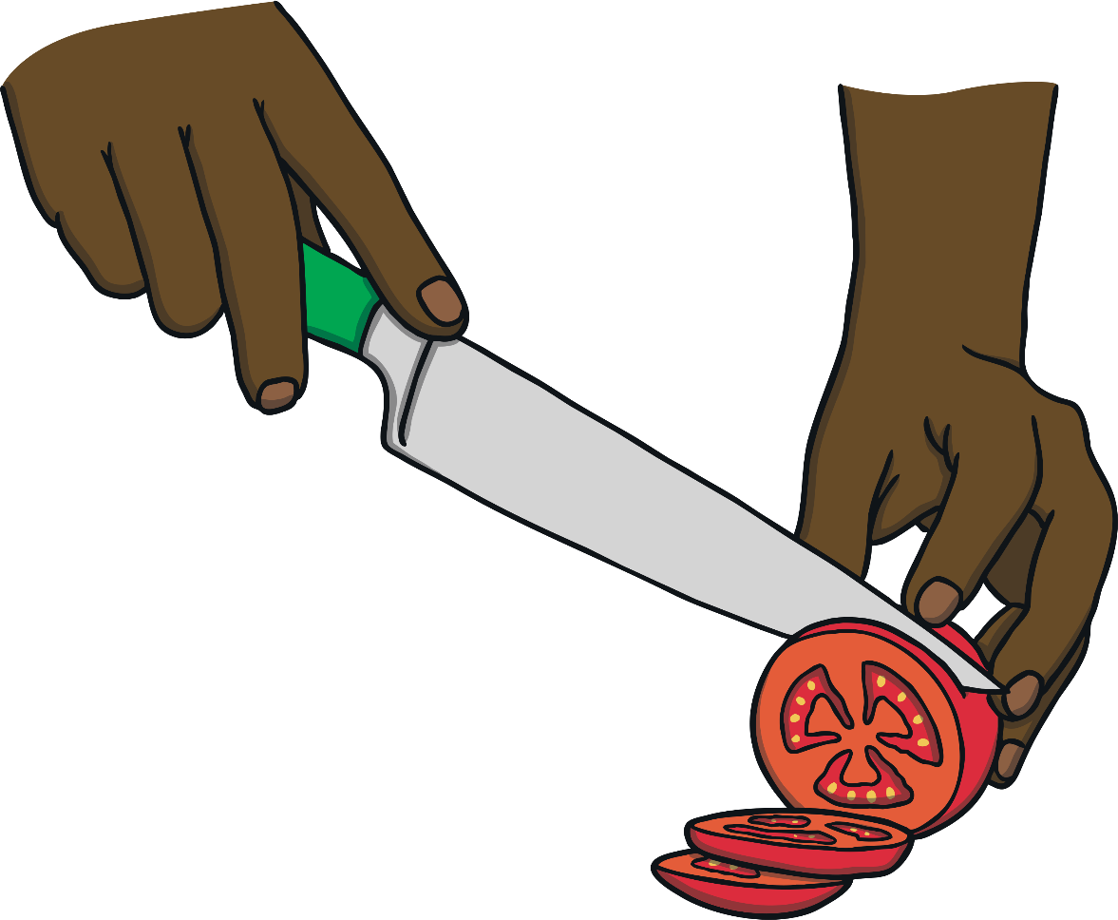
knife - a sharp tool used for cutting up food

Slide 10
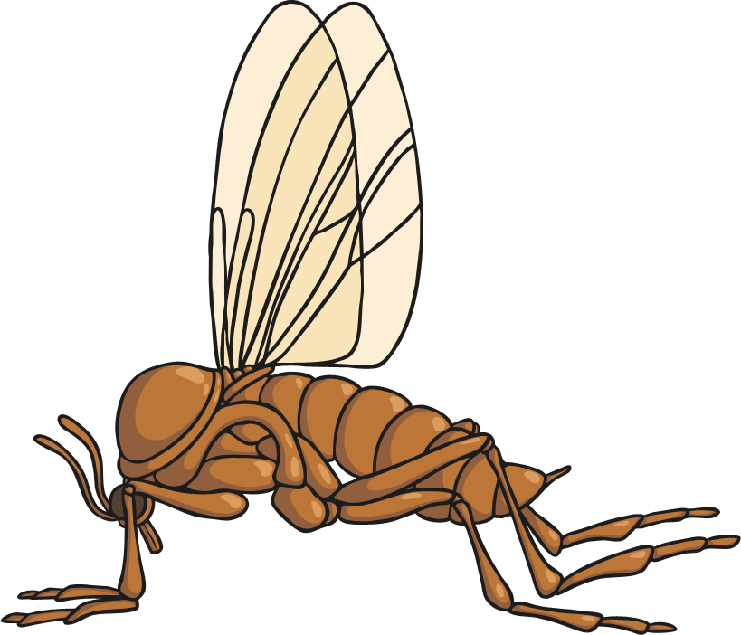
gnat -a very small flying insect that bites people and animals.

Slide 11
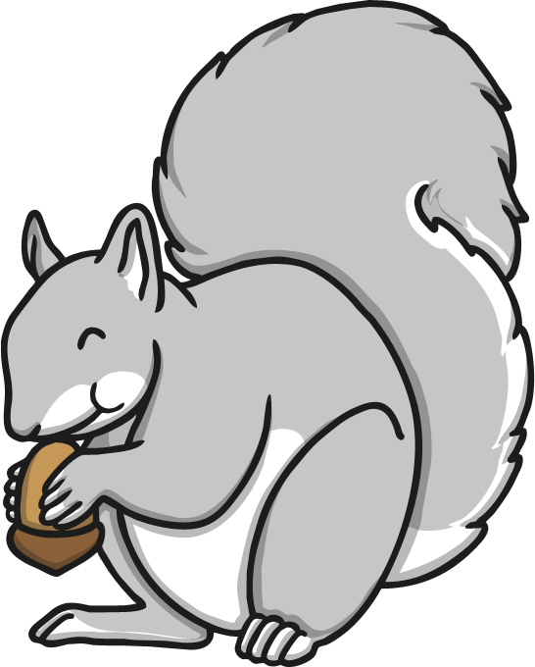
gnaw - to chew and bite something over and over again.

Slide 12
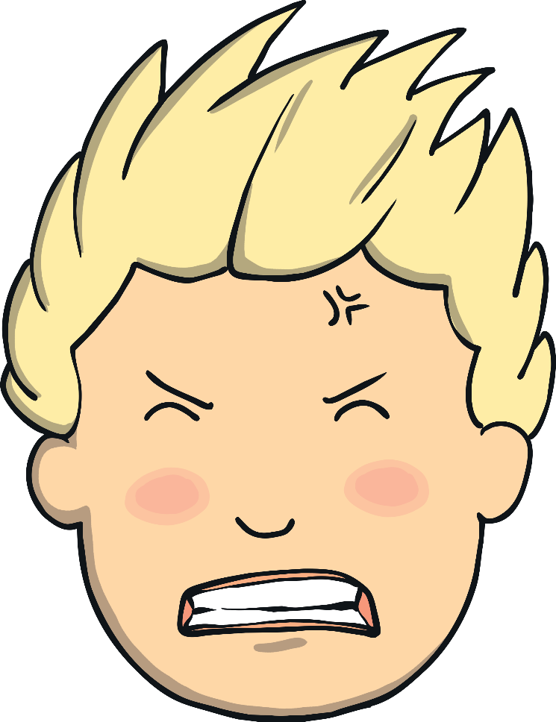
gnash - to bring your teeth together quickly,
often when you are angry.

Slide 13
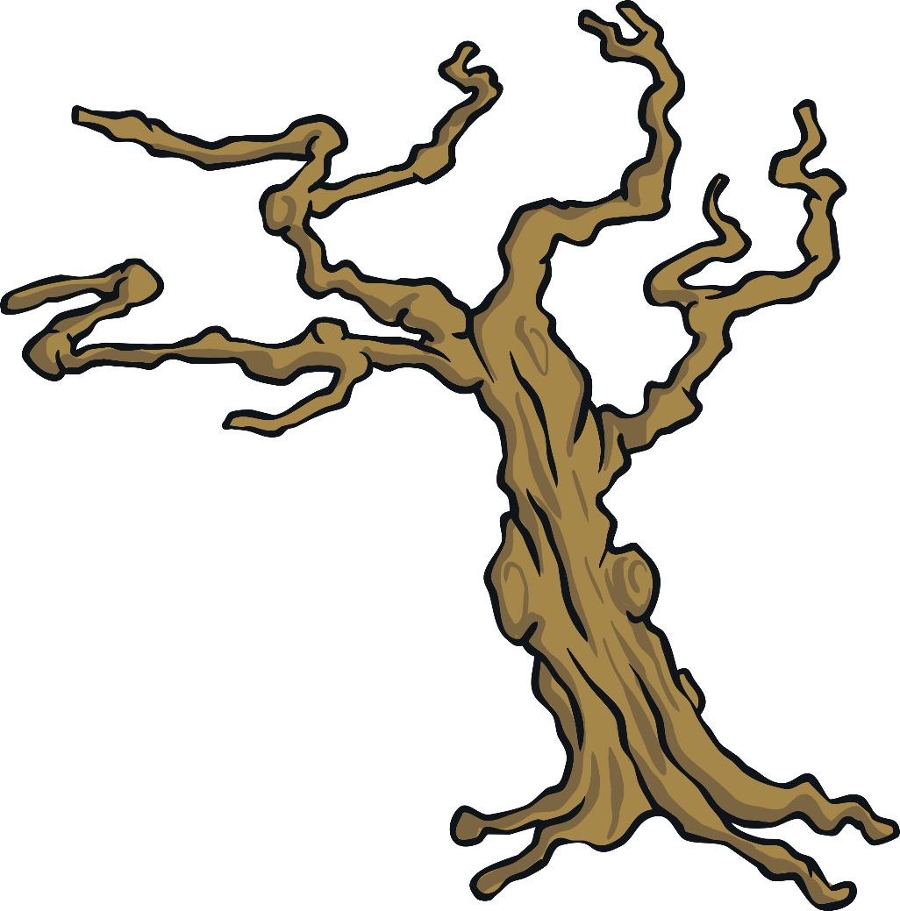
gnarled - twisted and rough – like an old tree trunk.

Slide 14
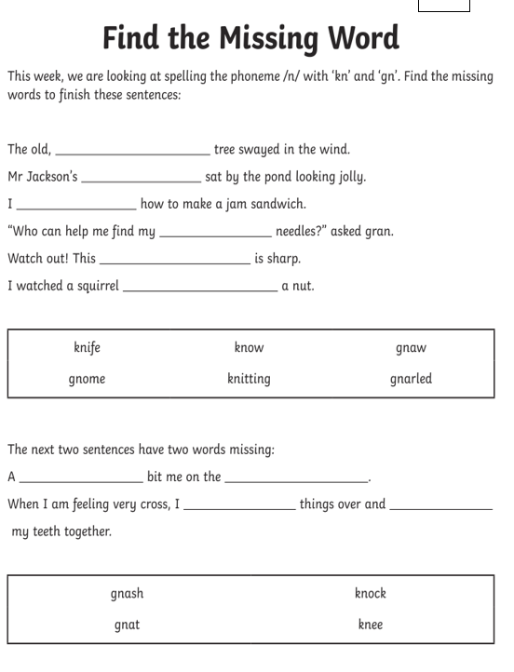
Task 1
Read the sentences and then read the word bank. Try to find the correct word to help your sentence make sense.

Slide 15
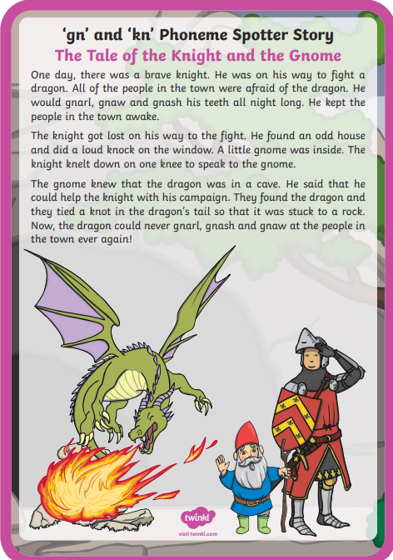
Task 2 – Phoneme Spotter
Read the story and then try to find the words with the digraphs ‘gn’ or ‘kn’.
Draw a circle around these words.

