Slide 1

Tuesday
12th January 2021

Slide 2
LO: To find the tens and ones of a two digit number.

Slide 3


Starter
Counting in 10’s
https://www.youtue.com/watch?v=elQQ8CQ8cNk

Slide 4


Which picture represents 3 tens and 5 ones?

Slide 5
What number is this?
3 tens and 7 ones
37

Slide 6
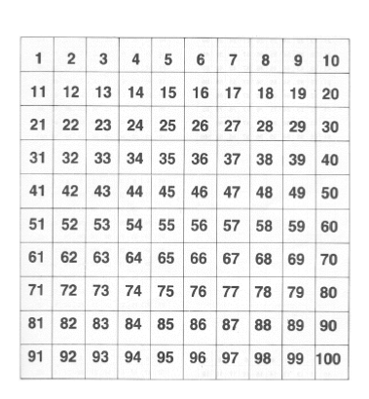
Lets look at the number on the hundred square
3 tens
37
7 ones
3 tens and 7 ones

Slide 7
37
Tens
Ones
3 tens and 7 ones

Slide 8
How many tens and ones?
23
23 = 2 Tens and 3 ones
Tens
Ones

Slide 9
Lets look at the number on the hundred square
23
23 = 2 Tens and 3 ones

Slide 10
How many tens and ones?
63
63 = 6 Tens and 3 ones
Tens
Ones

Slide 11
Lets look at the number on the hundred square
63
63 = 6 Tens and 3 ones

Slide 12
How many tens and ones?
12
12 = 1 Tens and 2 ones
Tens
Ones

Slide 13
How many tens and ones?
68 = 6 Tens and 8 ones
68

Slide 14
How many tens and ones?
99 = 9 Tens and 9 ones
99

Slide 15
Task
1
1

Slide 16
Extension task
https://www.bbc.co.uk/bitesize/topics/z8sfr82/articles/zw4g2nb

