Slide 1
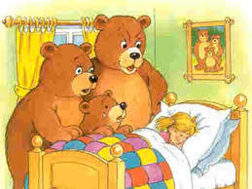

English

Slide 2

Let’s write a story!
Your story will be a
fiction story. This means
that you will think of
ideas from your
imagination. You will
become an author!

Slide 3
Let’s write…
The
I would like you to write a narrative story entitled
‘The Next Day…’.
Next Day…

Slide 4
What is a narrative?
The
A narrative is when you write down ideas or events in order of them happening.
Next Day…

Slide 5
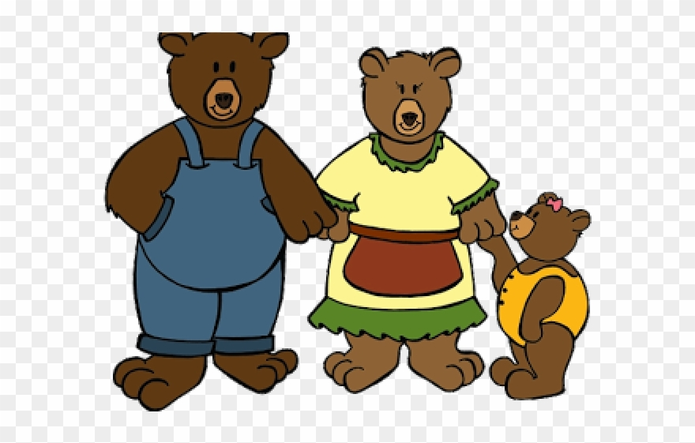
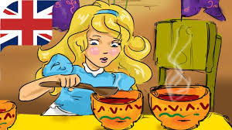
Learning Objective: To write a story with a beginning, a middle and an end.

Slide 6
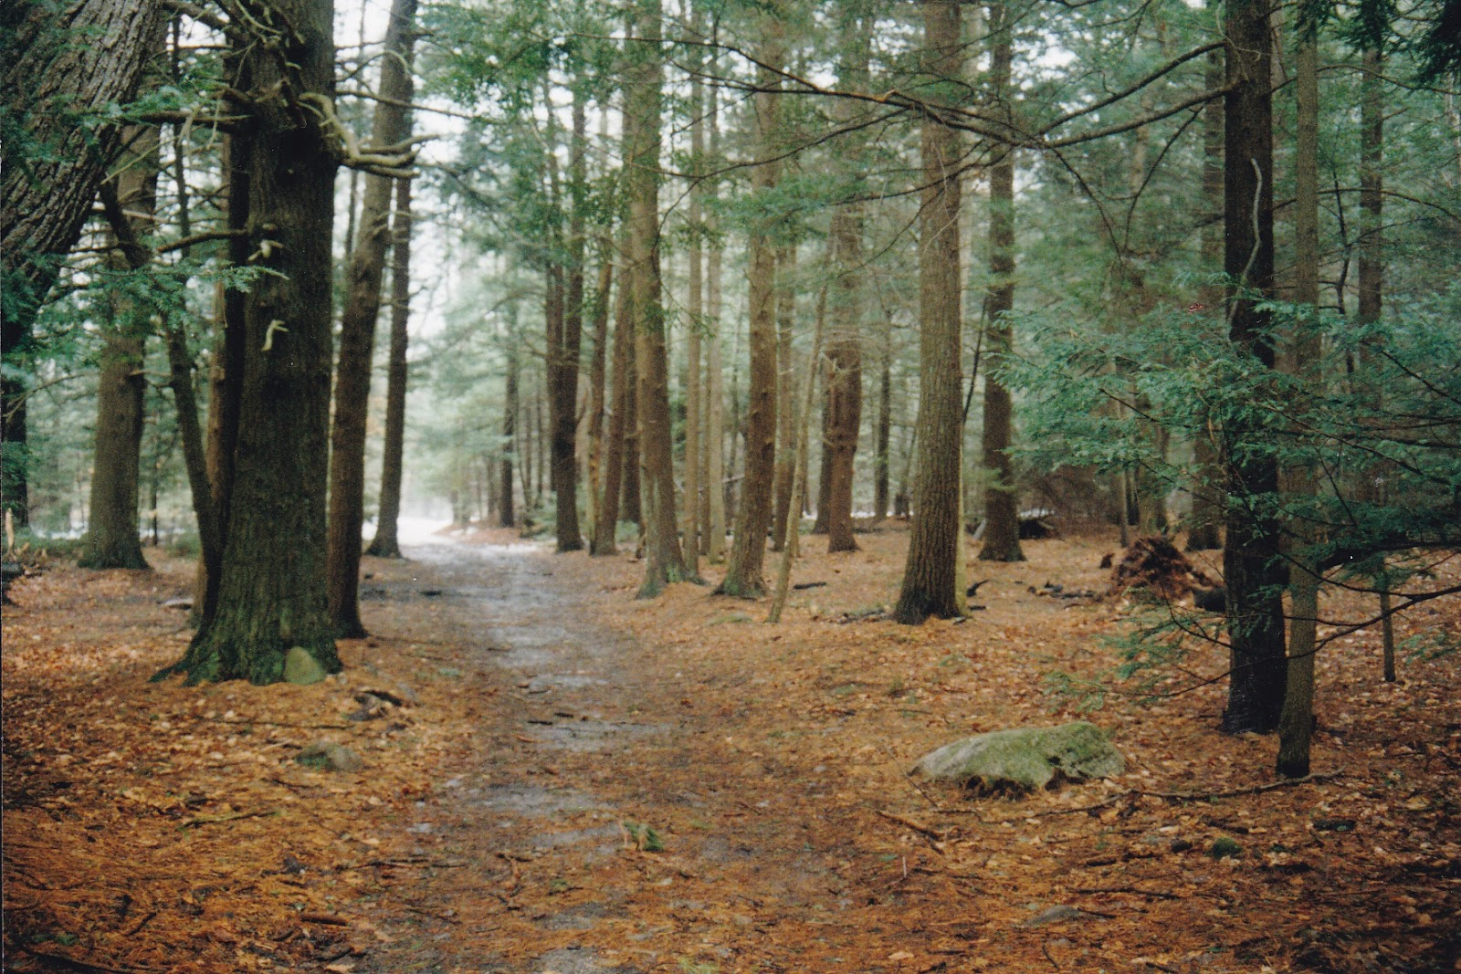
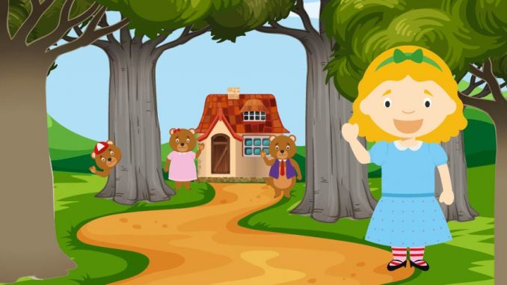
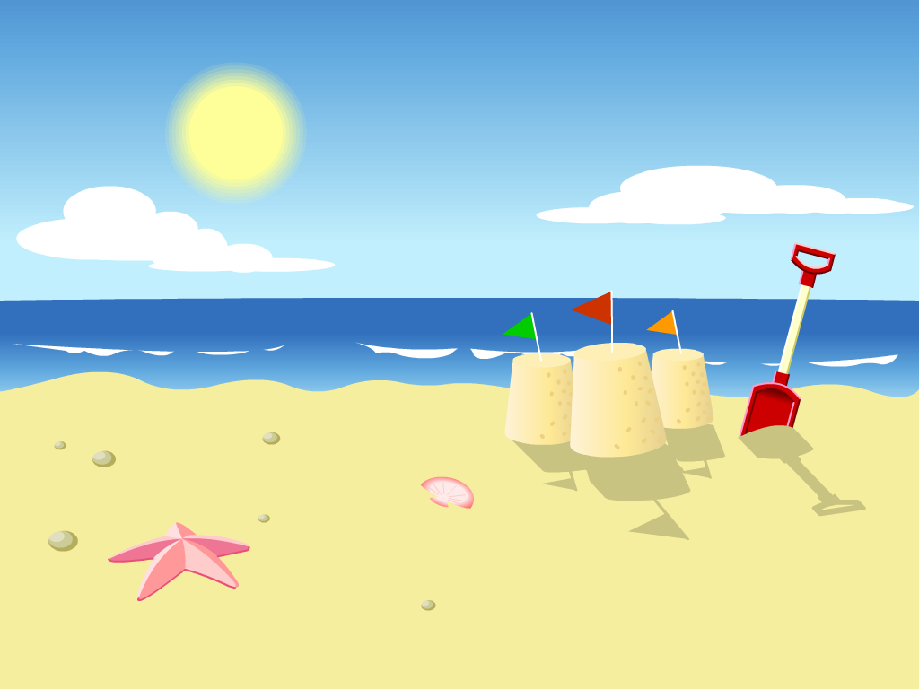
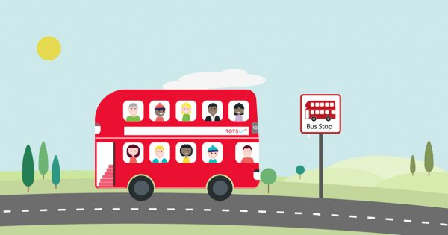
What are the important parts of a story?
The Setting
The Characters
The Beginning
The Middle
The End

Slide 7
Beginning…
The next day, Goldilocks felt quite sorry that she had made a mistake and gone into the Bear’s cottage without permission so she went back to see them!

Slide 8
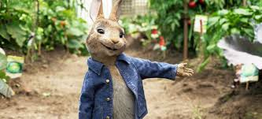
Beginning…
They were happy to see her and they invited her to the cinema to see the Peter Rabbit film.

Slide 9
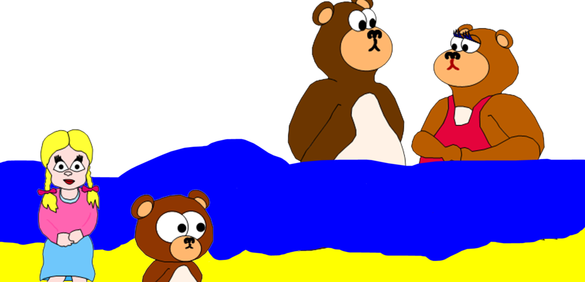
Middle…
When they came out of the cinema, the sun was shining and it was boiling hot so they decided to go to the beach..

Slide 10

Middle…
They had a great time playing in the sea but when they went to go home, their car had broken down!

Slide 11
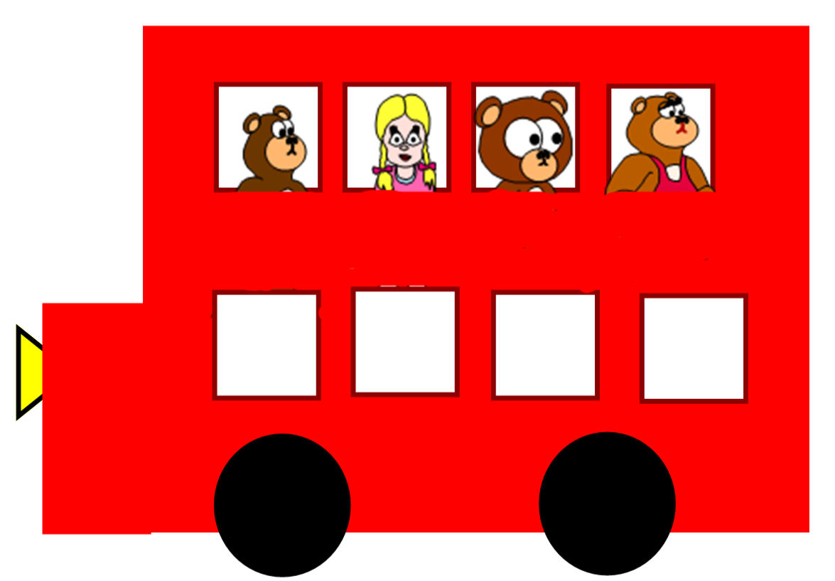
End…
They were very hot and very thirsty so they decided to get a bus home!

Slide 12

End…
Goldilocks was so happy that she had gone back to see the Bears to say sorry and they stayed good friends forever!

Slide 13


Remember…
Please use capital letters at the start of a sentence.
Remember to use full stops.
Can you try to use some adjectives please?
Read your work to check it makes sense.

