Slide 1

Friday
15th January 2021

Slide 2
L.O: To revise addition and subtraction.

Slide 3

Starter
Key words for Addition and Subtraction
https://www.youtube.com/watch?v=u6FjR235xK4
https://www.youtube.com/watch?v=uPX08O5TDjE

Slide 4
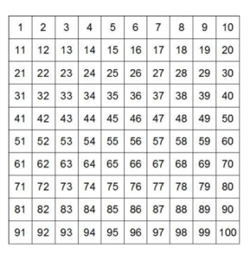
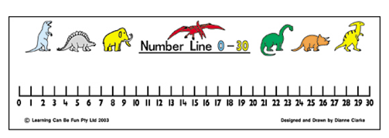


Remember we can use these to help us add.

Slide 5
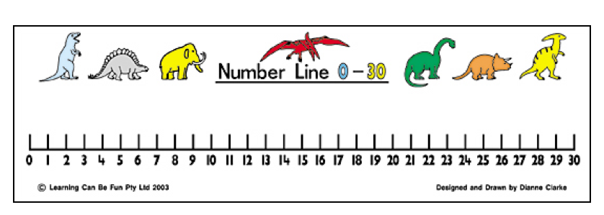

23 + 5 =
28

Slide 6
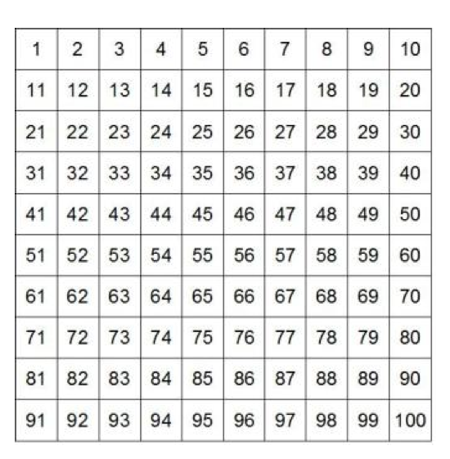

9 + 5 =
14

Slide 7

23 + 13 =
36

Slide 8

12 - 6 =
6

Slide 9
23 - 3 =
20

Slide 10

The sum shown
6-2 = 8
Are you sure Sue?
No, Sue is not correct. She has used addition when she should have used subtraction. 6-2 = 4

Slide 11
10 +3 = 13

Slide 12

20-2 =
18

Slide 14

10-3 =
7

Slide 15
Task

Slide 16
Extension Task

