Slide 1


English

Slide 2
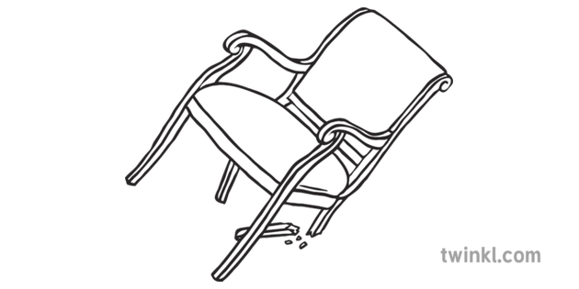
Learning Objective: To design a new chair for Baby Bear!

Slide 3
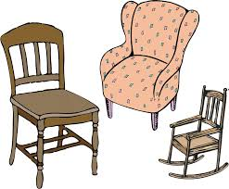
Let’s design!
Poor Baby Bear has no chair!
Often illustrators will draw settings in different ways.

Slide 4
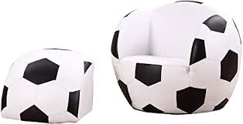
Chair Designs!

Slide 5
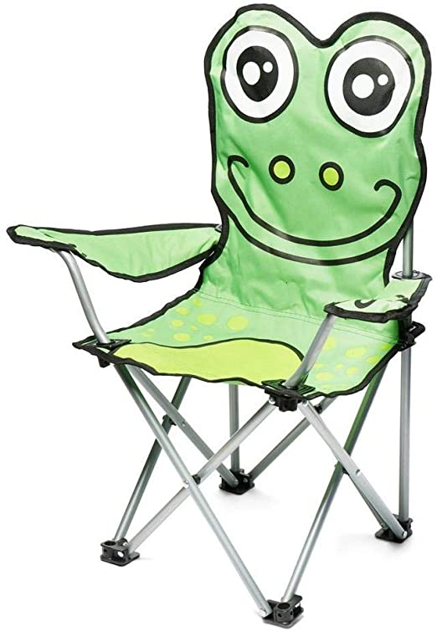
Folding Frog Chair!

Slide 6
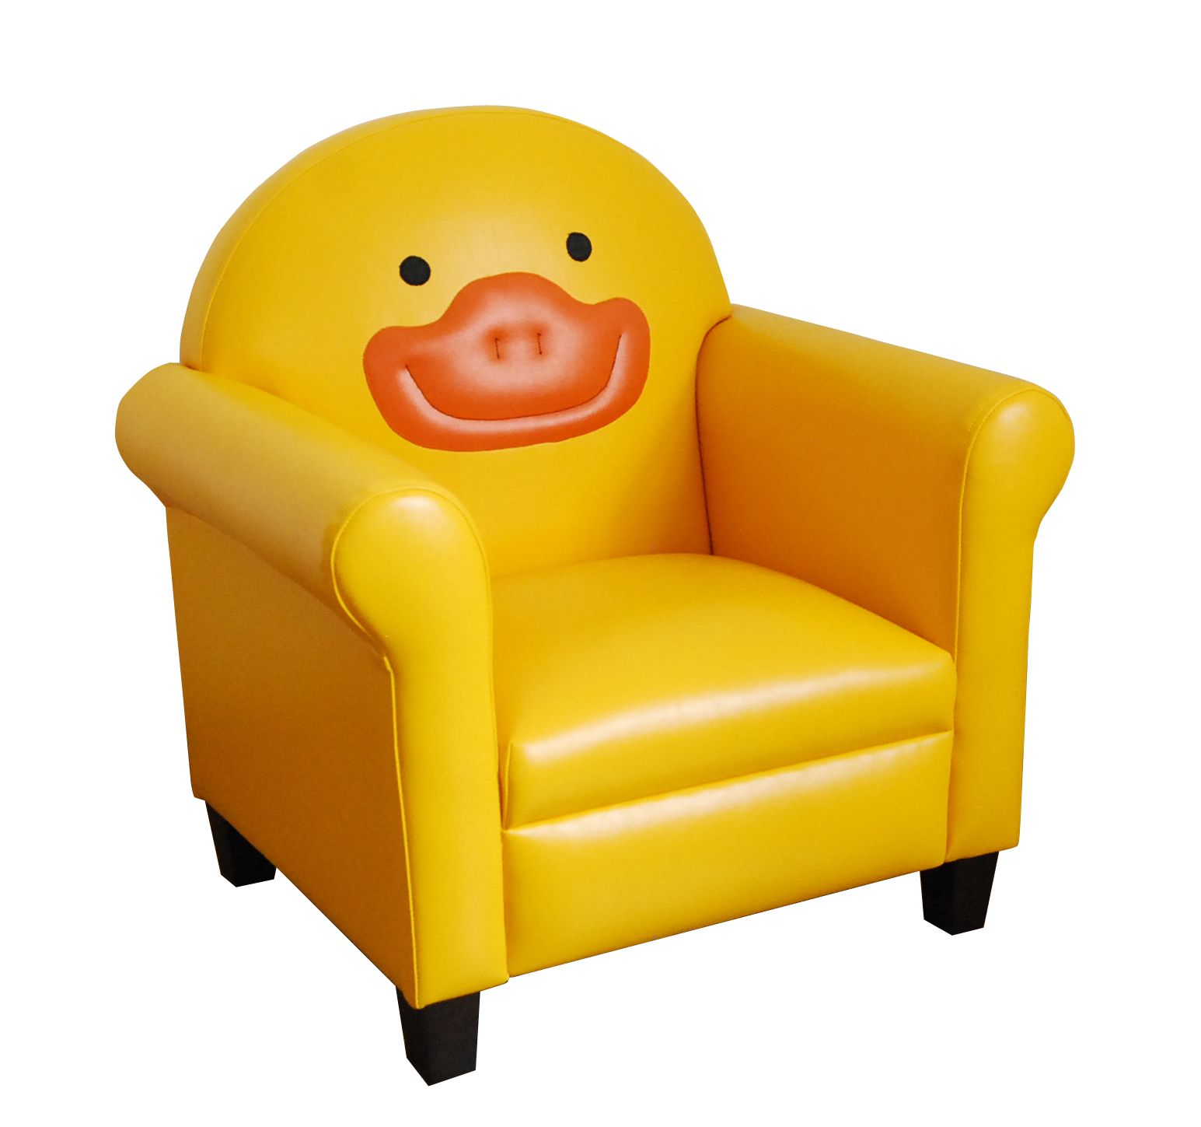
Quack Chair!

Slide 7
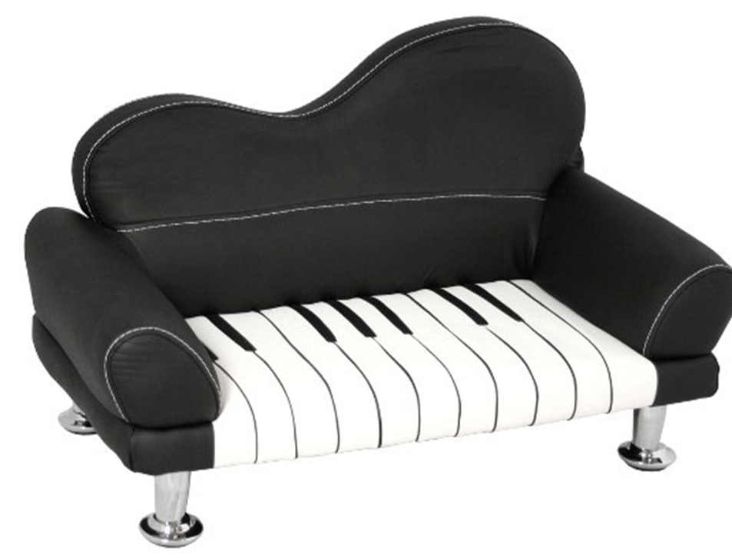
Piano Chair!

Slide 8
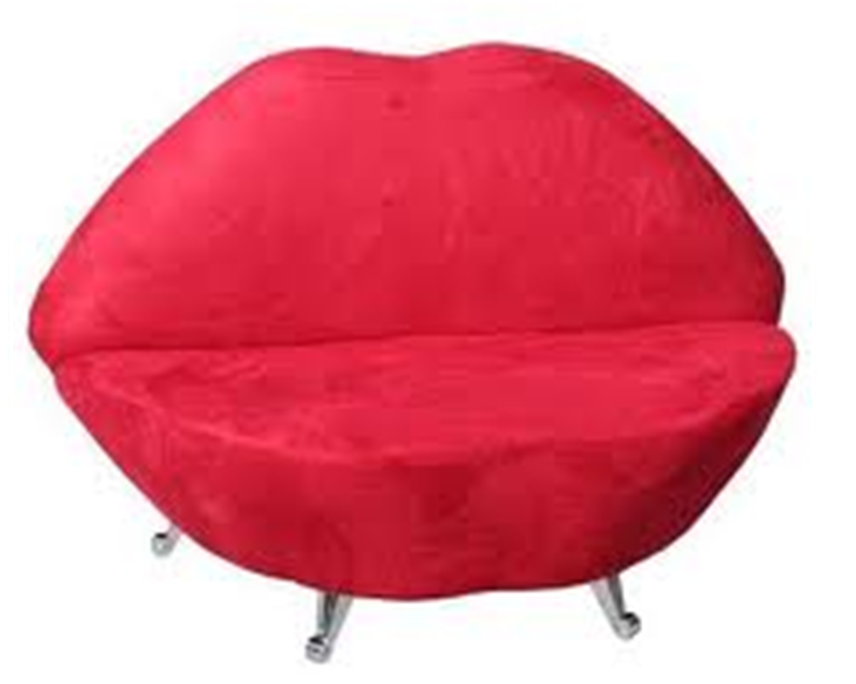

Slide 9
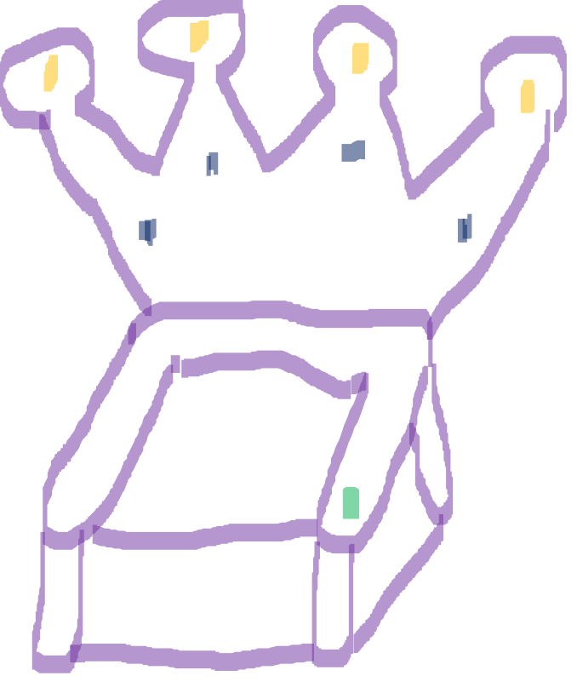

Slide 10
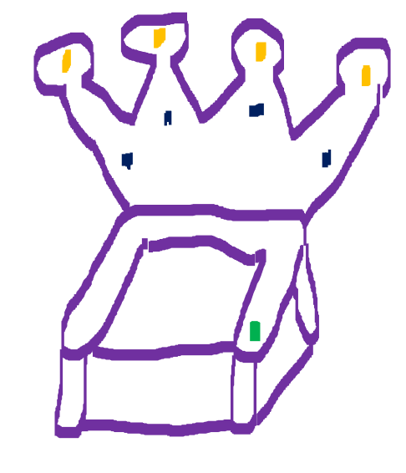

Let’s describe!
My chair is very comfy! It is purple and it has a white seat. At the back of the chair, there is a golden, sparkly crown. Baby Bear will love my chair because he can press a green button to receive a drink!

Slide 11
Challenge…
Could you try to use a conjunction?
and
but
so
because

Slide 12
Write your description…
Please use capital letters at the start of a sentence.
Remember to use full stops.
Can you try to use some adjectives please?
Read your work to check it makes sense.

