Slide 1
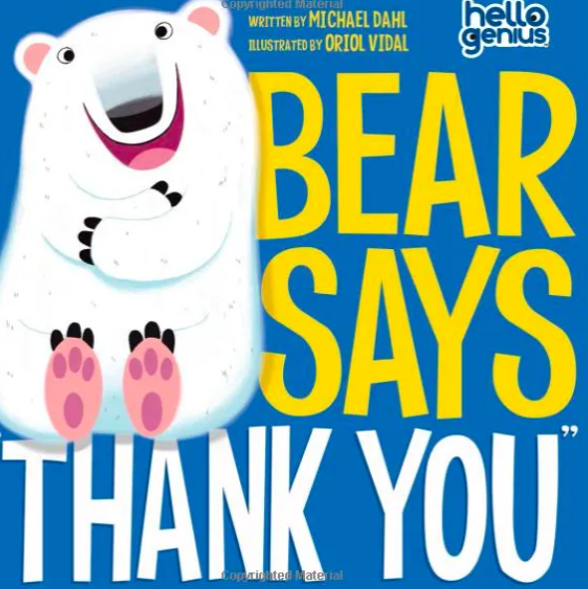
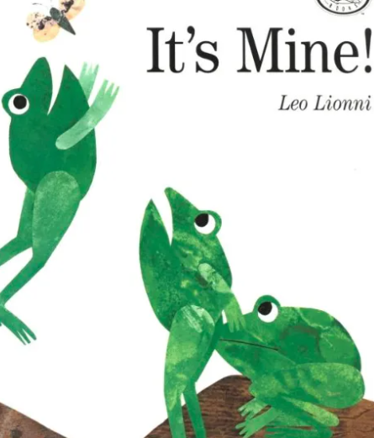
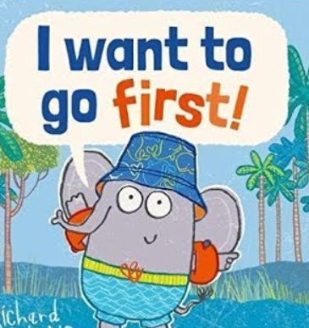

RE
What makes a story a very good way of teaching ?

Slide 2
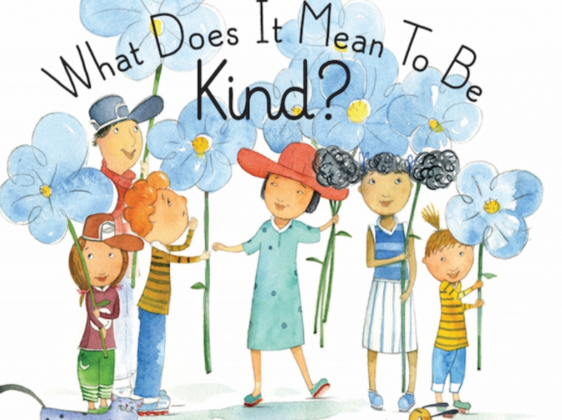
Learning Objective:
To understand the importance of being kind.

Slide 3
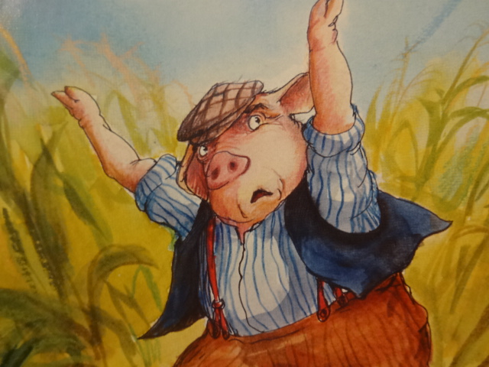
Poor old Farmer Ham!
Look at his face…
He looks very sad and worried.

Slide 4
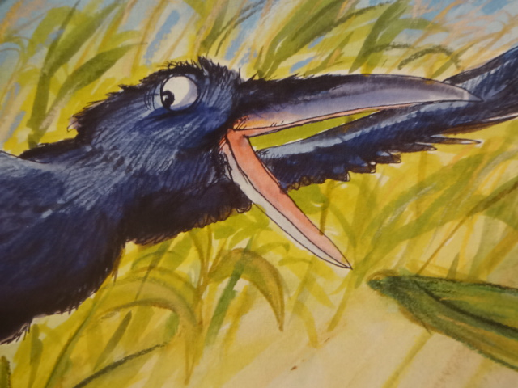
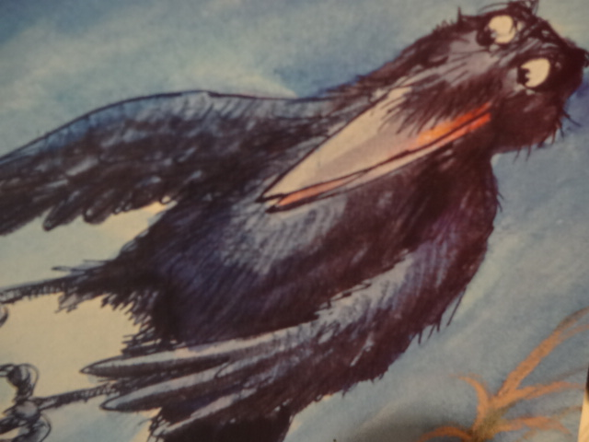
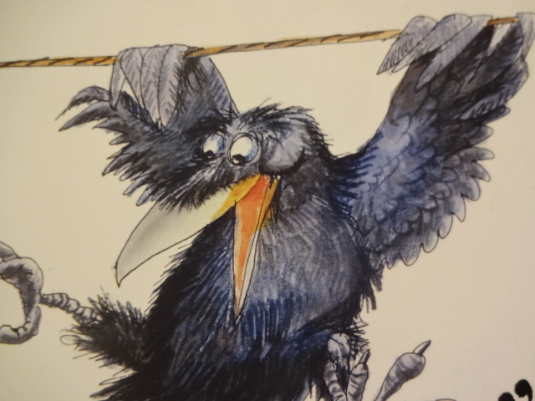
What are the crows doing?
Look at their faces… there are lots of them!
Do they look sad?

Slide 5
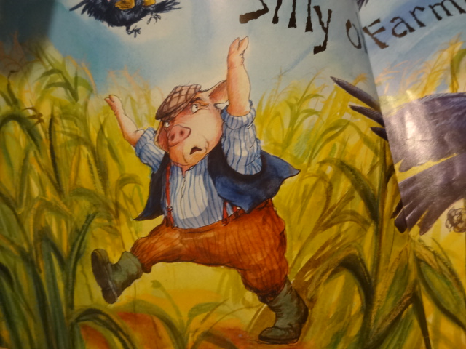
Farmer Ham is trying to save his corn and he has no help.
Who could he go to for help?

Slide 6
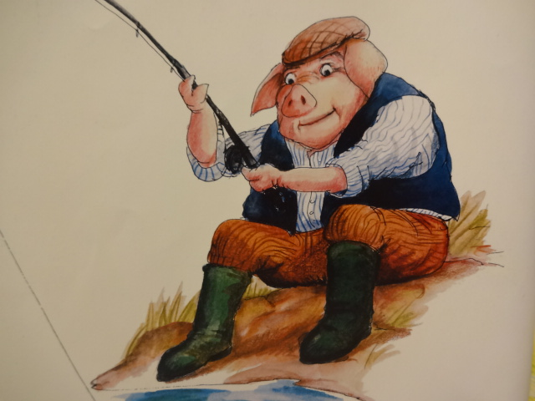
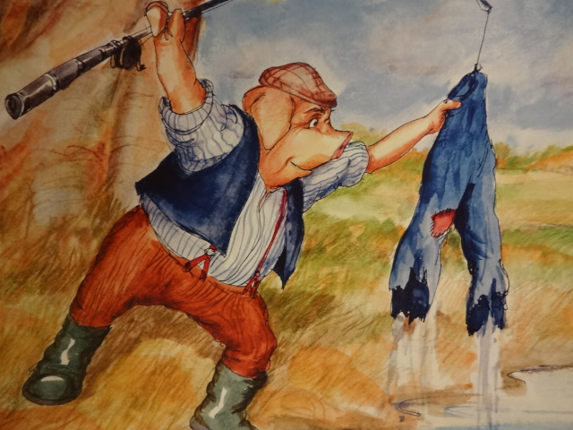
Why do you think that Farmer Ham didn’t shout at the Crows?
Perhaps he preferred not to be unkind.

Slide 7
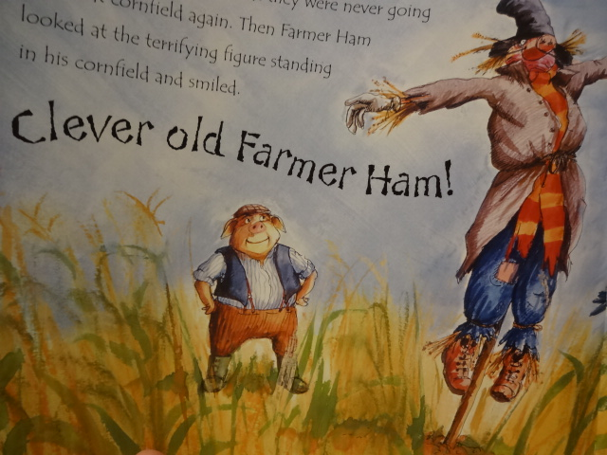
Farmer Ham had a clever plan…
He decided not to be unkind to the crows and he made a scarecrow and the crows went away with no corn.

Slide 8
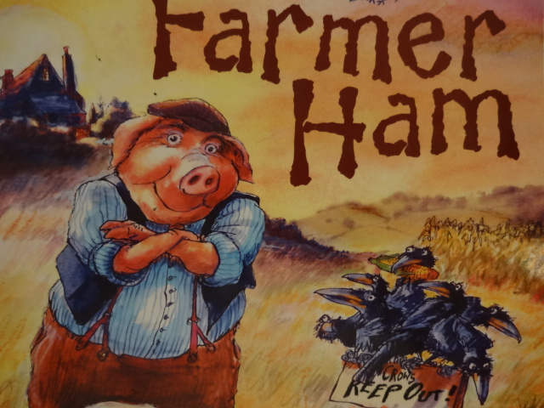
Who would you rather be?
Would you like to be the kind character?
Why?

Slide 9
Who would you rather be?
Would you like to be a crow?
What did they do?
They took the corn
They shouted at him
They called him silly and old
They laughed at him

Slide 10
Who will you choose?
Choose your character and draw them.
Write a few sentences to explain why your preference.
At the end of your work, write a sentence to explain who you would go to, if you needed help.

Slide 11
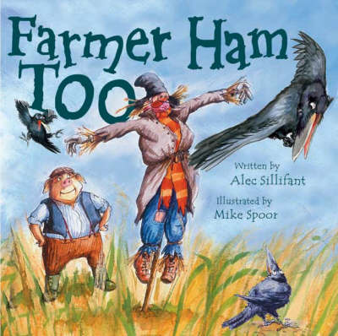
Further interest:
Next Monday during Story Time, I will read the sequel to Farmer Ham…
.
I wonder if the crows will come back!

