Slide 1

Thursday
14th January 2021

Slide 2
LO: To represent a number in tens and ones using pictures.

Slide 3

Starter
Recapping place value
https://www.youtube.com/watch?v=5W47G-h7myY

Slide 4
Match the numbers.
2 tens
7 ones
12
twenty-three
1 ten
2 ones
23
twenty-seven
2 tens
3 ones
27
twelve

Slide 5
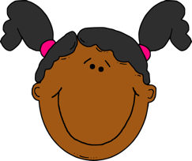
The number shown is 26, 2 tens and 6 ones.
Is Sue correct?
No, Sue is not correct. She has miscounted her ones.
There are 7 ones making it 27 (not 26).

Slide 6

Which picture represents 27?

Slide 7

Complete the table.
Number | Tens and ones | Ten frame | Sticks | Words
1 ten
4 ones
14
fourteen
2 tens
5 ones
Twenty five
25
2 tens
9 ones
Twenty nine
29

Slide 8
Fluency
Complete the table.
Number | Tens and ones | Ten frame | Sticks | Words
1 ten
5 ones
15
fifteen
2 tens
8 ones
Twenty eight
28
2 tens
8 ones
fifteen

Slide 9
Which representations show the number 23?
thirty-two
23
twenty-five

Slide 10



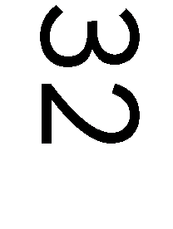

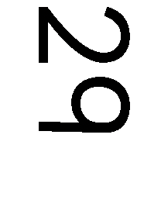
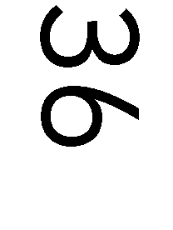
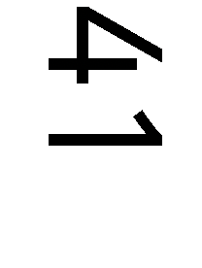
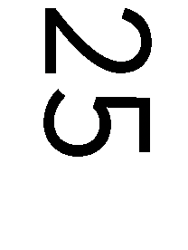


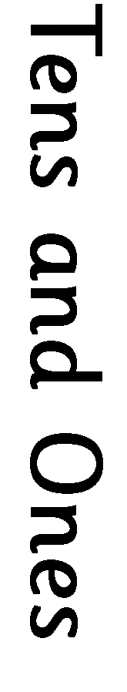

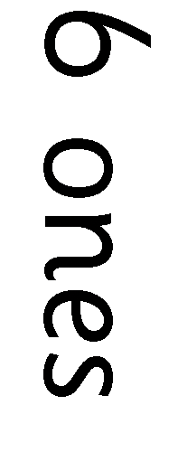
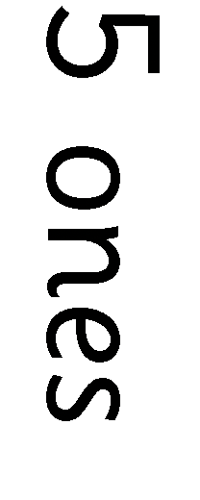

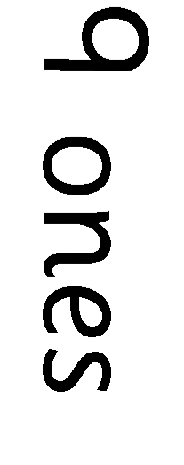
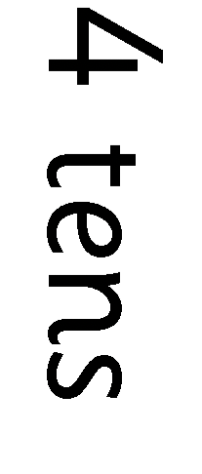
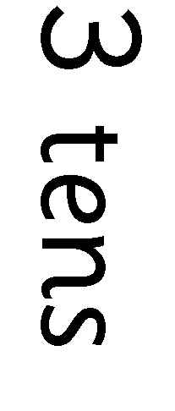
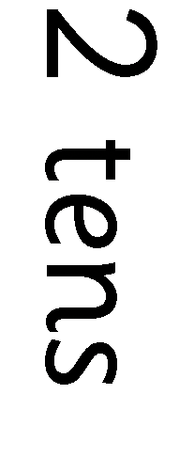
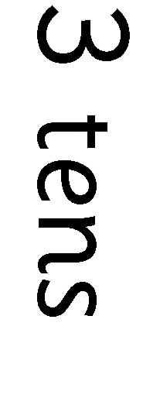
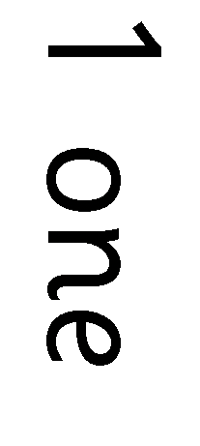
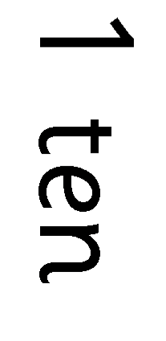


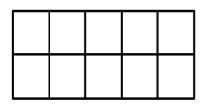

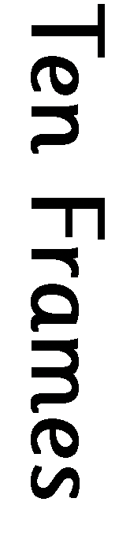
Task

Slide 11
Extension Task

