Slide 1


PSHE and Citizenship
Living in the Wider World | Britain
PSHE and Citizenship | Year 1 | Living in the Wider World | Britain | My School | Lesson 1

Slide 3
Aim
Aim
I can
I can describe ways that I can help my school community.
Success Criteria
Success Criteria
I can
I can
I can
I understand that I belong to the school community.
I can identify things that are helpful and not helpful to the school community.
This resource is fully in line with the Learning Outcomes and Core Themes outlined in the PSHE Association.
This resource is fully in line with the Learning Outcomes and Core Themes outlined in the PSHE Association.

Slide 4
The Big Questions

Slide 5

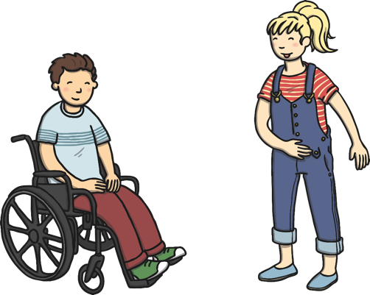
What can we do to help our school community?
What does it mean to belong to a community?

Slide 6
Reconnecting

Slide 7


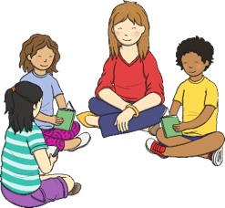
Community
A community is a group of people who live or work together in the same place, or who like to do the same kind of things.
What groups or communities do you belong to?
Sports Club – Football or Tennis
Beavers
Church

Slide 8
Exploring

Slide 9


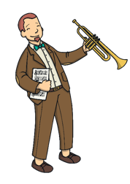

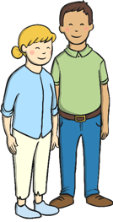
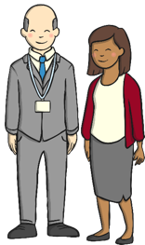
Our School
We all belong to our school community.
All the children who attend this school belong to the school community. There are lots of grown-ups that belong in our school community too.
Who belongs to our school community?
People Who Belong to Our School Community
Children
Teachers + LSA’s
Dinner ladies
Office staff

Slide 10

A Happy Community
What makes a happy community?
For a community to be happy, the people of the community have to work together.
If people in the community are friendly and kind to each other, the community will be a happy place.
Being polite, thoughtful and caring is helpful to the school community. Can you think of some things you could do that would be helpful to the school community?
If people in the community are not friendly and kind to each other, the community will not be a happy place.
Being mean, hurtful or unfriendly to others is not helpful to the school community. Can you think of any things that people might do that would be unhelpful to the school community?

Slide 11
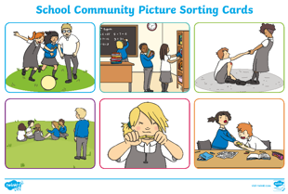
A Happy Community
We are going to work together to look at some behaviours that might happen in school. We are going to decide if they are helpful, or not so helpful, to the school community.

Slide 12

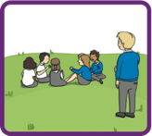
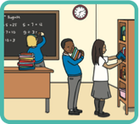
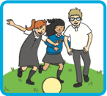
Helpful or Not Helpful?

Slide 13
Consolidating

Slide 14
How Can I Help?
We can all help our school community to be a happy place by making the people who belong to it feel happy.
We can do this by doing big things and also by doing little, every day things.
We can make sure we are helpful, kind and caring. We can listen to adults and children in school. We can make sure we treat all people in school and school property with respect. We can also share and keep things tidy.
Working together as a team is really important. It is also important to take care of each other by being good friends.

Slide 15
Reflecting

Slide 16

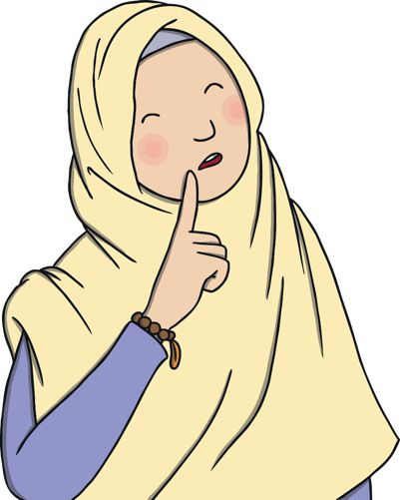
Think about It
How are you going to help our school community to be a happy place?

Slide 17

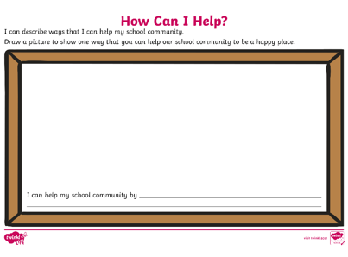
How Can I Help?
Draw a picture to show one way that you could help to make a happy school community, and then write a sentence to describe your picture. Use the key words from the word bank to help you.
Word Bank:
community help respect friend share listen care kind belong

