Slide 1
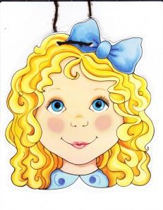

English

Slide 2
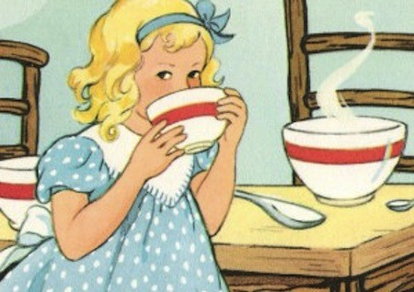
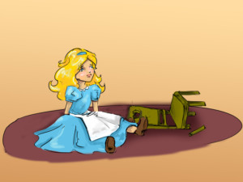
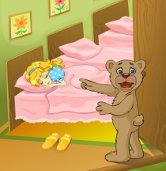
Learning Objective: To write a letter of apology.

Slide 3
What is an apology?
An apology is something that we say when we wish we had not said or done something.
An apology is another way of saying ‘sorry’.

Slide 4
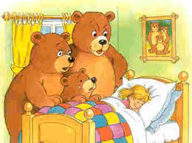
Today you will imagine that you are the cheeky little girl Goldilocks!
You are going to write a letter to the Three Bears to explain why you are sorry.
Try to use the word ‘I’ to say why you are sorry and that you won’t do it ever again!

Slide 5
Why are you sorry?
Are you sorry for going into the Bears’ house?
Was it a good idea to eat the porridge?
Did you mean to break Baby Bear’s chair?
Do you think that sleeping in Baby Bear’s bed was kind?

Slide 6
What would you like to change?
Would you like some friends?
Do you think you could go back to say sorry?
Would you like to play with Baby Bear?
Do you think that you should go into strange homes?

Slide 7
Remember to start your letter:
Dear Three Bears,
Use capital letters, full stops and finger spaces.
Maybe you could write a question and use a question mark.
Remember to end your letter:
From Goldilocks

