Slide 1
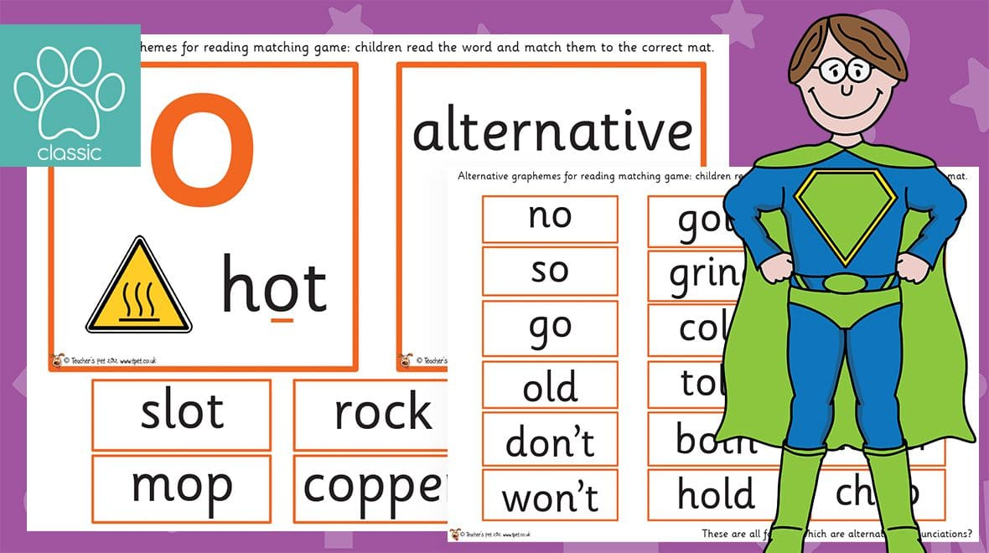

Year 1
Alternative sound for ‘o’
o
o

Slide 2


Let’s read!
pot

Slide 3

Let’s read!
pony

Slide 4

Let’s read!
mop

Slide 5

Let’s read!
open

Slide 6

Let’s read!
spot

Slide 7

Let’s read!
hold

Slide 8

Let’s read!
fond

Slide 9
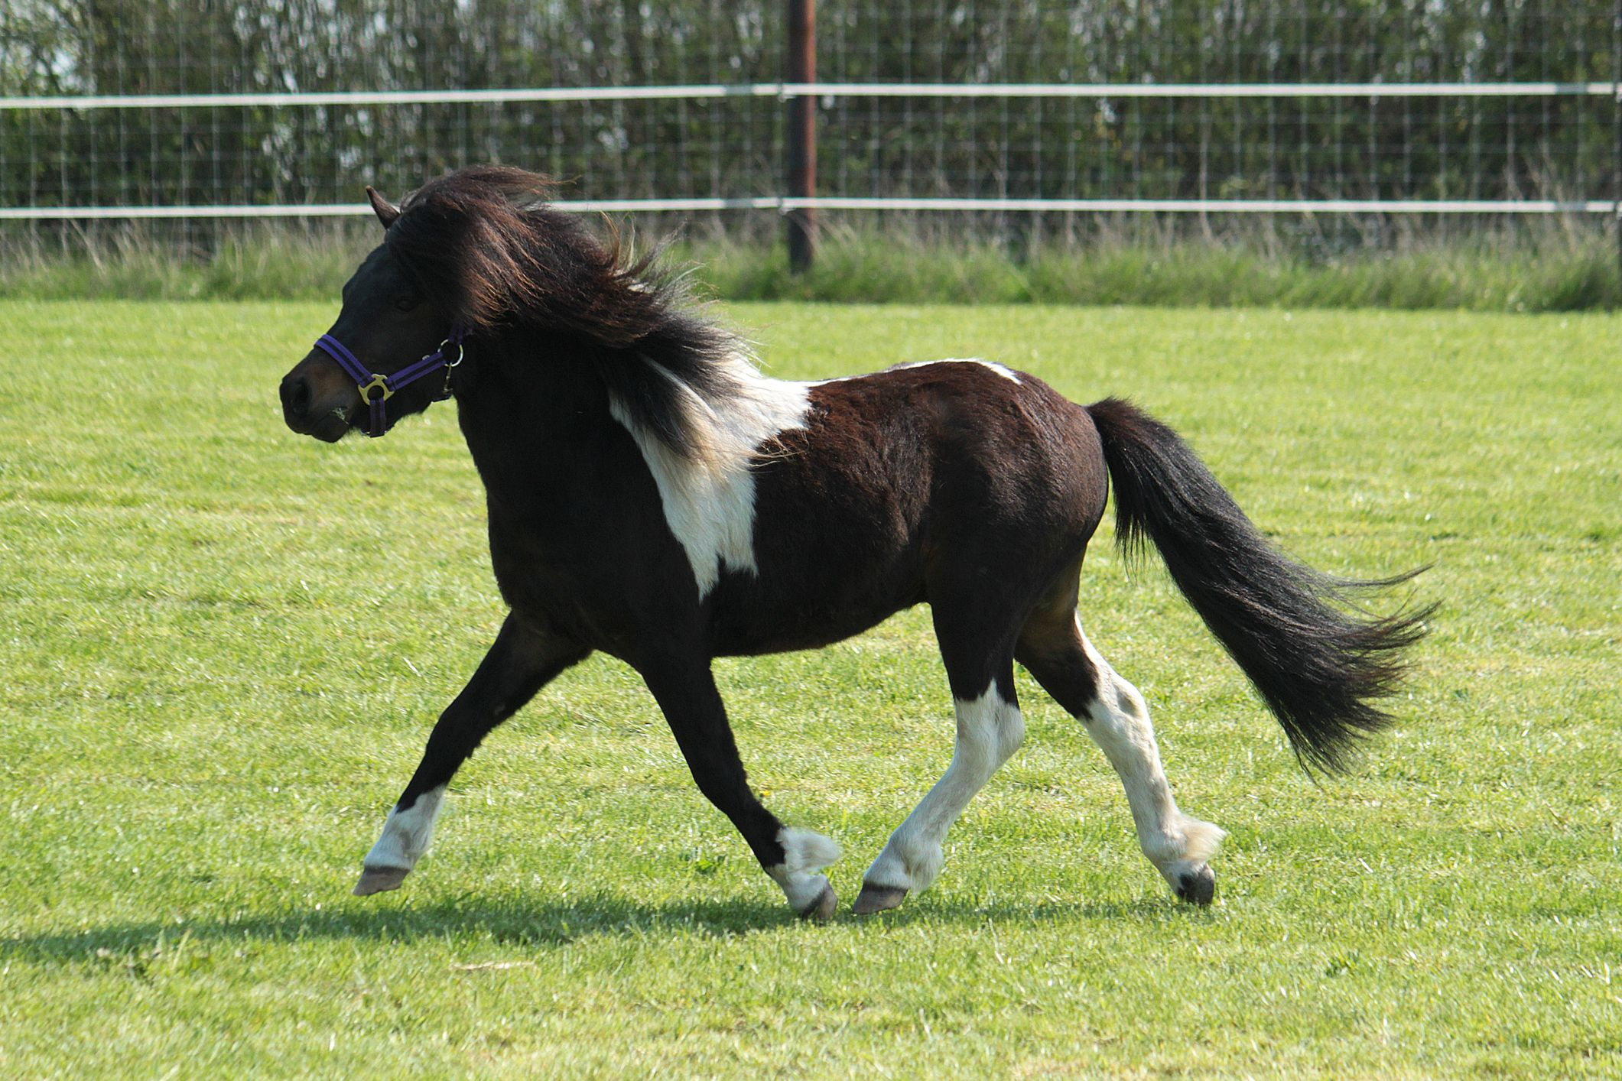
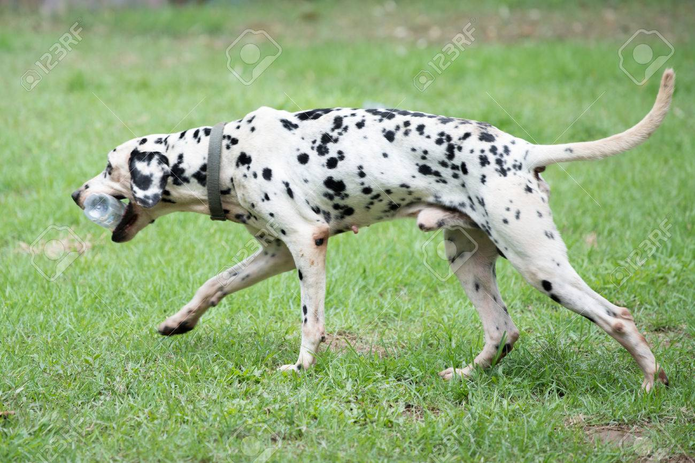
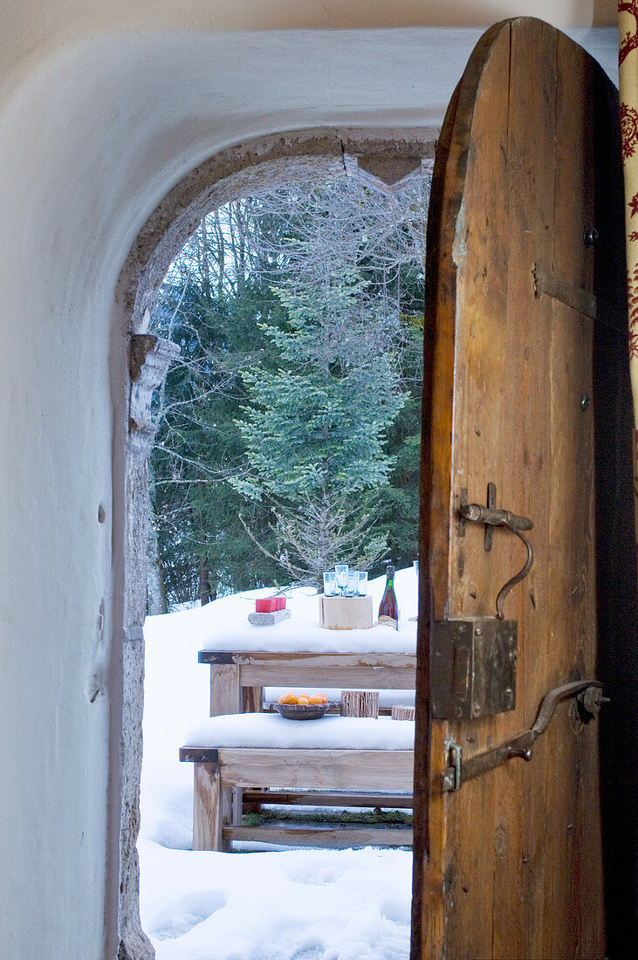

Read and Match
This dog has spots.
The wooden door is open.
A pony can trot quite fast.

Slide 10
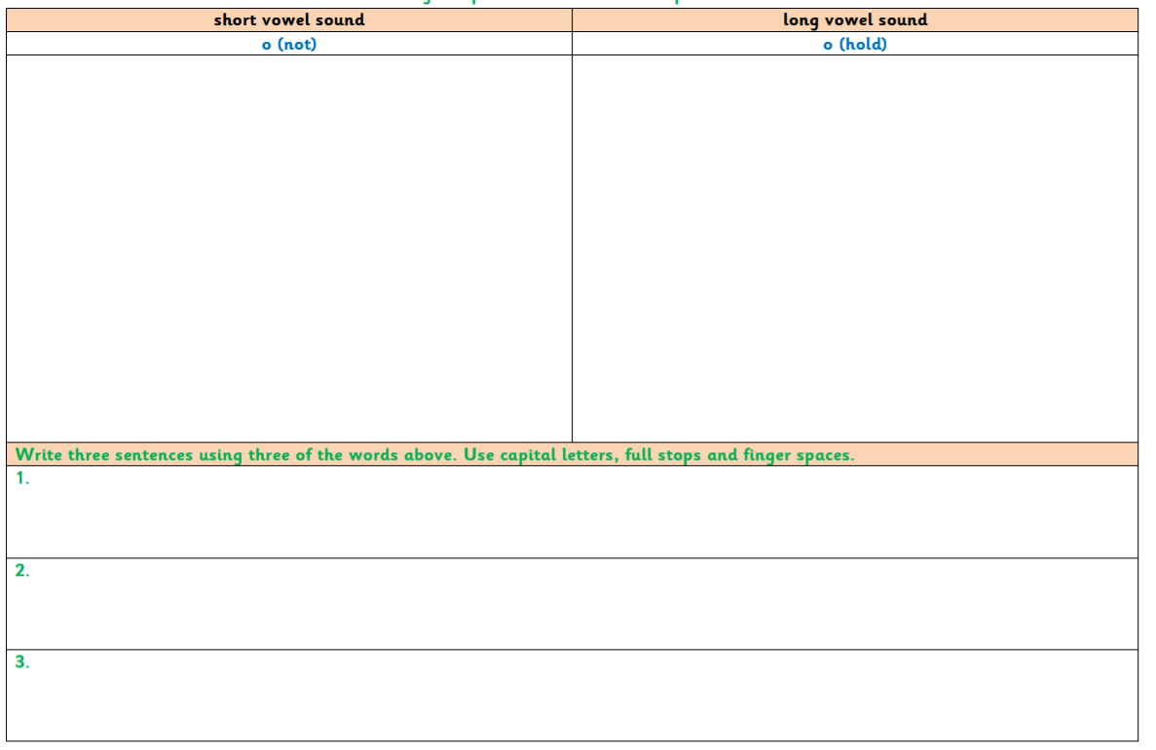
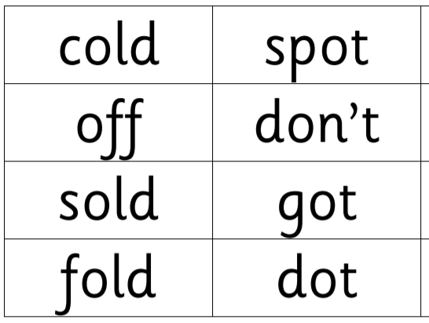
Read and sort the words.

Slide 11


Let’s write…
Choose three words and write a sentence using each word.
Remember to use a capital letters.
Remember to use a full stop.
Remember to use finger spaces.

