Slide 1
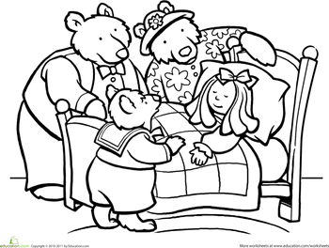

English

Slide 2

Learning Objective: To create a ‘Wanted’ poster.

Slide 3
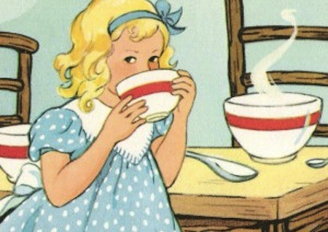
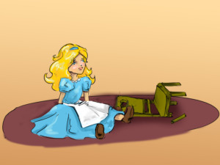
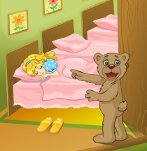
What has Goldilocks been doing?
She went into a house without permission!
She ate porridge… She broke a chair… She got in a bed!

Slide 4
Would you like Goldilocks to come into your home to eat your breakfast?
Do you think that Goldilocks has made a mistake?
Do you think that the Three Bears should have locked their door?

Slide 5
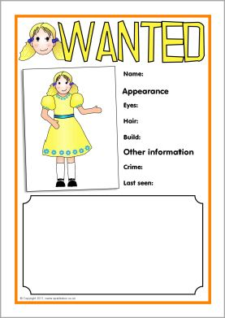
How could you tell others about Goldilocks?
Let’s create a poster that
can give lots of information.

Slide 6
What do you need to include?
What does she look like?
What does she do if she comes to a home?
Is she hungry or tired?
What can everyone do to prevent her from coming to your door?

Slide 7
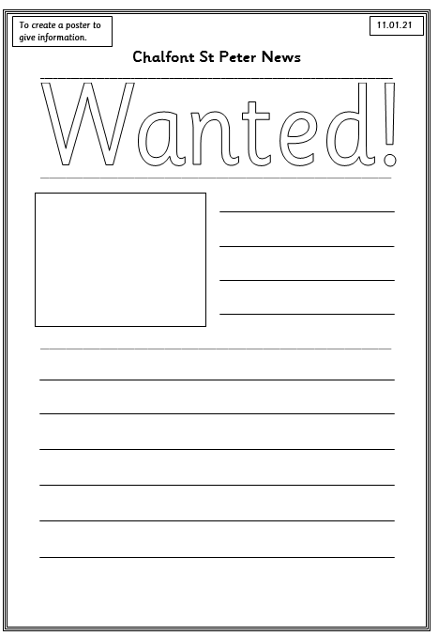
Remember to draw her picture, describe her appearance and use adjectives!

