Slide 1
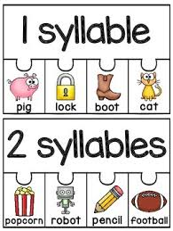

Year 1 Syllables

Slide 2
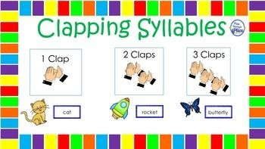
What is a syllable?

Slide 3
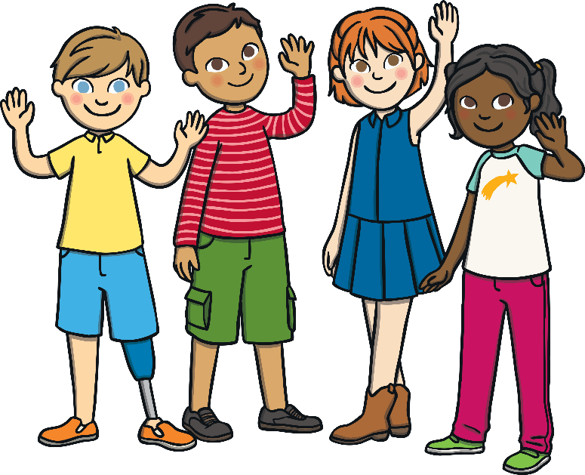
Which sounds make up the missing word?
i
f
r
d
qu
l
ch
a
h
e
n
ou
ch
i
l
d
r
e
n
Reveal Answer

Slide 4
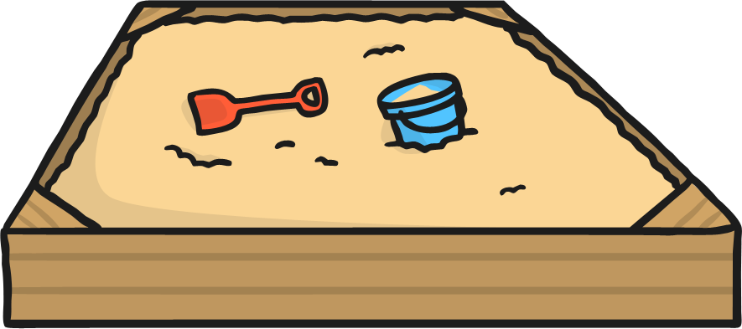
Which sounds make up the missing word?
s
t
f
y
a
o
c
p
d
n
u
i
s
a
n
d
p
i
t
Reveal Answer

Slide 5
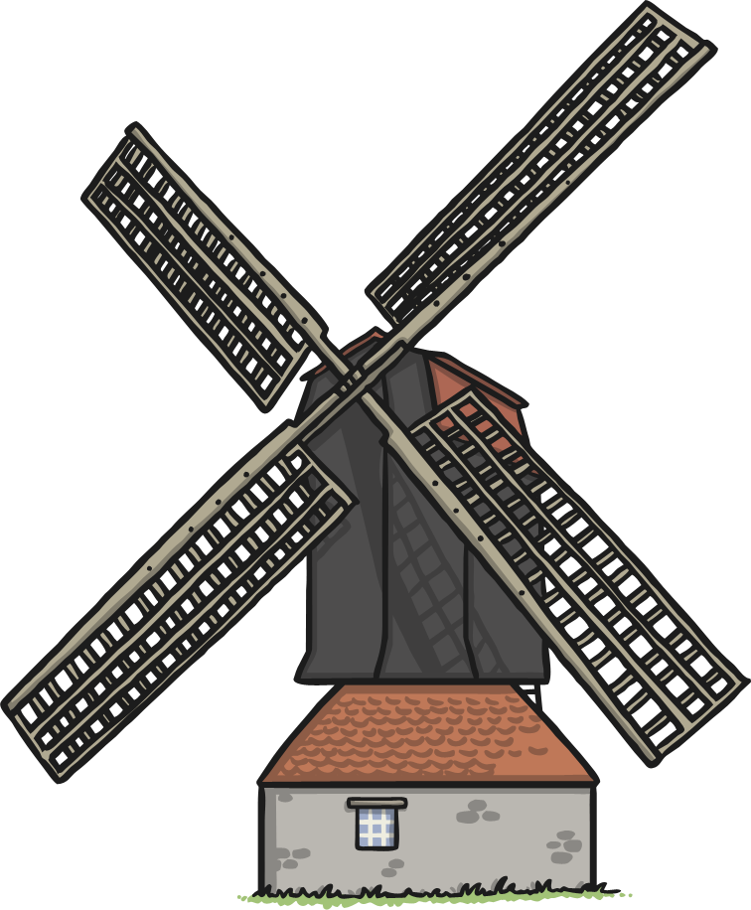
Which sounds make up the missing word?
i
i
f
b
er
p
ll
q
d
n
m
w
w
i
n
d
m
i
ll
Reveal Answer

Slide 6
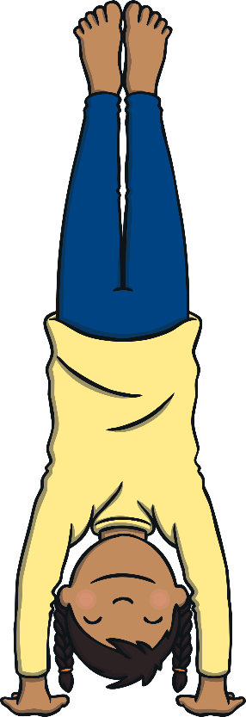
Which sounds make up the missing word?
n
h
a
p
e
r
s
t
a
d
n
d
h
a
n
d
s
t
a
n
d
Reveal Answer

Slide 7
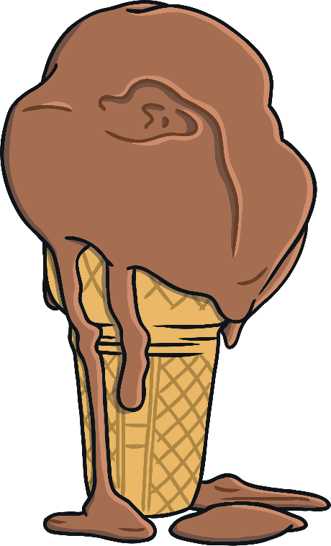
Which sounds make up the missing word?
i
d
oo
p
m
j
l
t
ng
er
u
e
m
e
l
t
i
ng
Reveal Answer

Slide 8
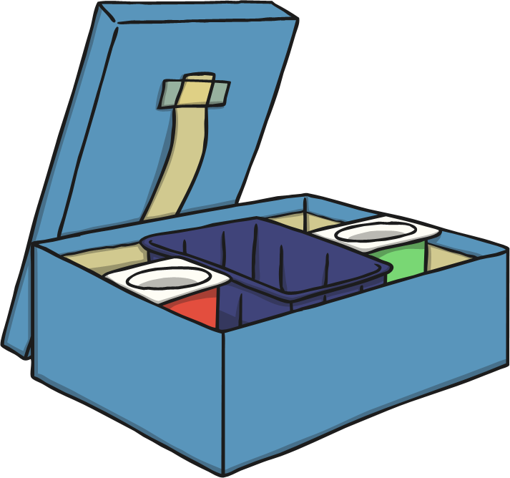
Which sounds make up the missing word?
n
ee
f
x
l
o
s
u
a
i
ch
b
l
u
n
ch
b
o
x
Reveal Answer

Slide 9
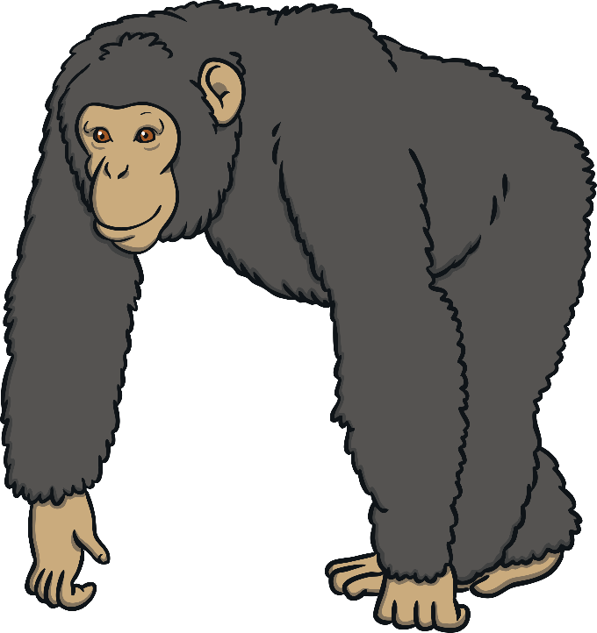
Which sounds make up the missing word?
j
i
m
p
z
ch
s
t
a
ee
n
ng
ch
i
m
p
a
n
z
ee
Reveal Answer

Slide 10
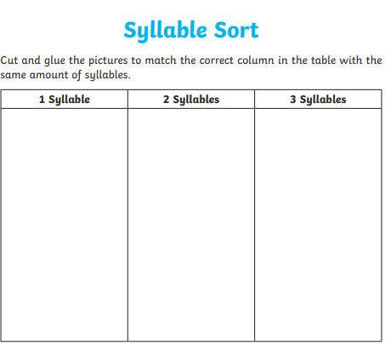
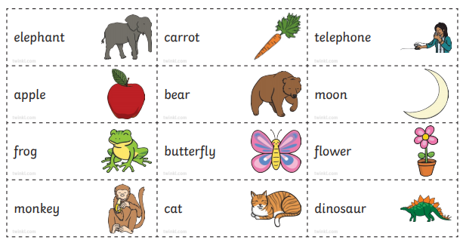
Year 1 Syllable Sort!

Slide 11
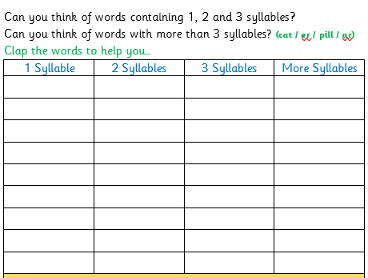
Syllable Challenge!

