Slide 1

ew
oo
u-e
What are the digraphs and phonemes for the sound ‘oo’?
o
ue
u

Slide 2
blue

Slide 3
dew

Slide 4
truth

Slide 5
cute

Slide 6
do

Slide 7
noon

Slide 8
glue

Slide 9
flute

Slide 10
to

Slide 11
few

Slide 12
hoop

Slide 13
you
group

Slide 14
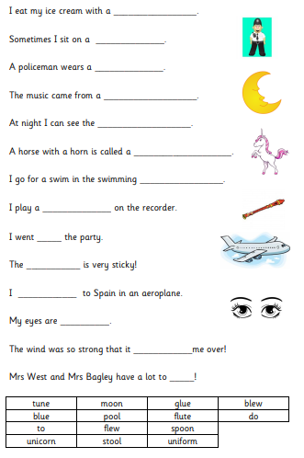
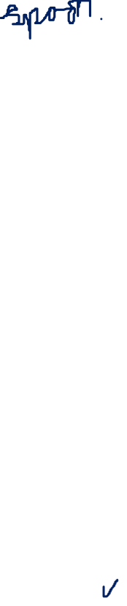
Read the sentences and then read the words in the word bank.
Use the words that ‘fit’ into the sentences.

