Slide 1
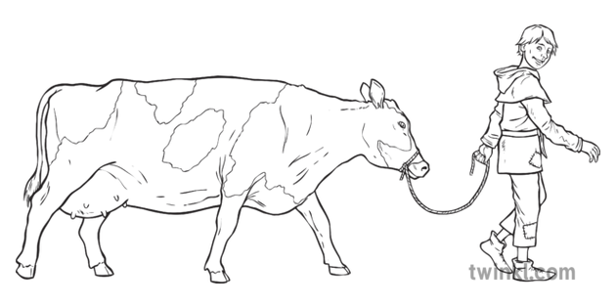

English

Slide 2
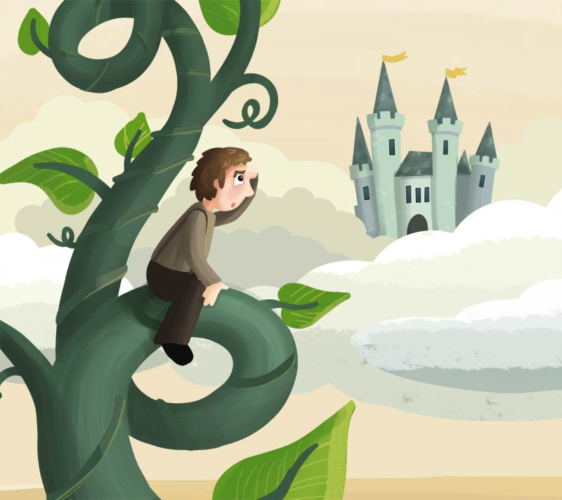
Learning Objective: To retell a story in chronological order.

Slide 3
What is chronological order?
It is the order in which things happen.
What is retelling?
It is remembering all the events in the story, writing them down.

Slide 4
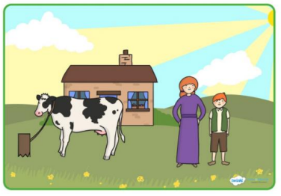
Let’s begin…
Use the pictures if you need help from a picture clue.
Once upon a time there was a little boy who lived with his mother and a black and white cow.

Slide 5
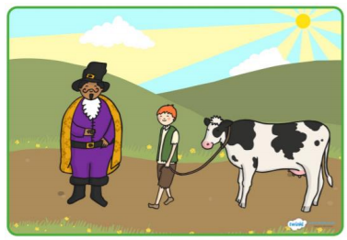
Let’s continue to retell the story…
.
They were very poor so Jack had to sell his cow at the market. On the way he met a man who swapped the cow for 5 magic beans.

Slide 6
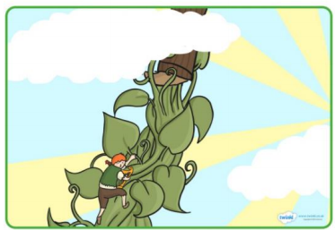
Let’s continue to retell the story…
.
Jack climbed down the beanstalk so fast but he was being followed by the huge giant!

Slide 7
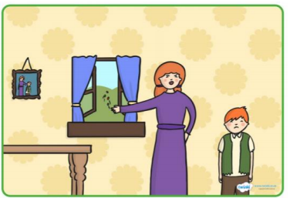
Let’s continue to retell the story…
.
When he arrived home, Jack’s mum was not happy to see the magic beans and she threw them out of the window!

Slide 8
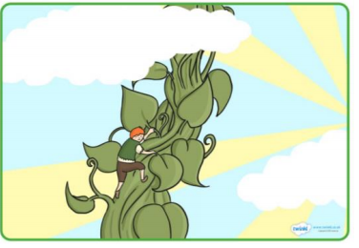
Let’s continue to retell the story…
.
In the morning, Jack saw a tall, green beanstalk growing right up to the clouds! He decided to climb up…

Slide 9
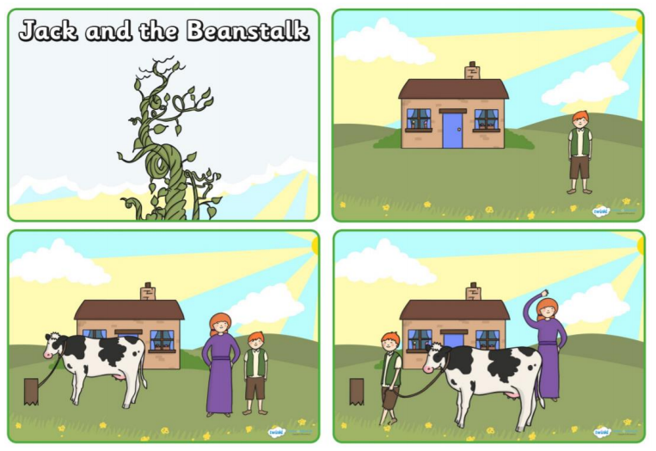
Remember to order the events before you begin to write.

Slide 10
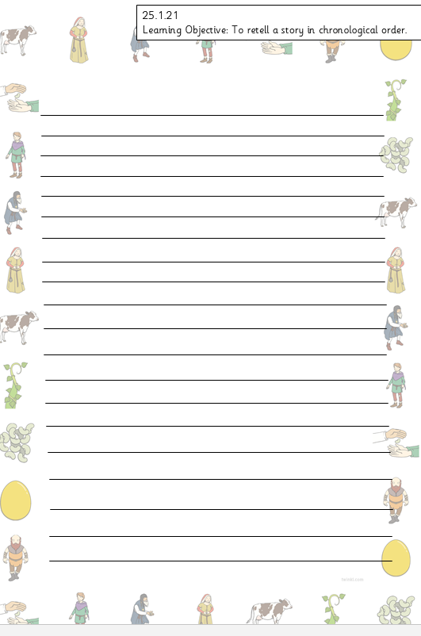
Use your yellow book to retell the story or if you prefer, you can use the writing paper.

Slide 11
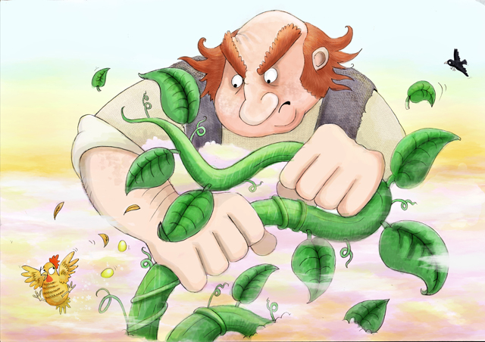
Writing sentences…
Please use capital letters at the start of your sentence.
Please use full stops at the end of your sentence.
Please use finger spaces.
Please use adjectives.
Please use conjunctions. (and, but, so, because)

Slide 12


