Slide 1
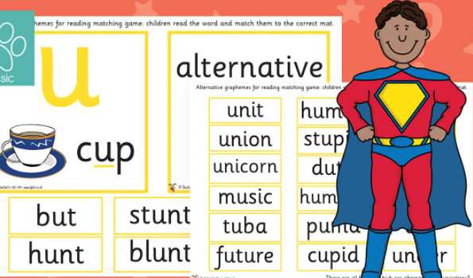

Year 1
Alternative sound for ‘u’
u
u

Slide 2

What sound does ‘u’ make?
cut
full
c
unit

Slide 3

Let’s read!
mug
c

Slide 4

Let’s read!
pull
c

Slide 5

Let’s read!
uniform
c

Slide 6
Let’s read!
truck
c

Slide 7

Let’s read!
push
c

Slide 8

Let’s read!
jump
c

Slide 9

Let’s read!
unicorn
c

Slide 10

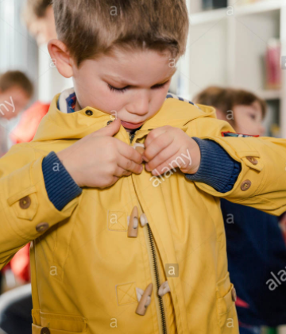
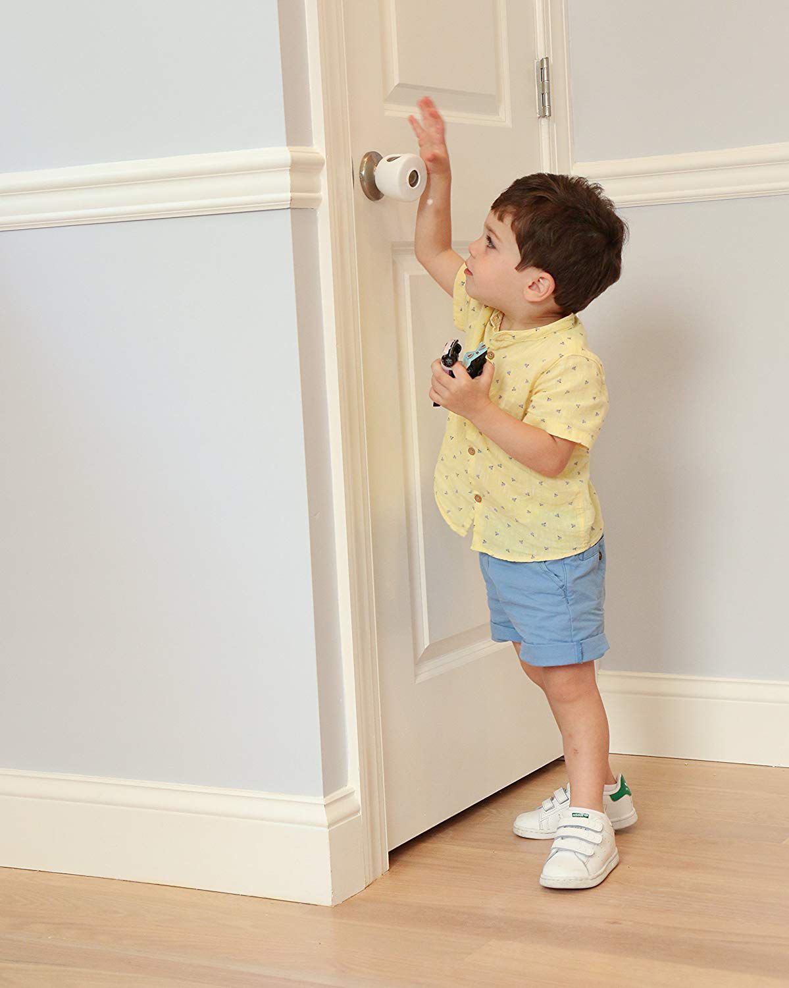

Read and Match
I will put my coat on.
My uniform is red.
Please shut the door .

Slide 11
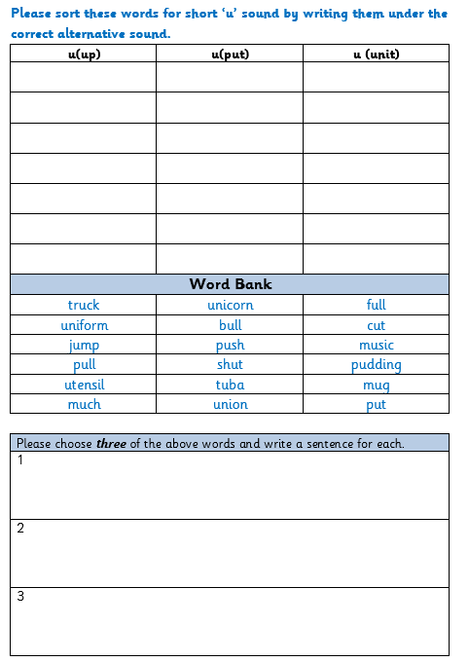
Read the words in the word bank.
Try to ‘hear’ the sound that the ‘u’ is making.
Write the word in the correct column.

