Slide 1

Friday
29th January 2021

Slide 2

L.O: To know doubles and understand the concept.

Slide 3

Starter
https://www.youtube.com/watch?v=9XXWSyAWxPw

Slide 4

What is Doubling?

Slide 5

What is Doubling?

Slide 6
2
Double 1 is…..

Slide 7
6
Double 3 is…..

Slide 8
10
Double 5 is…..

Slide 9
No !!!!

Slide 10
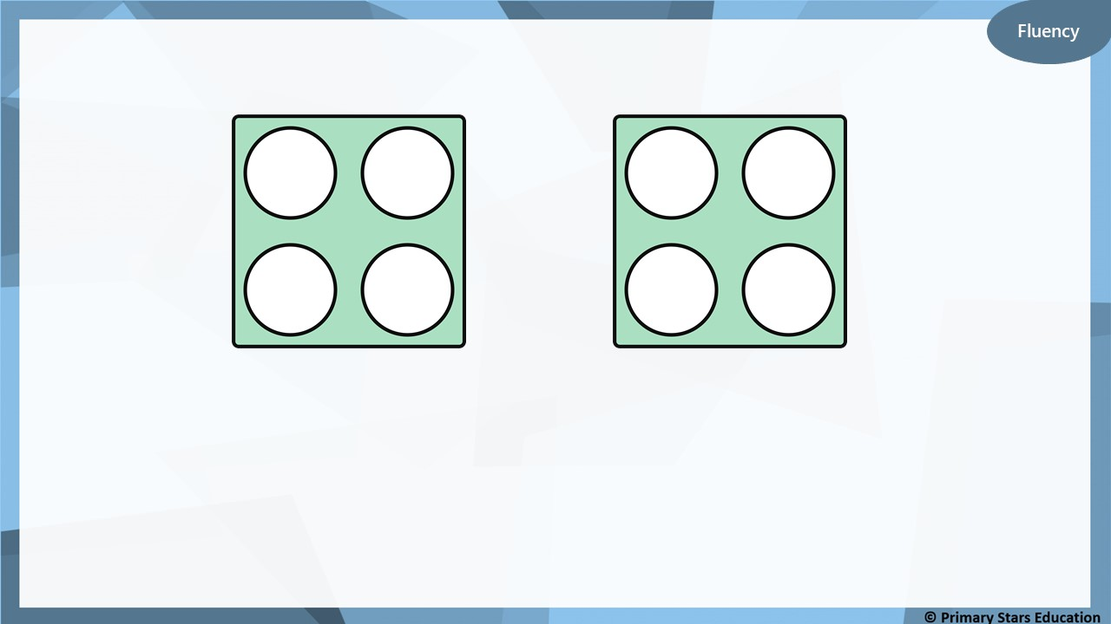
4
8
Double _____ is _____

Slide 11
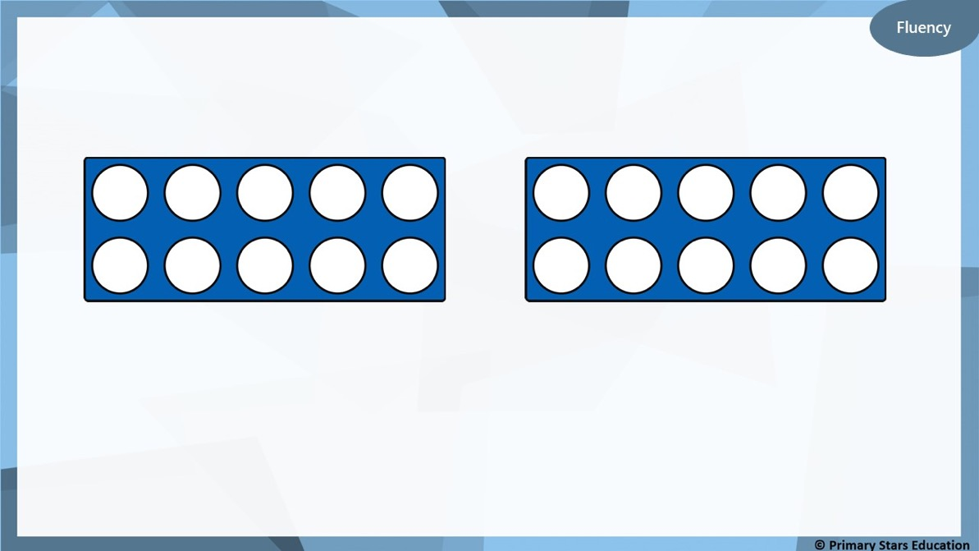
10
20
Double _____ is _____

Slide 12

6 + 6 =
12

Slide 13
7 + 7 =
14

Slide 14
8 + 8 =
16

Slide 15
9 + 9 =
18

Slide 16
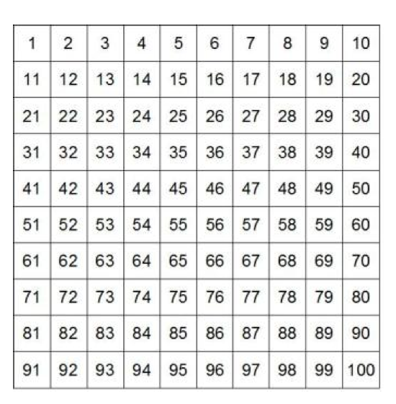
.
Double 10
is 20
10 + 10 = 20

Slide 17
.
18 + 18 =
36

Slide 18
.
12 + 12=
24

Slide 19
.
Task
6
Notes:
draw

Slide 20
.
Task
20
14 + 14 =

Slide 21
.
Extension

