Slide 1
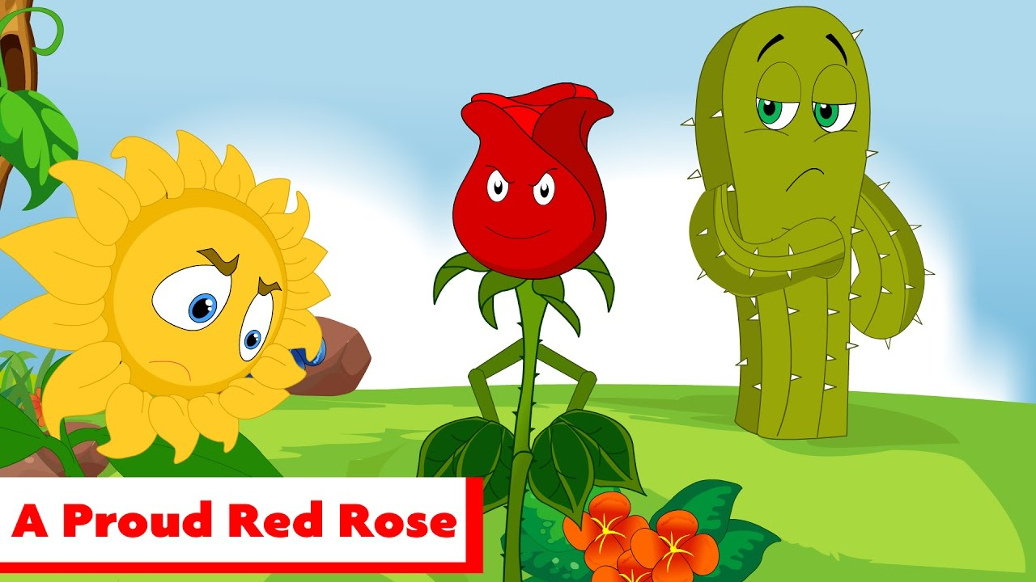

The Proud Rose

Slide 2
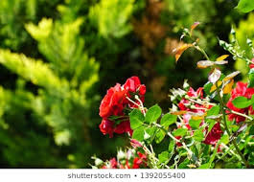
One beautiful Spring day a red rose blossomed in a forest. Many kinds of trees and plants grew there. As the rose looked around, a pine tree said, ‘What a beautiful flower you are. I wish I was red and beautiful.’

Slide 3
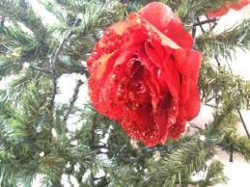
Another tree said, ‘Don’t be sad pine tree. We cannot all have everything.
The rose turned and said, ‘It seems that I am the most beautiful flower in the forest.

Slide 4
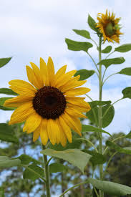
A sunflower raised a yellow head and said, ‘Why do you say that? In this forest there are many beautiful plants and you are just one of them.

Slide 5
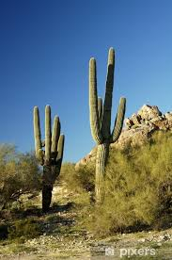
Well I can see everyone looking at me and admiring me.’ said the red rose. Then the rose looked at the cactus and said, ‘Look at that ugly plant full of thorns!’

Slide 6
The pine tree said, ‘What kind of words are these? Who can say what beauty is? You have thorns too!’

Slide 7
The rose was angry and tried to move away from the cactus but it could not. The rose spent many days speaking rudely saying, ‘You are a useless plant and I wish I wasn’t growing next to you.’

Slide 8

Although the cactus felt sad, it did not say anything. Spring passed and Summer brought hot weather with no rain.

Slide 9
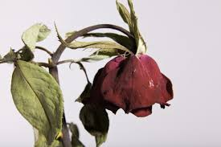
Animals and plants desperately needed water and the rose began to wilt.
One day the red rose saw birds place their beaks into the cactus and fly away refreshed.

Slide 10
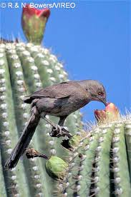
The rose asked the pine tree what the birds were doing.
The pine tree told the rose that the birds were drinking water from the cactus. The rose was so surprised.

Slide 11
The rose was so thirsty and wished that the cactus would give her some water but she had been so unkind.
The cactus asked the birds to take some water to the rose and help her.

Slide 12
The rose was very grateful and soon felt much better but the rose was so ashamed that it had been so mean to the cactus.
The rose said, ‘Sorry’ to the cactus and it never judged anyone on their appearance again.

Slide 13

Draw a picture of the rose and the cactus.
Write a few sentences to explain why it is important to respect others and to always be polite even though we may look different.

