Slide 1
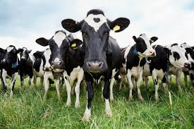

English

Slide 2
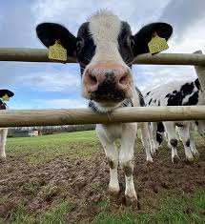
Learning Objective:
To write non-fiction facts.

Slide 3
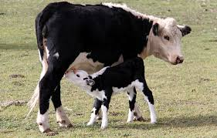
What do you know about cows?
Cows are mammals.
A mammal is an animal that gives birth to live young and they feed their babies with milk.

Slide 4
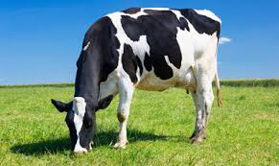
What do you know about cows?
Cows are herbivores.
A herbivore is an animal that only eats plants in their daily diet. They only need plants to get energy.

Slide 5
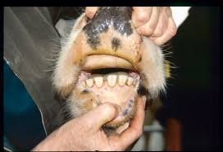
More facts…
Cows don’t have teeth on top at the front of their mouth; instead they have a hard pad on which to chew.

Slide 6
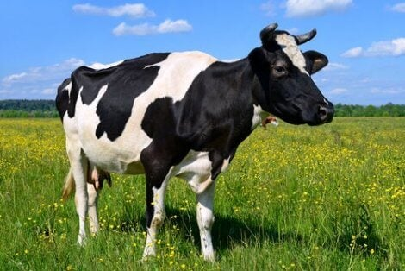
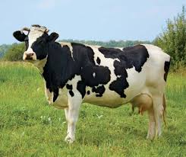
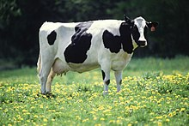
More facts…
Black and white cows are called ‘Holstein’ Cows and their markings are like fingerprints; they are all different.

Slide 7
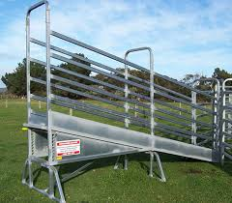
Did you know…
Cows can walk up steps but they find it very tricky to walk down! This is because their body is big and their legs are not that strong.

Slide 8
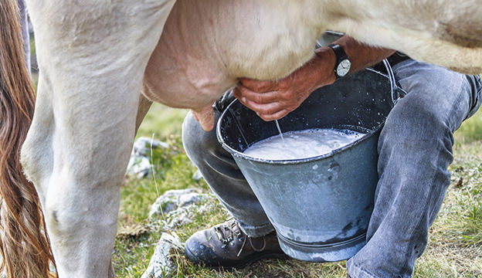
Cows give us milk!

Slide 9
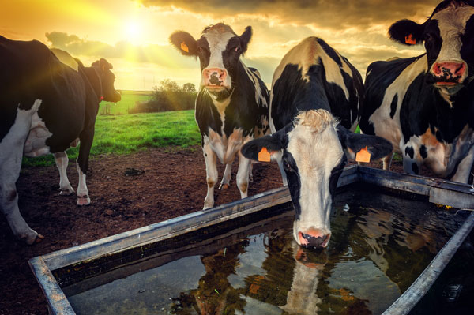
Did you know…
If it is hot, cows will drink 140 litres of water in a day. If they do not have enough water, they will produce less milk.

Slide 10
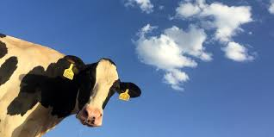
Did you know…
Cows are colour blind; they find it very tricky to see the colours red and green.

Slide 11
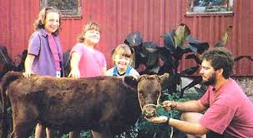
Did you know…
A ‘Dexter’ cow is very small and people sometimes keep them as a pet.

Slide 12
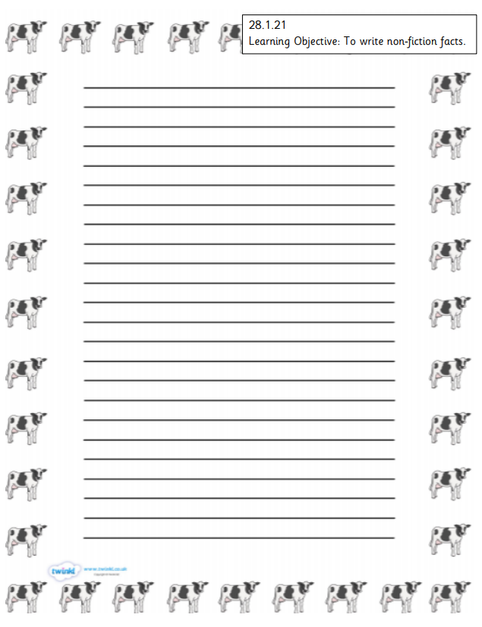
Read the information again.
Write some non-fiction facts.
Remember the sentence rules.
Draw a cow!

