Slide 1


PSHE and Citizenship
Living in the Wider World | Diverse Britain
PSHE and Citizenship | KS1| Living in the Wider World | Diverse Britain | My Country | Lesson 4

Slide 3
Aim
I can describe what it is like to live in the British Isles.
Success Criteria
I can identify Britain on a map.
I can draw pictures about living in Britain.
I can say what I like best about Britain and why.
I understand that it is important to treat all people with kindness
and respect.
I can identify what makes Britain a diverse country.
This resource is fully in line with the Learning Outcomes and Core Themes outlined in the PSHE Association’s Programme of Study.

Slide 4

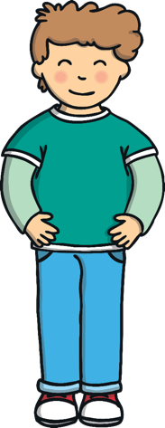

What is Britain?
What is it like to live in the British Isles?

Slide 5

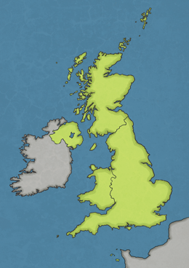
What Do I Know?
What do you know about the nation we live in?
Think of three things you know about our nation.
1. We are an island.
2. Britain is made up of England, Scotland, Wales and Northern Ireland.
3. We speak English.

Slide 6
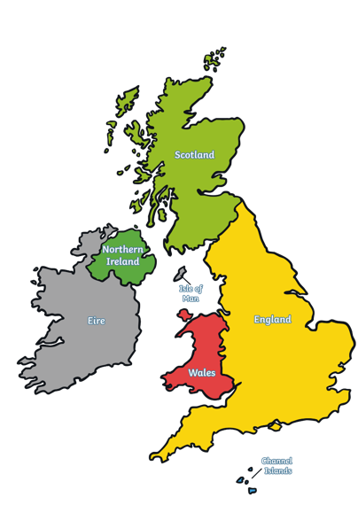

Britain
This is a map of The United Kingdom of Great Britain and Northern Ireland.
The United Kingdom of Great Britain and Northern Ireland is a nation which is made up of England, Wales and Scotland on the island of Great Britain and Northern Ireland on the island of Ireland.
Islands such as the Isles of Scilly and the Isle of Wight are also part of the United Kingdom of Great Britain.
Click the dots to reveal…
Jersey, Guernsey and the Isle of Man are part of the British Isles but not the United Kingdom.
Although the Isle of Man and the Channel Islands of Guernsey and Jersey are not part of the United Kingdom, the people who live there are British citizens.
Scotland
Northern Ireland
England
Wales
Channel Islands
Isles of Scilly

Slide 7
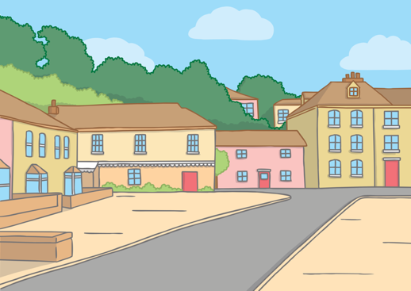
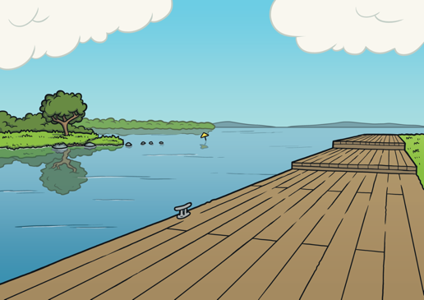
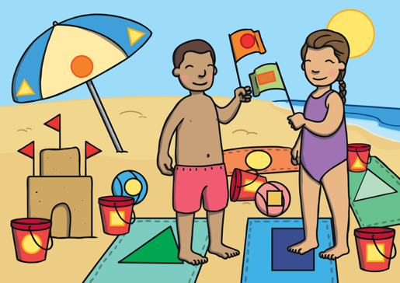
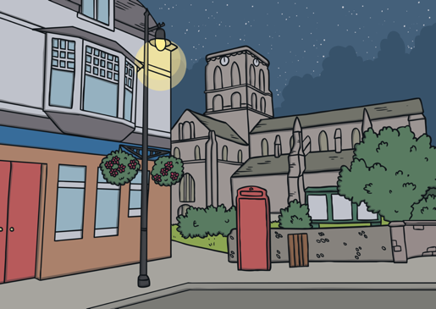
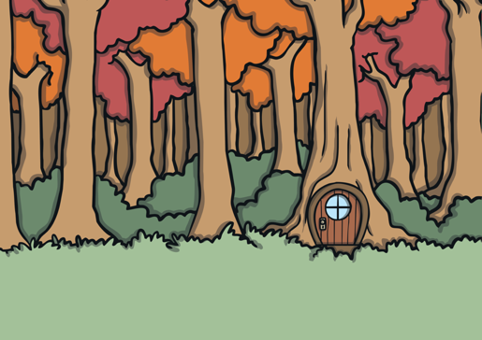
Britain
Great Britain is an island. This means it has water all the way around it.
In Britain, there are cities, towns and villages.
Lots of different kinds of people live in our nation. This makes it an exciting place to live.
There are also mountains, lakes, rivers, forests and lots of beaches too!

Slide 8
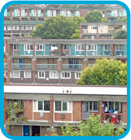
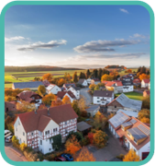
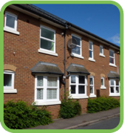
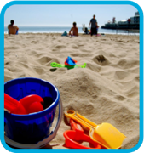
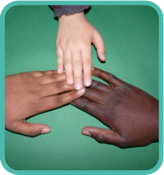
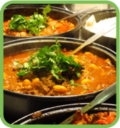
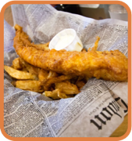

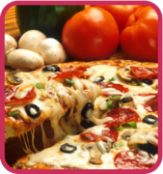
Our nation is diverse. This means there are lots of different people. Some will be the same as us and others will be different. It also means there are different places to visit and different things to do and experience. Diversity helps us learn and grow as people. It is something to be celebrated.

Slide 9
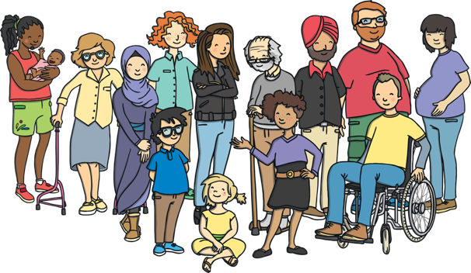
What I Like Best
Britain is a diverse country. Let’s embrace this and treat all people, no matter who they are, what they look like or where they are from, with the kindness and respect they deserve. This is everyone’s right and helps all people live safe, happy and healthy lives!
There are a lot of wonderful things about living in our nation, as well as things we would perhaps like to change for the better.

Slide 10
What is Britain?
What is it like to live in the British Isles?
Have you learnt anything new today?

Slide 11
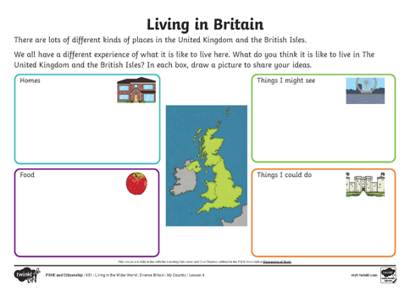
Task
The United Kingdom and the British Isles are diverse nations; we all have a different experience of what it is like to live here.
What do you think it is like to live here?
Your task today is to draw pictures to share your ideas.

