Slide 1
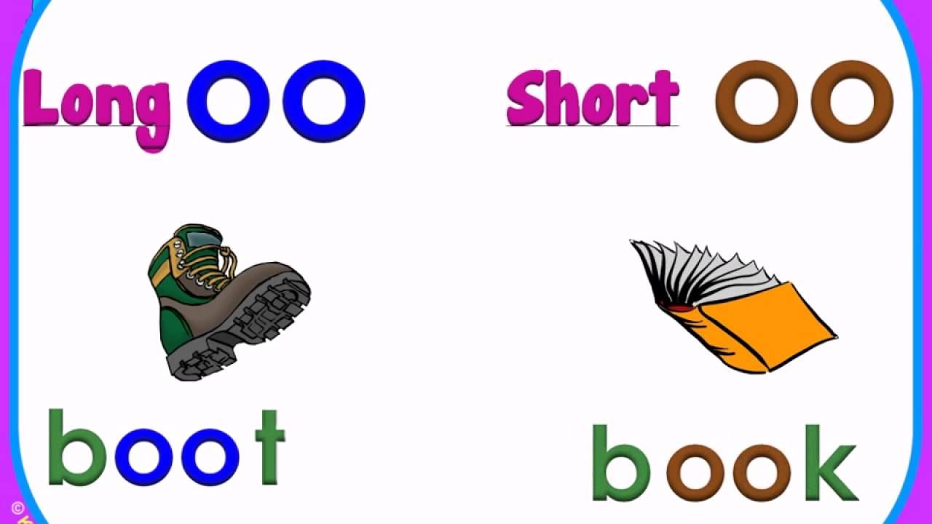

Year 1
Alternative sound for ‘oo’

Slide 2
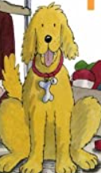

Let’s read?
foot
c
oo
moon

Slide 3

Let’s read!
soon
c
oo

Slide 4

Let’s read!
pool
c
oo

Slide 5

Let’s read!
book
c
c
oo

Slide 6

Let’s read!
took
c
c
oo

Slide 7

Let’s read!
spoon
c
c
oo

Slide 8

Let’s read!
hook
c
c
oo

Slide 9

Let’s read!
cool
c
c
oo

Slide 10
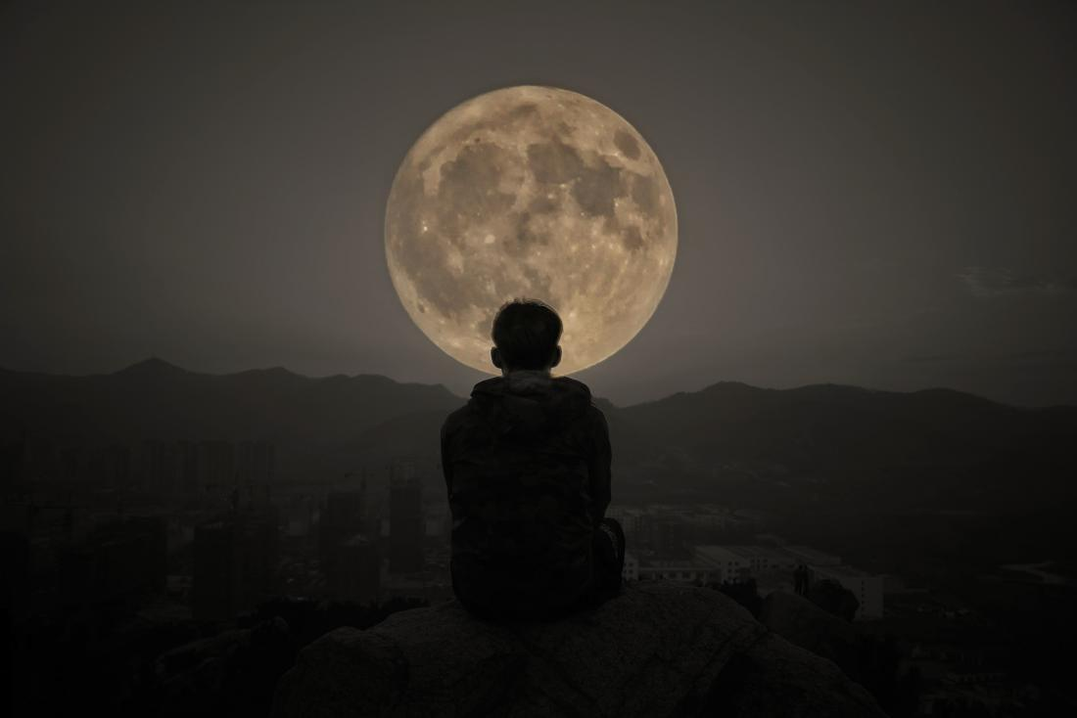
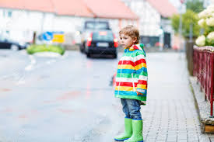
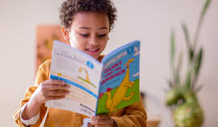

Read and Match
Look at the moon.
I read my book today.
My boots are green.

Slide 11
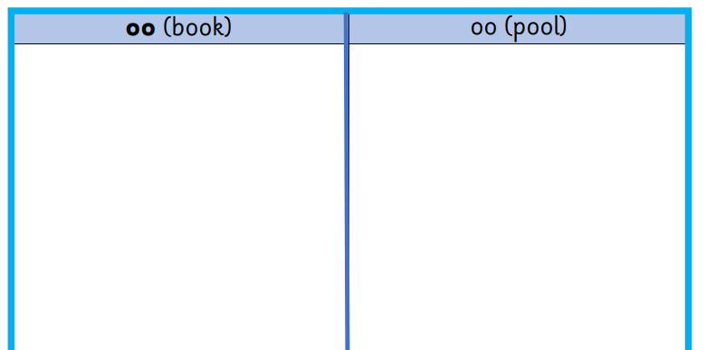
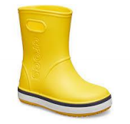


Cut out the pictures and say the word out loud.
Try to ‘hear’ the sound that the ‘oo’ is making.
Stick the picture in the correct column.

