Slide 1

Tuesday
26th January 2021

Slide 2
L.O: To subtract 10 or multiples of 10 less than.

Slide 3

Starter
https://www.youtube.com/watch?v=mD1npIcl1BU

Slide 4


What is the number?
tens
ones
46

Slide 5


What number is this?
3 tens and 4 ones
34

Slide 6
What happens when you take 10 away?
tens
ones
33
43

Slide 7
What happens when we take 10 away?
2
3 tens and 6 ones
26

Slide 8
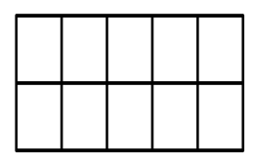
What happens when we subtract 10?
26
1

Slide 9
What is 10 less?
5
60

Slide 10
57
47
37
Tens
Ones
27

Slide 11
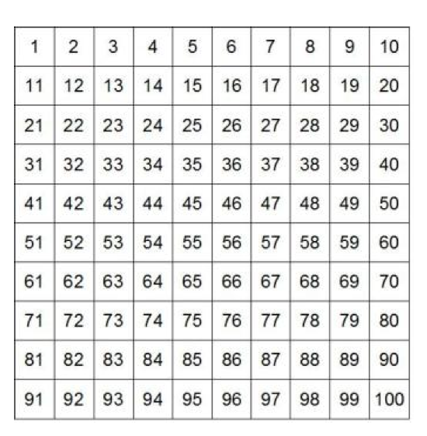

.
10 less than 20
10

Slide 12
.
10 less than 76
66

Slide 13
.
20 less than 46
26

Slide 14
.
Task

Slide 15
.
Extension Task

