Slide 1
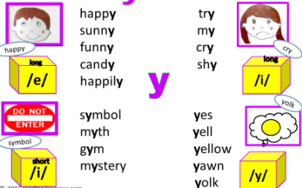

Year 1
Alternative sound for ‘y’.

Slide 2


yellow

Slide 3
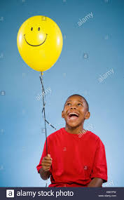
happy

Slide 4
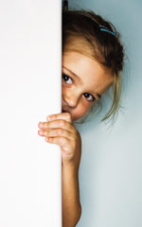

shy

Slide 5
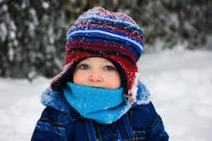

chilly

Slide 6
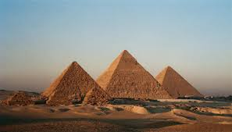

pyramid

Slide 7
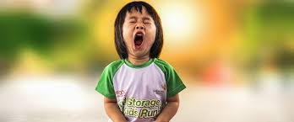

yawn

Slide 8
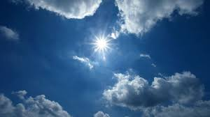

sky

Slide 9
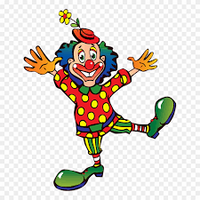
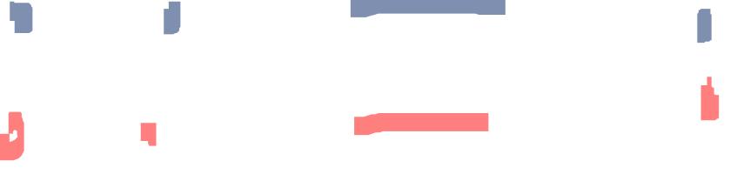
funny

Slide 10
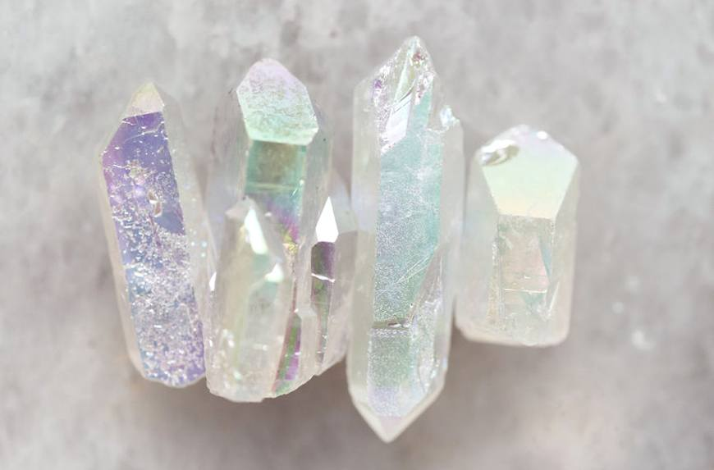

crystal

Slide 11
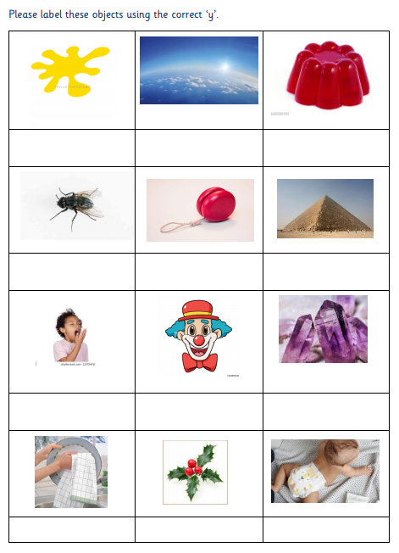
Look at the picture. Identify the object.
yellow
Say the word for the picture out loud.
All the words have ‘y’ within them. Can you think where the ‘y’ might be placed?

Slide 12


Using and applying…
Choose three words and write three sentences.
The sun is yellow and when it is shining I get a hot head so I must wear a hat.

