Slide 1
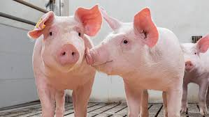

English

Slide 2
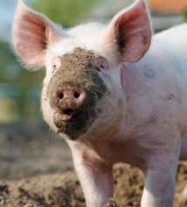
Learning Objective:
To write non-fiction facts.

Slide 3
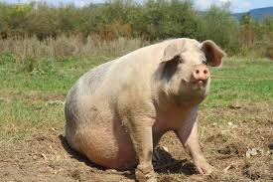
What do you know about pigs?
Pigs are mammals.
A mammal is an animal that gives birth to live young and they feed their babies with milk.

Slide 4
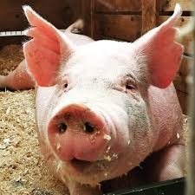
What do you know about pigs?
Pigs are omnivores.
An omnivore is an animal that eats plants and meat in their daily diet. They get their energy from plants and meat.

Slide 5
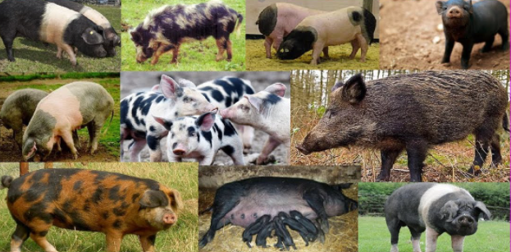
Did you know…
There are 16 types of pig and they live for between 10 and 15 years.

Slide 6
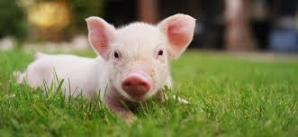
More facts…
A male pig is called a ‘boar’. A female pig is called a ‘gilt’ if she hasn’t had piglets but if she has had some babies, she is called a ‘sow’.

Slide 7
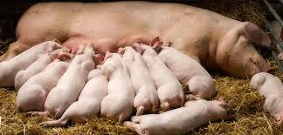
More facts…
Pigs usually give birth to about 10 piglets; can you imagine looking after 10 babies?

Slide 8
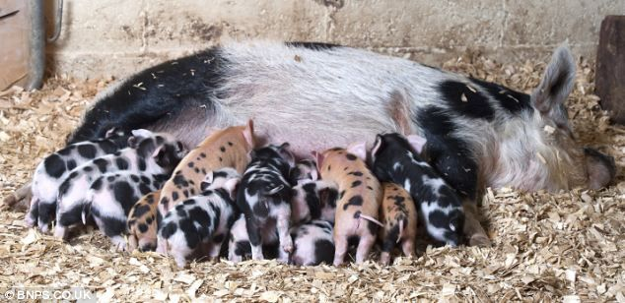
More facts…
This pig has given birth to 27 piglets and that is most ever recorded!

Slide 9
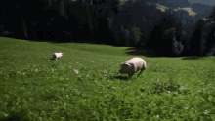
More facts…
Pigs can run very fast and wild pigs can run even faster. It is very tricky to catch a pig because they do not run in a straight line; they run in a zig zag!

Slide 10
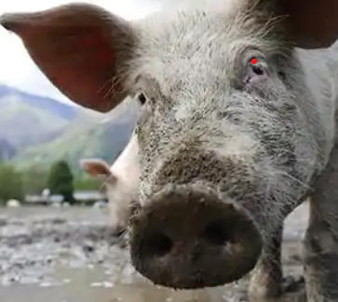
Did you know…
Pigs do not have very good eyesight but they do have a very clever snout! Their snout is flexible and it can find food under the ground that cannot be seen from above the ground!

Slide 11
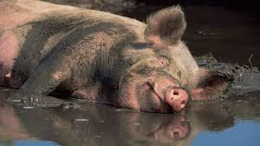
Pigs are clean animals!
Pigs cannot sweat so they roll in mud to keep themselves cool.

Slide 12
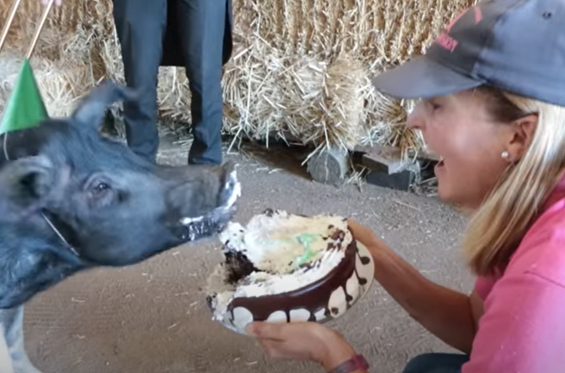
Did you know…
Pigs enjoy a yummy birthday cake!

Slide 13
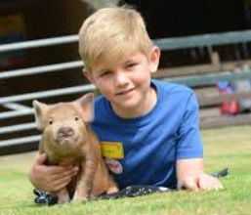
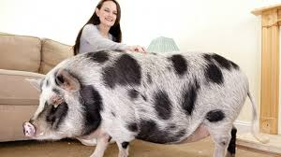
Did you know…
A ‘micro’ pig is very small and cute. Some people like to keep these pigs for pets living in their homes!

Slide 14

Read the information again.
Write some non-fiction facts.
Remember the sentence rules.
Draw a pig!

