Slide 1

Thursday
4th February 2021

Slide 2
L.O: To double coin values.

Slide 3

Starter
https://www.youtube.com/watch?v=vs8F_g3MGtM&t=2s

Slide 4
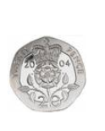
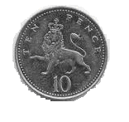
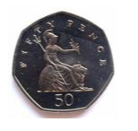

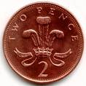
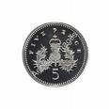
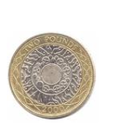
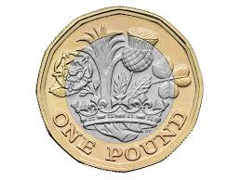
Coins
1p
2p
5p
10p
20p
50p
£1
£2

Slide 5
Name the Coin
1p

Slide 6
Name the coin
2p

Slide 7
Name the coin
5p

Slide 8
10p

Slide 9
Coins
20p

Slide 10
Coins
50p

Slide 11
Coins
100p
200p
£1

Slide 12
Coins
£2

Slide 13
https://www.youtube.com/watch?v=vs8F_g3MGtM&t=2s
Doubling
20p
40p

Slide 14
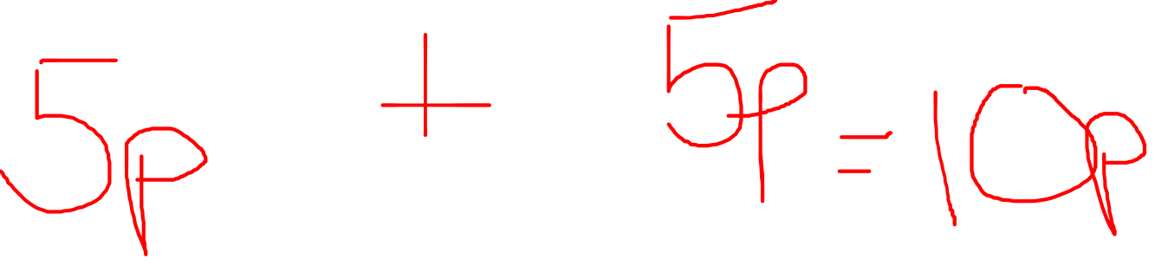
https://www.youtube.com/watch?v=vs8F_g3MGtM&t=2s
Doubling

Slide 15
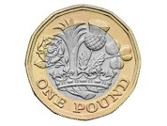
https://www.youtube.com/watch?v=vs8F_g3MGtM&t=2s
Doubling
£1
£2

Slide 16
https://www.youtube.com/watch?v=vs8F_g3MGtM&t=2s
Doubling
£4
£2

Slide 17

.
Task

