Slide 1

PSHE and Citizenship
Living in the Wider World | Diverse Britain
PSHE and Citizenship | KS1 | Living in the Wider World | Diverse Britain | British People | Lesson 5

Slide 3
Aim
I can explore how people living in the British Isles can be different and how they are the same.
Success Criteria
I can think about why it is important to have differences.
I can think about why it is important to show respect to others.
I can write down how I can make all people feel happy and welcome.
This resource is fully in line with the Learning Outcomes and Core Themes outlined in the PSHE Association’s Programme of Study.

Slide 4

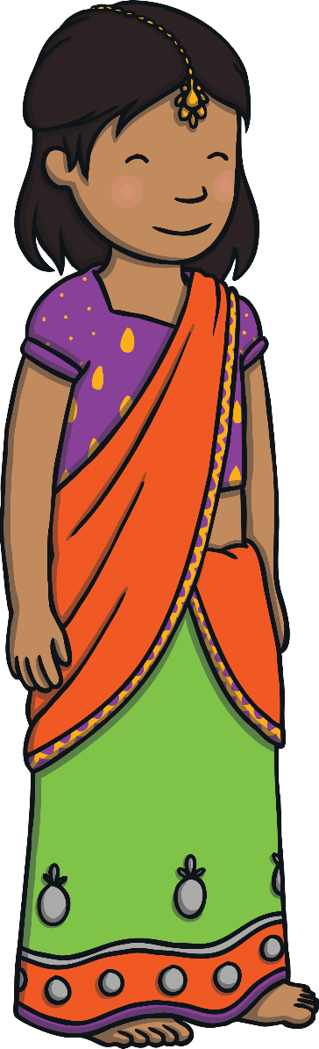
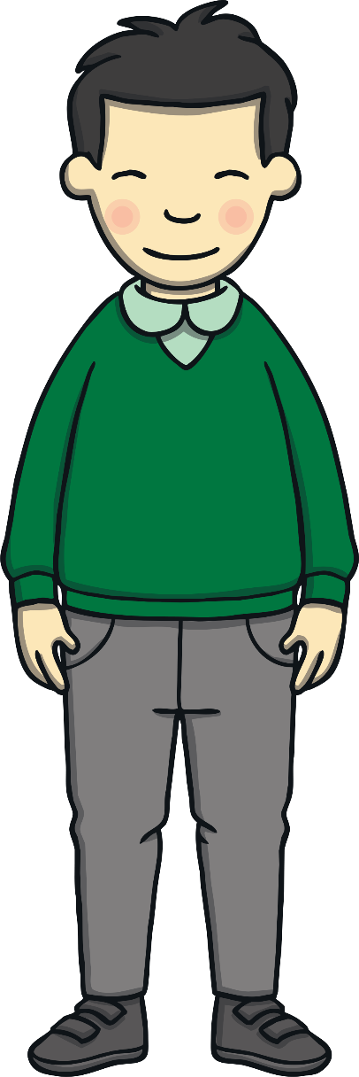
In what ways can British people be different from one another?
How are British people similar to one another?

Slide 5
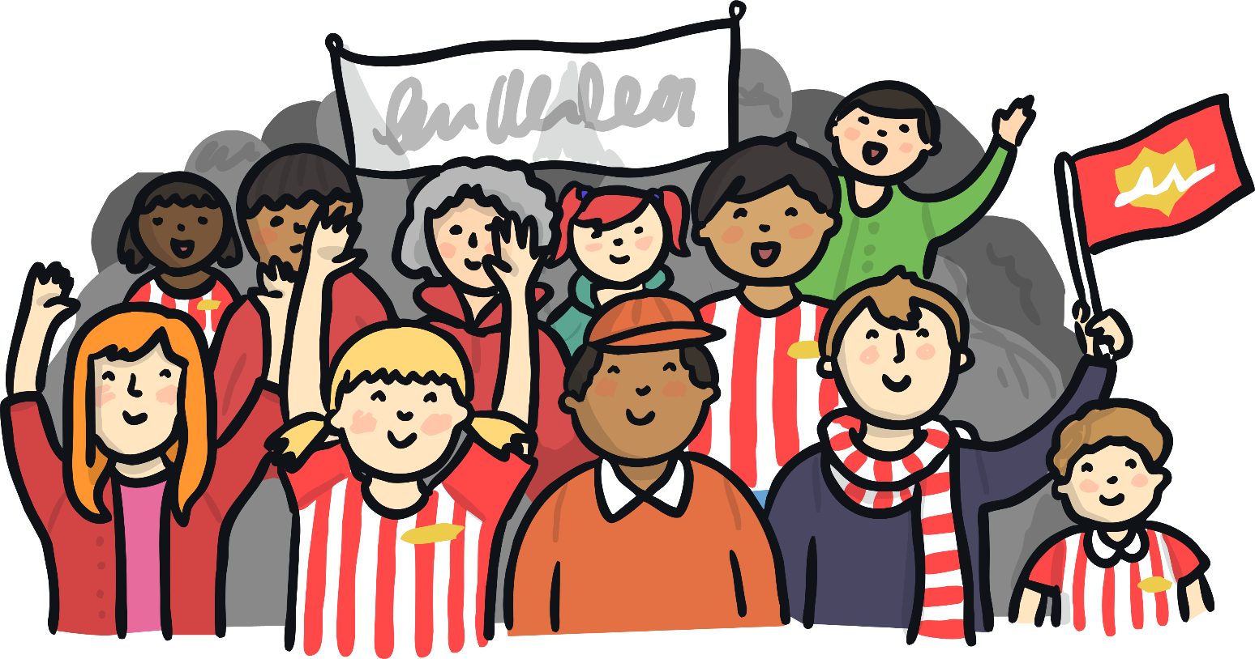
Similarities and Differences
People have lots of similarities and differences.
Similarities are things that are the same and differences are things that are different.
There are many ways that people can be different from each other.
There are also lots of ways that people can be similar.
In the whole world, no two people are completely the same. This is very exciting!

Slide 6
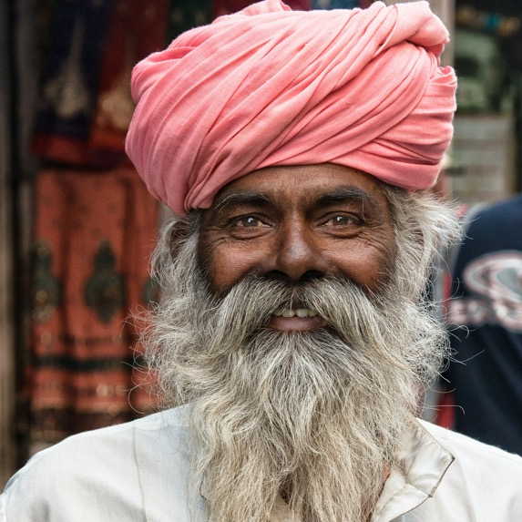
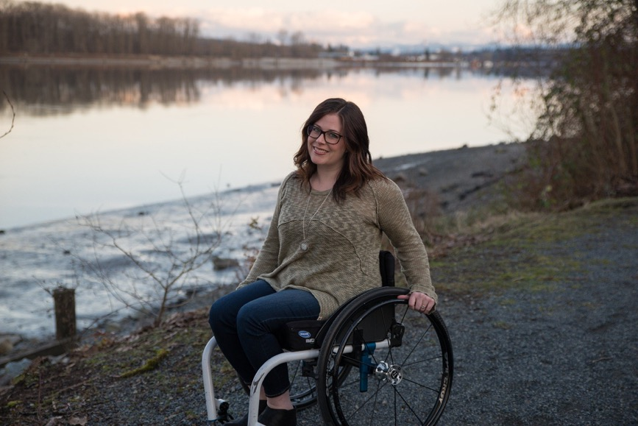
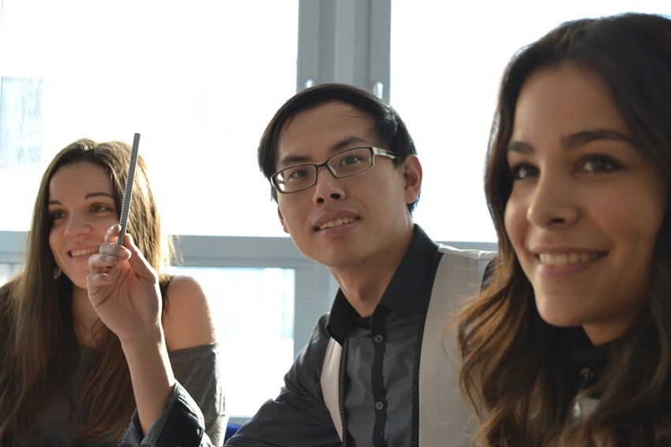
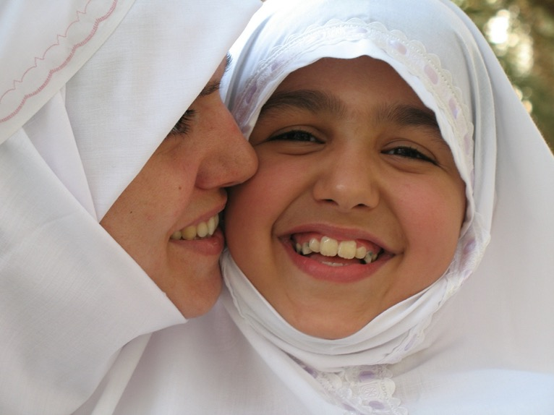
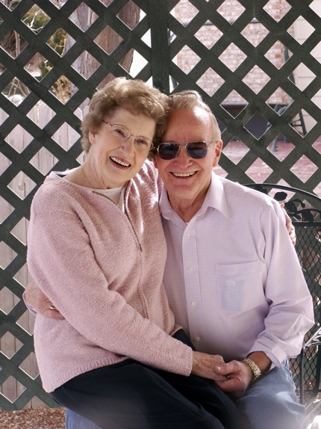
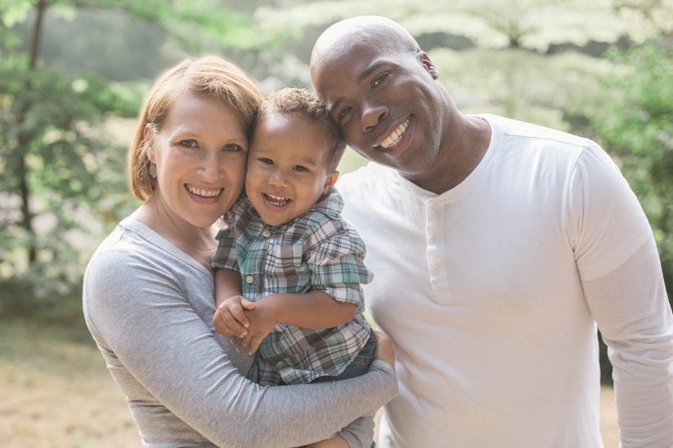
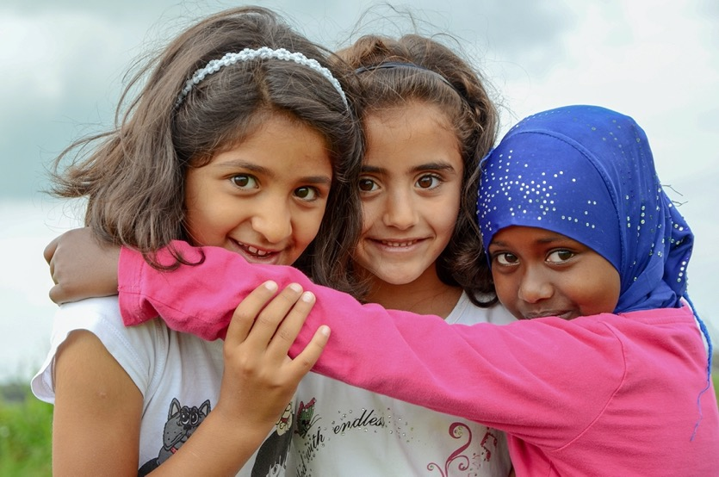
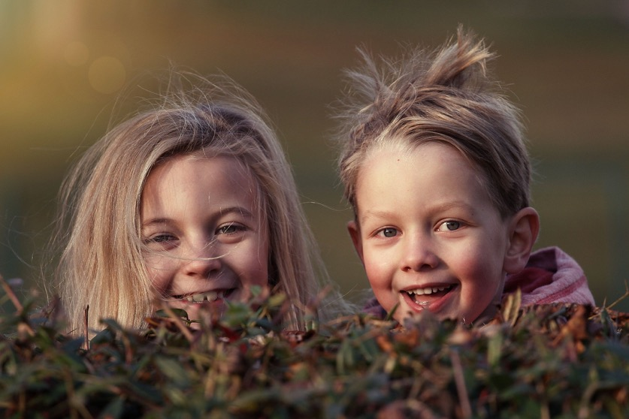
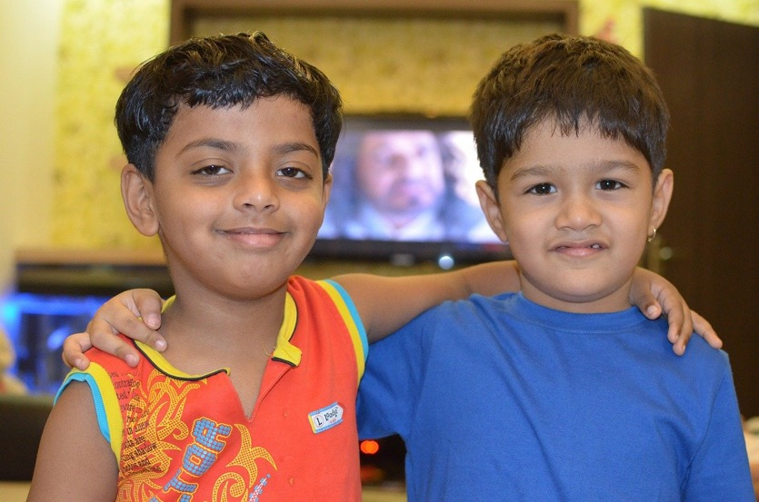
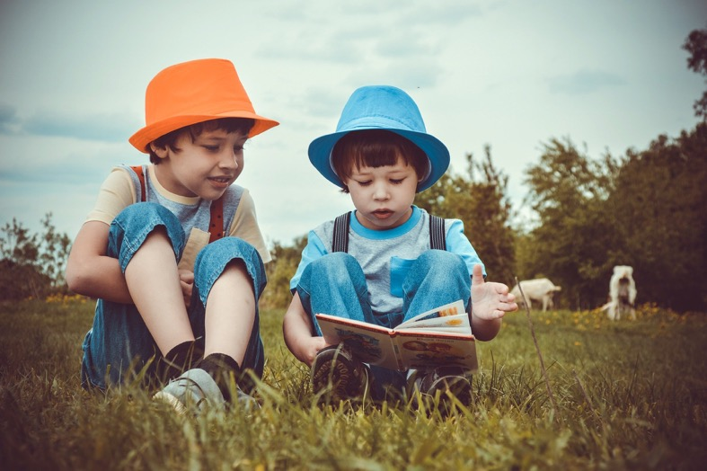
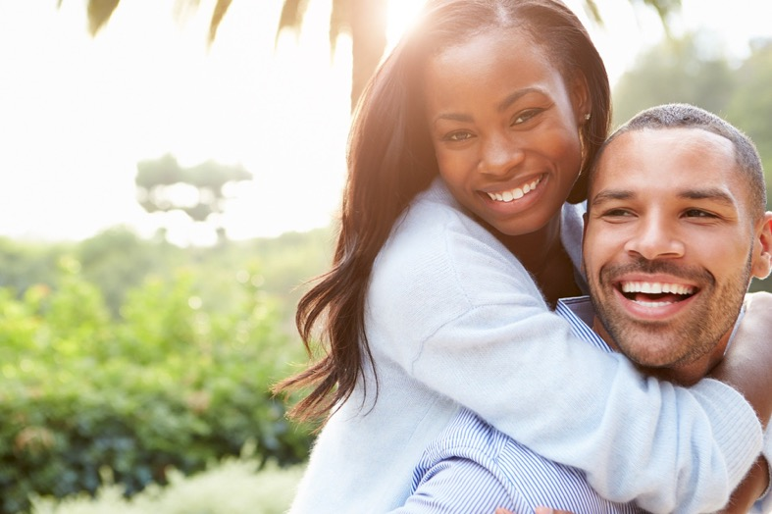
British People
Just like there are lots of different children and adults in our class and school, there are lots of different kinds of people living in The United Kingdom of Great Britain and Northern Ireland and the British Isles.
Do you know how all of these people are similar?
They are all British!

Slide 7
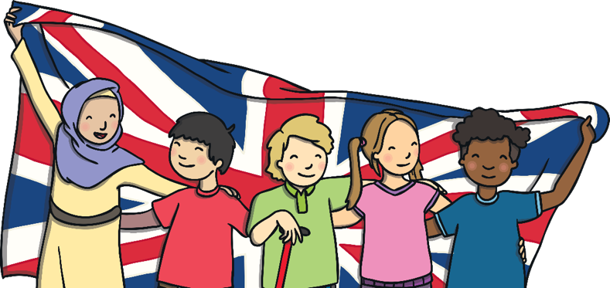
British People
The United Kingdom of Great Britain and Northern Ireland and other British Isles are multicultural nations.
This means that the British people who live in these places come from many different backgrounds.
British people can look very different from each other. They can have different coloured hair and skin and eyes to each other.
They wear lots of different kinds of clothes, eat many different kinds of food, speak many languages and enjoy doing lots of different kinds of things.
This is something for us to respect and celebrate!

Slide 8
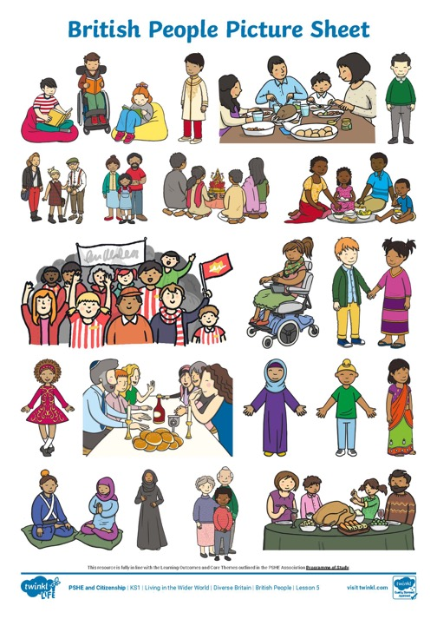
Being Different
Look carefully at the pictures of British people.

Slide 9
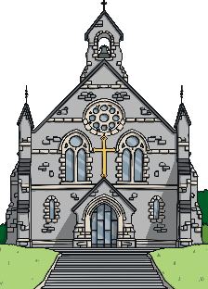
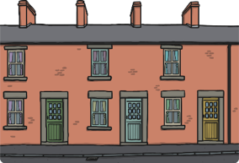
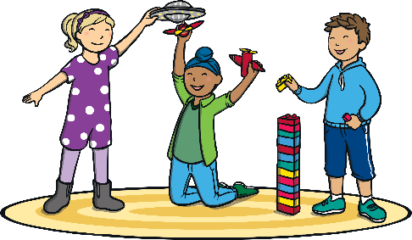
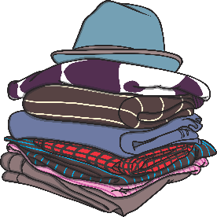
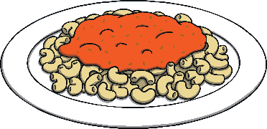
Being Different
Remember, although we are all different, we are all British. How wonderful that we live in a nation full of lots of different kinds of people!

Slide 10
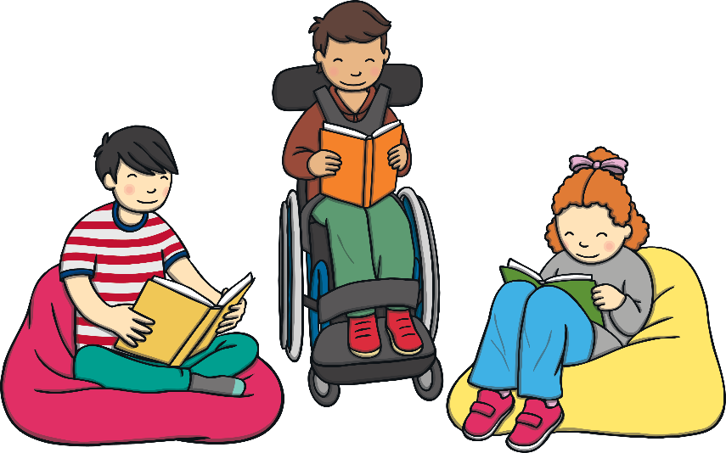

Celebrating Differences
We have seen that lots of different kinds of people are British and that this is something to respect and feel happy about.
We can enjoy spending time with, and learning about, people who are different from us. This can often teach us new and exciting things.

Slide 11
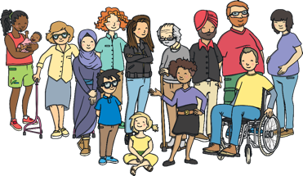
Respecting Others
Differences are exciting!
However, there is an important way in which we are all the same. All British people and all people throughout the world have the right to live as they choose, dress as they choose and believe what they choose. All people are equal and no one is more important, more deserving or more special than anyone else.
All people have the right to live a happy, healthy and safe life. One in which they have the chance to achieve their dreams and goals.
We can help this to happen by respecting the differences between people.
If somebody is different from us, we can show that we respect them and help to make them feel happy.
We can do this by smiling at them, being friendly and finding out more about their way of life. We can also do all we can to help them live happy, safe and healthy lives.

Slide 12
In what ways can British people be different from one another?
How are British people similar to one another?
How will you use all you have learnt today outside of school?

Slide 13
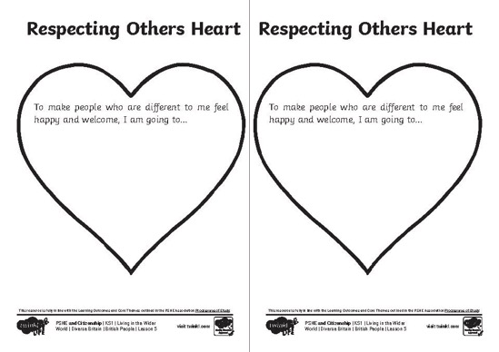
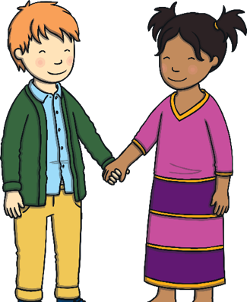
Respecting Others
How could you show that you respect the differences of people you meet?
Use the hearts to write and draw ways that you can show people who are different from you that you respect them.
Together we can make our country a happy and welcoming place for all people!

