Slide 1

Wednesday
3rd February 2021

Slide 2
L.O: To recognise coins.

Slide 3

Starter
https://www.youtube.com/watch?v=dFzAU3u06Ps&ts

Slide 4
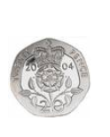
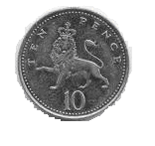
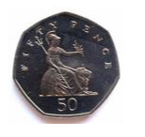

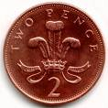
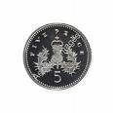
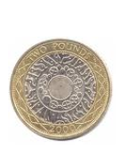
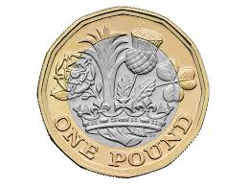
Coins
1p
2p
5p
10p
20p
50p
£1
£2

Slide 5

Coins
1p

Slide 6

Coins
2p

Slide 7
Coins
5p

Slide 8
Coins
10p

Slide 9
Coins
20p

Slide 10

Coins
50p

Slide 11
Coins
100p
£1

Slide 12
Coins
200p
£2

Slide 13
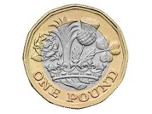
How much money do I have?
£5

Slide 14

How much money do I have?
£10

Slide 15
How much money do I have?
£1
100p

Slide 16
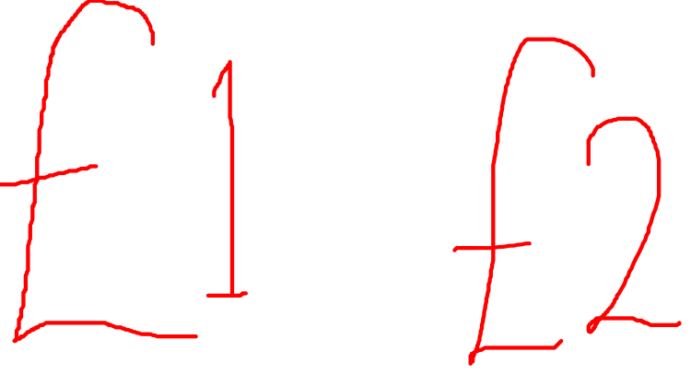
The way to write £1

Slide 17
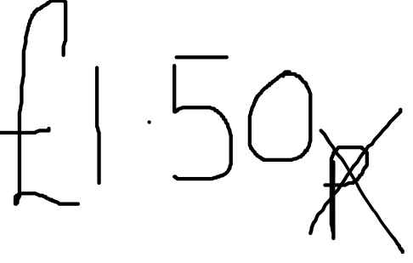
How much money do I have?
£1
50p

Slide 18
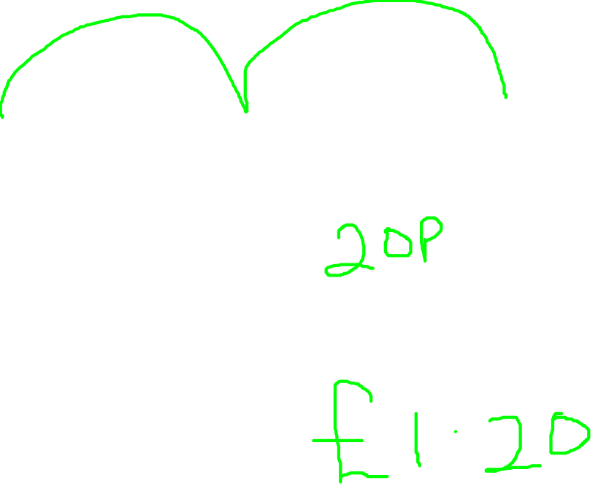
How much money do I have?
£1
10p
10p

Slide 19
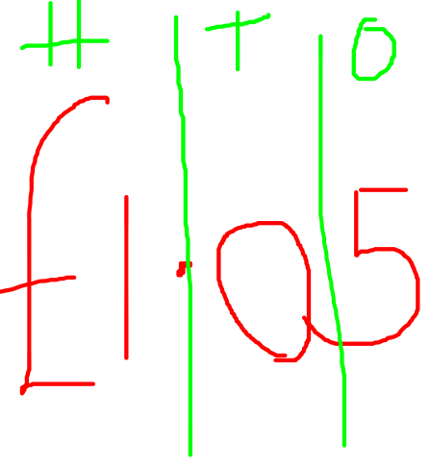
How much money do I have?
£1
5p

Slide 20
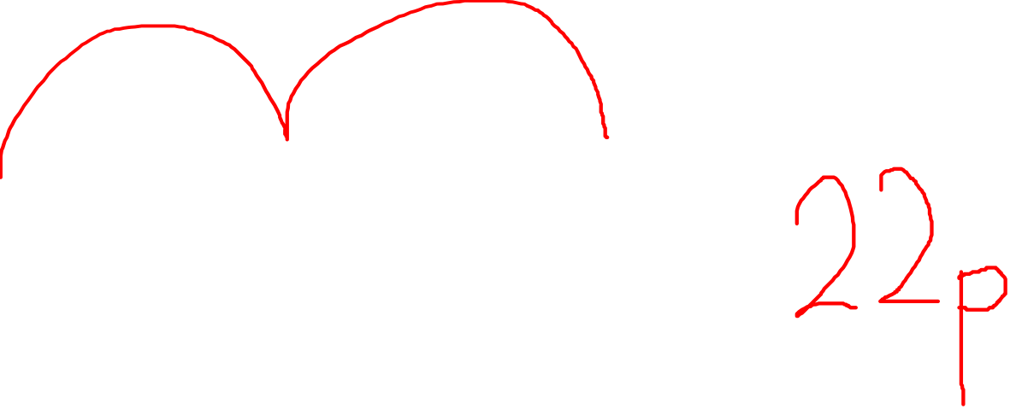
How much money do I have?
20p
1p
1p

Slide 21
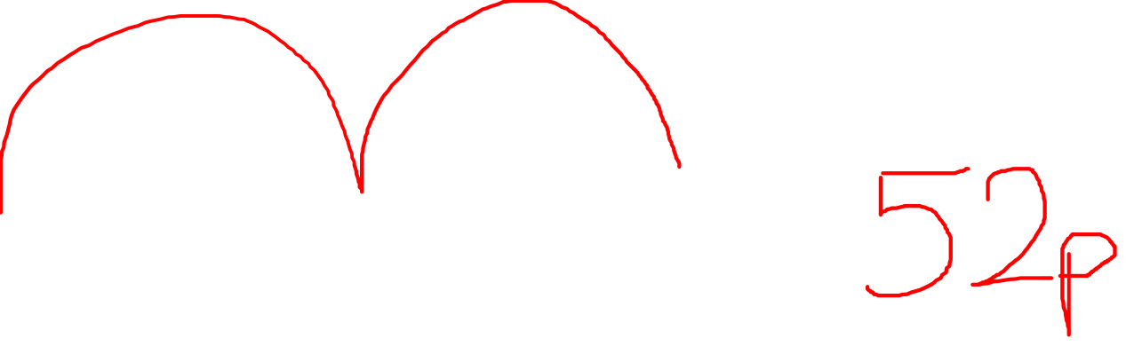
How much money do I have?
50p
1p
1p

Slide 22


.
1 star

Slide 23
.
2 star

Slide 24
.
3 Star

