Slide 1
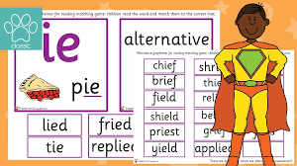

Year 1
Alternative sound for ‘ie’.
ie
ie
ie

Slide 2


cries

Slide 3

shield

Slide 4

tie

Slide 5

chief

Slide 6

pie

Slide 7

field

Slide 8

thief

Slide 9

lie

Slide 10

die

Slide 11
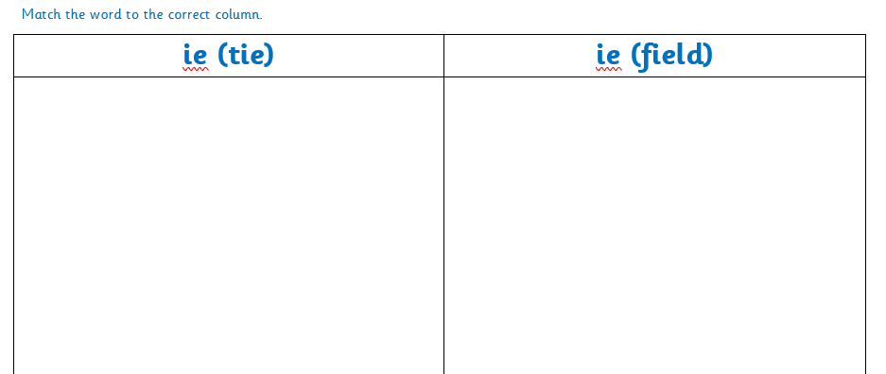
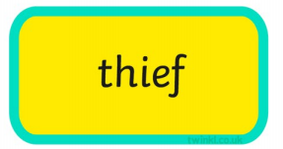
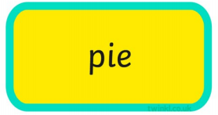



Slide 12


