Slide 1



Slide 2
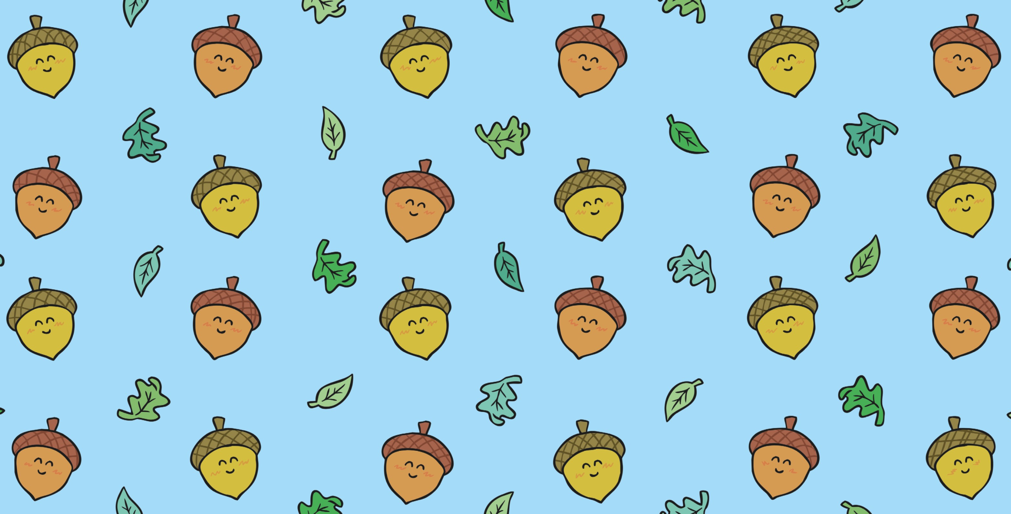

Slide 3
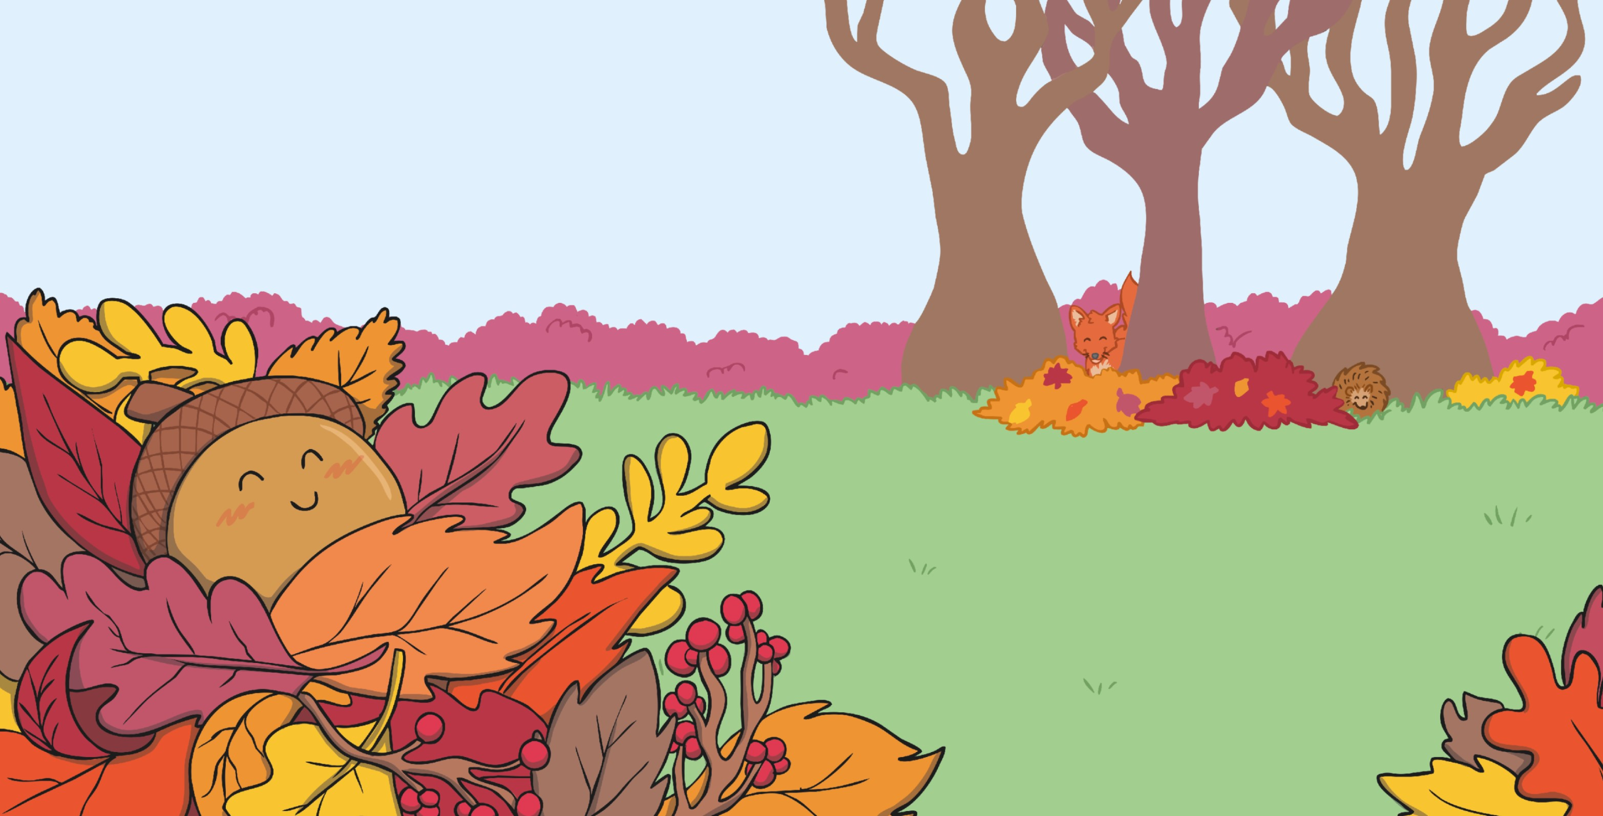


A little brown acorn fell down to the ground,
one windy and wet autumn day.
and right there, he decided to stay.
The dry
leaves quickly covered him up
He snuggled up warm in his big leafy bed,
deep down where he couldn’t be found.
Along came a walker, who stepped on his head and
him right into the ground.

Slide 4
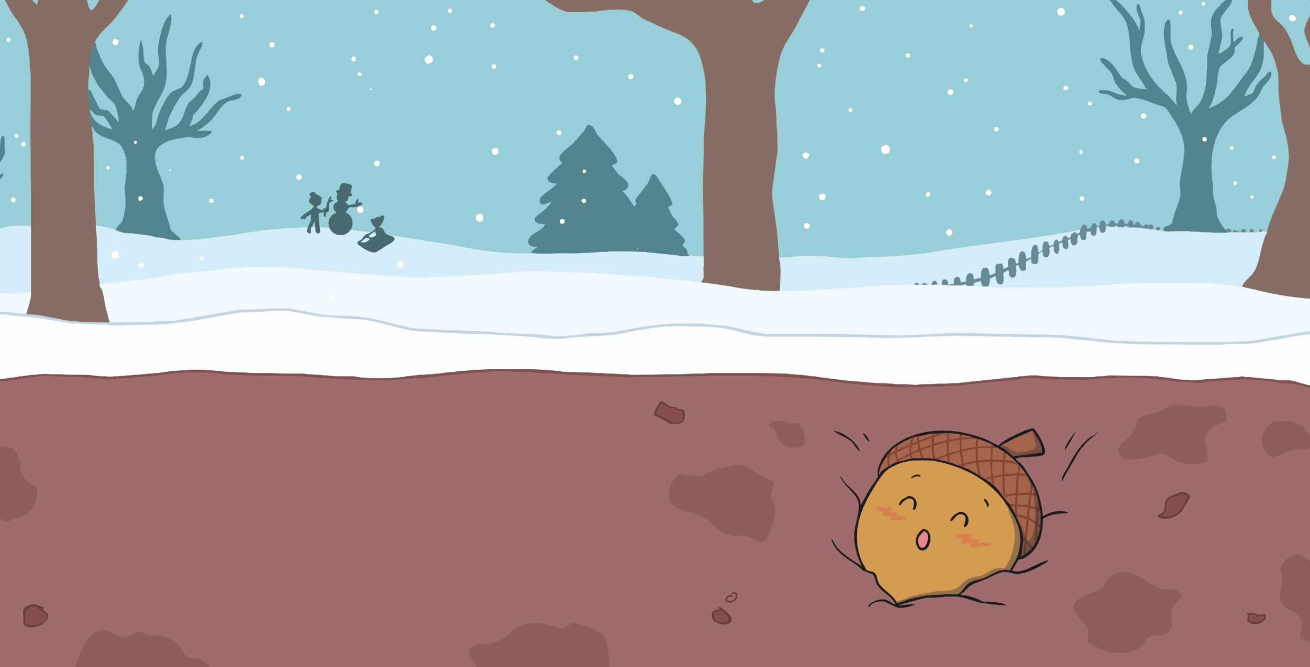


The weather grew colder as winter drew in
and soon he was buried in
He lay there so patiently, frozen in mud,
awaiting the right time to

Slide 5
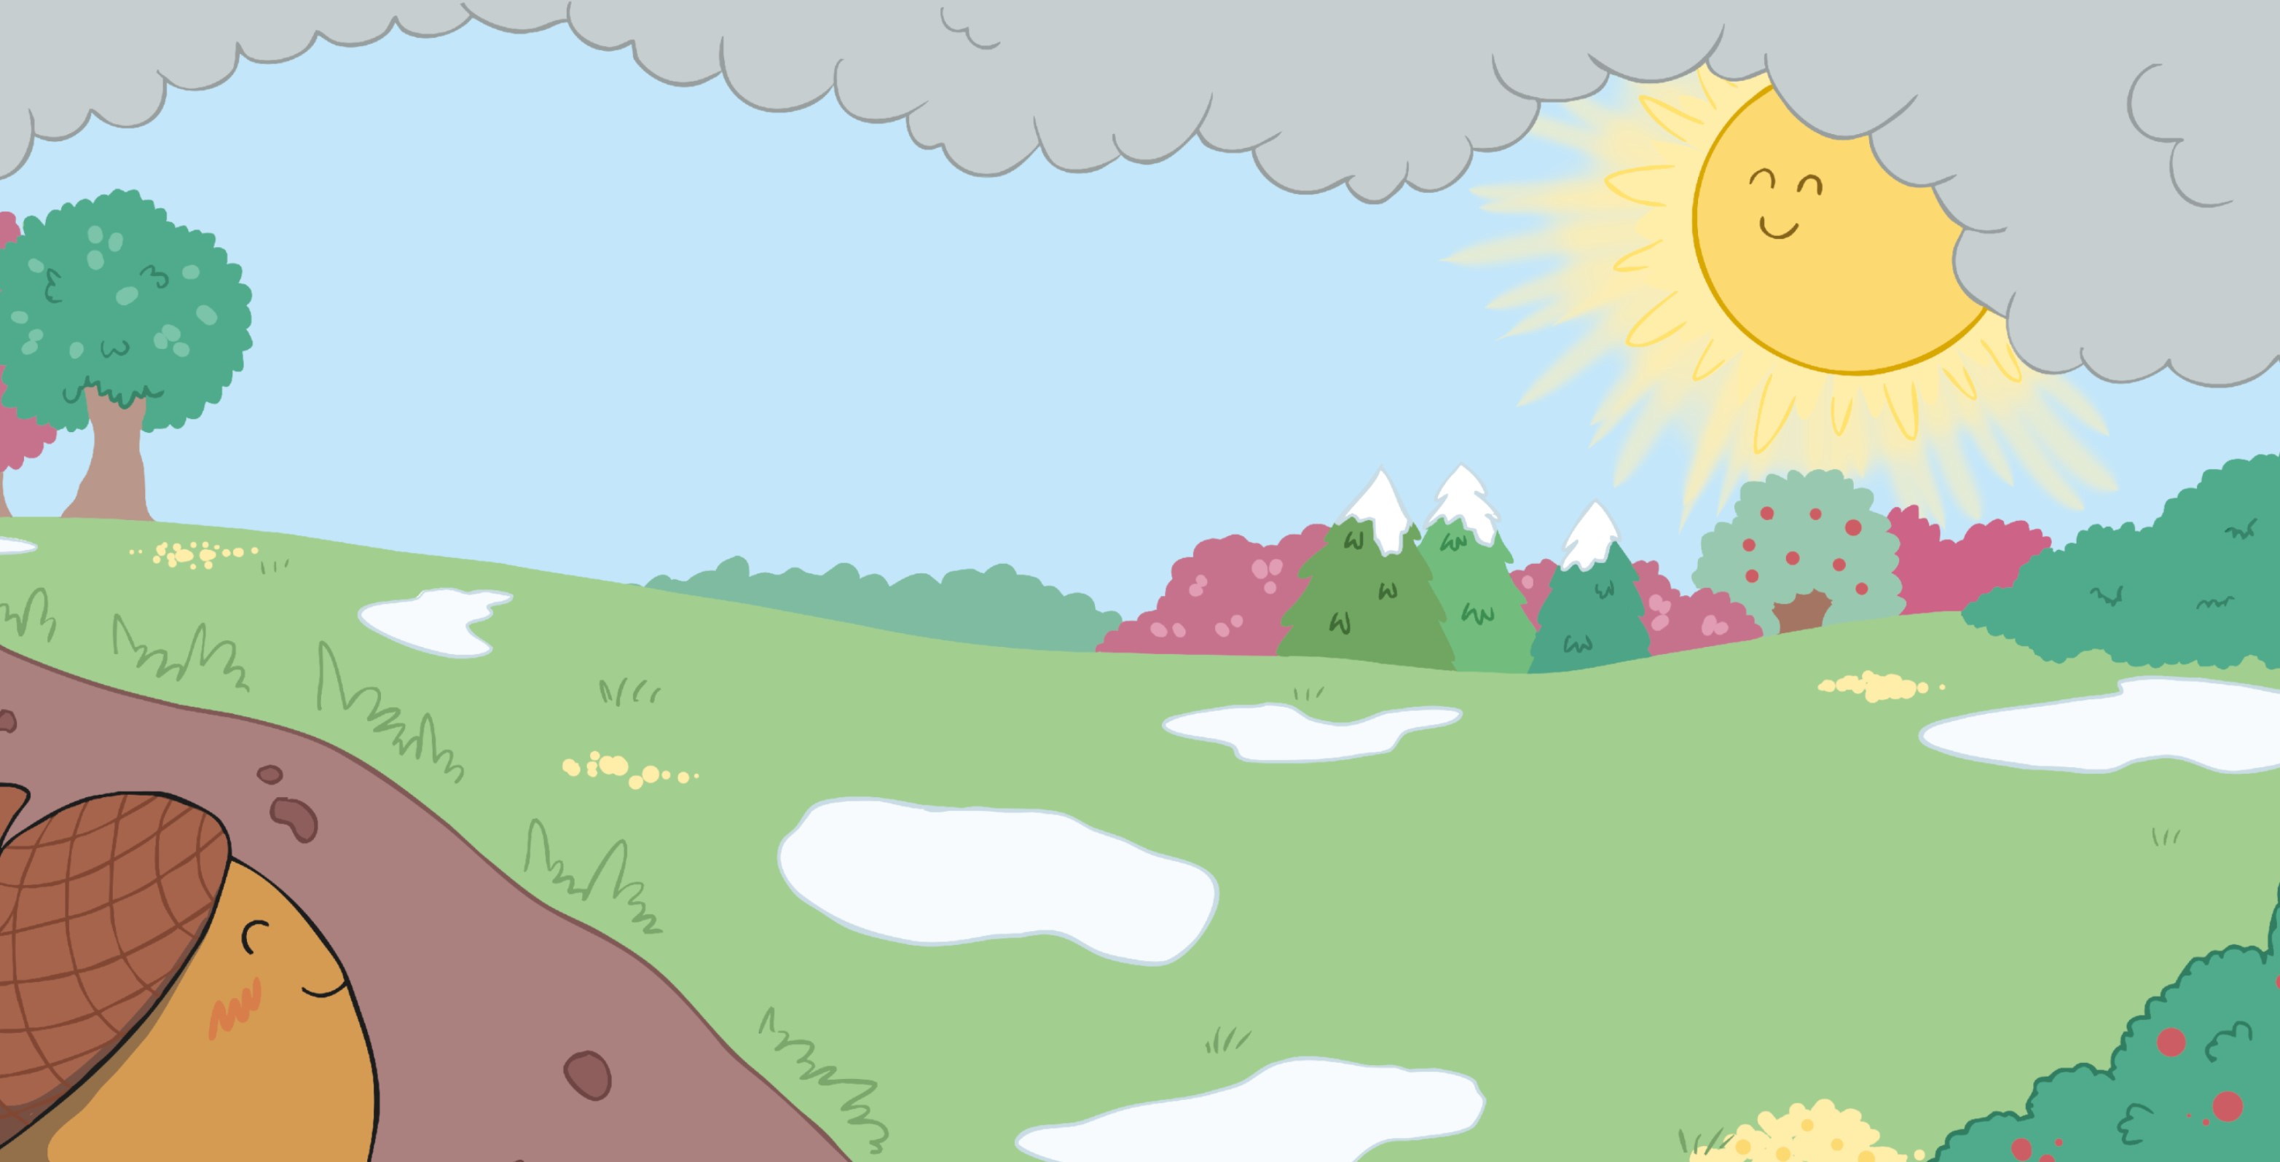


The chill of the winter months
dragged on and on; the snow
stayed around for a
Then finally, from behind heavy grey clouds,
the sun gave a welcoming

Slide 6
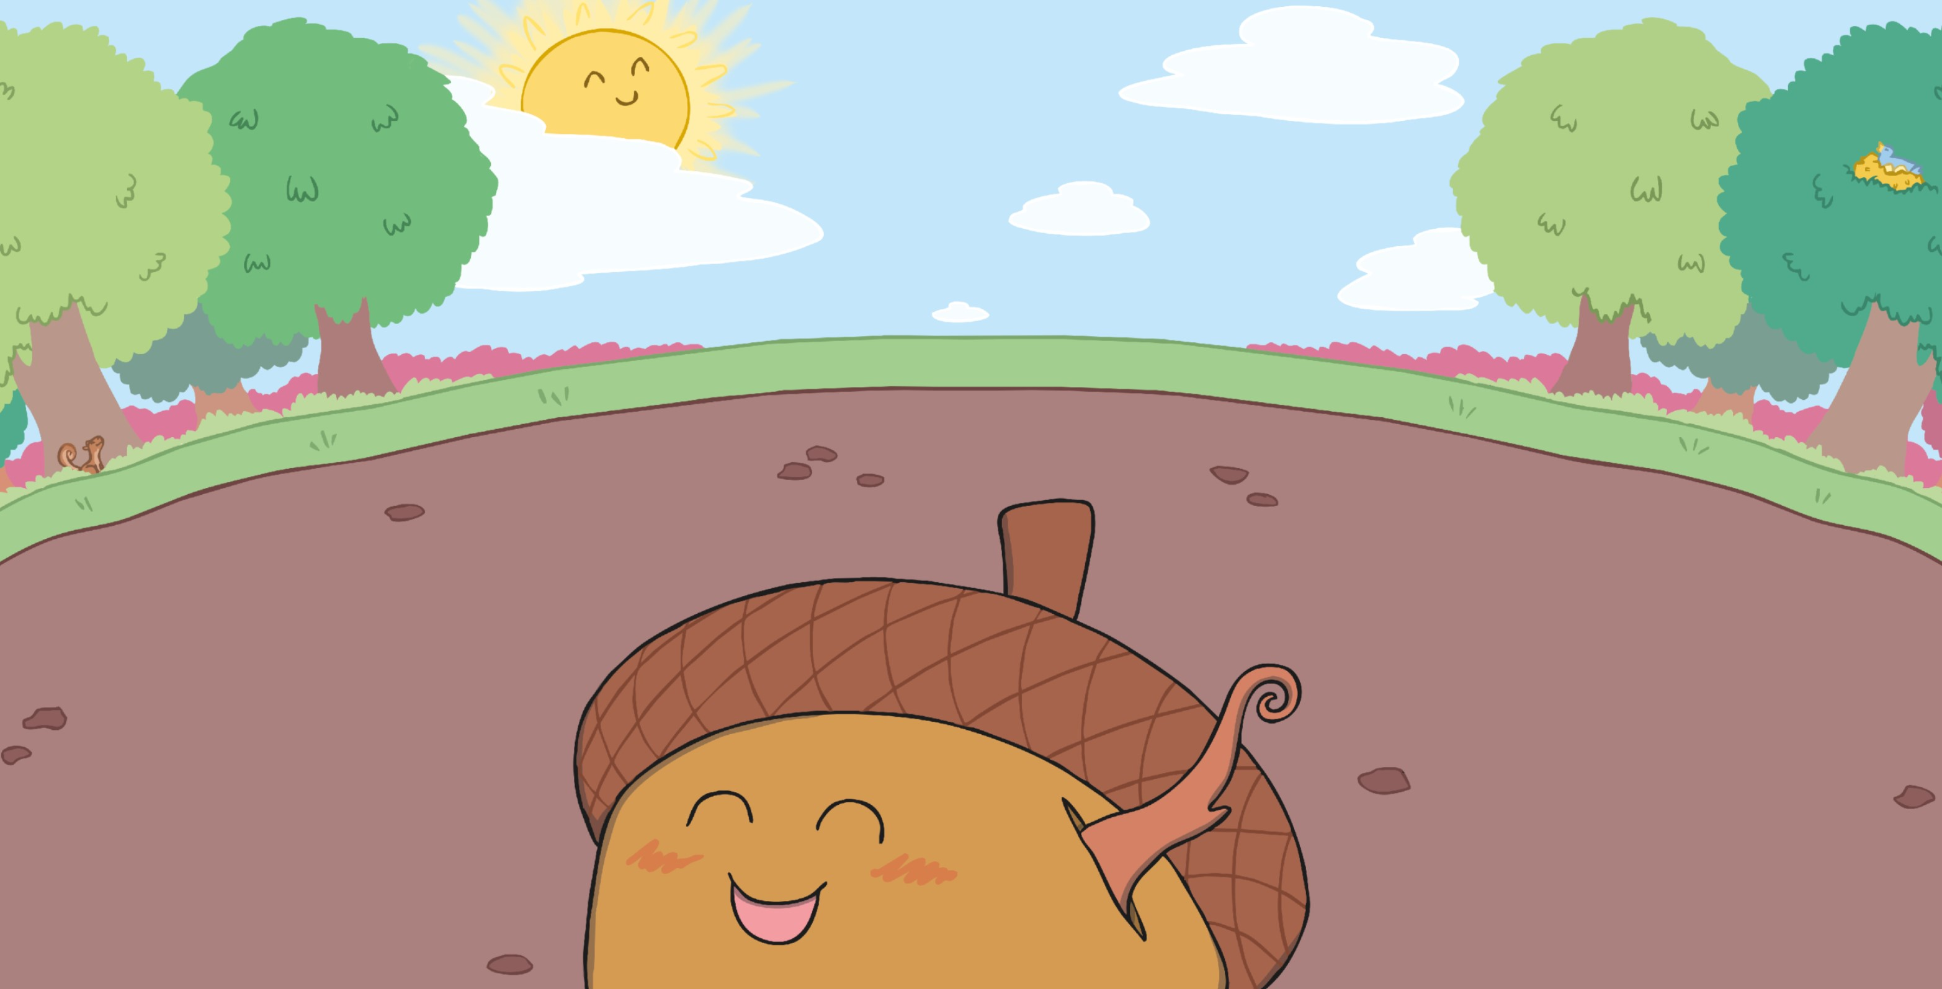



He gave a small
The spring had arrived
so the acorn woke up
and let out a laugh and a
a soft gentle
and started to grow and to sprout.

Slide 7
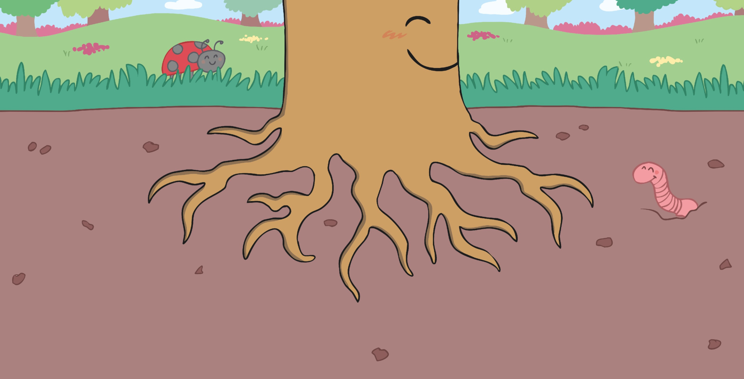


Below him
roots,
So he could begin to grow
seeking water to drink and holding him firm where he stood.
each day and find his own place in the wood.

Slide 8
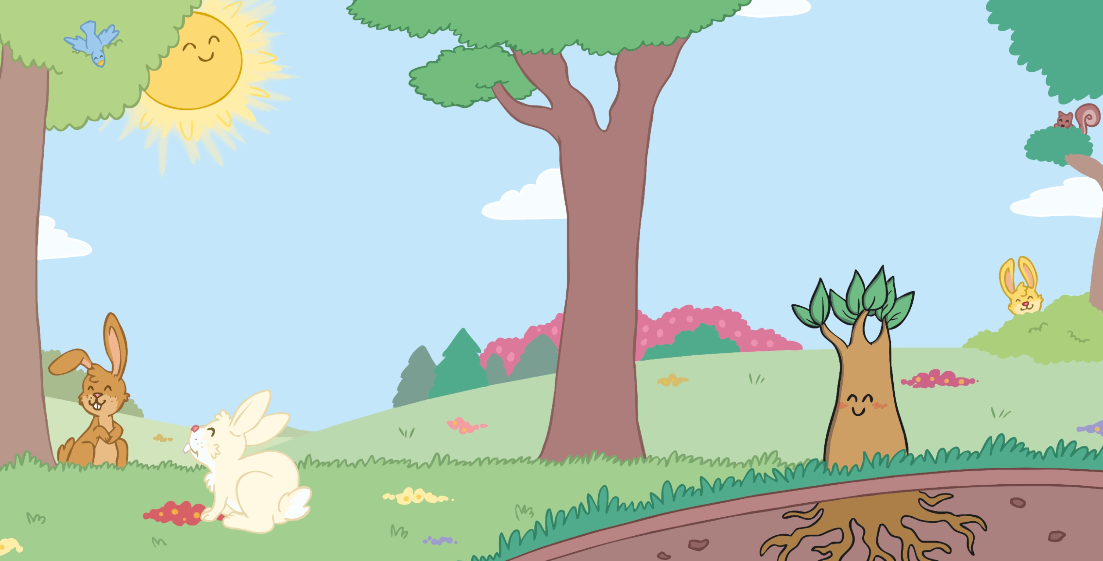


They reached for the sun and
its warm shining light; the
made them move to and fro.
His roots travelled deeper, his stem
up tall and soon his green leaves
were on show.

Slide 9
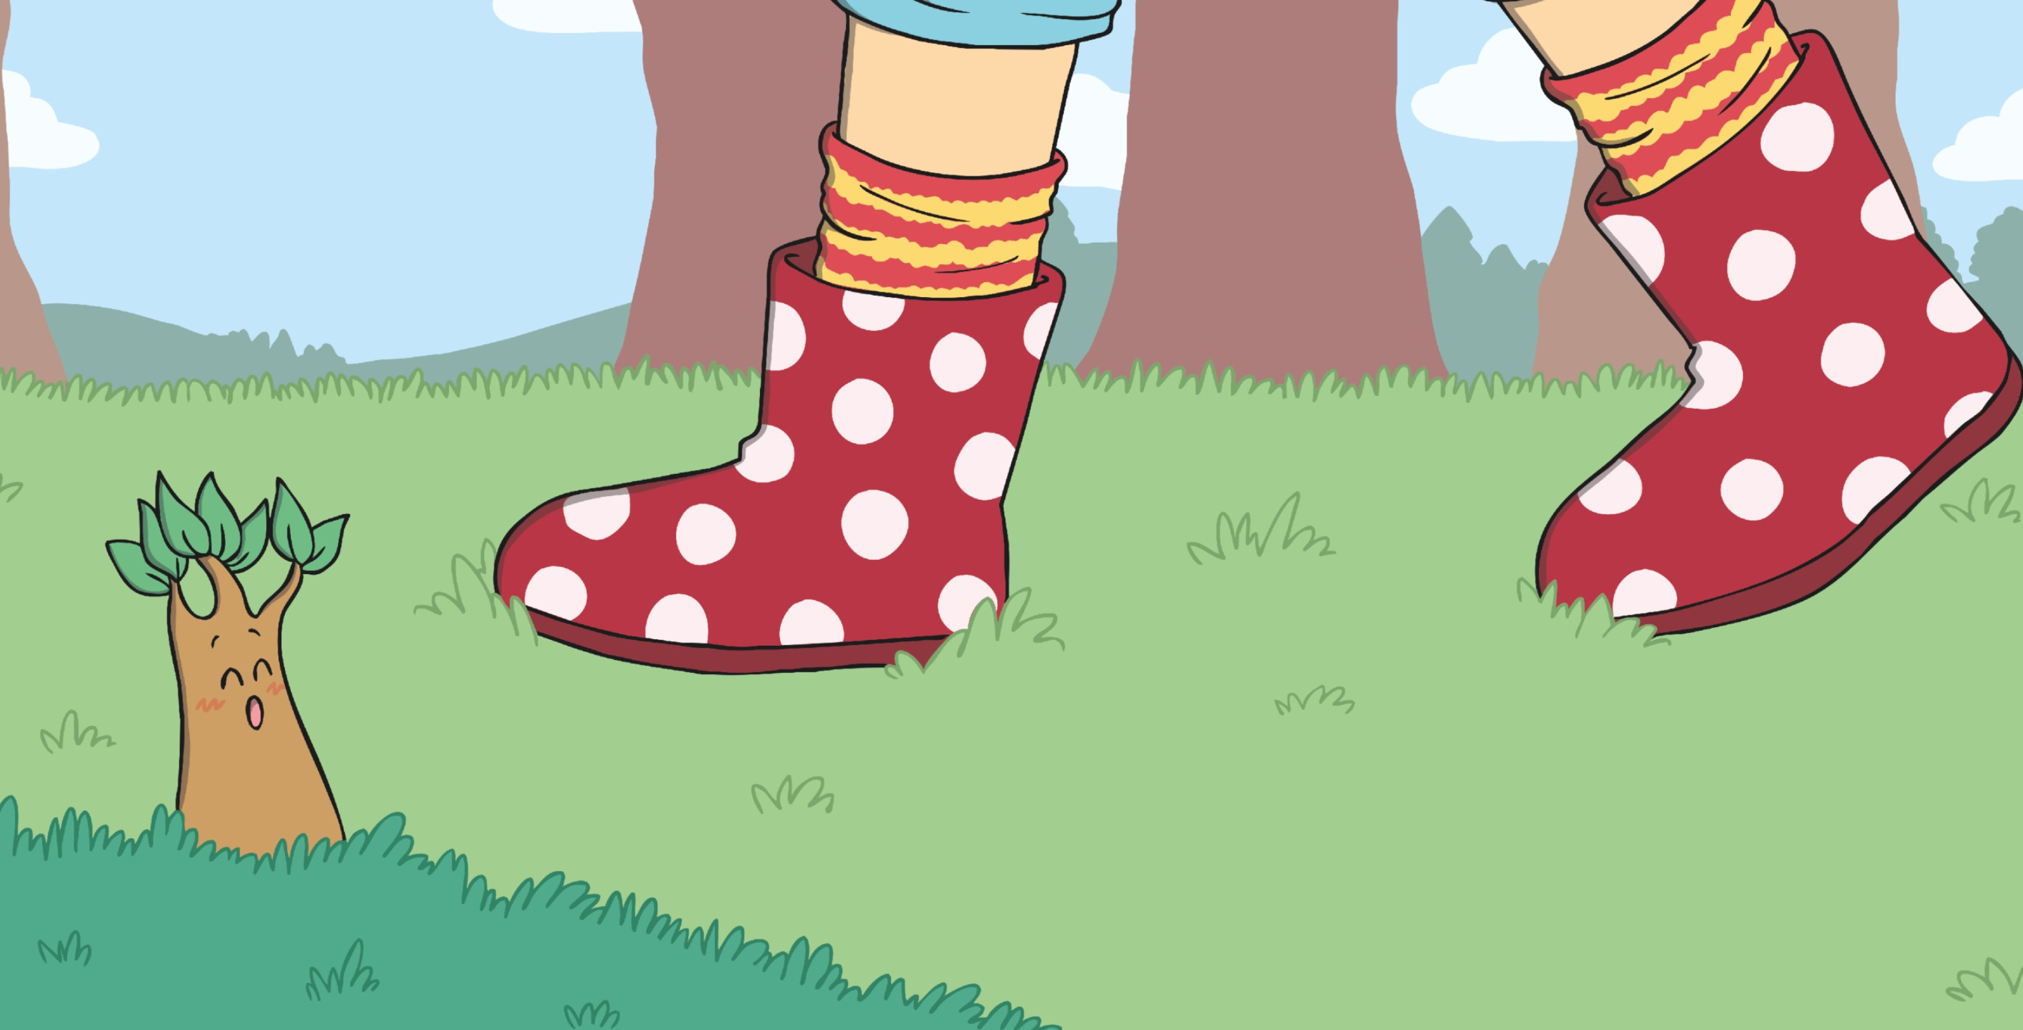


The little green sapling
grew slowly each day;
becoming an
is not fast.
It takes many years to grow just
enough
to be noticed if someone walks past.

Slide 10
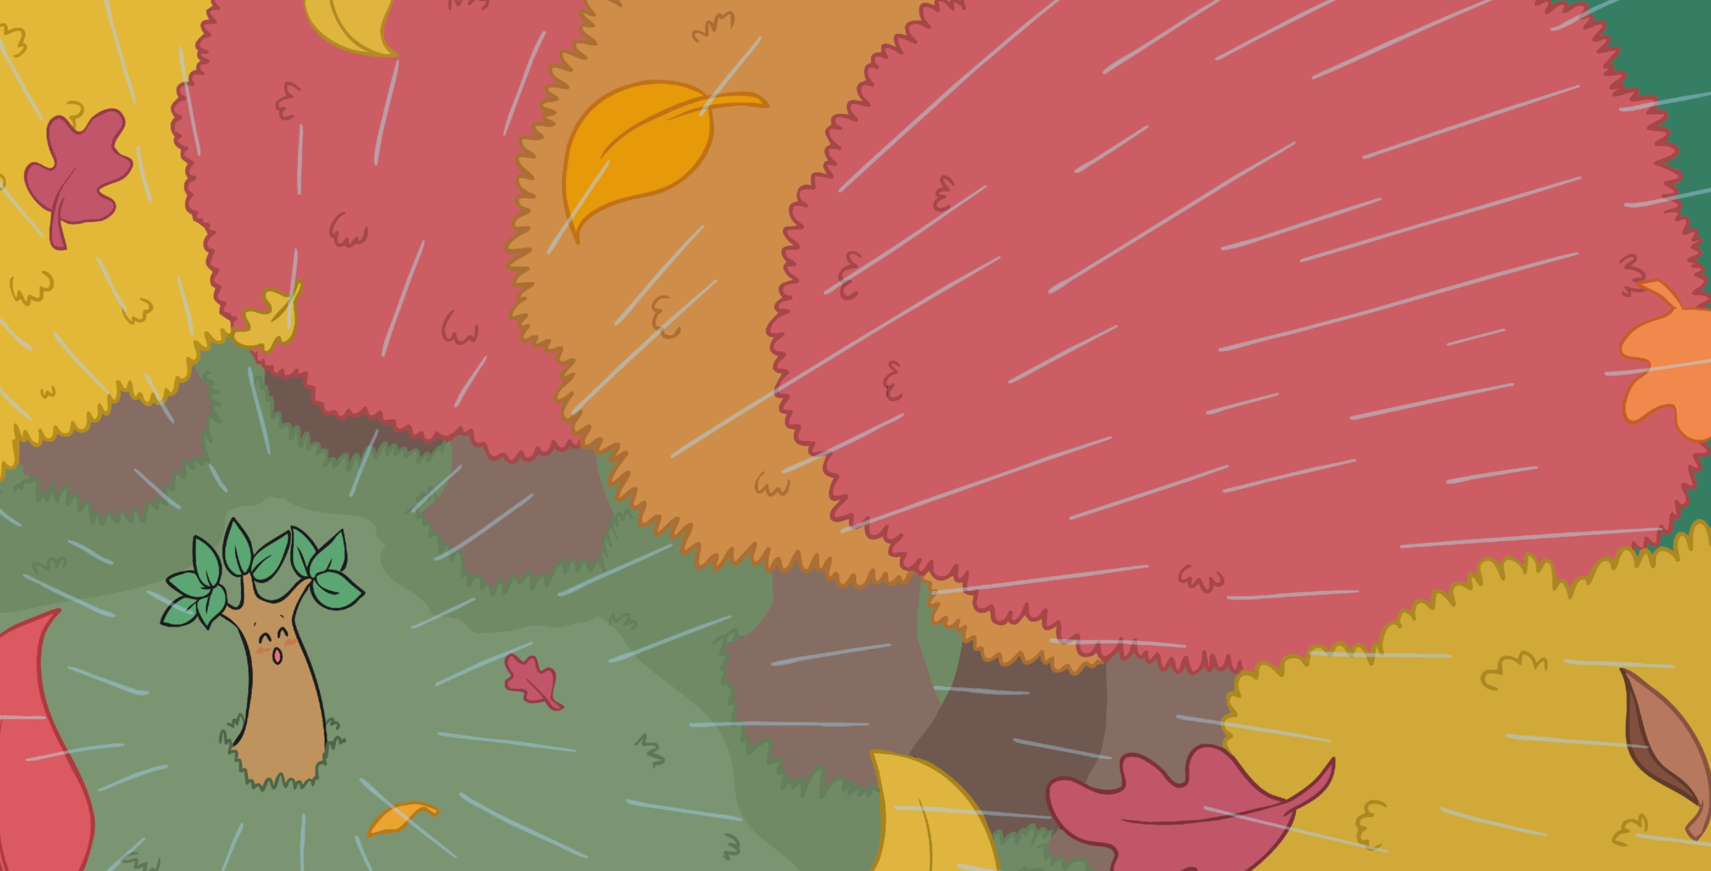


As spring turned to summer, the cool
soon ended and it became dry.
Then autumn began to steal time from each day
and bring long dark
to the sky.

Slide 11



The seasons by and in no time at all,
the acorn grew into a tree.
He so slowly, straight up to the sky,
trunk thickening for all to see.

Slide 12
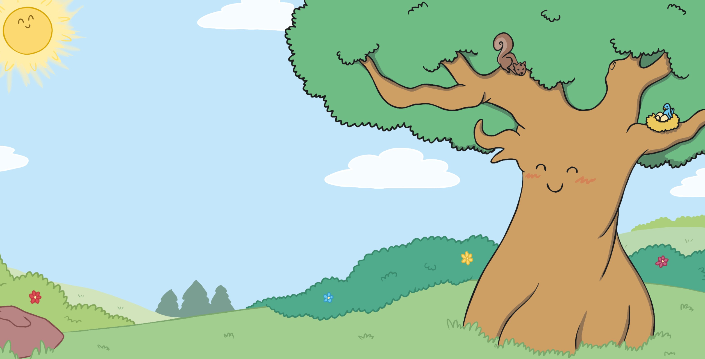


Now, twenty years later, he’s reached his full
and stands up so mighty and strong.
His branches are
as wide as can be, his roots now incredibly long.

Slide 13
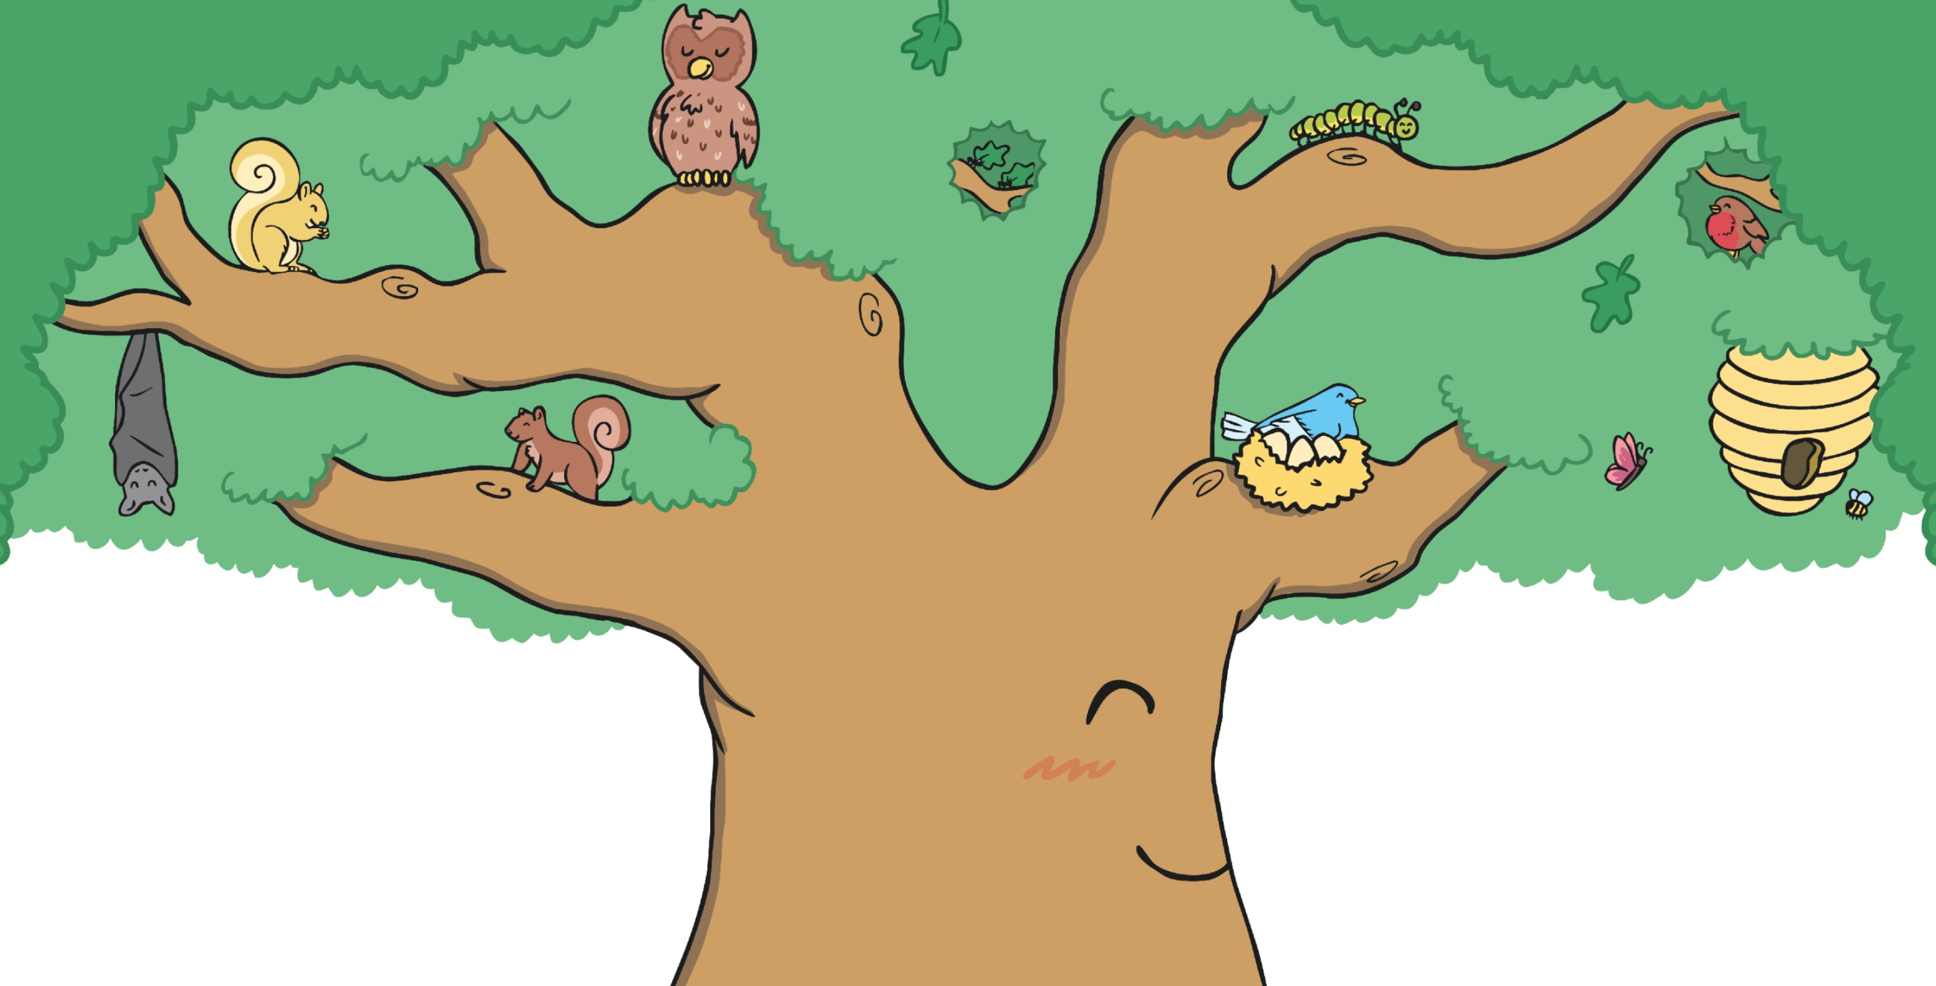


The oak guards the forest
by day and by night and listens
for each and howl.
His branches are home to the squirrels and
some bats and a wise tawny owl.

Slide 14
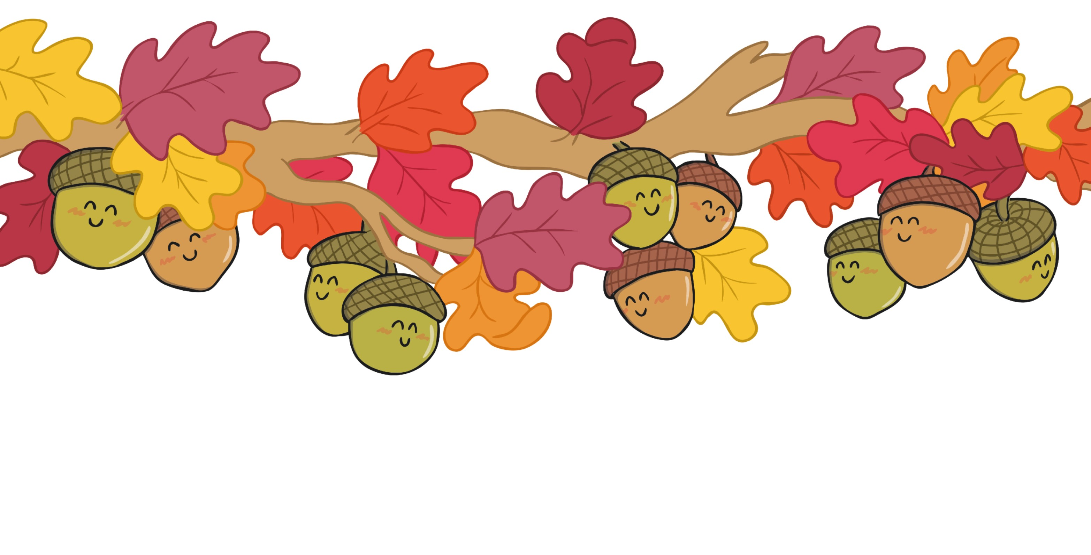


All
On each of his
new acorns hang on,
they sit tight and wait,
each ready and raring to go.
excited to see what’s below.

Slide 15
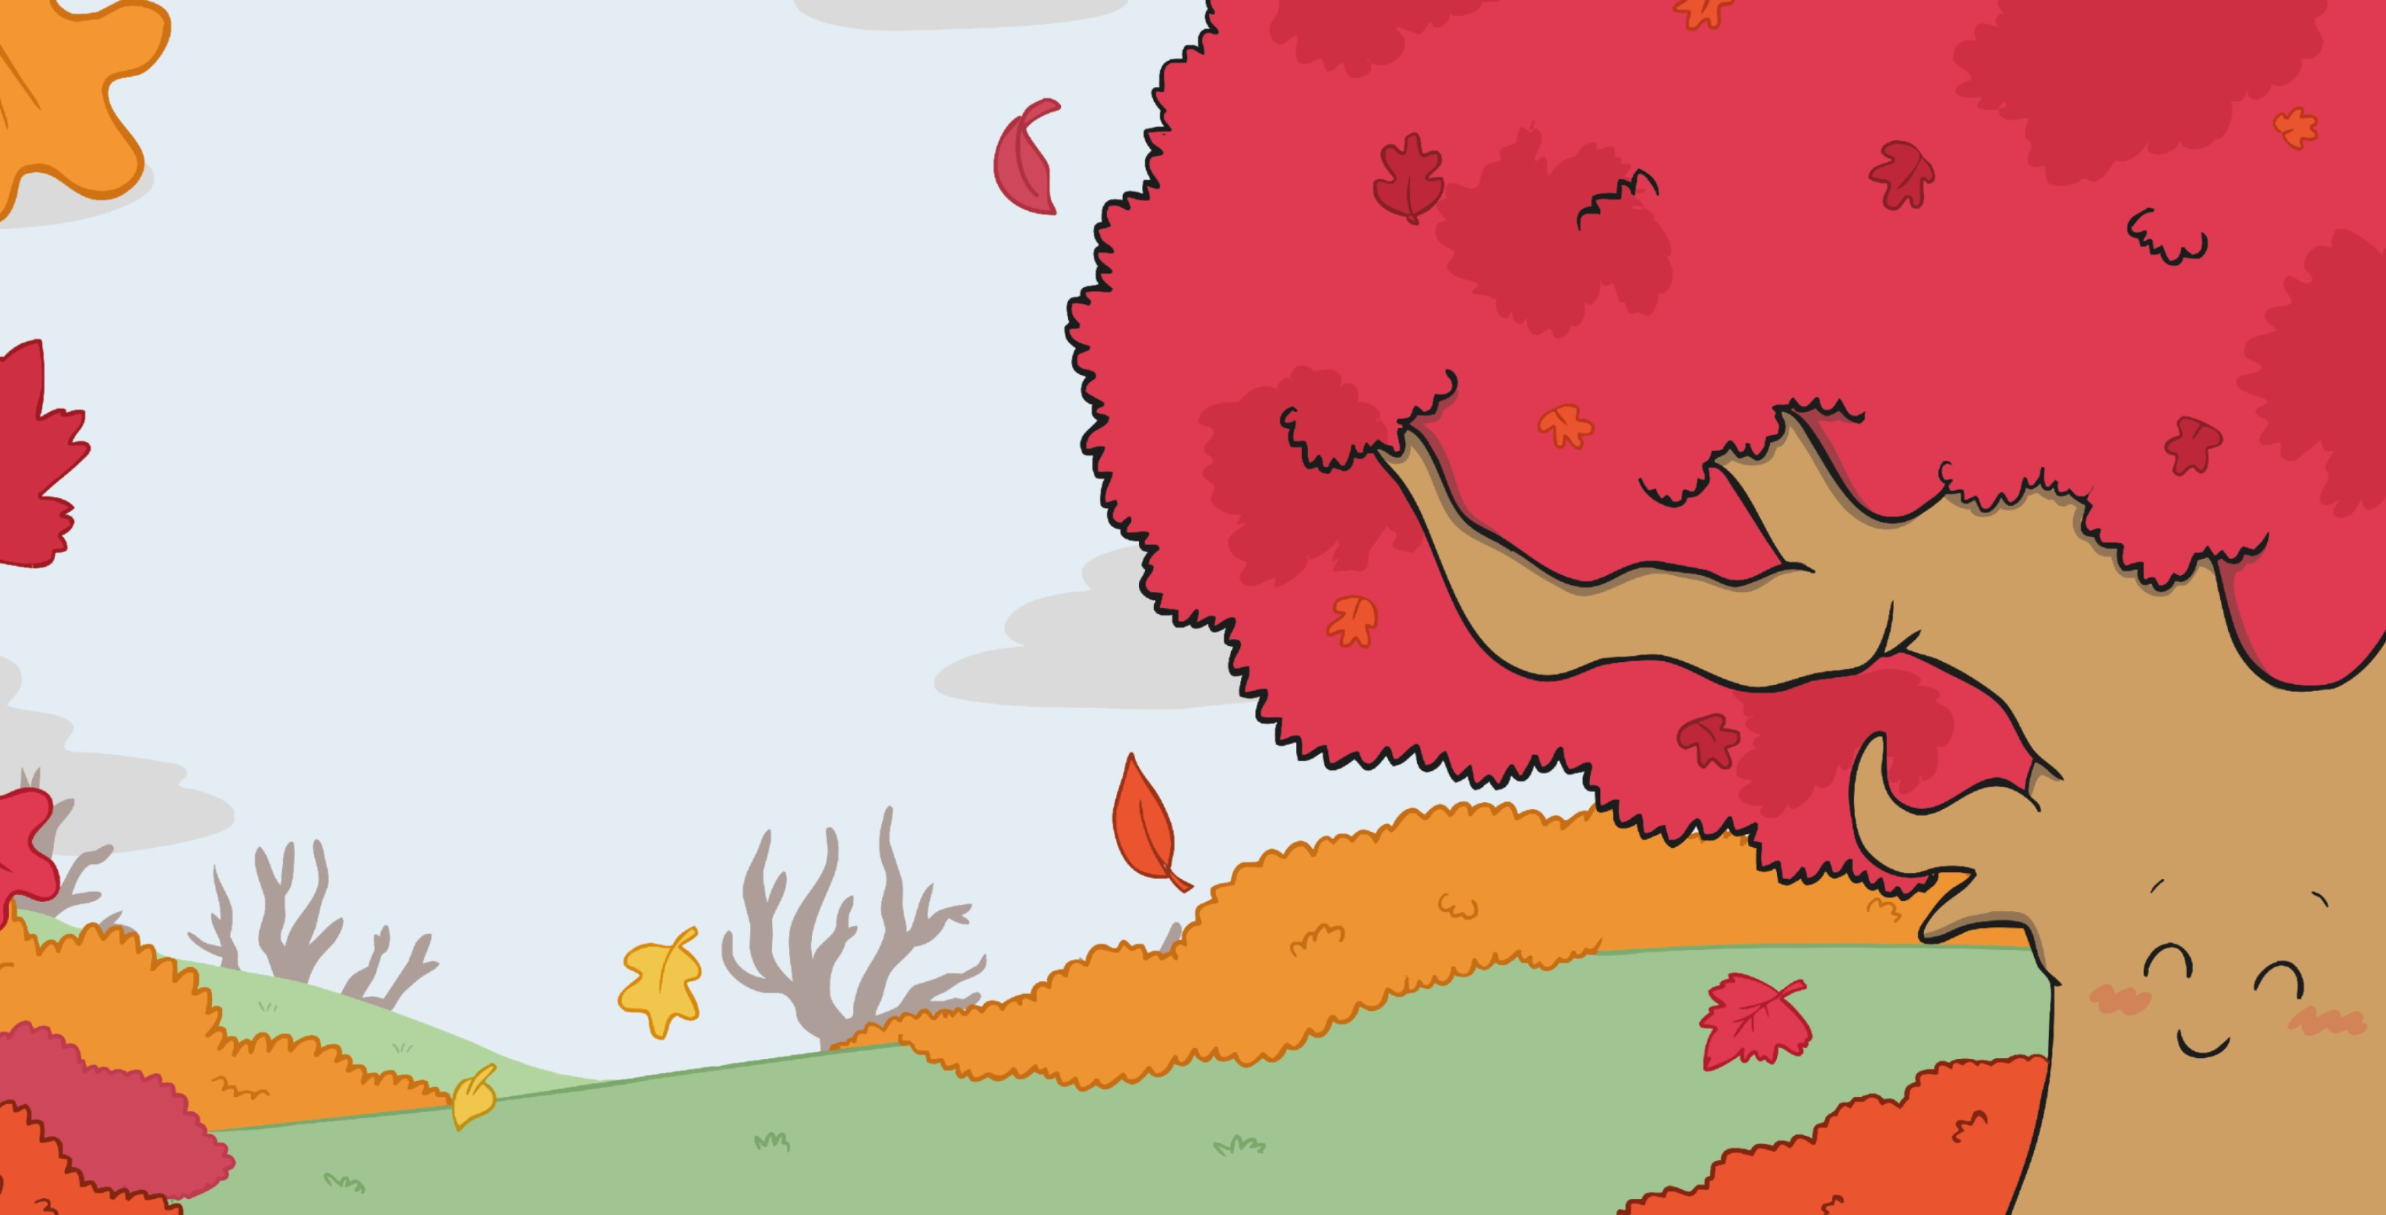


The summer soon ends; no more
days or beautiful, sunny blue sky.
As autumn returns, with its rich reds and browns,
the trees wave the
goodbye.

Slide 16
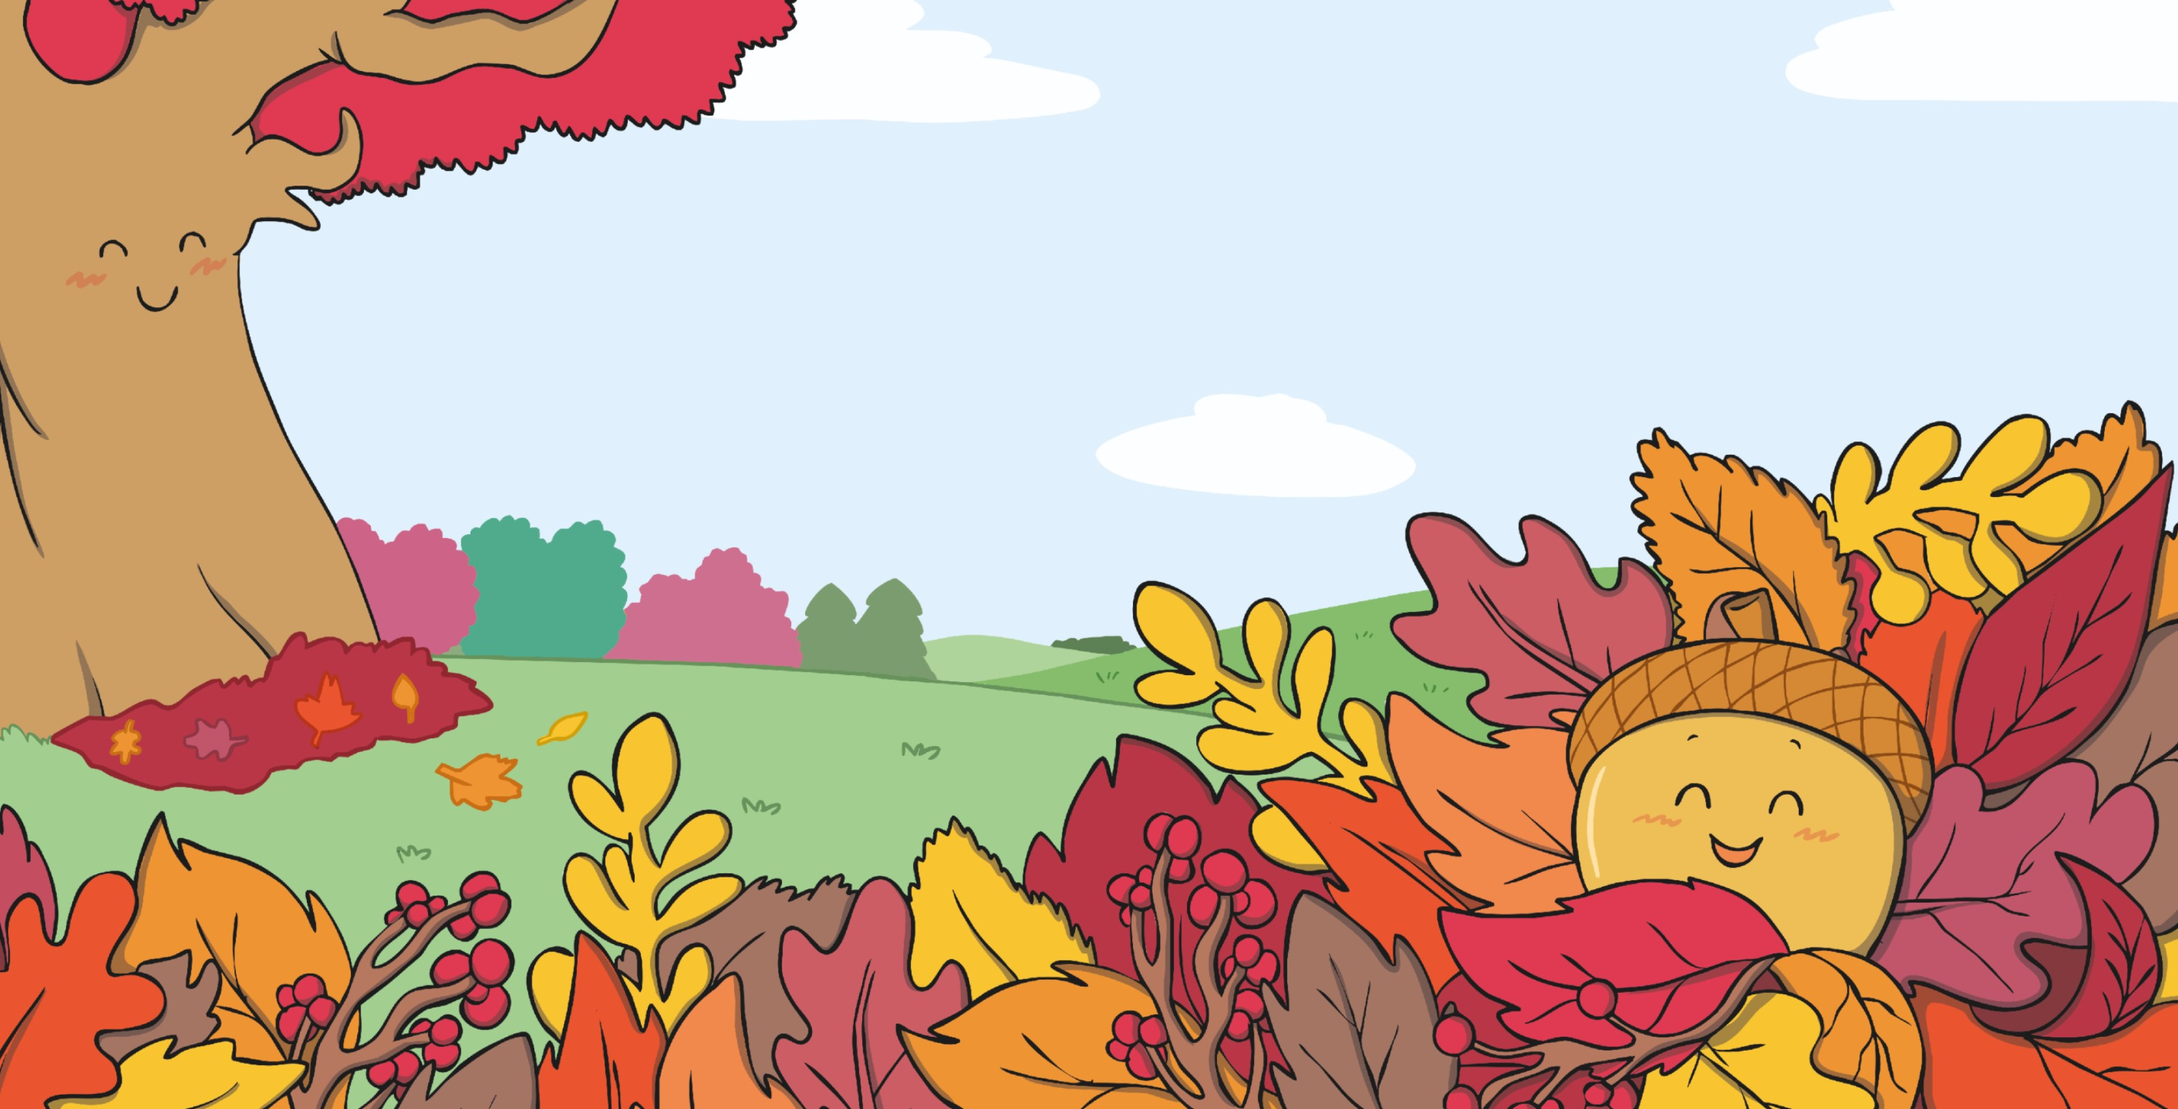

The dry leaves quickly cover him
up and right there, he is happy to stay.
A little brown acorn
down to the ground, one windy
and wet autumn day.

Slide 17


