Slide 1
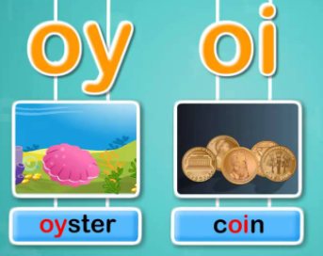

Year 1
‘oy’ and ‘oi’

Slide 2

toy

Slide 3

boy

Slide 4

joy

Slide 5
royal

Slide 6

boil

Slide 7

soil

Slide 8

foil

Slide 9

spoil

Slide 10
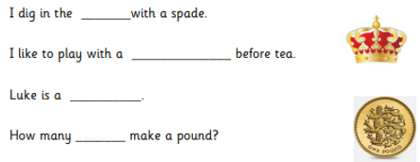

Read the words in the word bank.
soil
Read the first question.

Slide 11
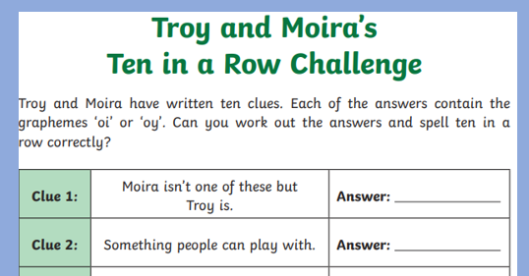
Read the clues!

