Slide 1

English
Captions and Labels

Slide 2
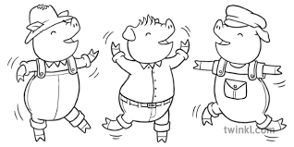
Learning Objective:
To write captions and labels.

Slide 3
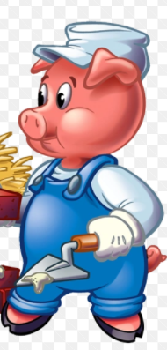
What is a caption?
A caption is a short sentence that describes a picture.
The pig has blue trousers.

Slide 4




Fred and Sam played on the beach.

Slide 5

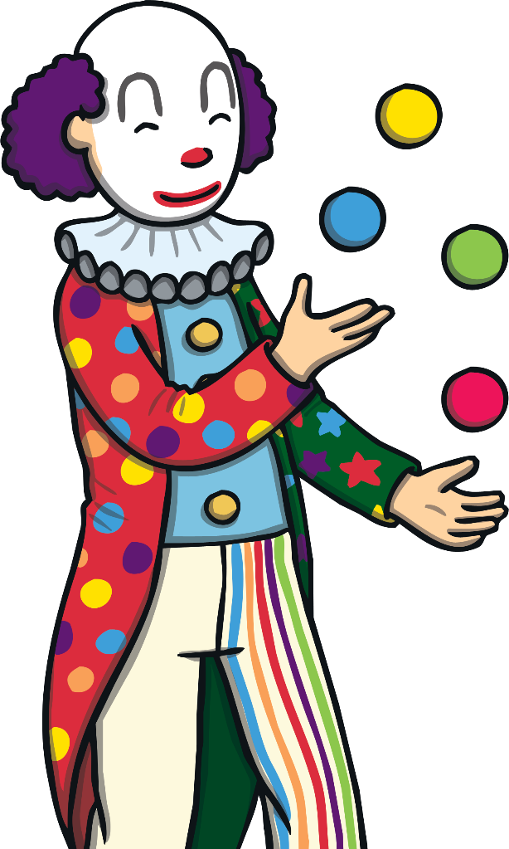
The clown is juggling.

Slide 6
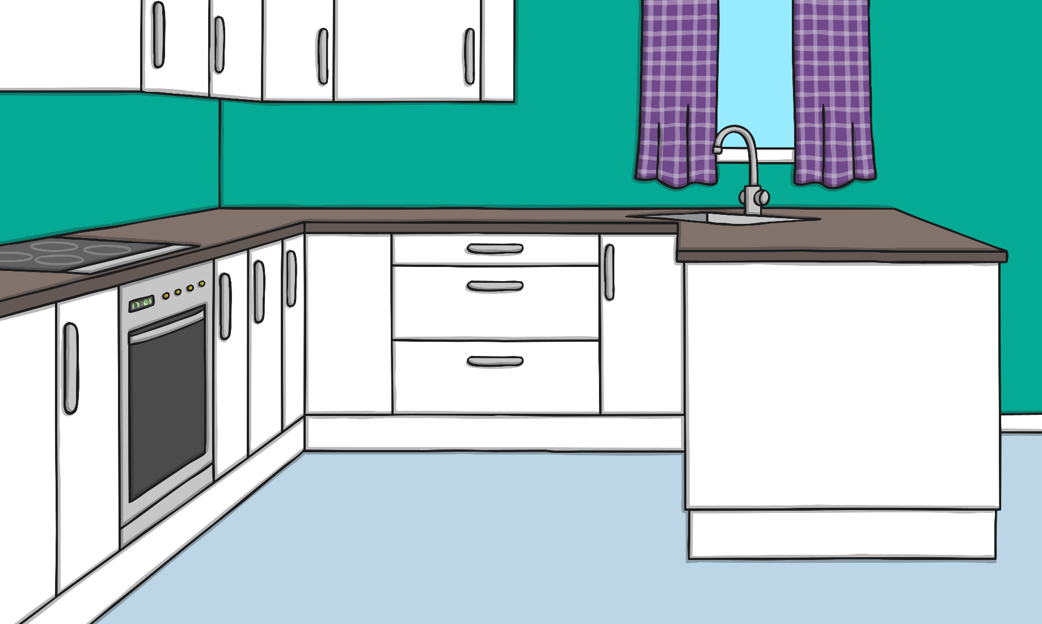

Milk is good for children’s teeth.

Slide 7



The frog sits by the pond.

Slide 8

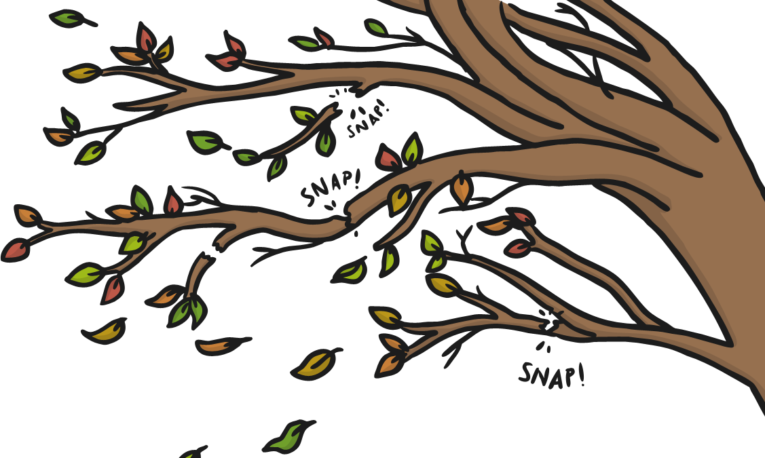
I can hear twigs snapping in the wind.

Slide 9
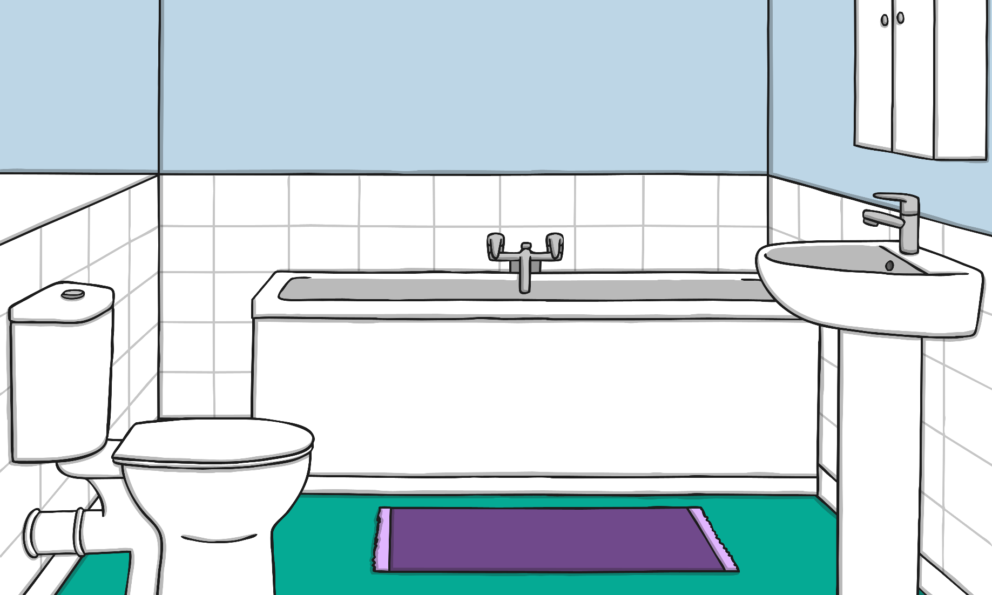
A drip from the tap drops in the sink.

Slide 10
What is a label?
Labels are words which help you to identify an object and parts of the object.
white hat
ear
eye
blue trousers

Slide 11
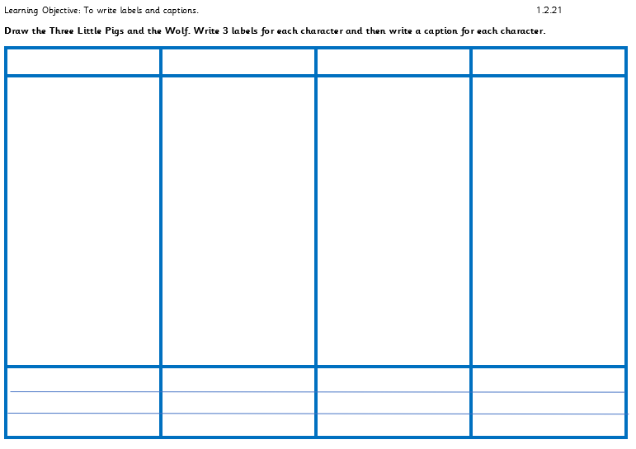
Write a title.
Draw a character.
Write a caption.
Write two labels on each character.

Slide 12
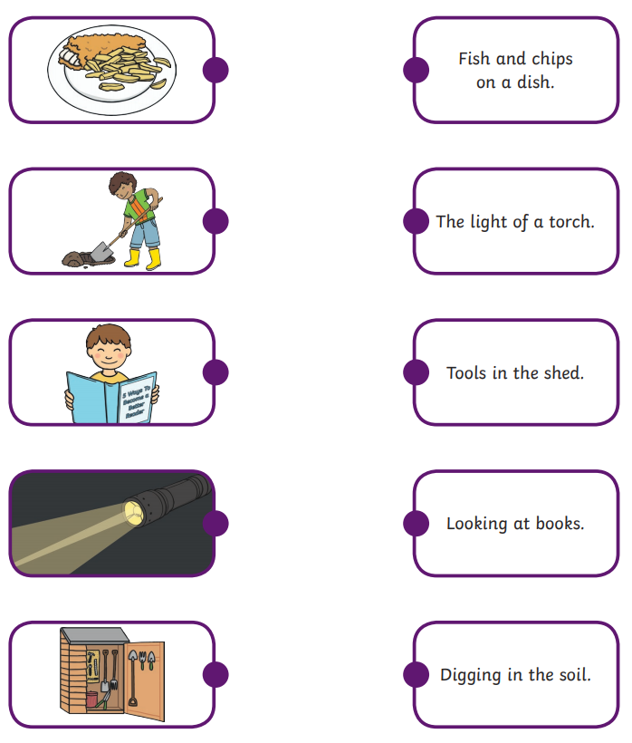
Optional activity…
Read the captions and draw a line to the correct picture.

