Slide 1

Year 1
Alternative choices for the sound ‘oo’
u
oo
oul

Slide 2

Let’s read!
push

Slide 3

Let’s read!
foot

Slide 4
Let’s read!
would

Slide 5

Let’s read!
pull

Slide 6

Let’s read!
cook

Slide 7
Let’s read!
should

Slide 8

Let’s read!
full

Slide 9

Let’s read!
wool

Slide 10

Let’s read!
could

Slide 11
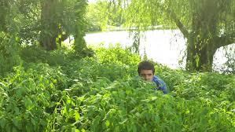
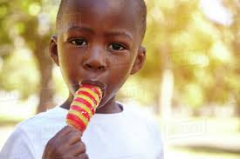
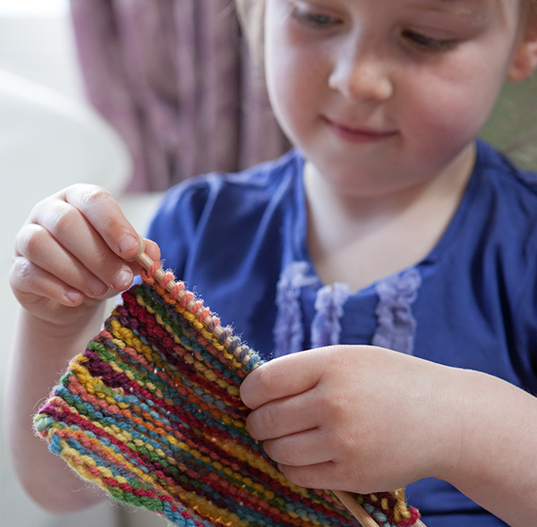

Read and Match
I would like an ice lolly.
I knit with some wool.
Don’t hide in the bush.

Slide 12
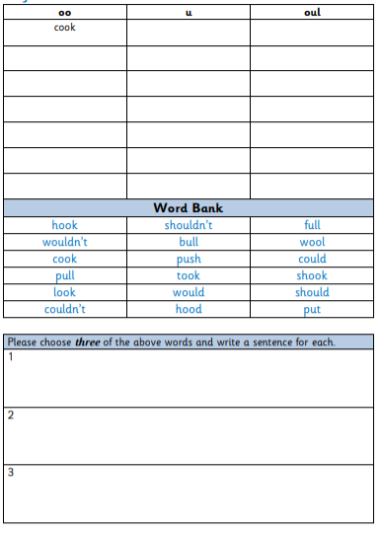
Read the words in the word bank.
Spot the phoneme, digraph or trigraph in each word.
Write three
sentences.
Write the word in the correct column.

