Slide 1
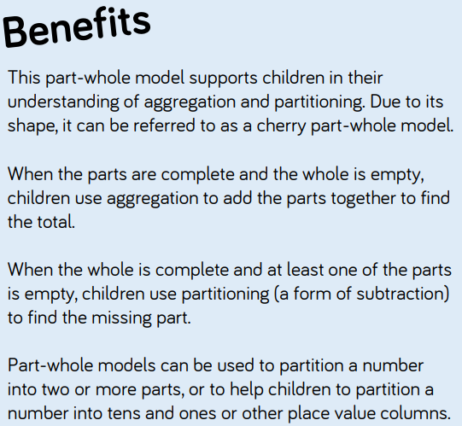

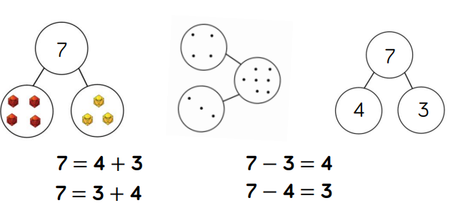
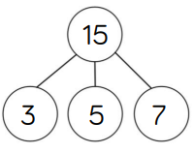
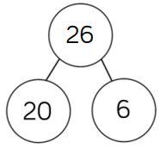
White Rose Maths Calculation Representations & Models
Overview of the different models and images that can support the teaching of different concepts:

Slide 2

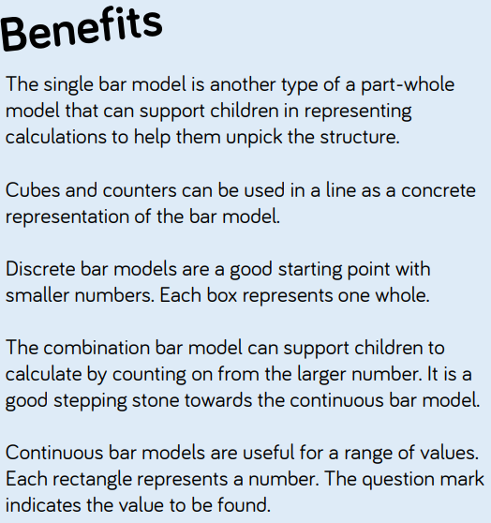
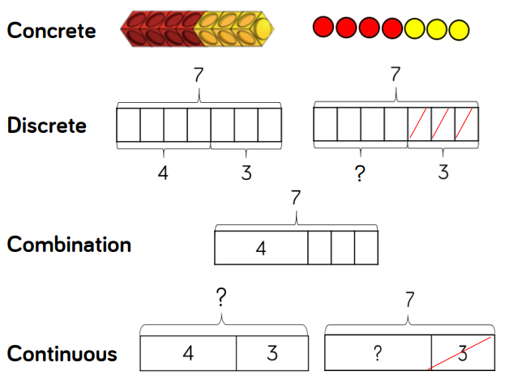
White Rose Maths Calculation Representations & Models

Slide 3

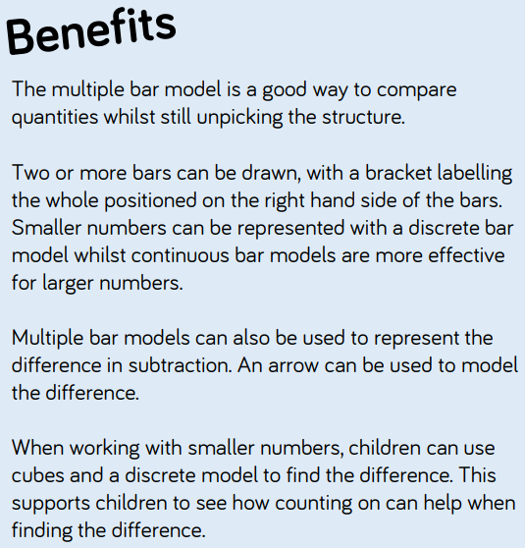
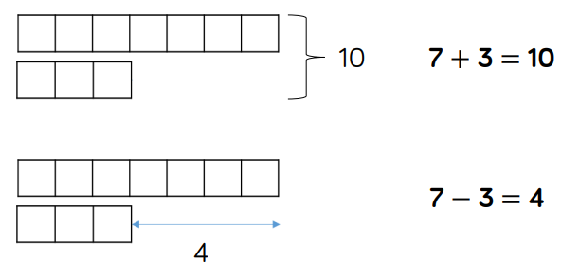
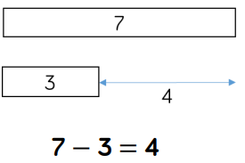
White Rose Maths Calculation Representations & Models

Slide 4

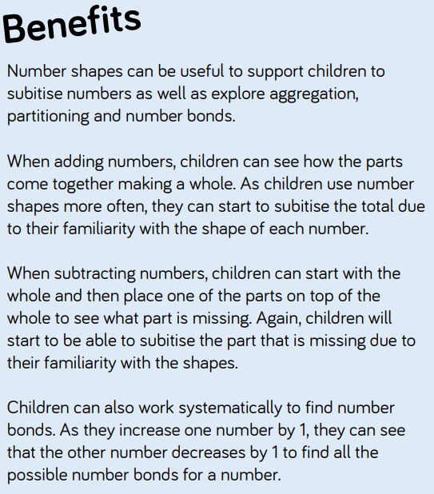
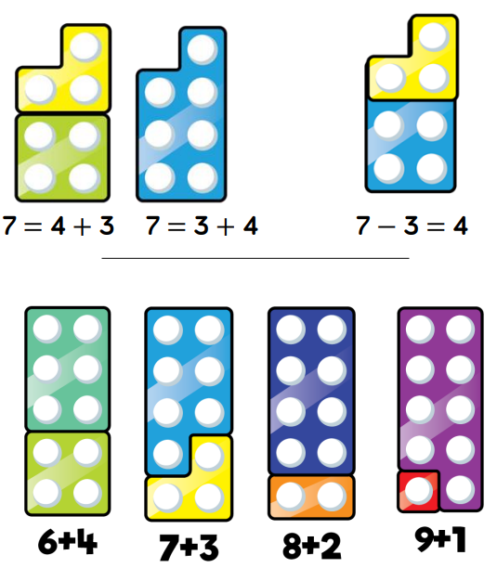
White Rose Maths Calculation Representations & Models

Slide 5

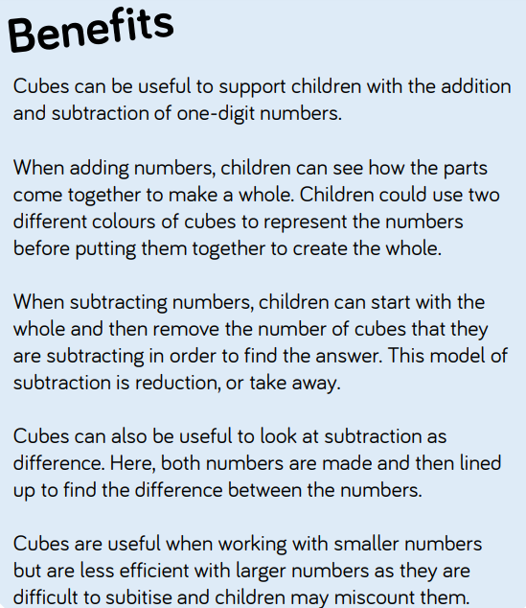
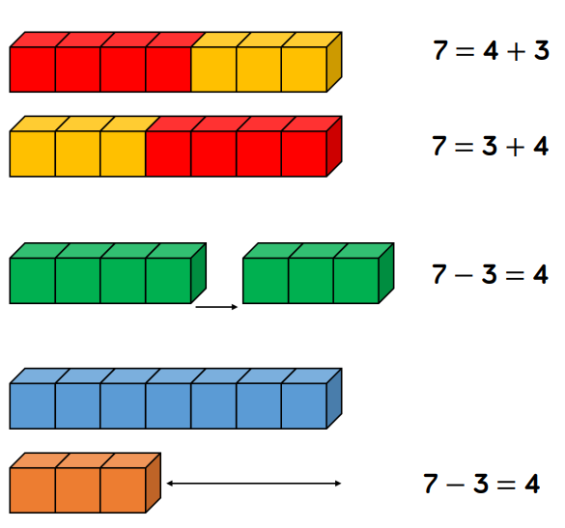
White Rose Maths Calculation Representations & Models

Slide 6

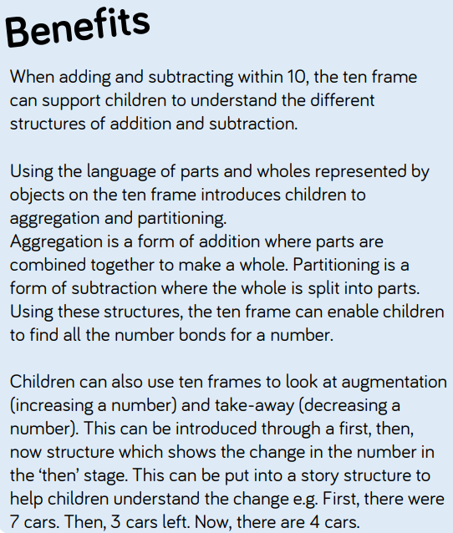
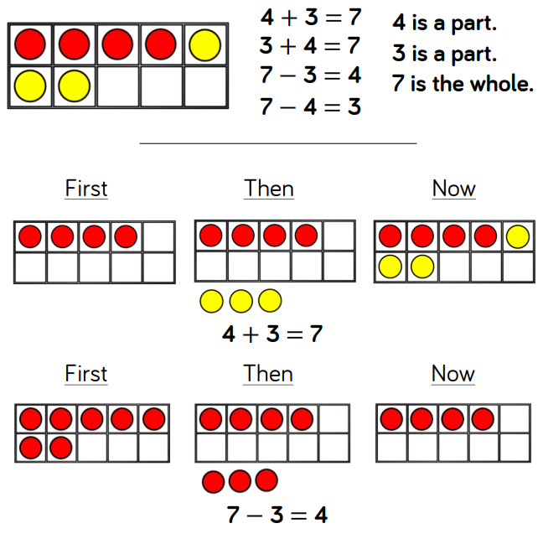
White Rose Maths Calculation Representations & Models

Slide 7

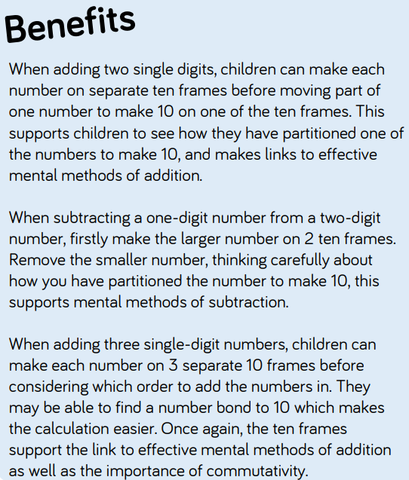
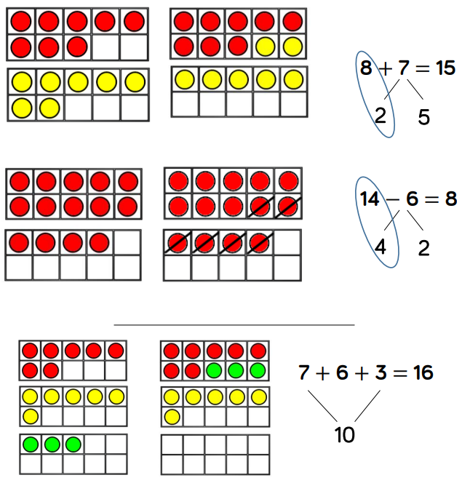
White Rose Maths Calculation Representations & Models

Slide 8

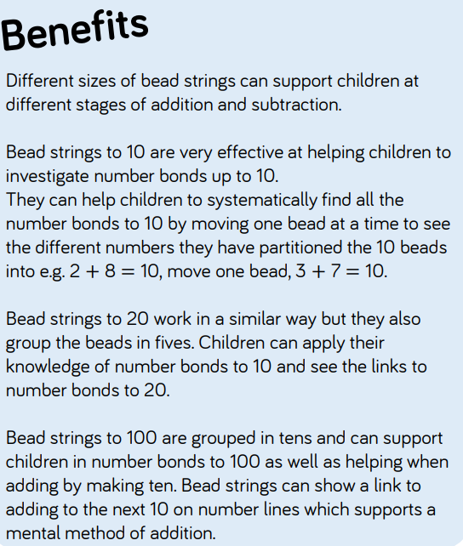
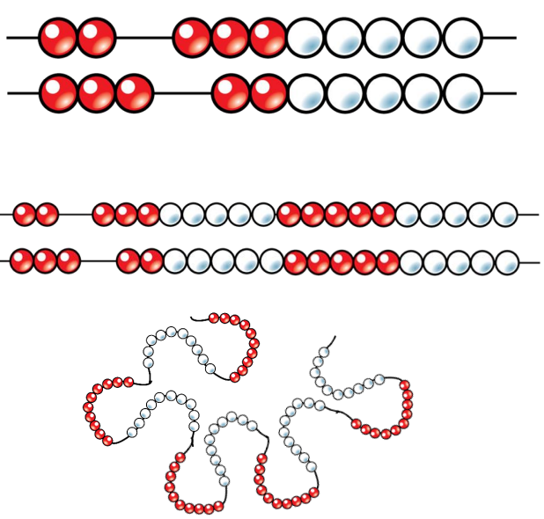
White Rose Maths Calculation Representations & Models

Slide 9

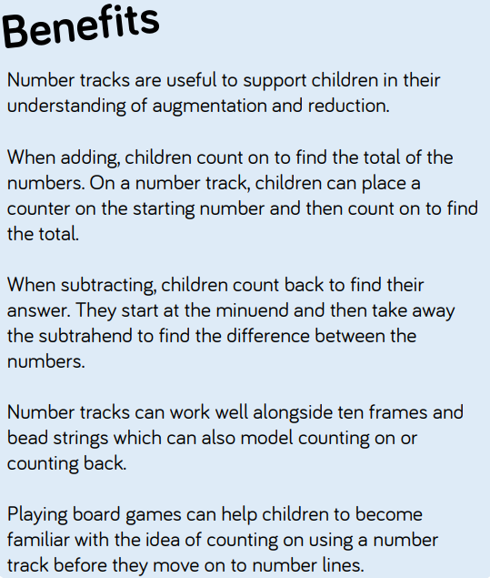
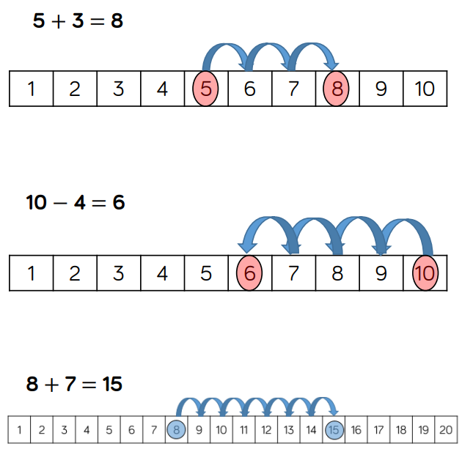
White Rose Maths Calculation Representations & Models

Slide 10

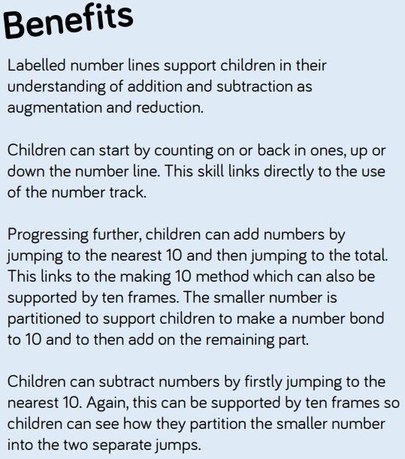
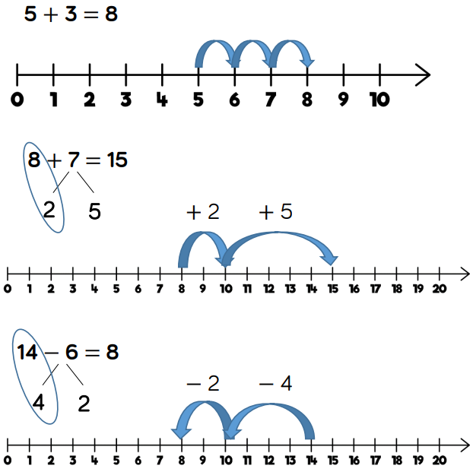
White Rose Maths Calculation Representations & Models

Slide 11

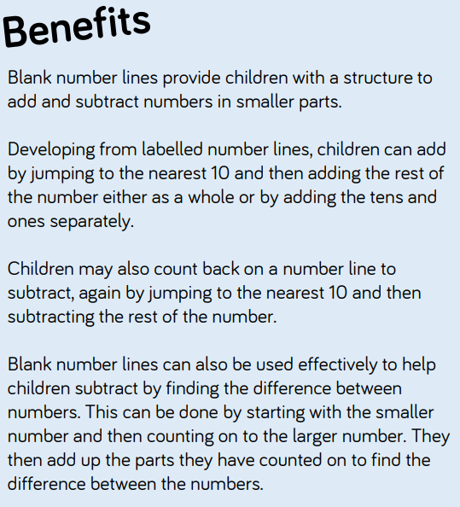
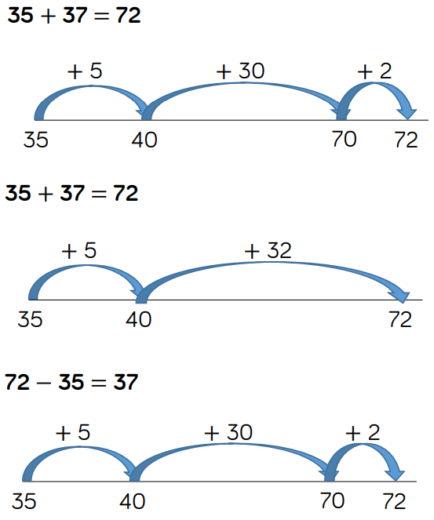
White Rose Maths Calculation Representations & Models

Slide 12

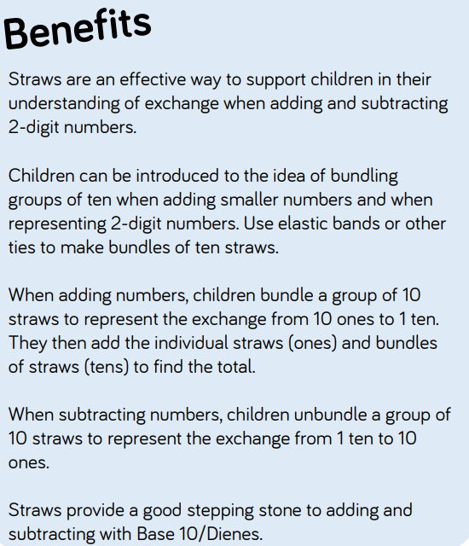
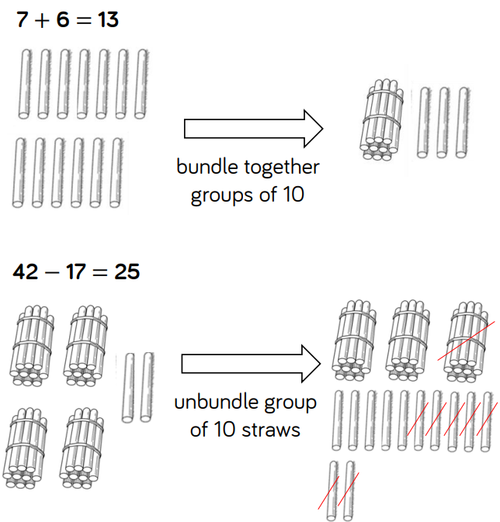
White Rose Maths Calculation Representations & Models

Slide 13

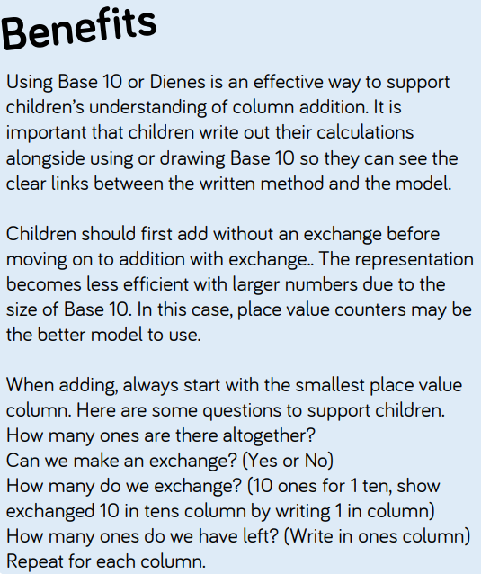
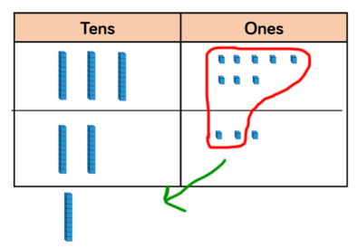
White Rose Maths Calculation Representations & Models

Slide 14

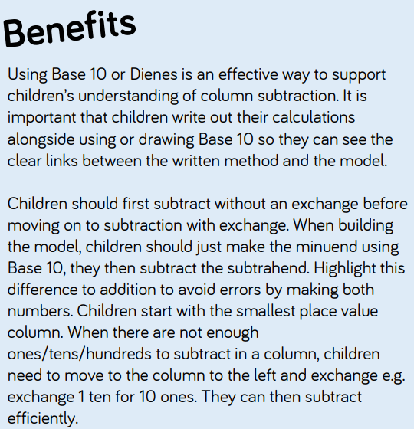
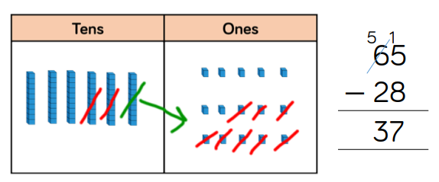
White Rose Maths Calculation Representations & Models

Slide 15
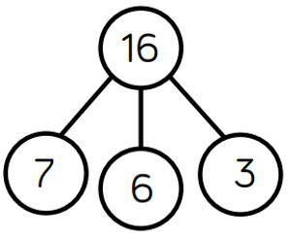
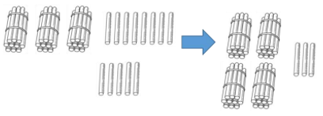
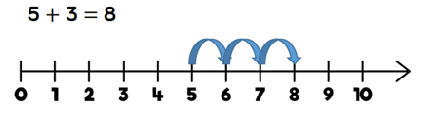

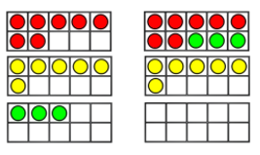
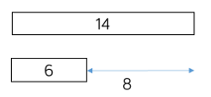
White Rose Maths Skills
The following slides show how the representations and models are used in Year 2.

Slide 16
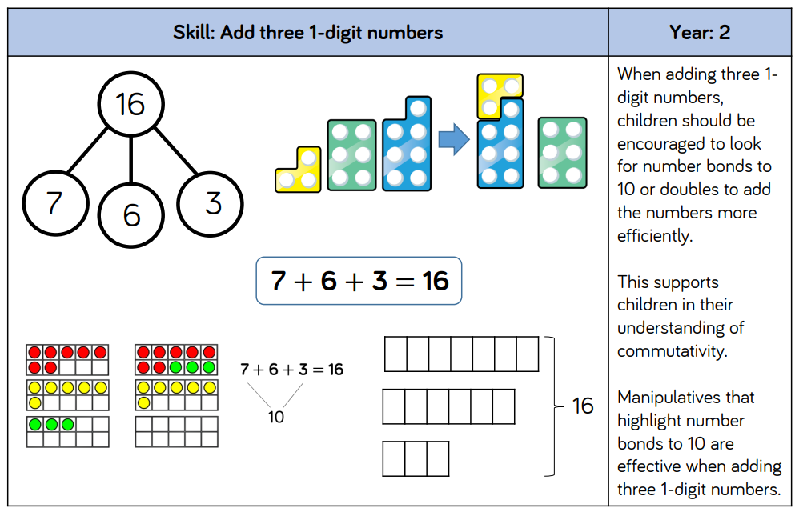
Addition – Models & Images to support teaching of concepts

Slide 17
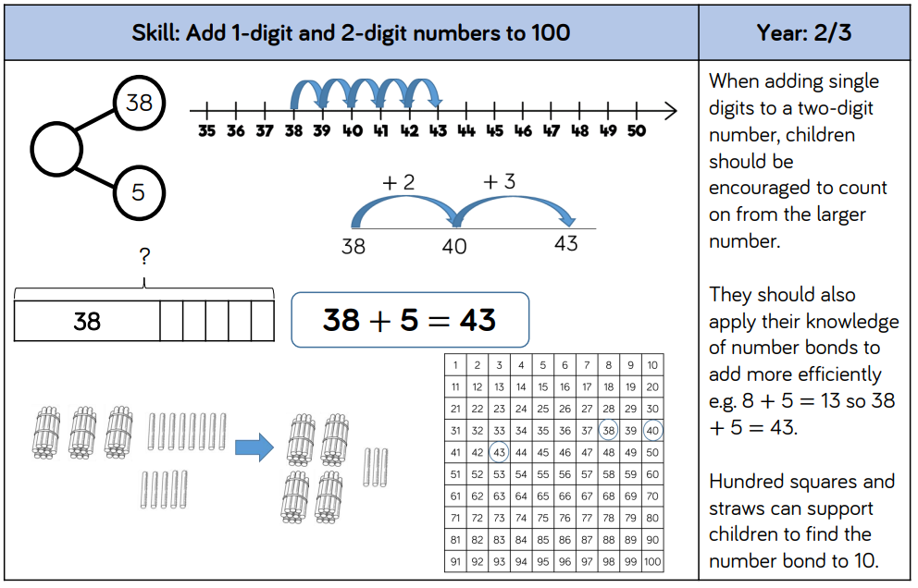
Addition – Models & Images to support teaching of concepts

Slide 18
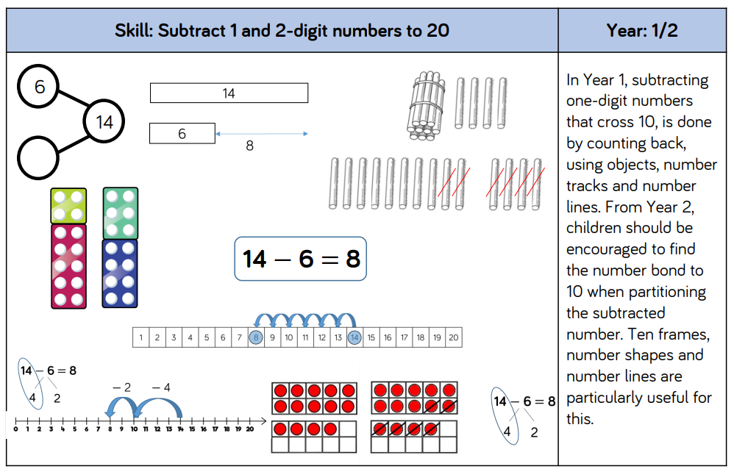
Subtraction – Models & Images to support teaching of concepts

Slide 19
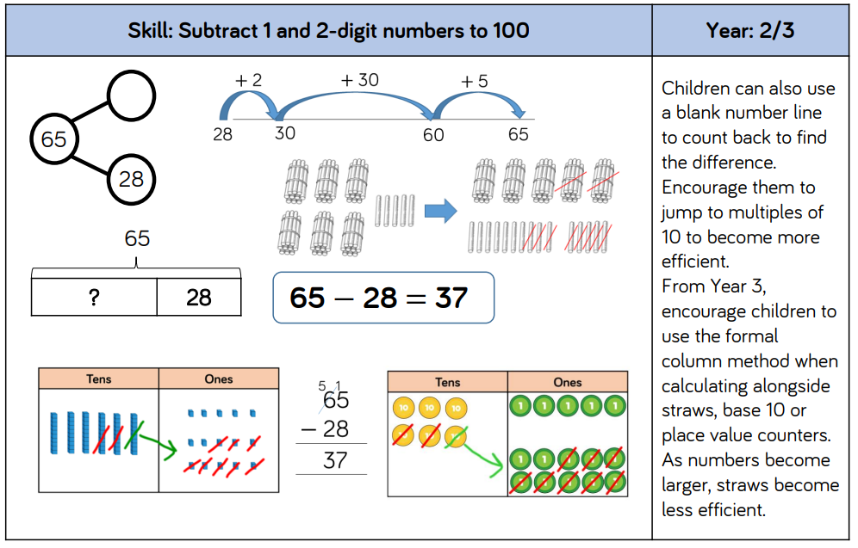
Subtraction – Models & Images to support teaching of concepts

Slide 20
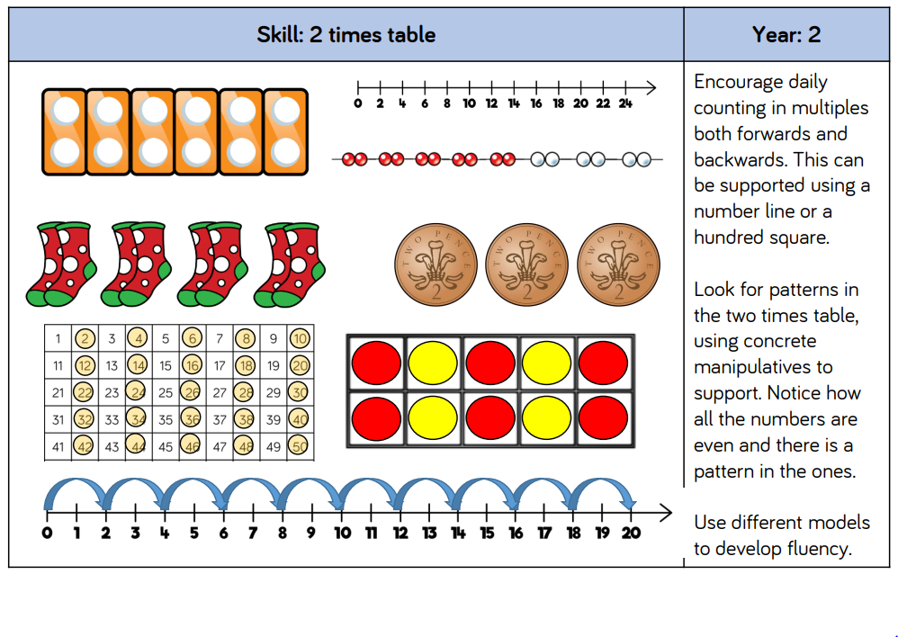
Multiplication – Models & Images to support teaching of concepts

Slide 21
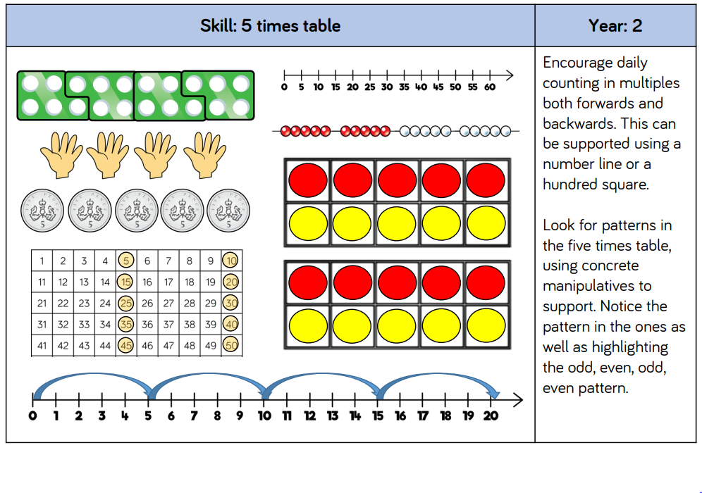
Multiplication – Models & Images to support teaching of concepts

Slide 22
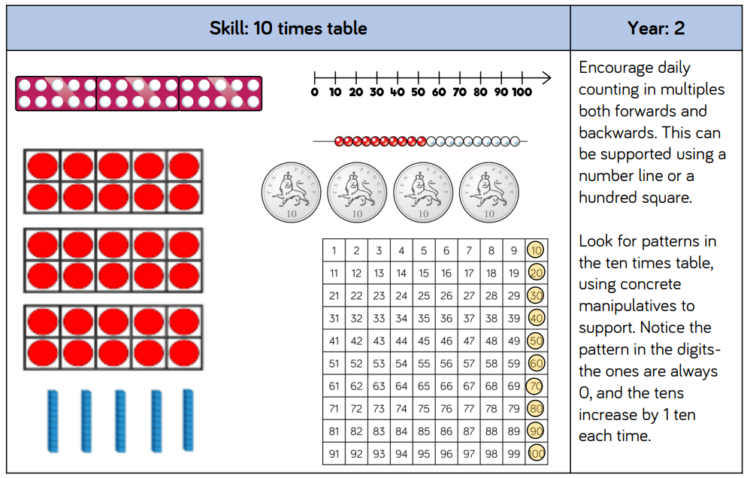
Multiplication – Models & Images to support teaching of concepts

Slide 23
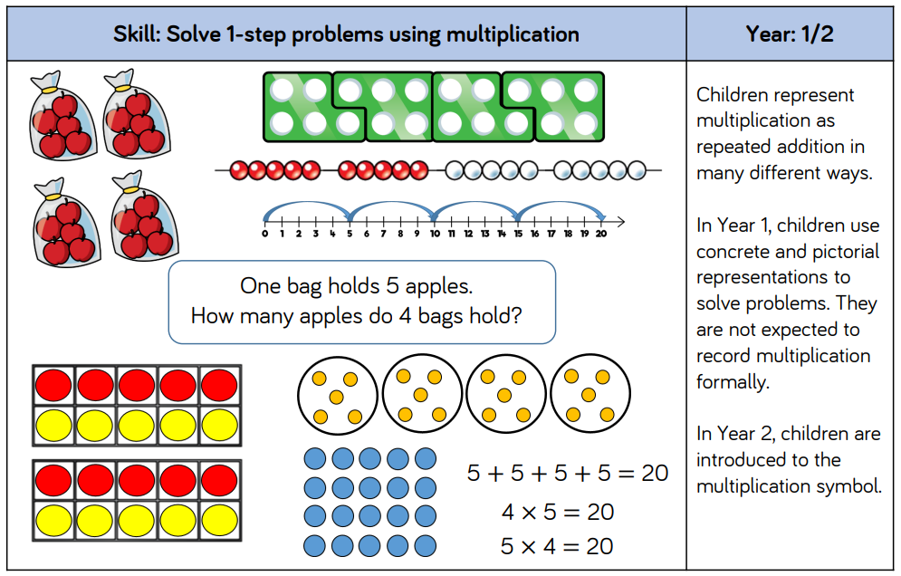
Multiplication – Models & Images to support teaching of concepts

Slide 24
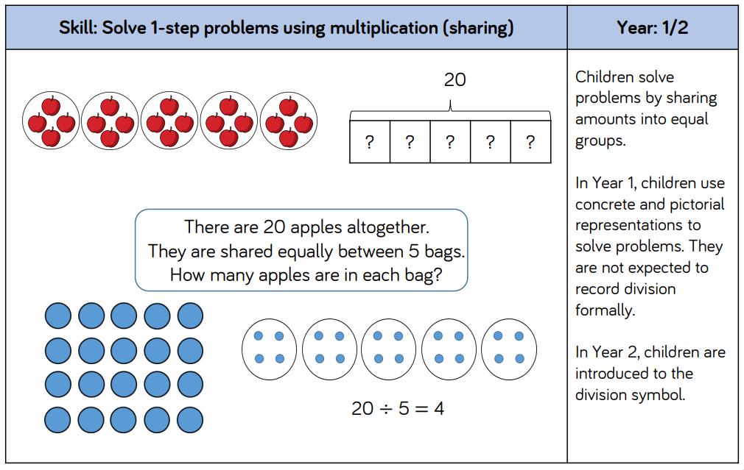
Division – Models & Images to support teaching of concepts

Slide 25
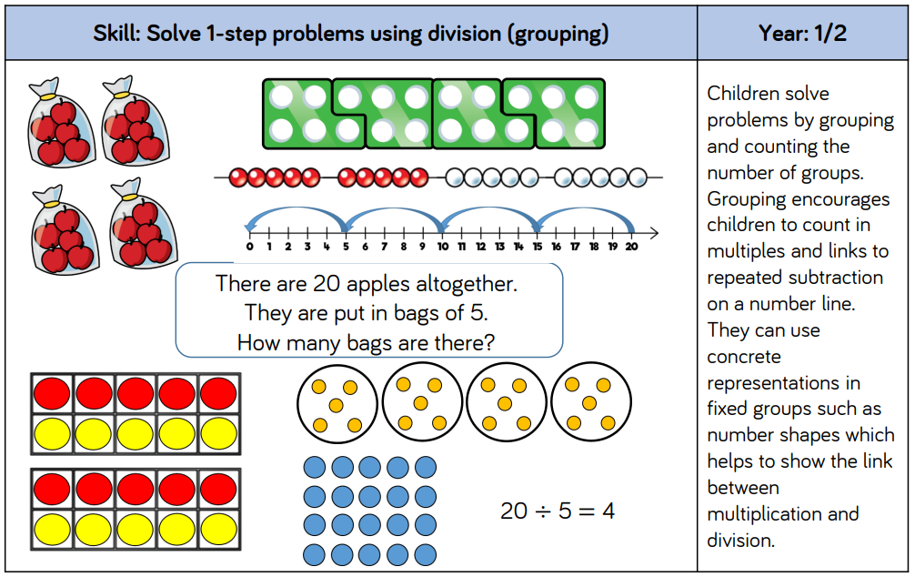
Division – Models & Images to support teaching of concepts

