Slide 1


Slide 2


Slide 3


Slide 4


Slide 5


Slide 6


Slide 7


Slide 8


Slide 9


Slide 10


Slide 11


Slide 12


Slide 13


Slide 14


Slide 15


Slide 16


Slide 17


Slide 18


Slide 19


Slide 20


Slide 21


Slide 22


Slide 23
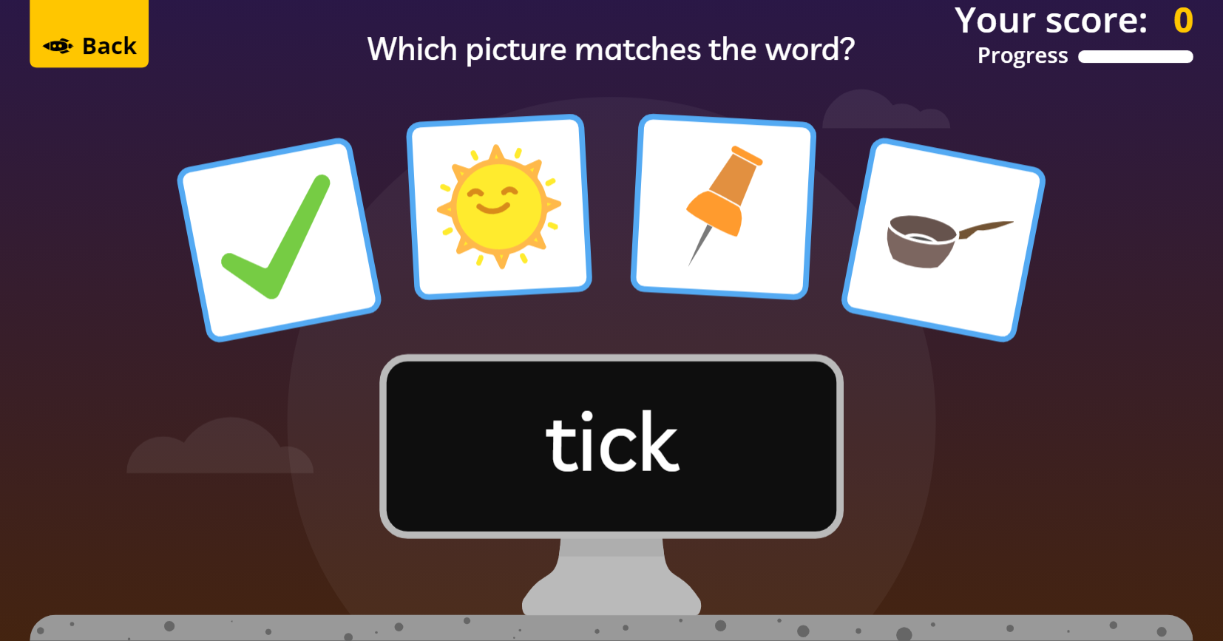
https://www.phonicsplay.co.uk/resources/phase/2/pick-a-picture Phase 2 Set 1-5

