Slide 1


Slide 2
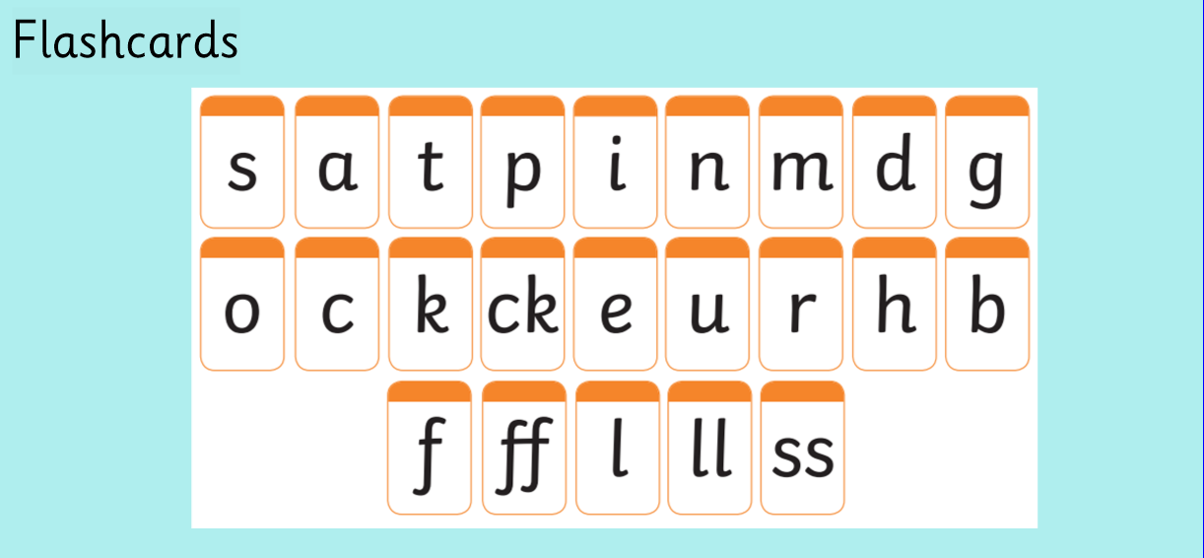

Slide 3
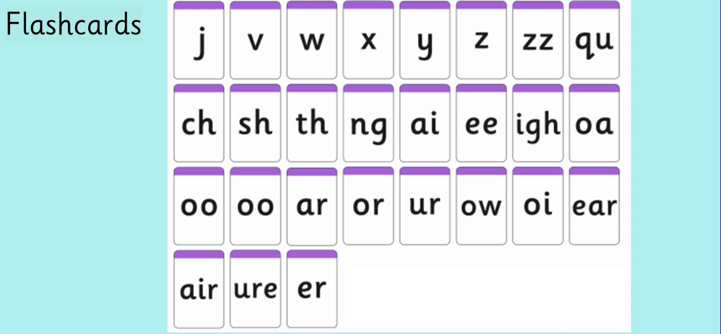

Slide 4
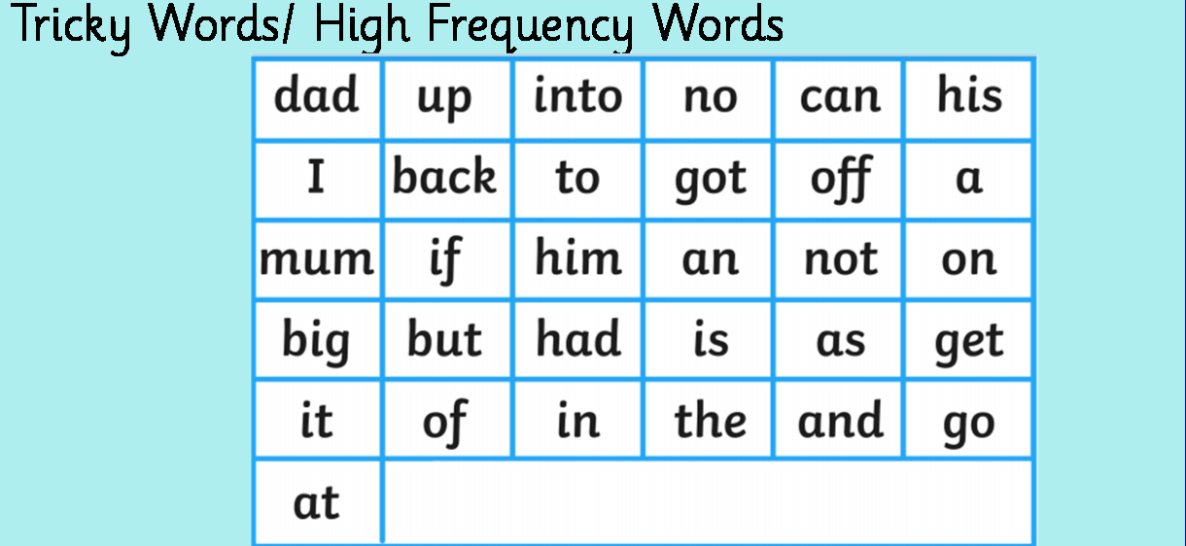

Slide 5
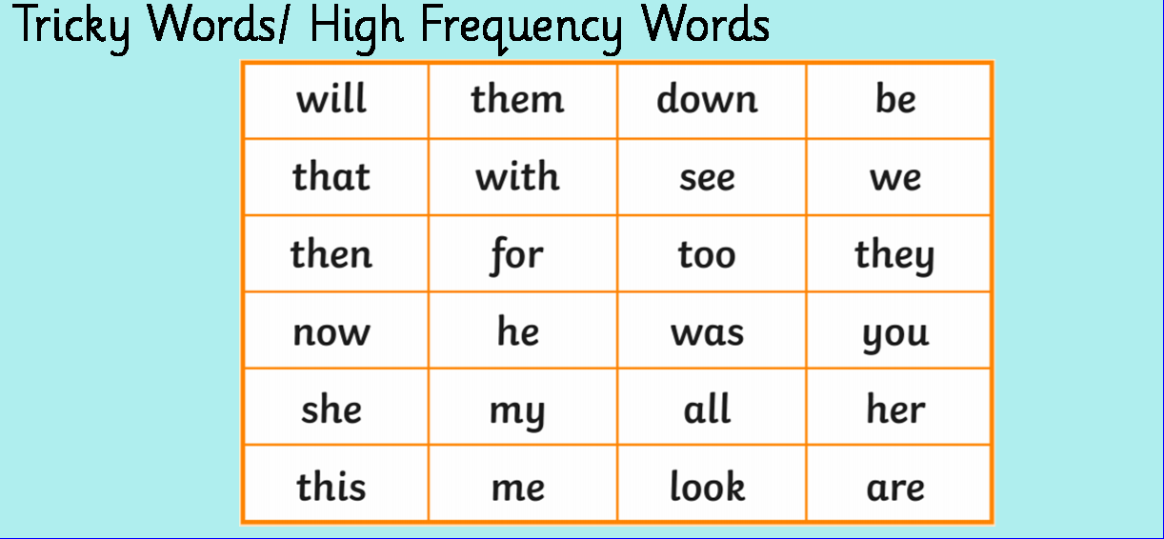

Slide 6
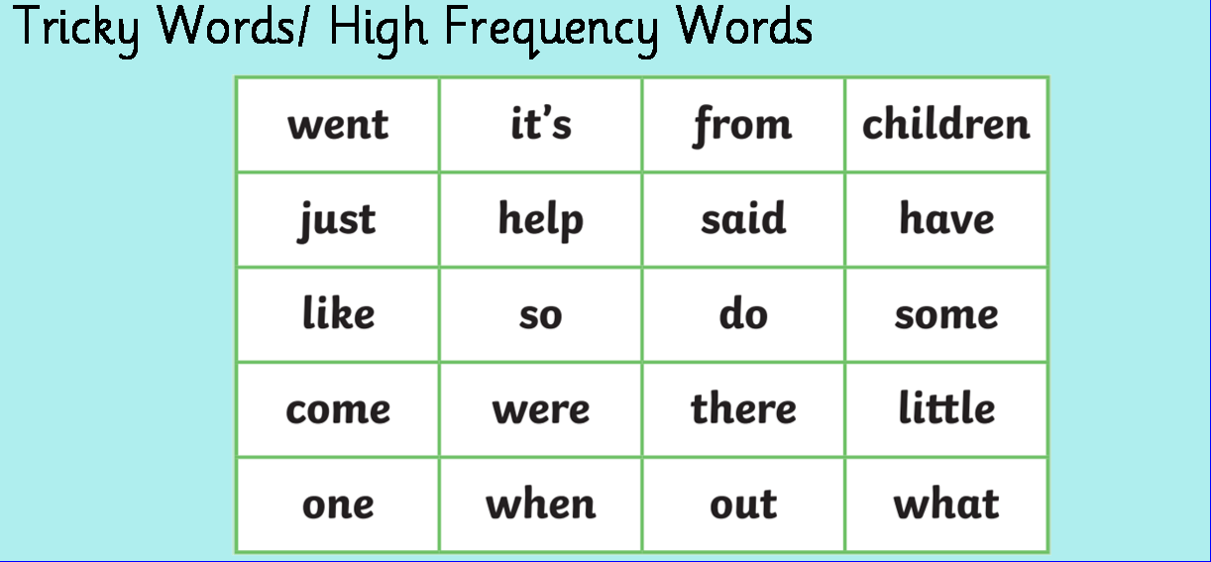

Slide 7

https://www.youtube.com/watch?v=TvMyssfAUx0&t=2s

Slide 8

https://www.youtube.com/watch?v=R087lYrRpgY

Slide 9
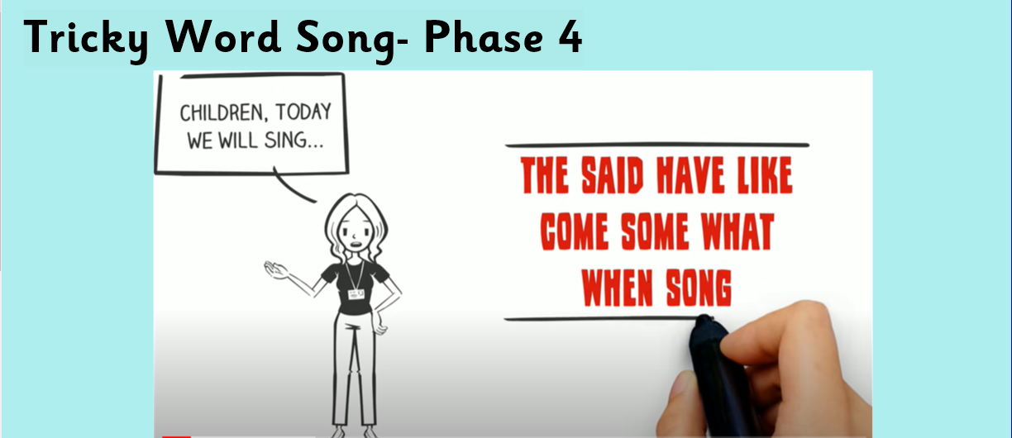
https://www.youtube.com/watch?v=3NOzgR1ANc4&t=35s

Slide 10


Slide 11


Slide 12
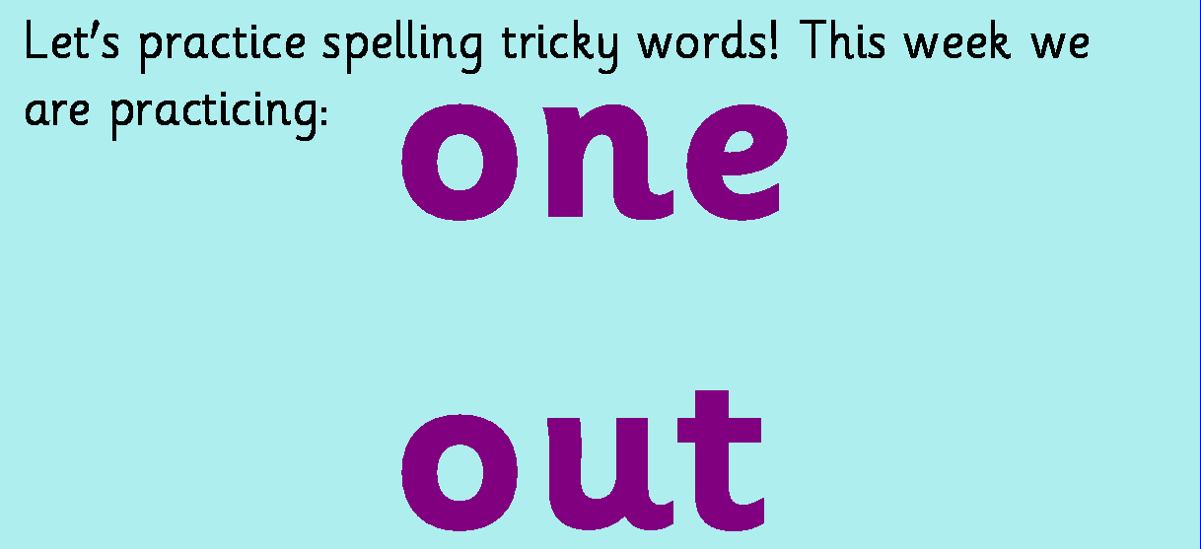

Slide 13


Slide 14


Slide 15
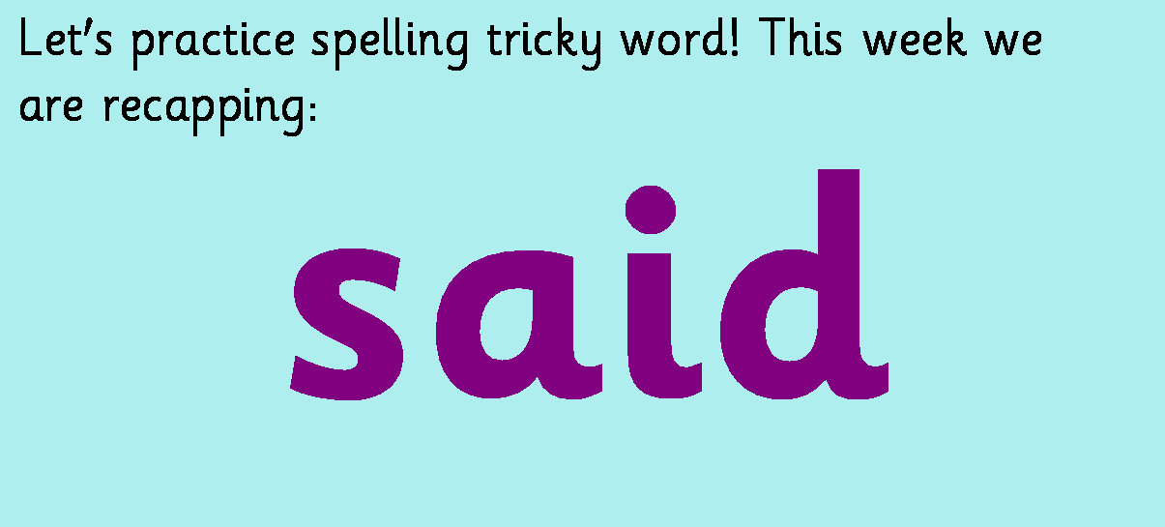

Slide 16


Slide 17


