Slide 1
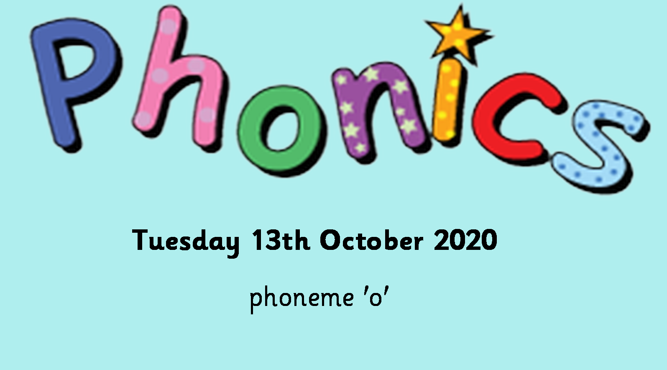

Slide 2
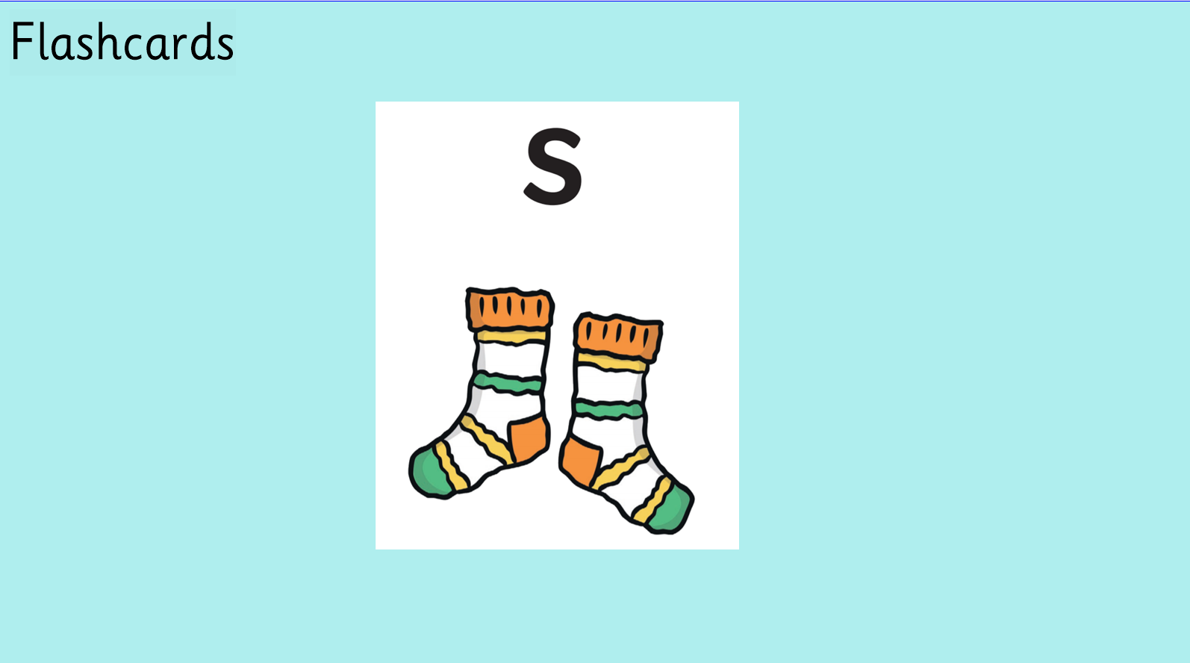

Slide 3


Slide 4


Slide 5
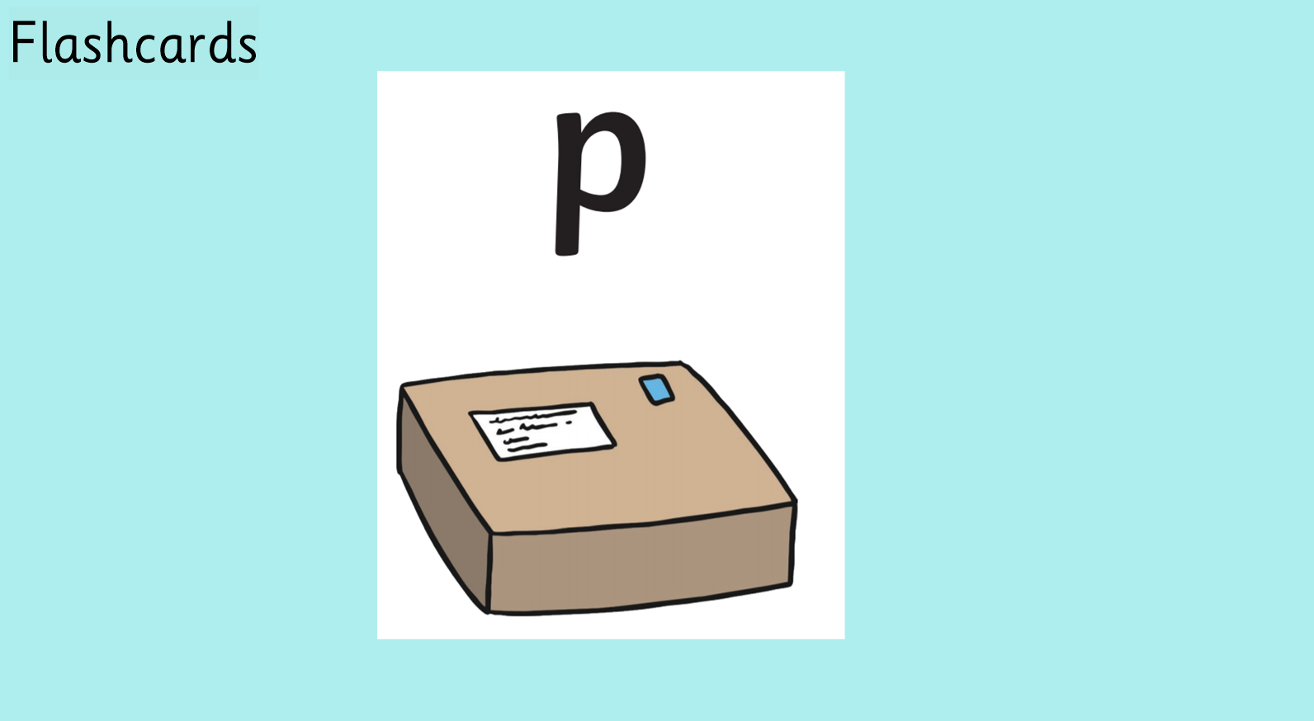

Slide 6
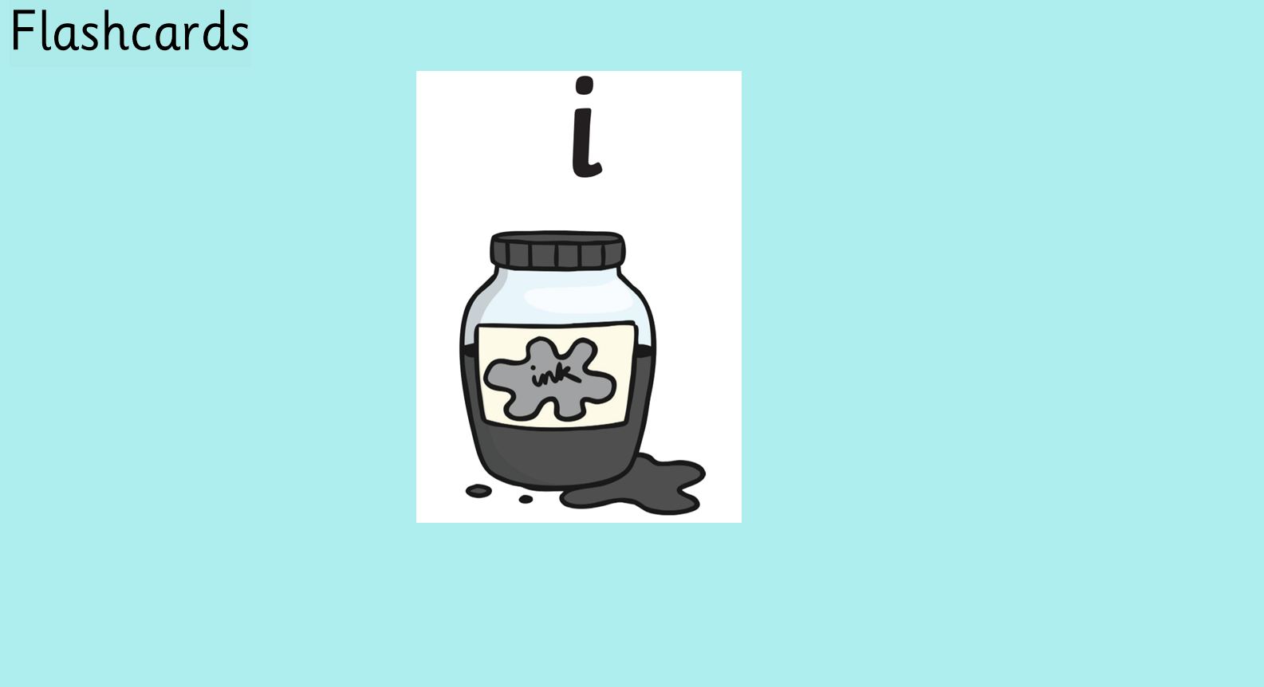

Slide 7


Slide 8


Slide 9


Slide 10
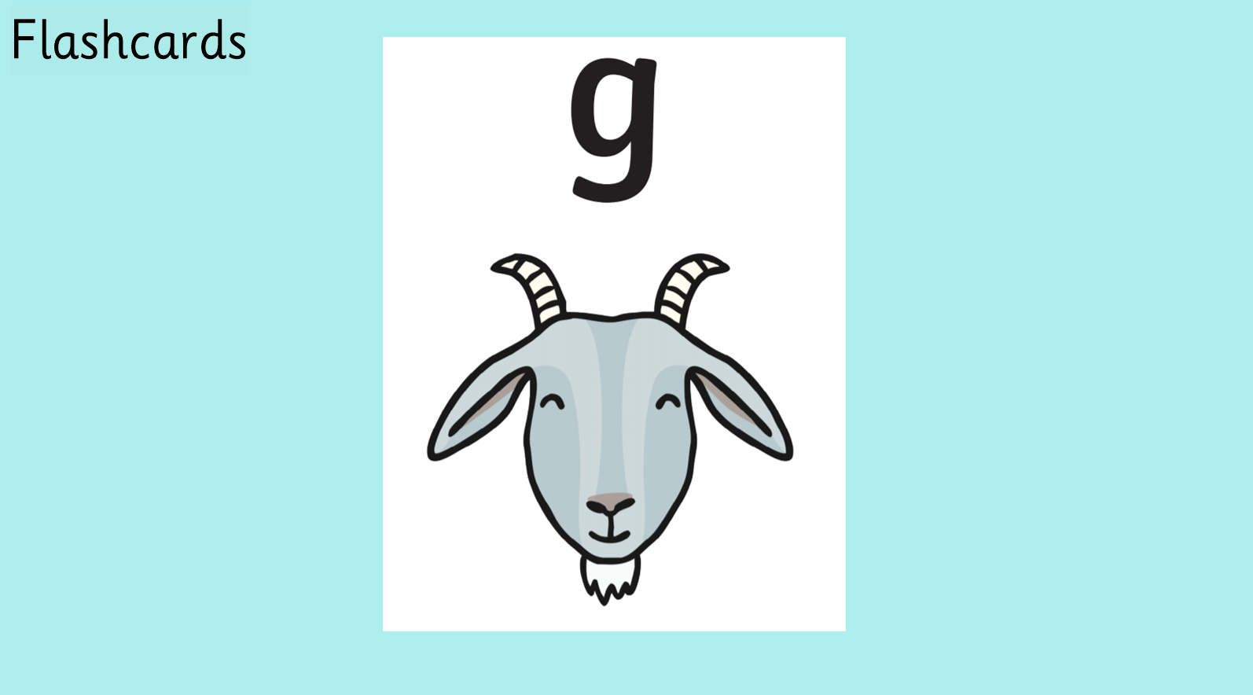

Slide 11


Slide 12


Slide 13


Slide 14


Slide 15


Slide 16


Slide 17

https://www.youtube.com/watch?v=oWbY5EKys60

Slide 18
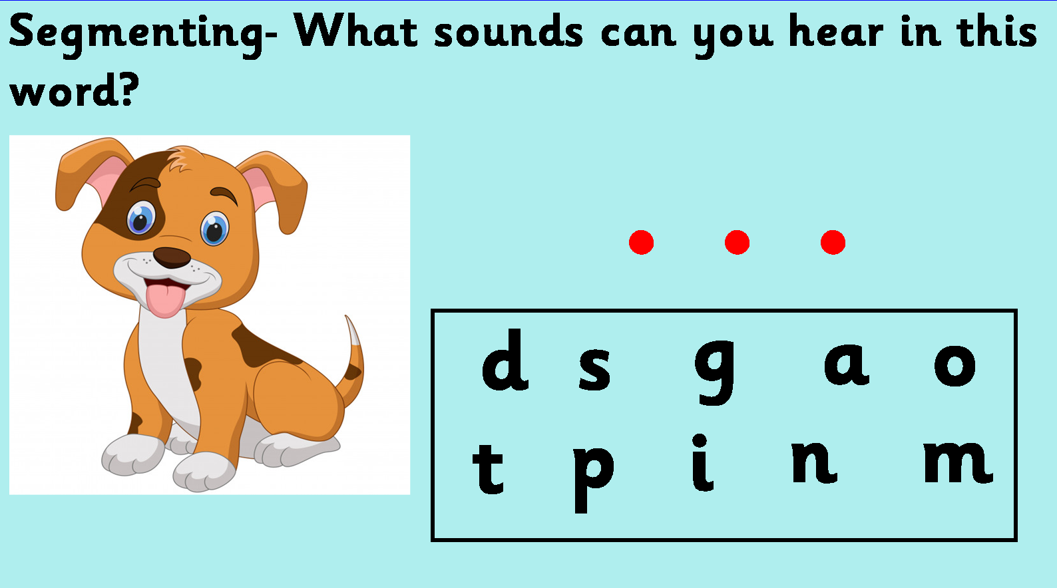

Slide 19


Slide 20
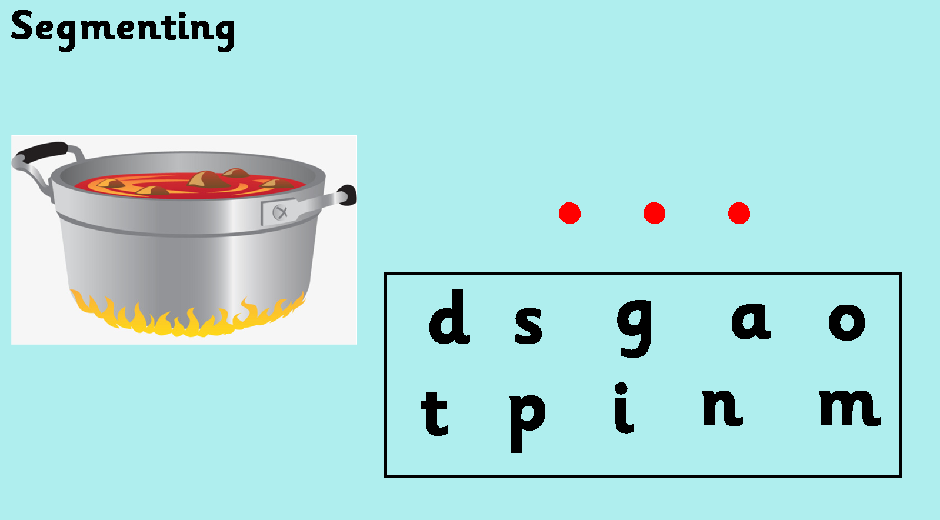

Slide 21
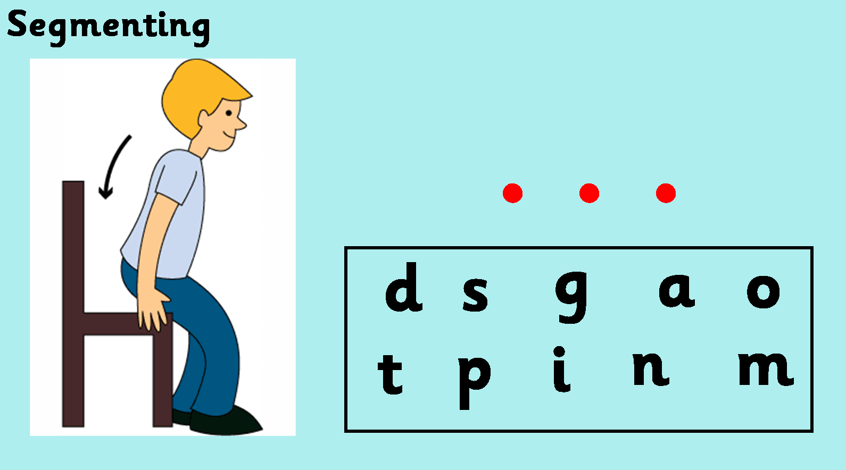

Slide 22
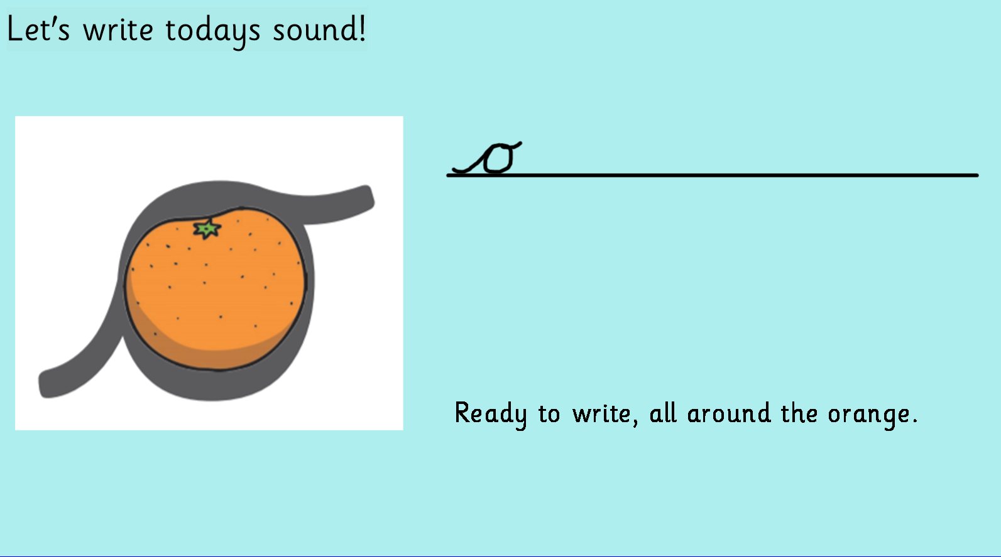

Slide 23


