Slide 1

Week Beginning: 12th October 2020
L.O To segment a word.
My Continent

Slide 2


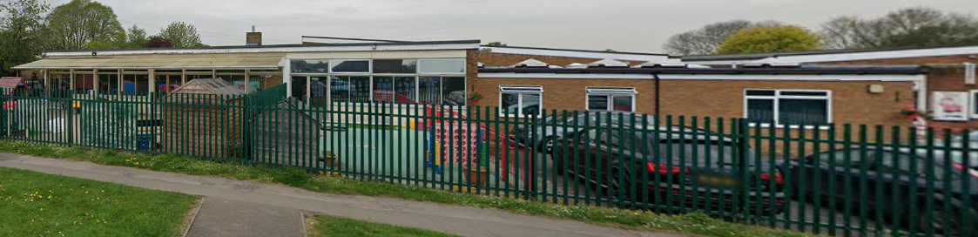
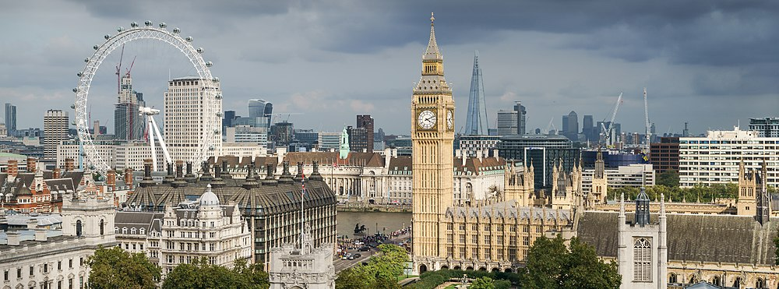
What have we learnt so far?
This is me!
I am part of a family
I go to school in Chalfont St Peter
I live in England and the capital is London

Slide 3
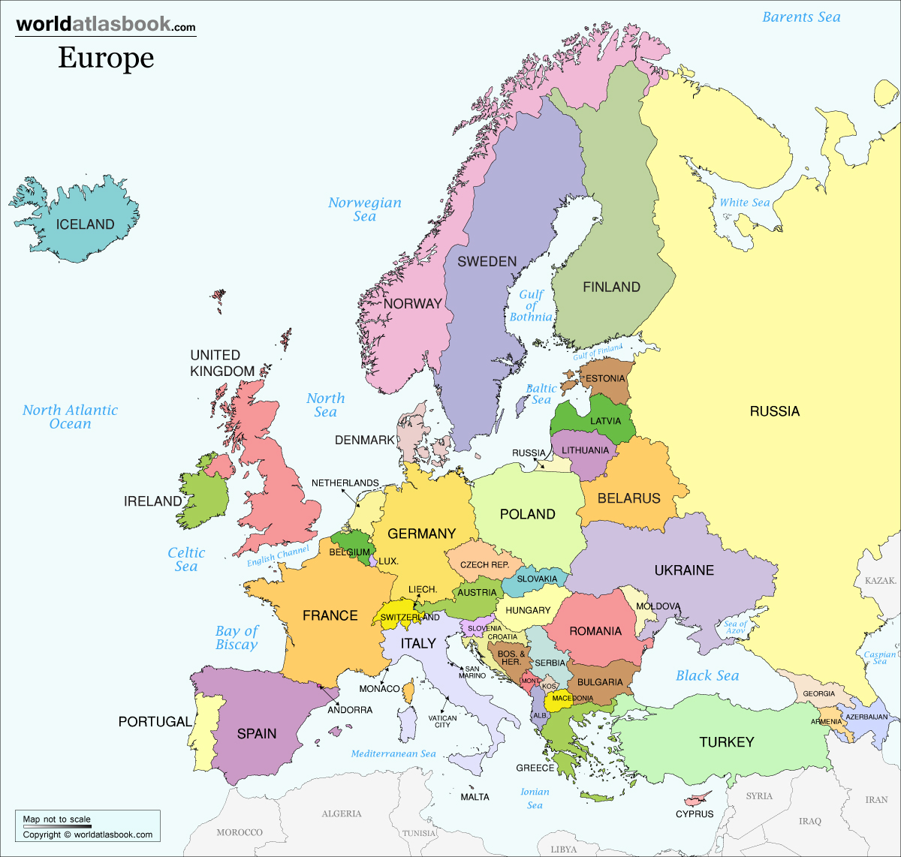
Our continent.
Our Continent
This Photo by Unknown Author is licensed under CC BY

Slide 4
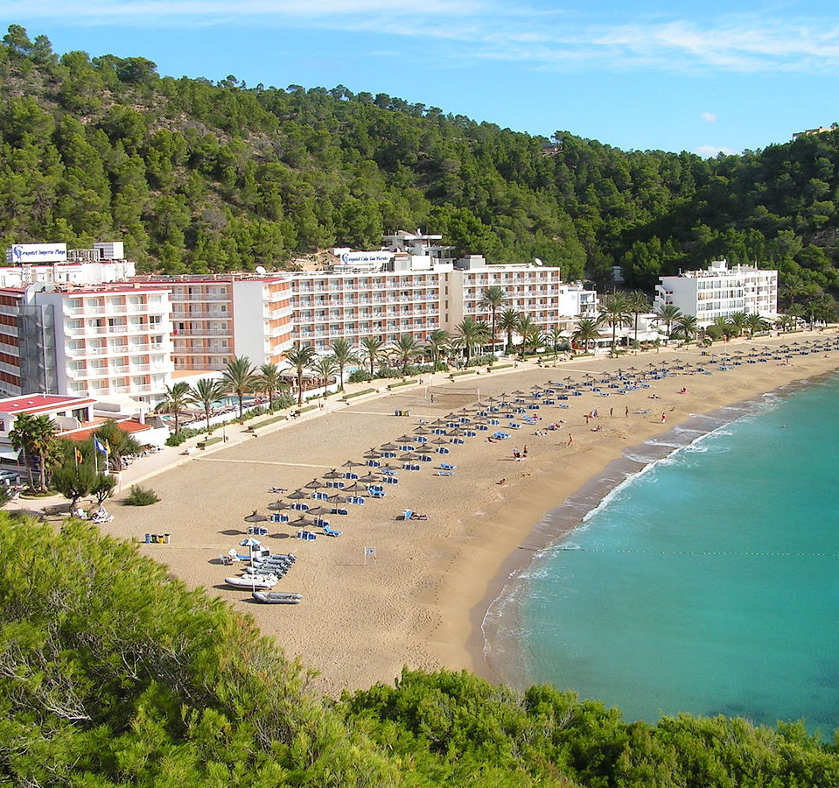
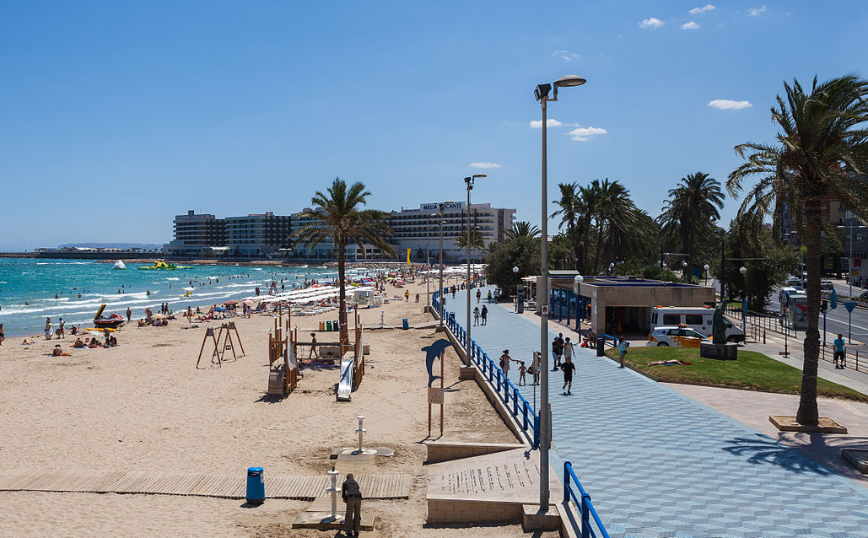
Europe
This Photo by Unknown Author is licensed under CC BY-SA
This Photo by Unknown Author is licensed under CC BY-SA
We live in the continent of Europe. Many people fly or drive to different countries in Europe for their holidays. Where have you been on holiday?

Slide 5
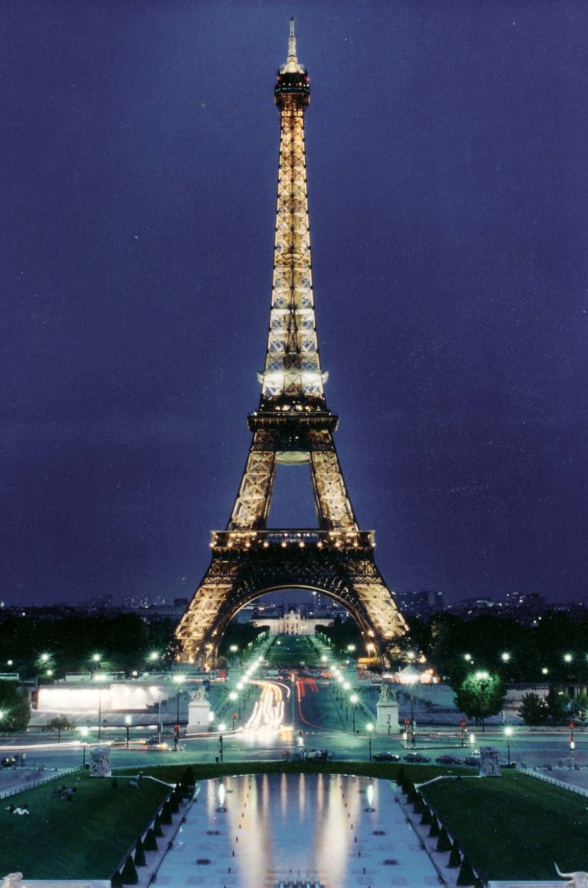
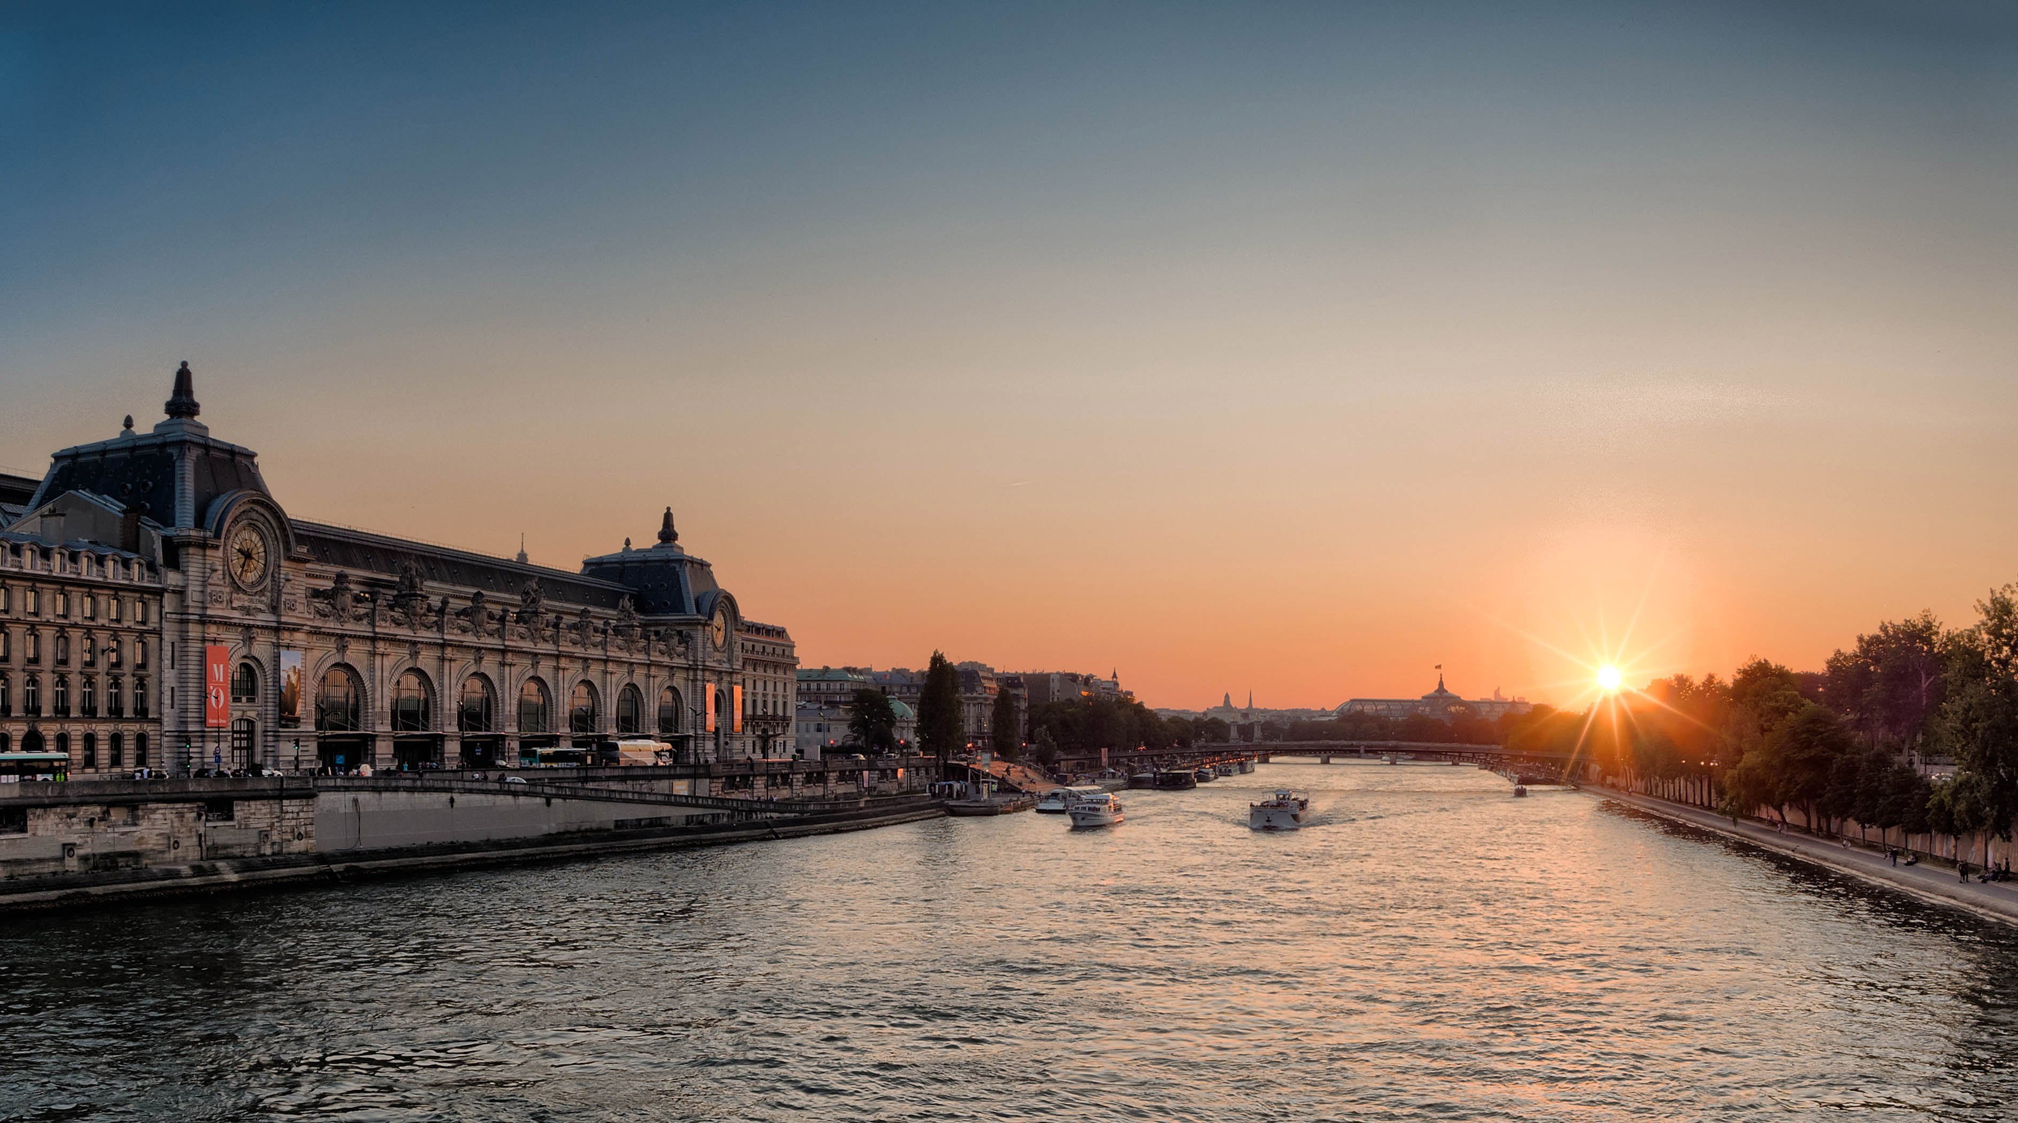
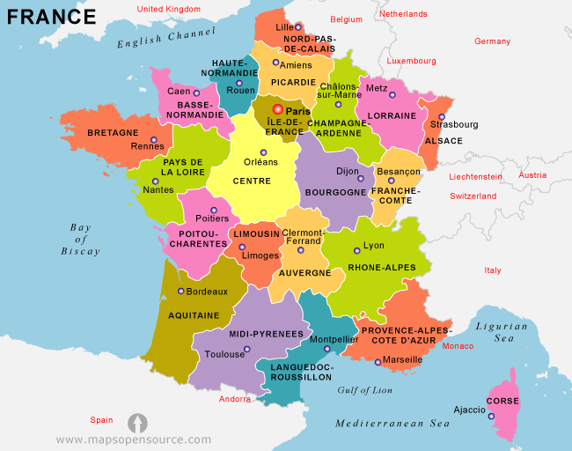
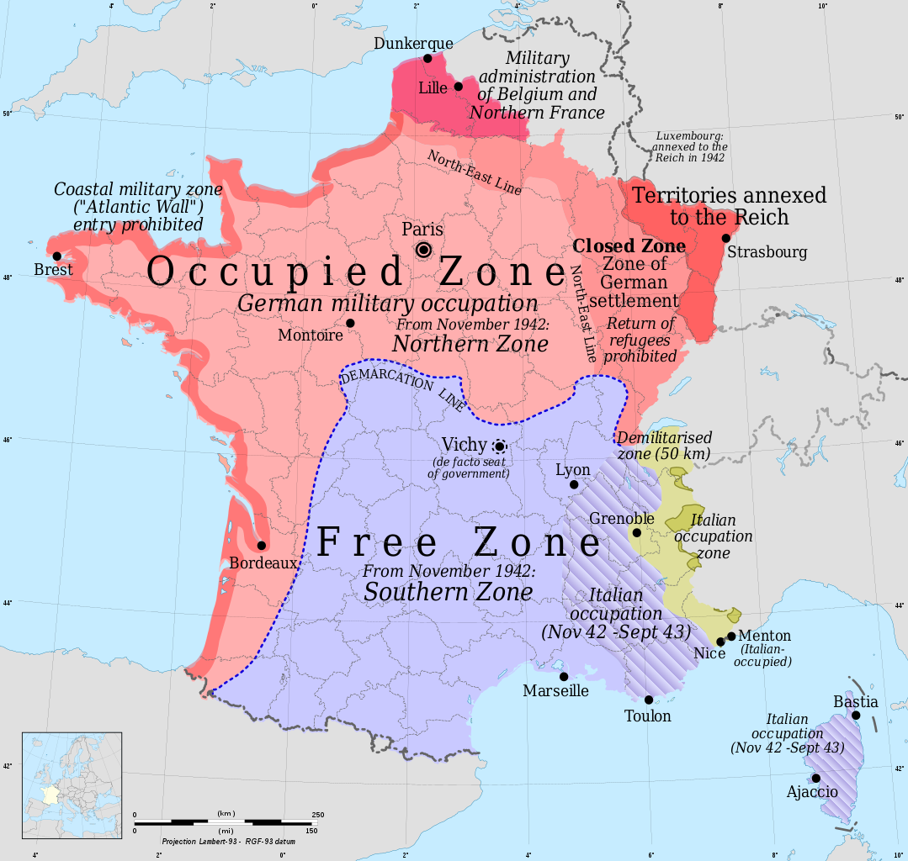
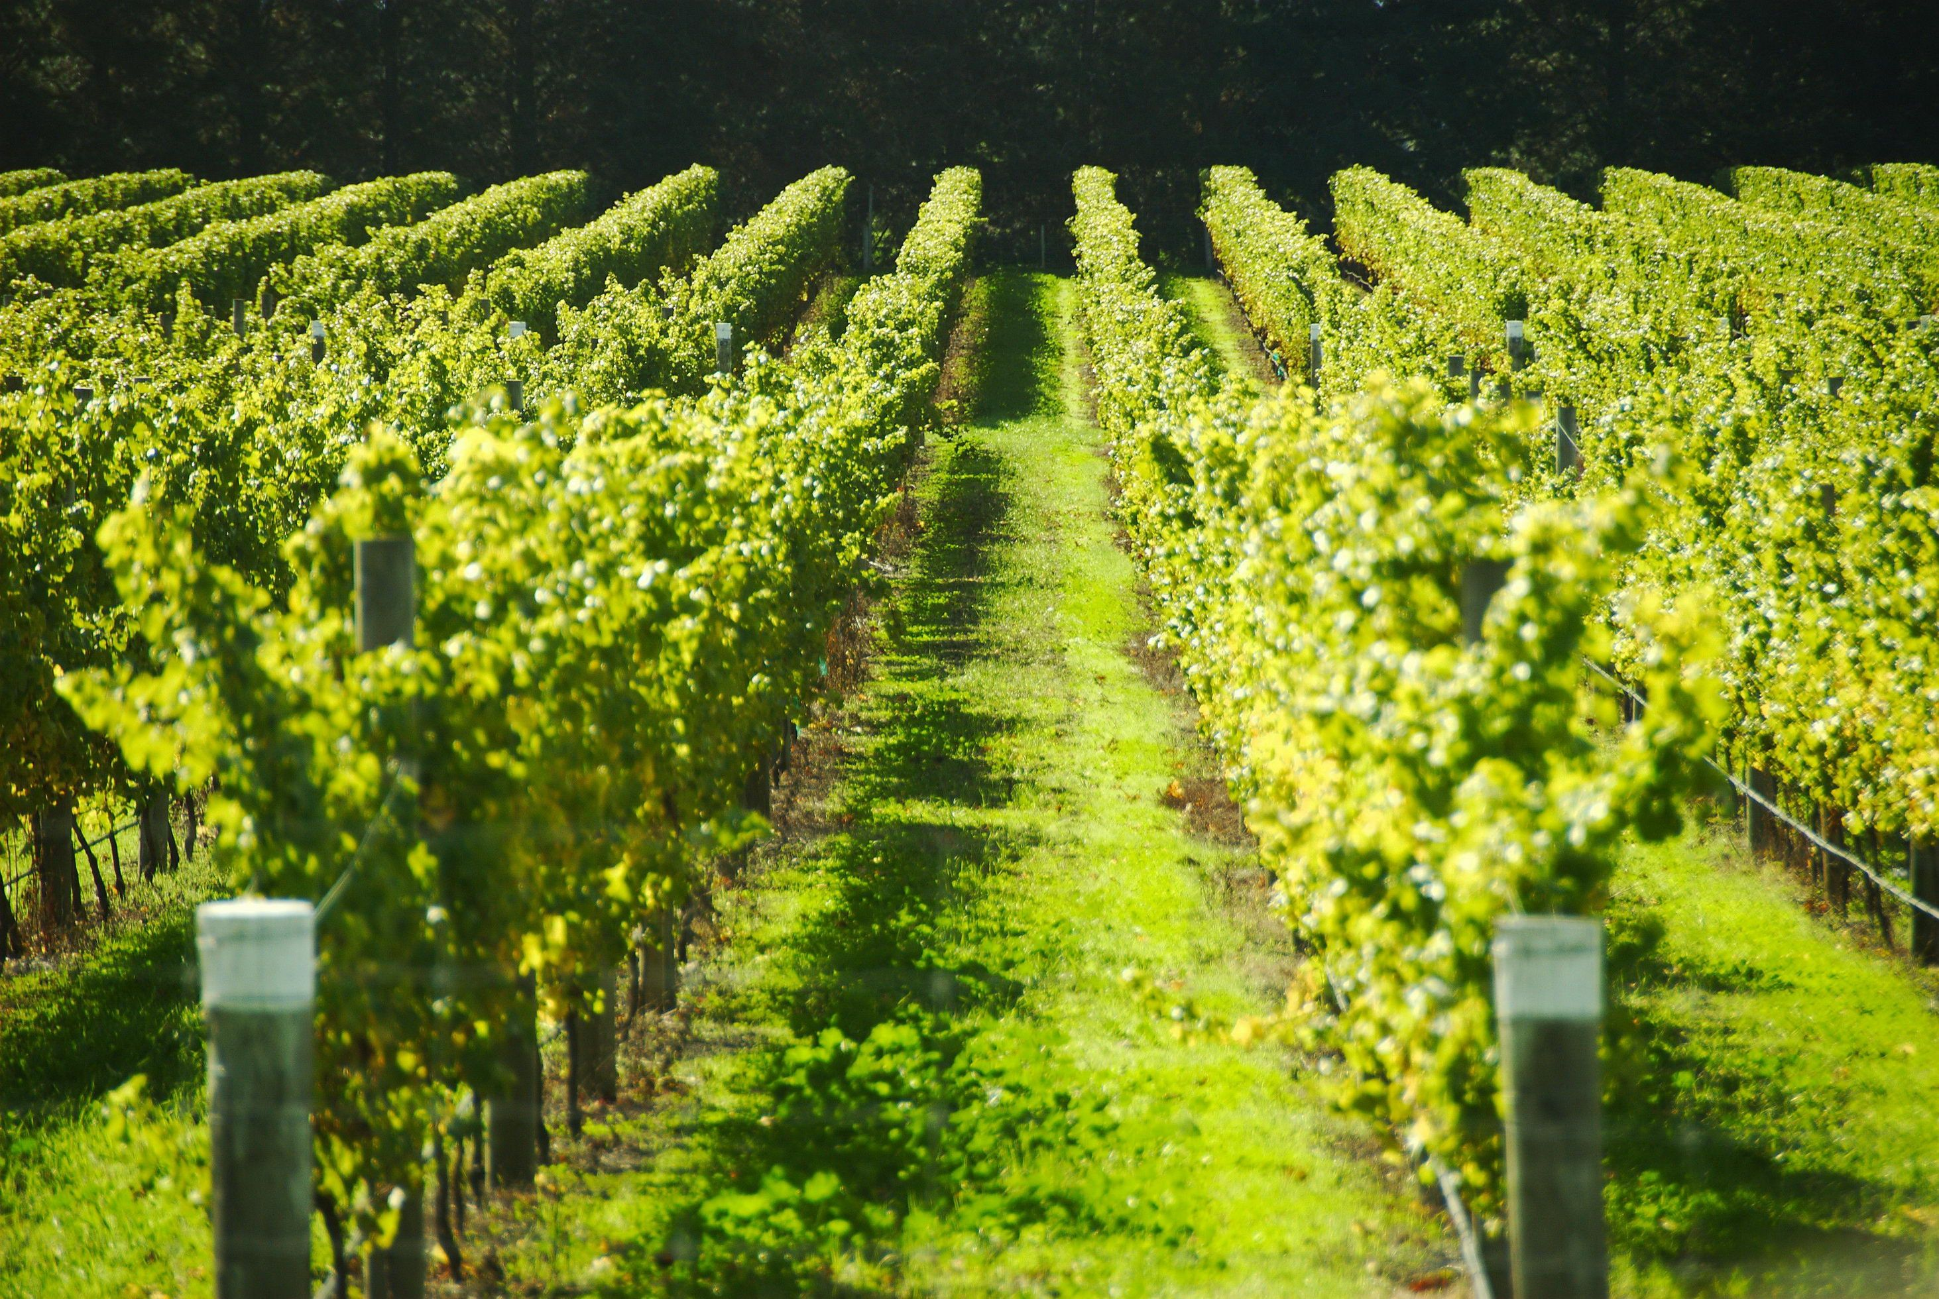

France. The capital city of France is Paris.
This Photo by Unknown Author is licensed under CC BY-SA
This Photo by Unknown Author is licensed under CC BY-SA
This Photo by Unknown Author is licensed under CC BY-SA

Slide 6
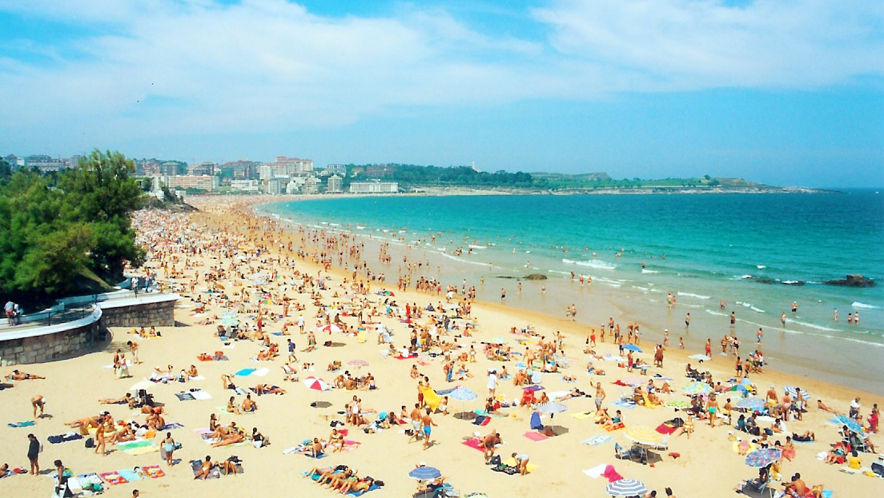

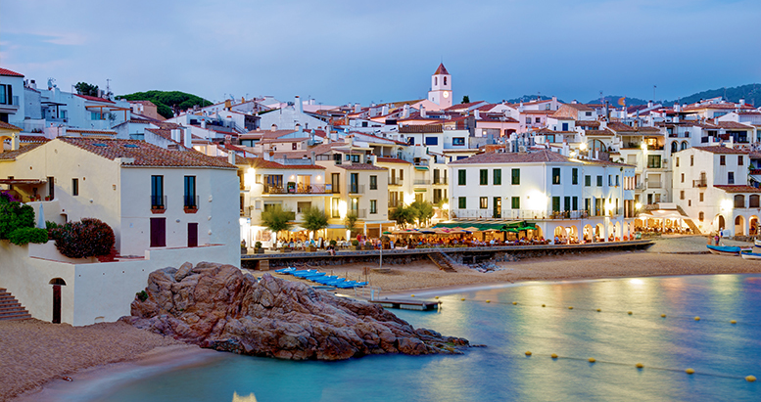
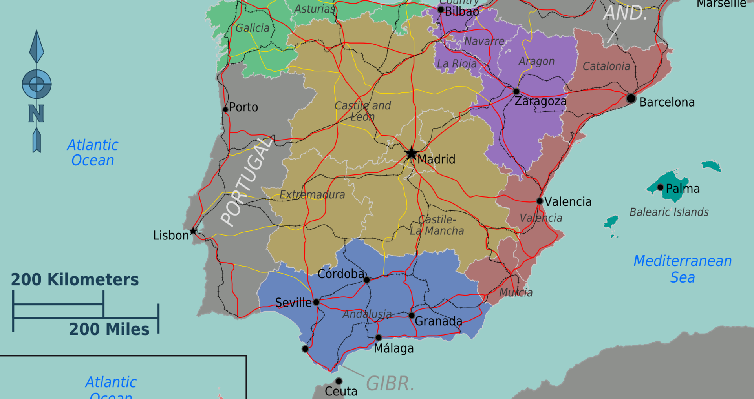
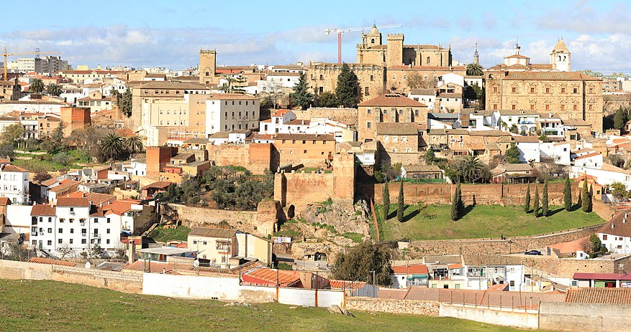
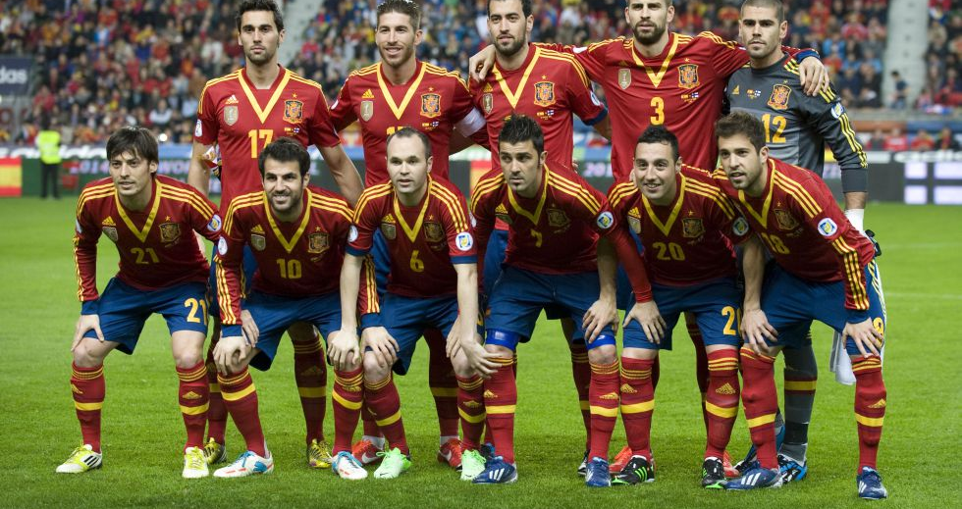
Spain.
Spain. The capital city of Spain is Madrid.
This Photo by Unknown Author is licensed under CC BY-SA
This Photo by Unknown Author is licensed under CC BY-NC-ND
This Photo by Unknown Author is licensed under CC BY-SA
This Photo by Unknown Author is licensed under CC BY-SA
This Photo by Unknown Author is licensed under CC BY-SA
This Photo by Unknown Author is licensed under CC BY-SA-NC

Slide 7
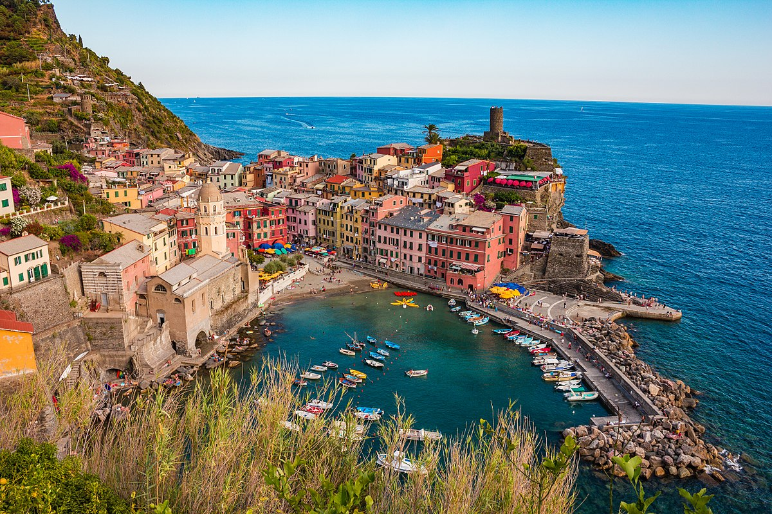
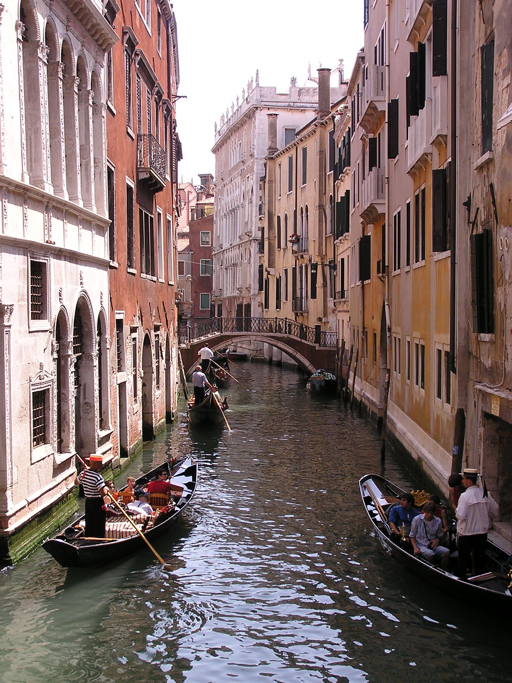
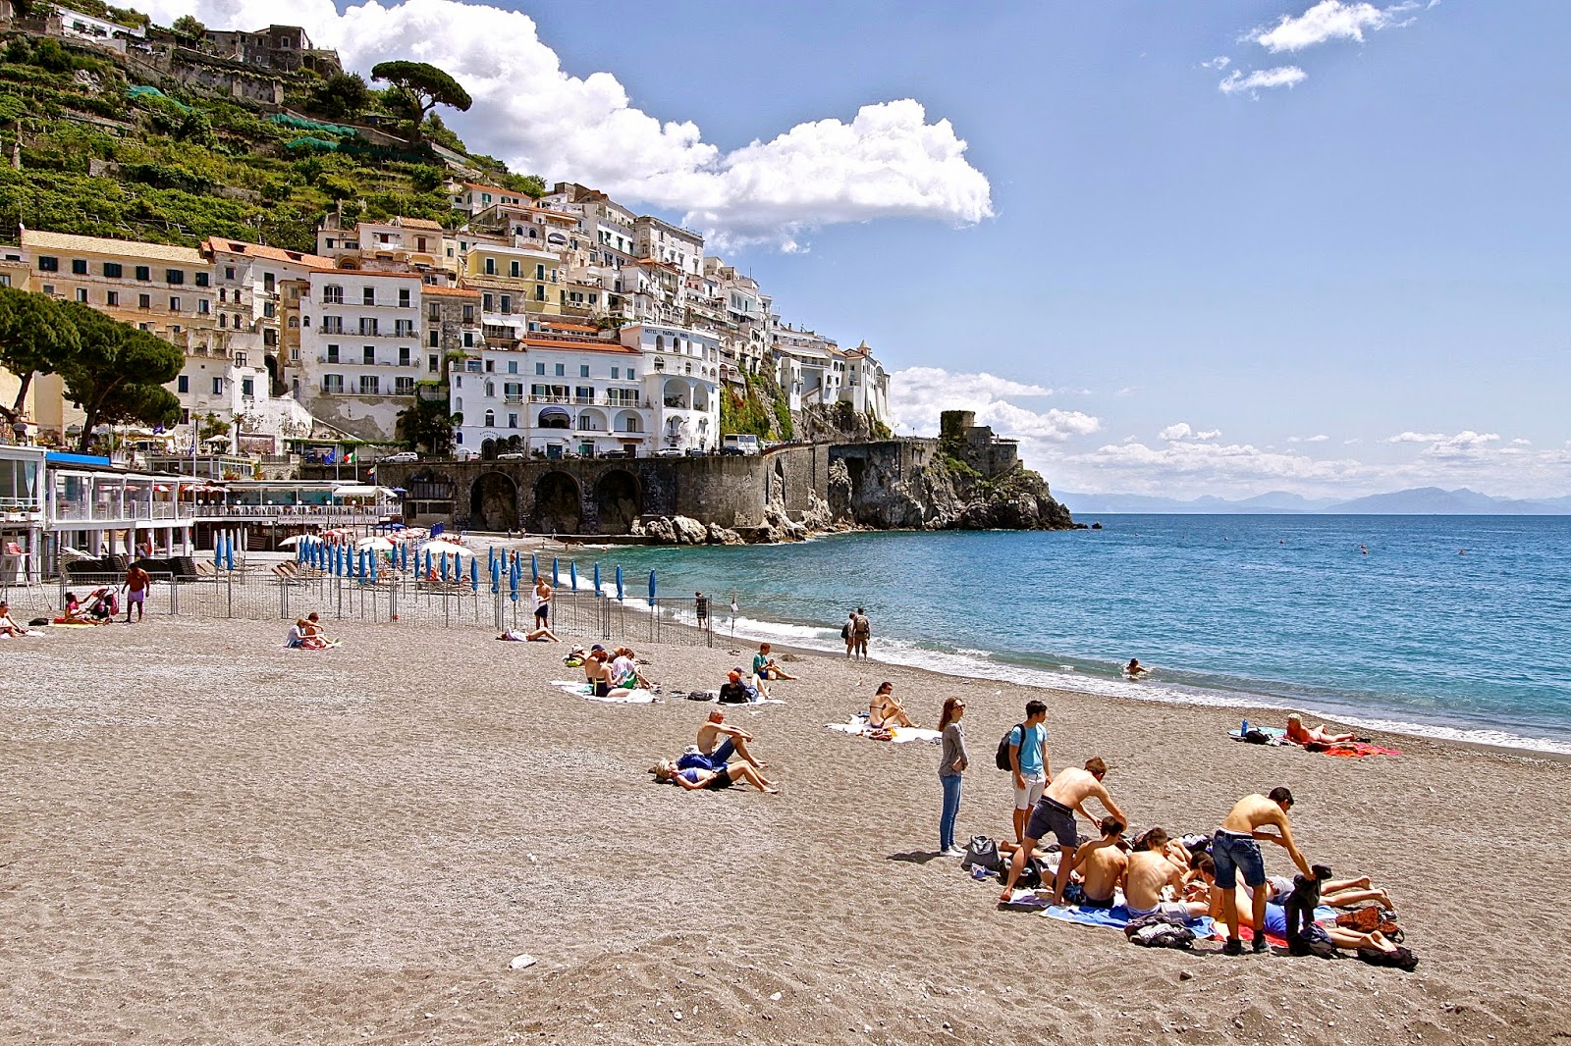
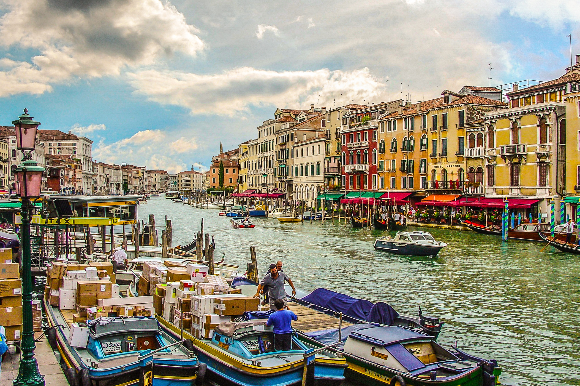

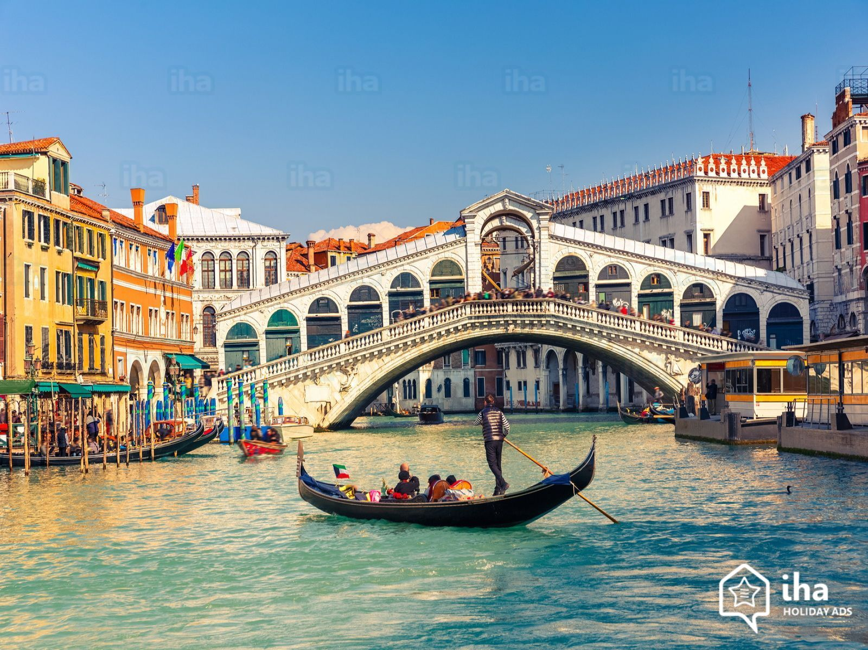
Italy. The capital of Italy is Rome.
This Photo by Unknown Author is licensed under CC BY-SA
This Photo by Unknown Author is licensed under CC BY-NC-ND
This Photo by Unknown Author is licensed under CC BY-SA
This Photo by Unknown Author is licensed under CC BY-SA
This Photo by Unknown Author is licensed under CC BY-SA-NC

Slide 8
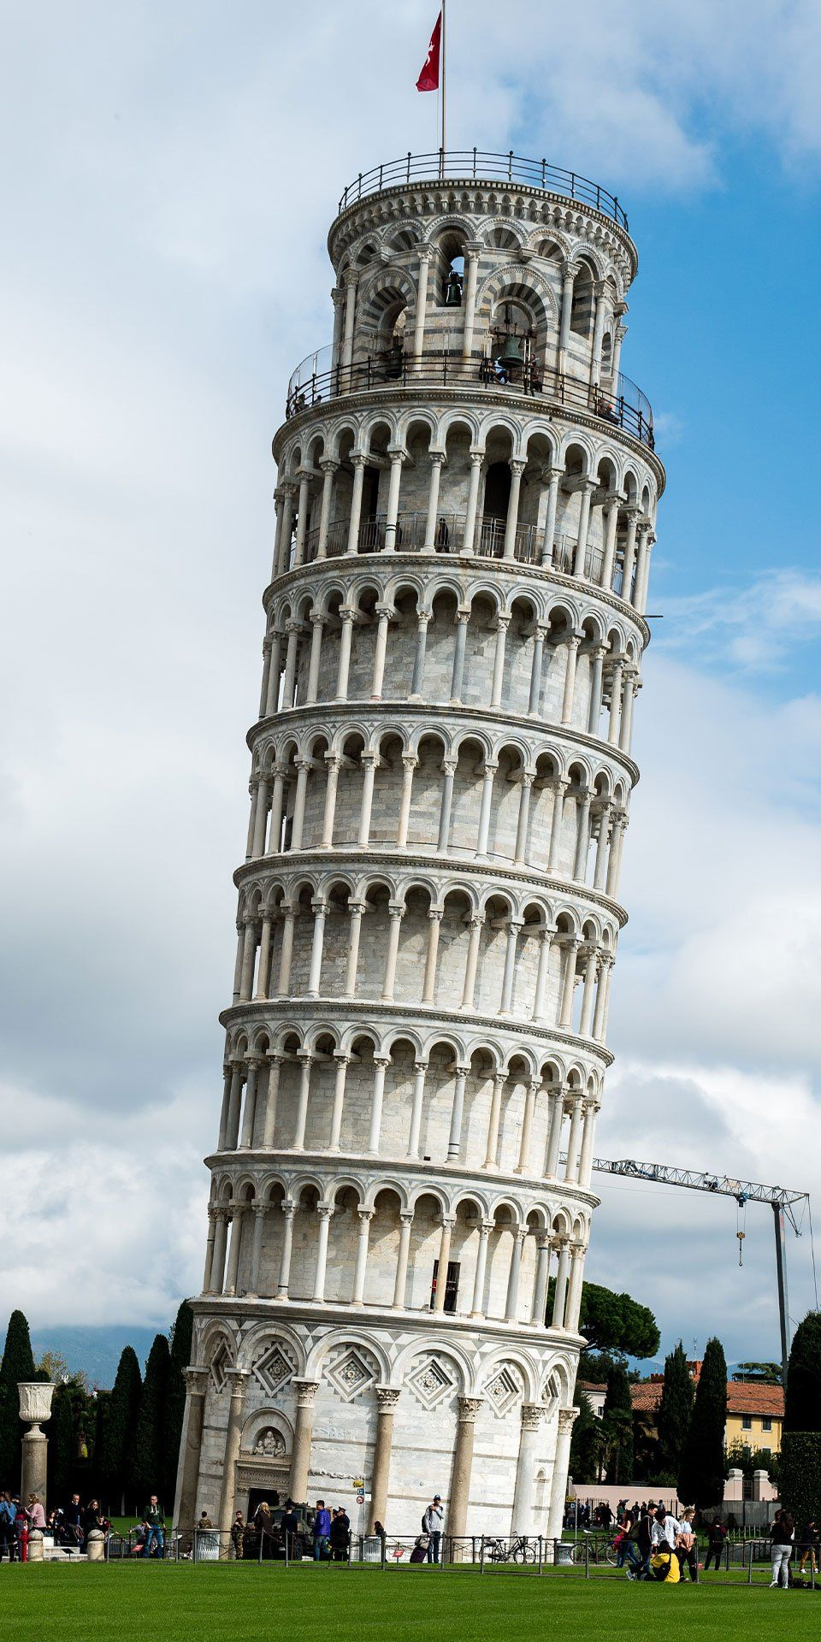
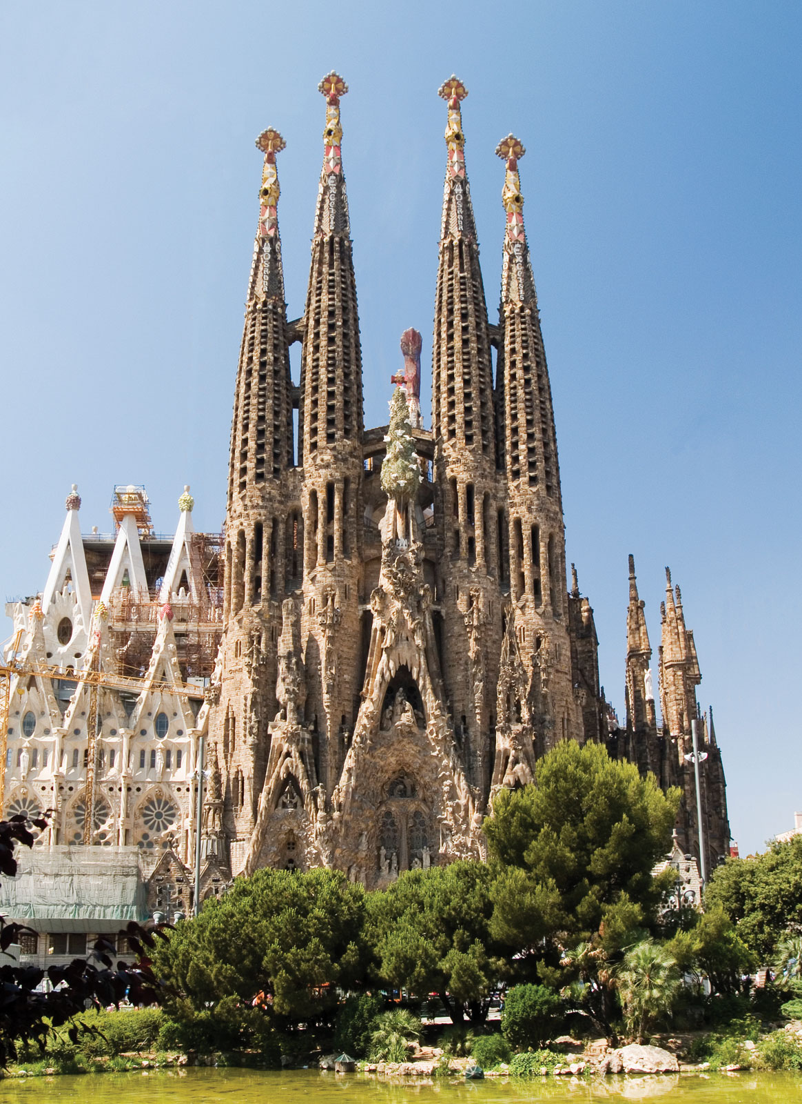
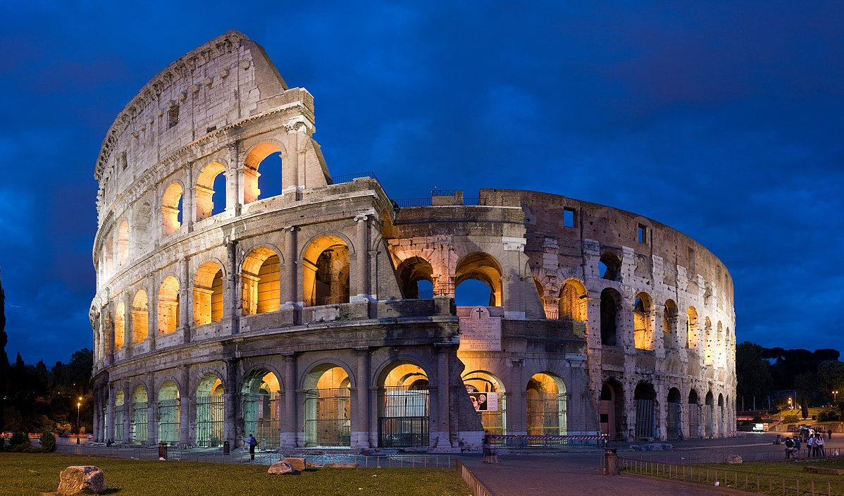
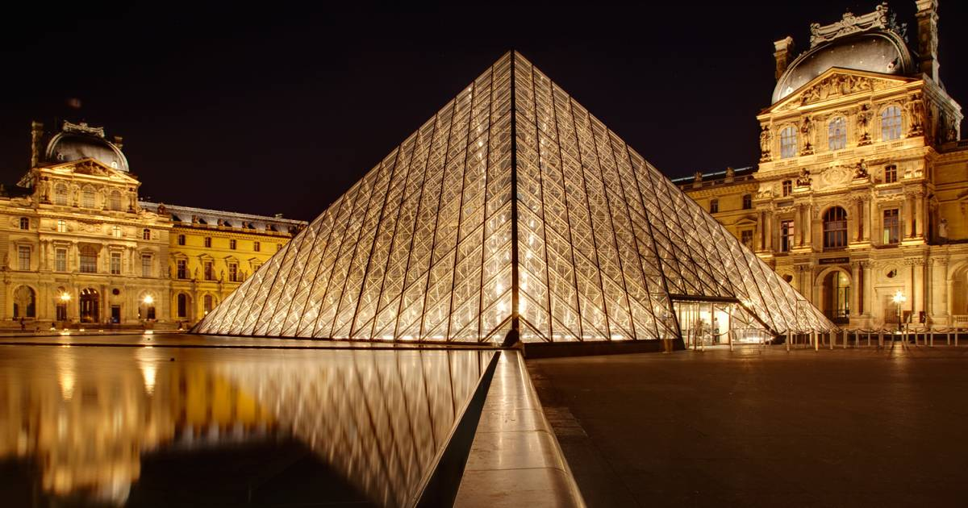
Where have you been? Where would you like to go?

Slide 9
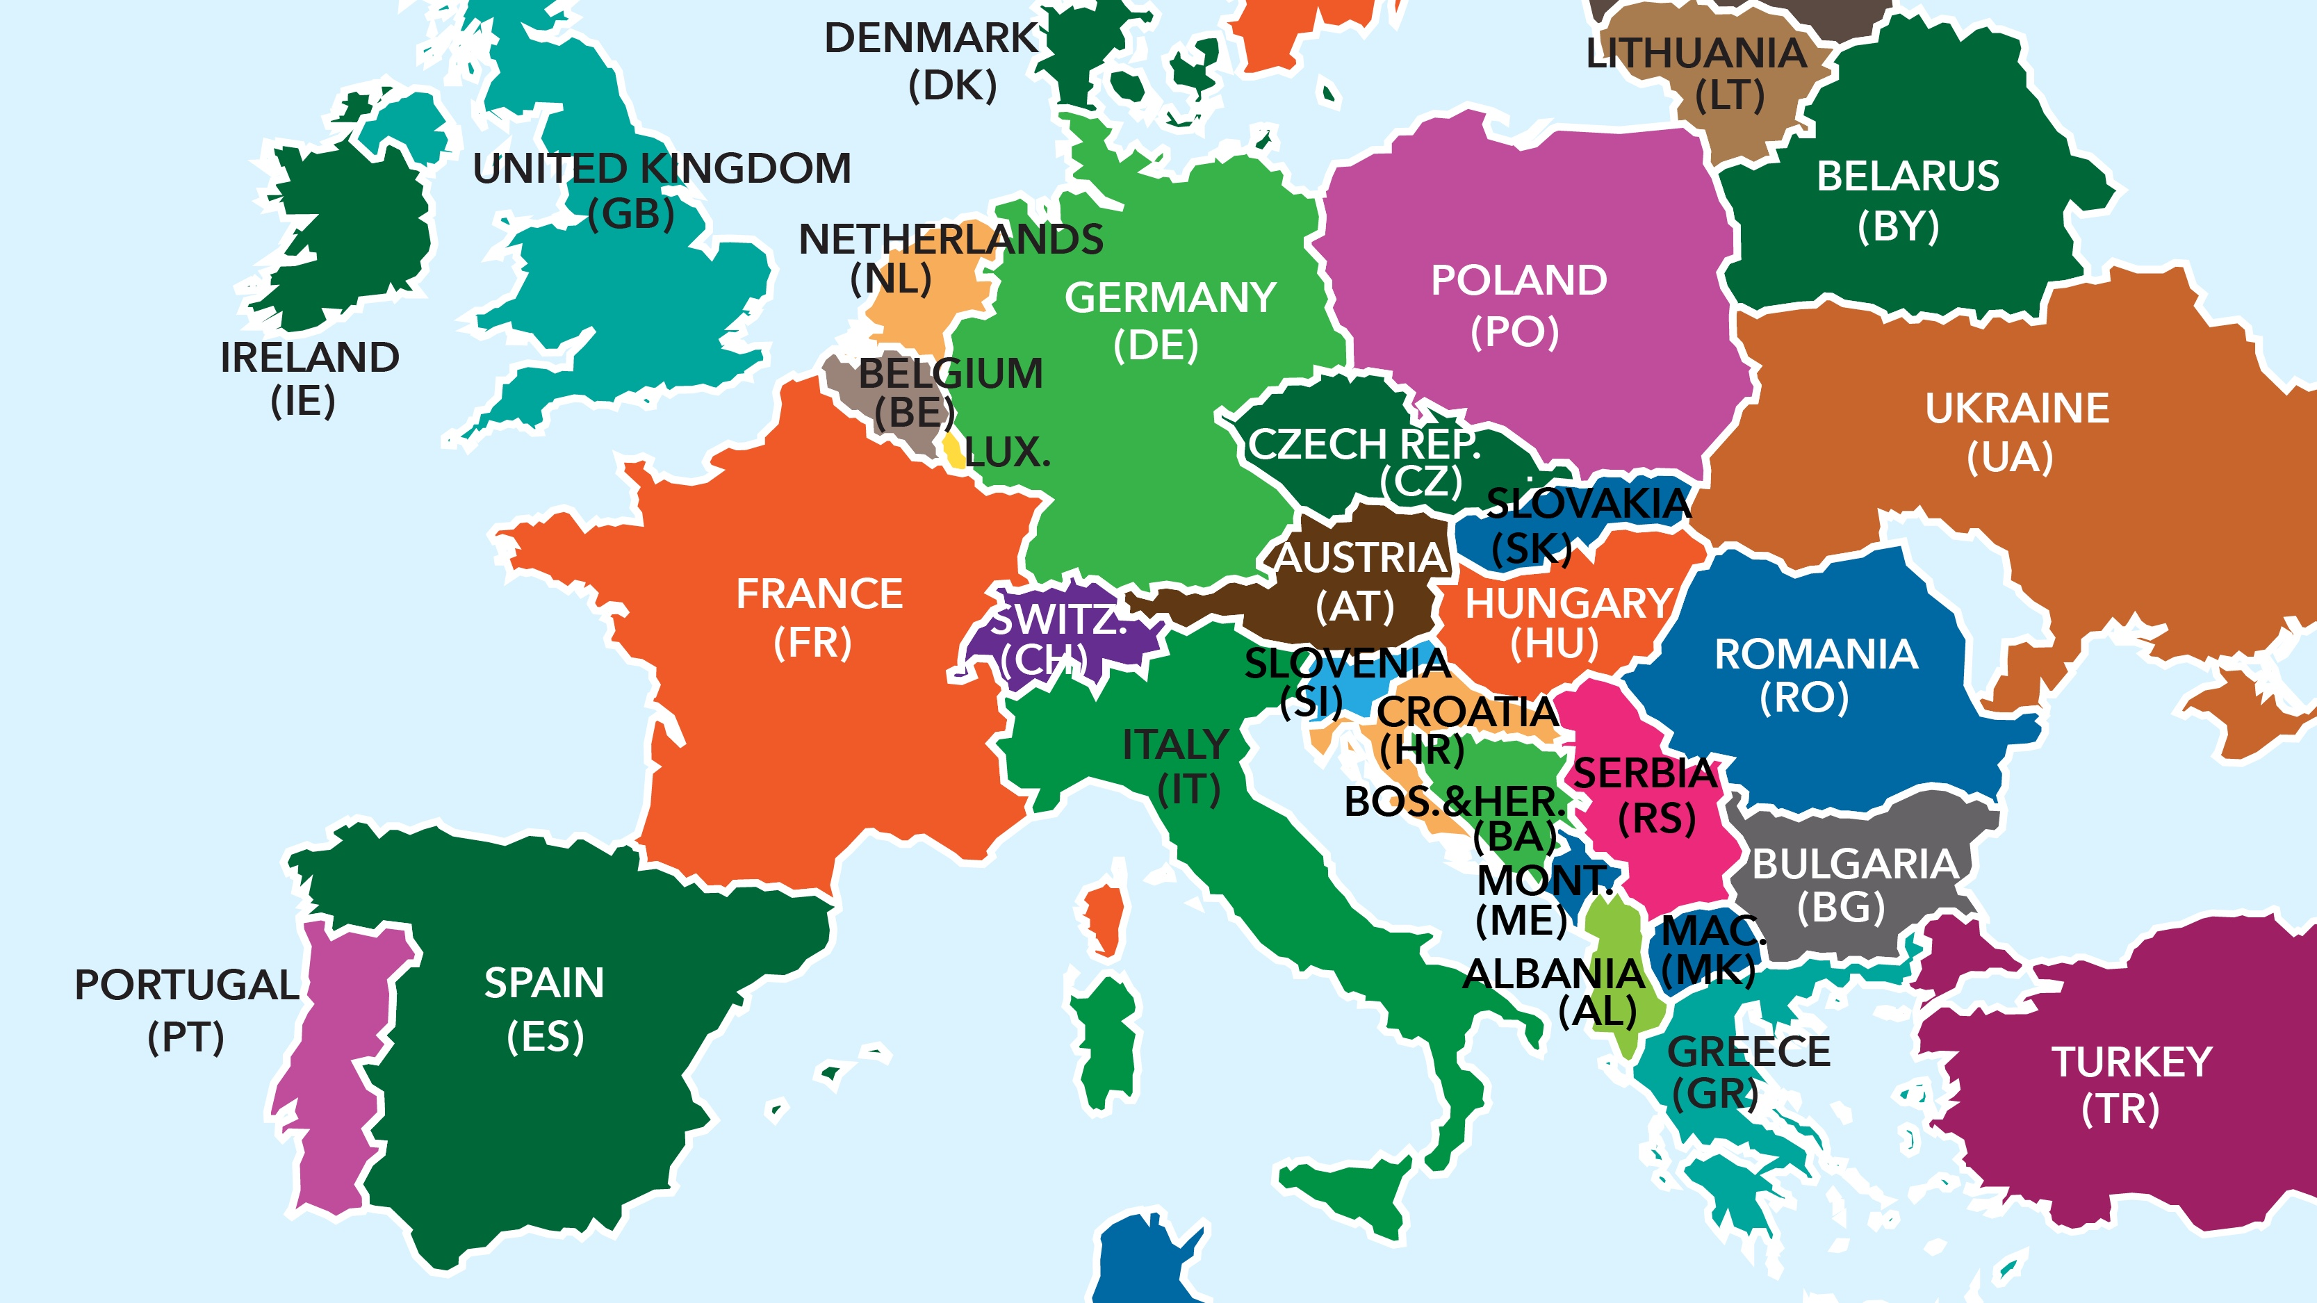
What have we learnt now?
This is me!
I am part of a family
I go to school in Chalfont St Peter
I live in the continent of Europe
I live in England and the capital is London

