Slide 1
Landmarks in Europe

Slide 2
What is a landmark?
An important building or monument

Slide 3

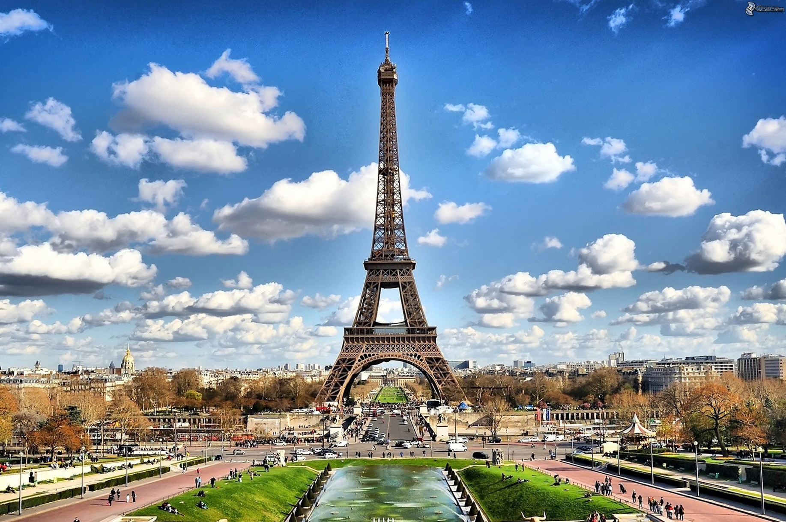
Eiffel Tower

Slide 4
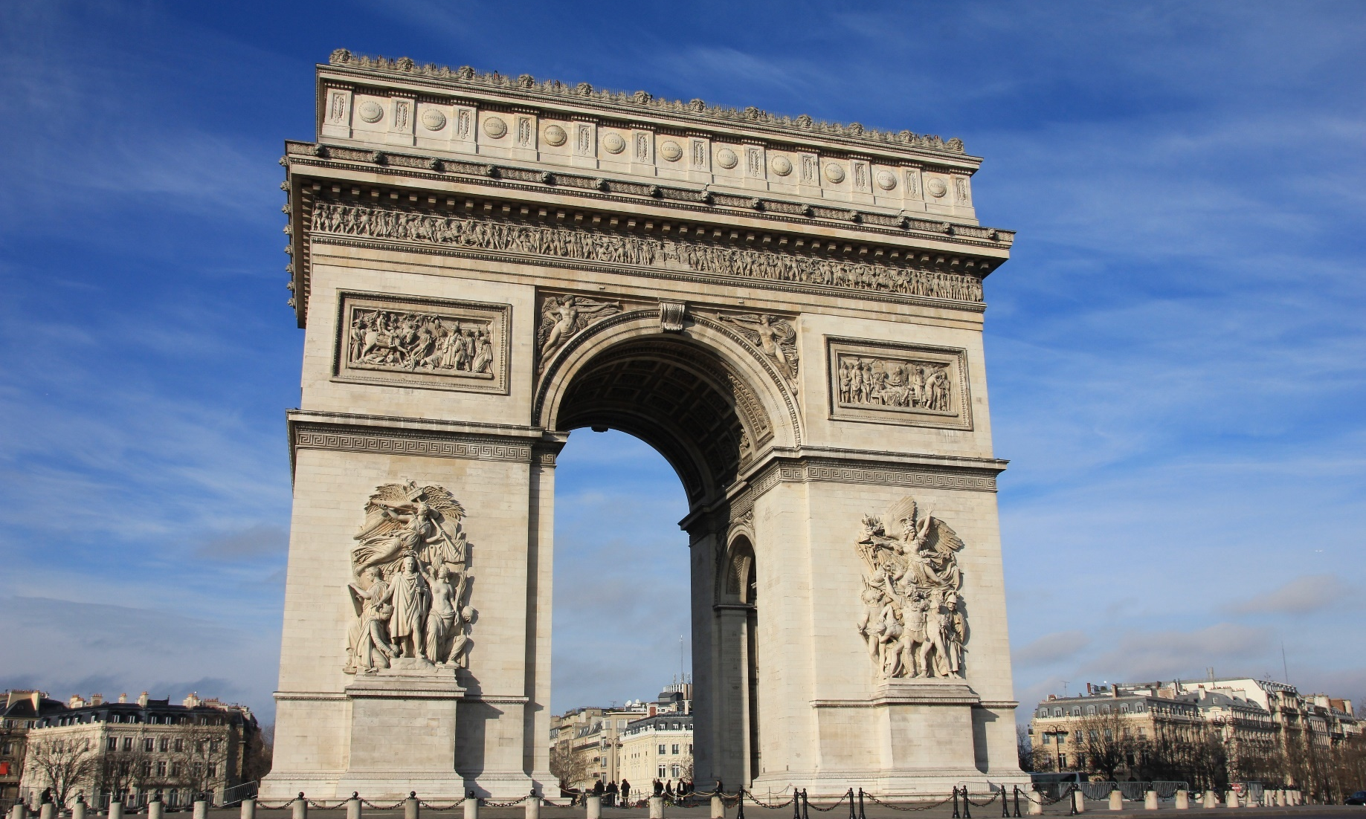
Arc de Triomphe

Slide 5

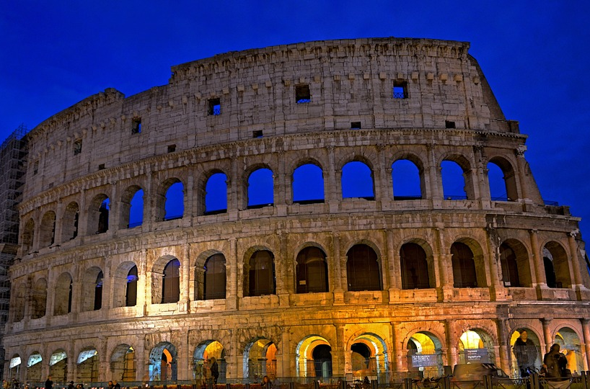
Colosseum

Slide 6
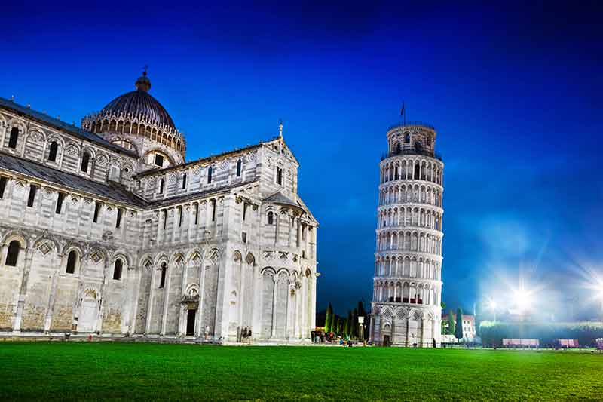
Leaning Tower

Slide 7

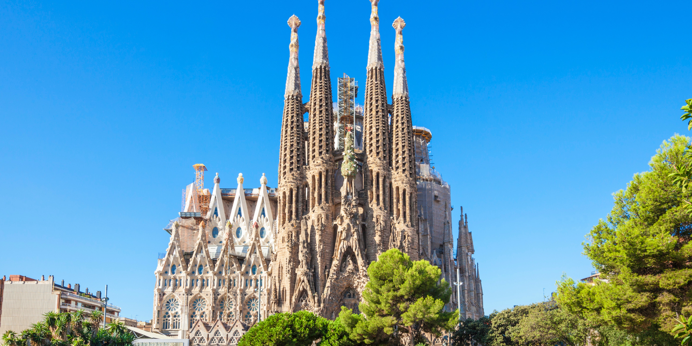
Sagrada Familia

Slide 8

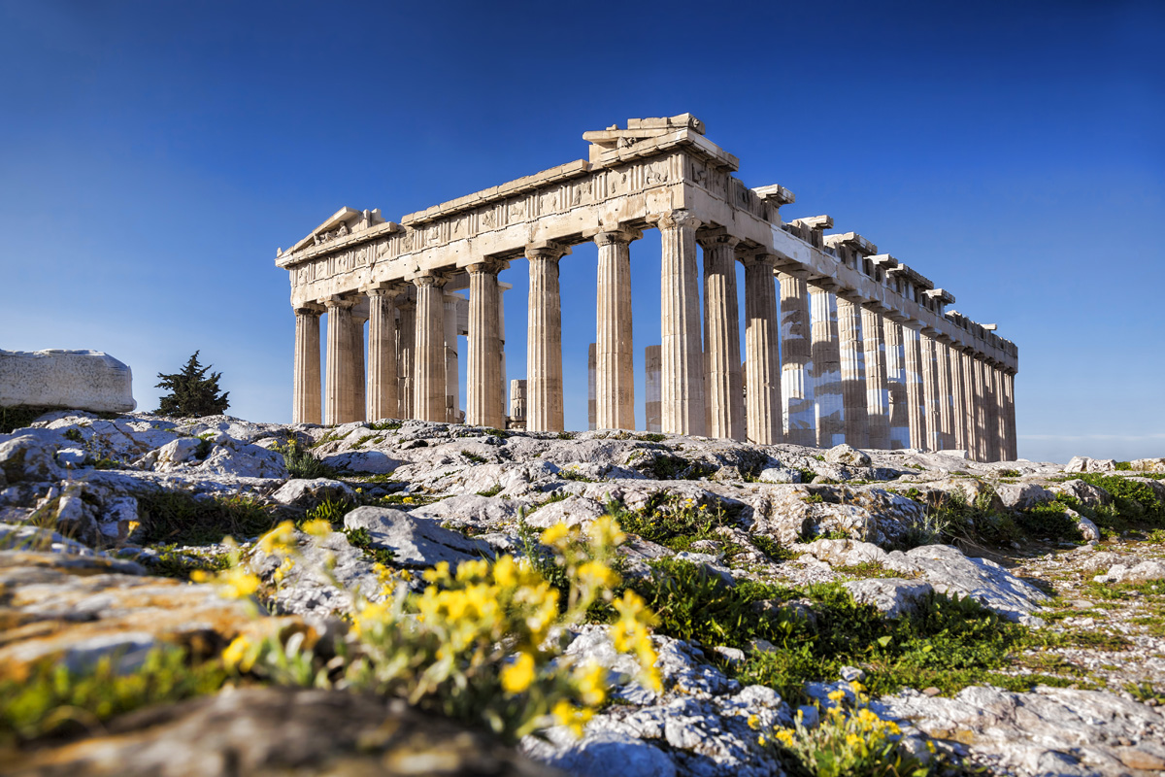
The Acropolis

Slide 9

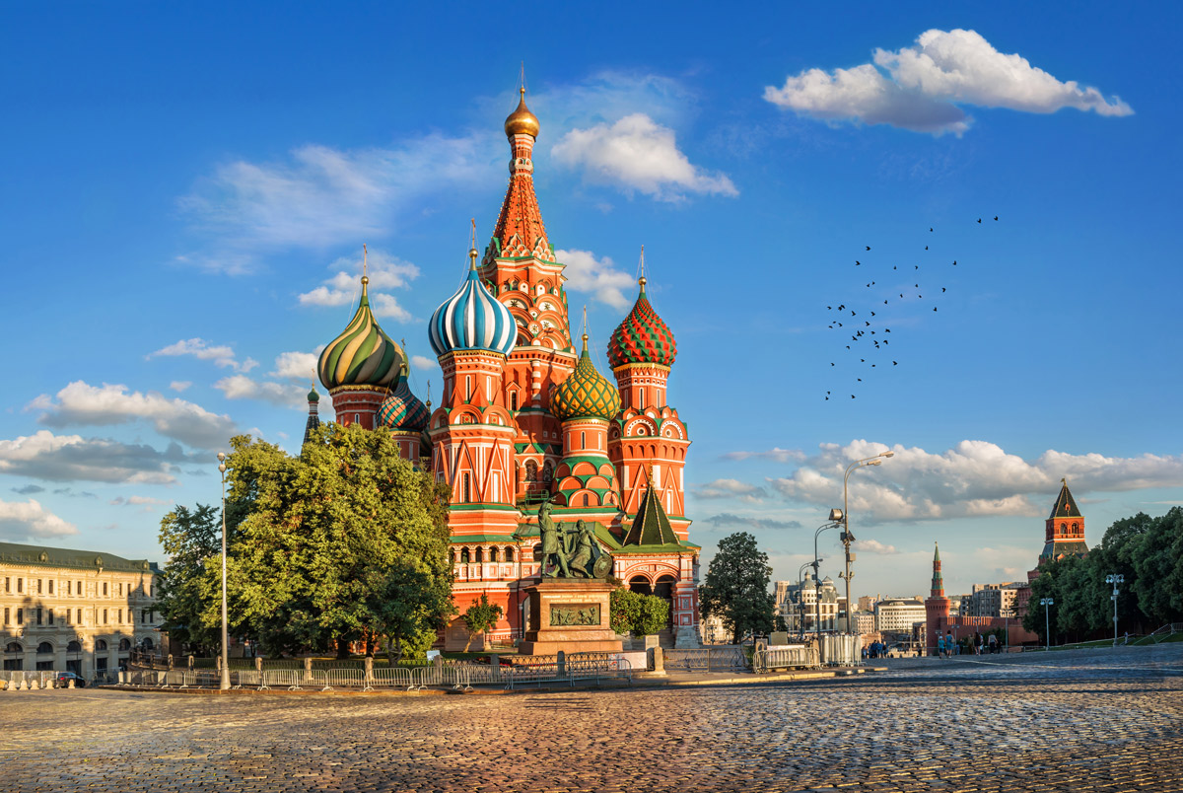
St Basil’s Cathedral

Slide 10
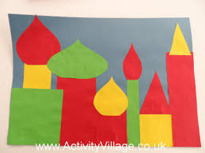
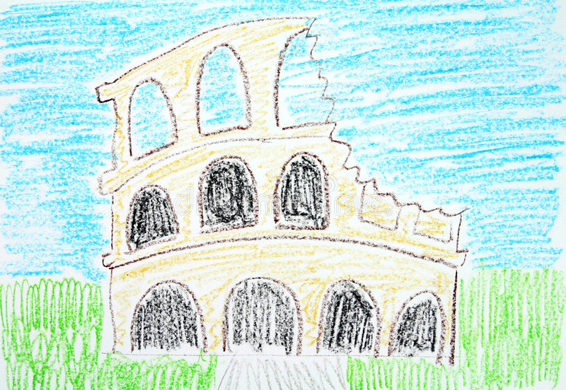
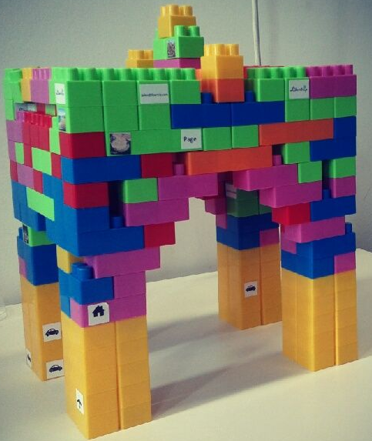
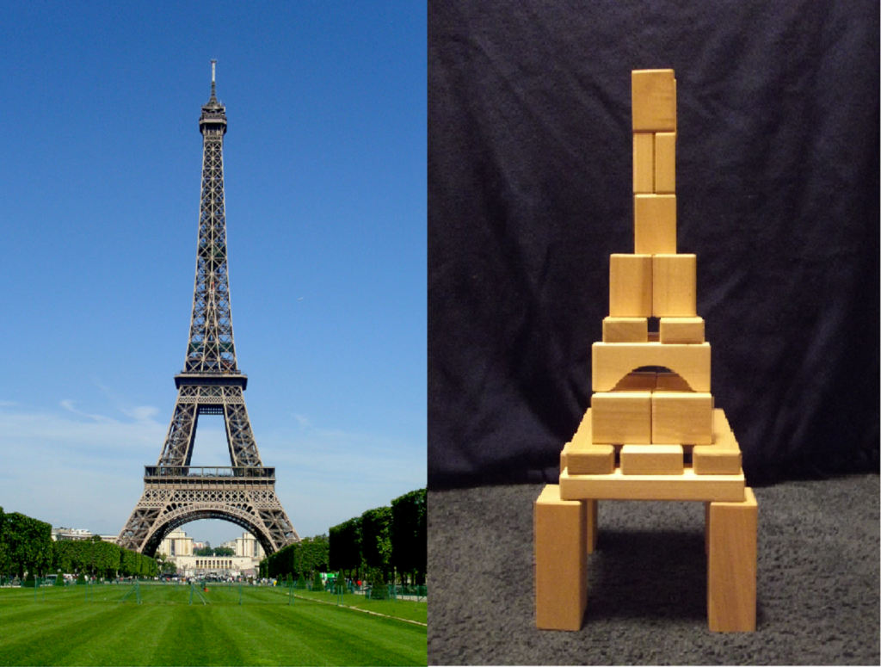
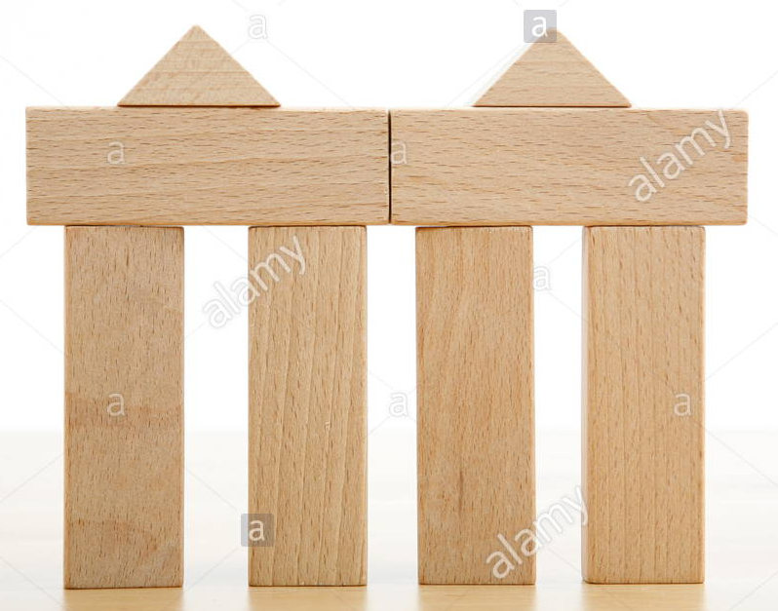
Challenge: Can you create one of these landmarks?
You could build it, paint it, draw or collage.

