Slide 1
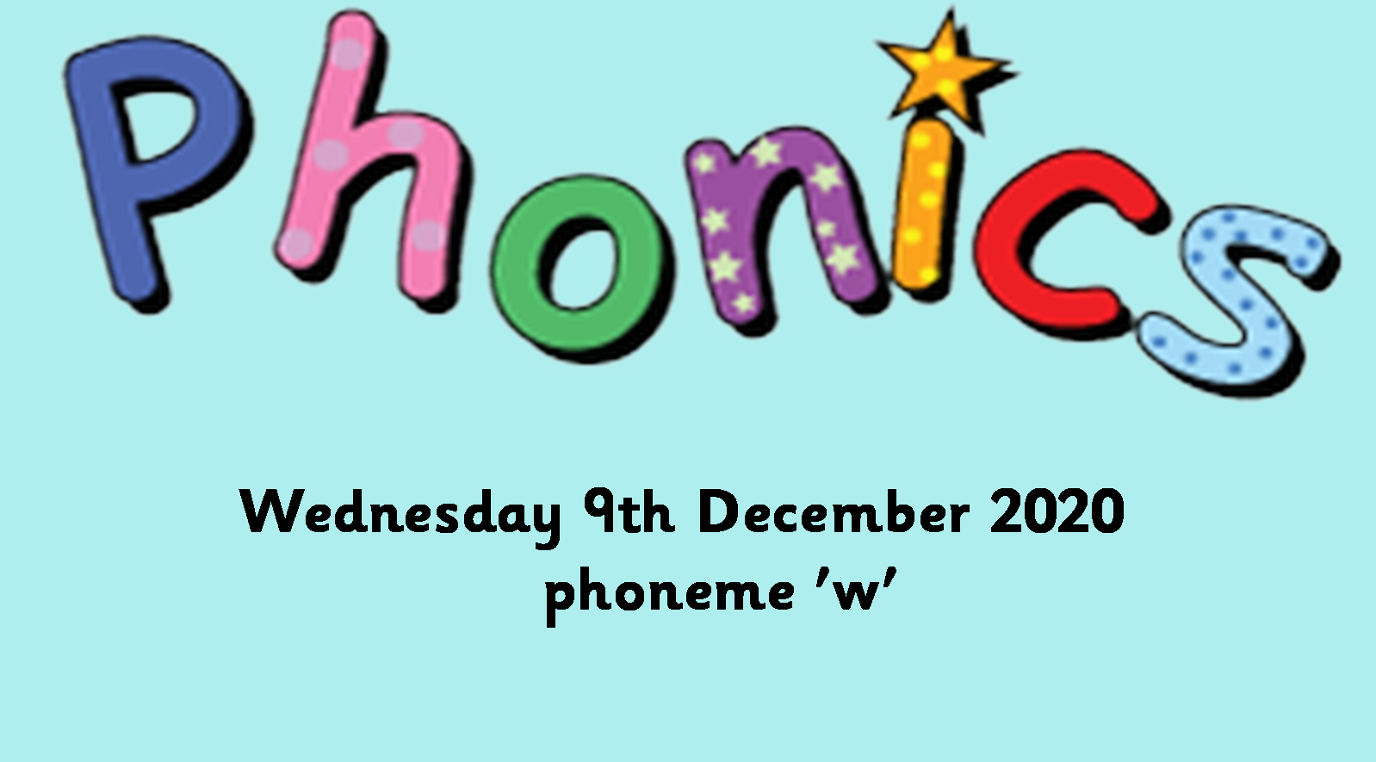


Slide 2
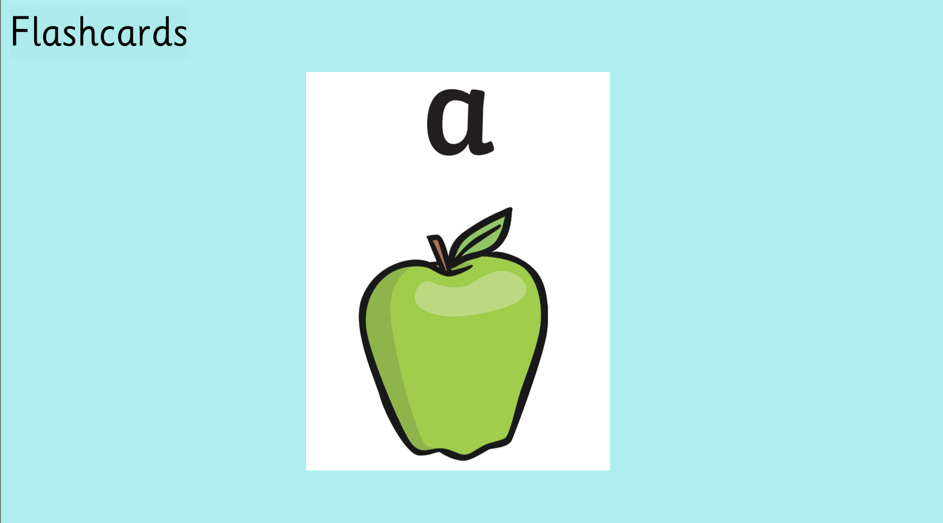

Slide 3
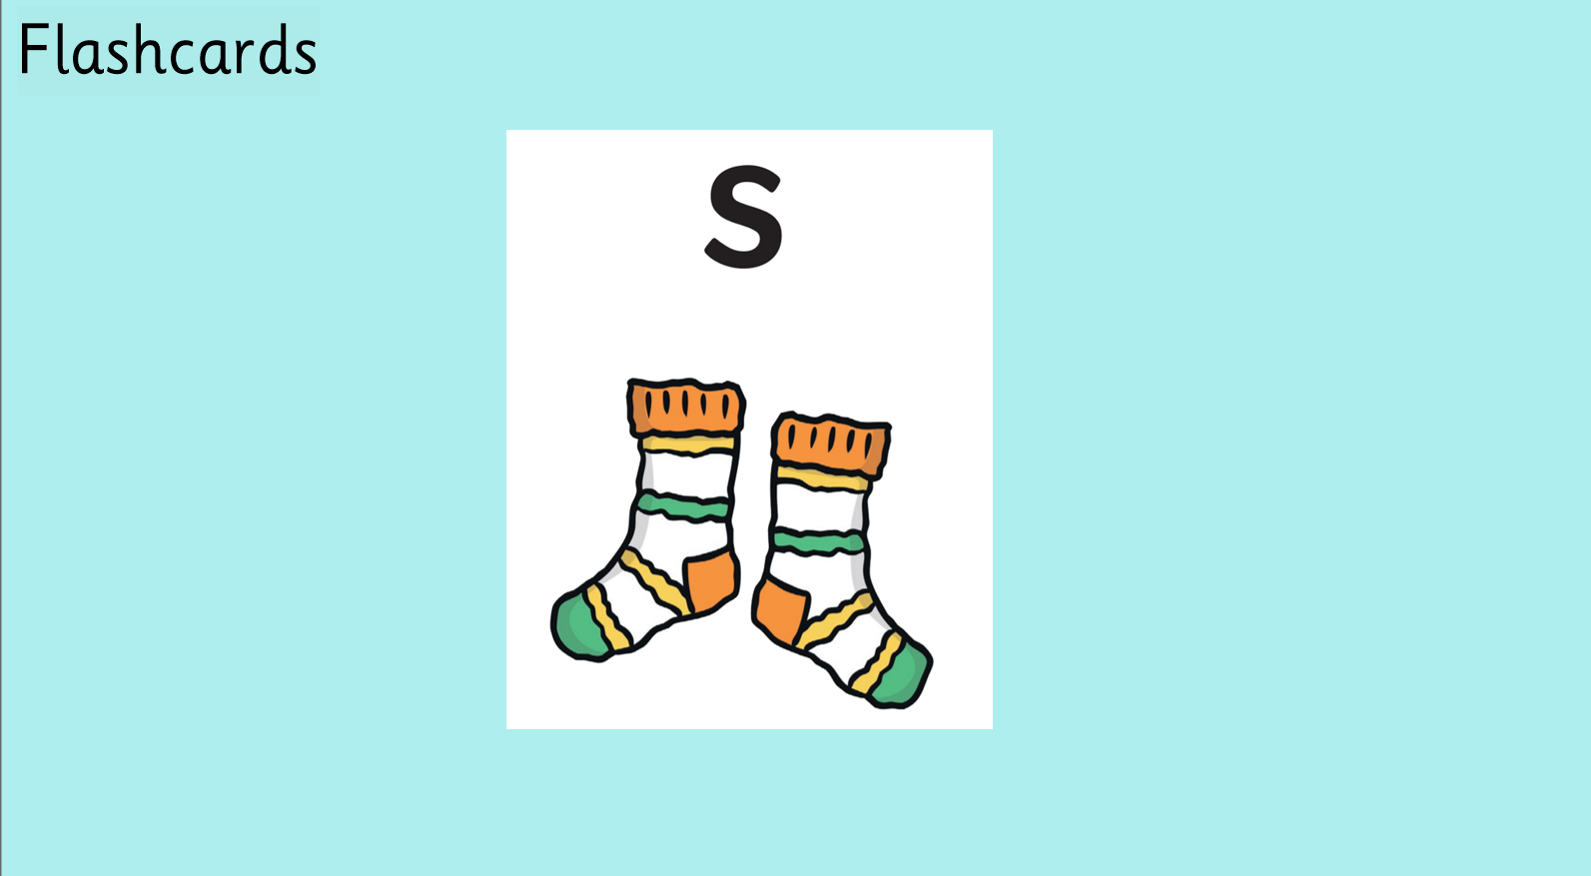

Slide 4
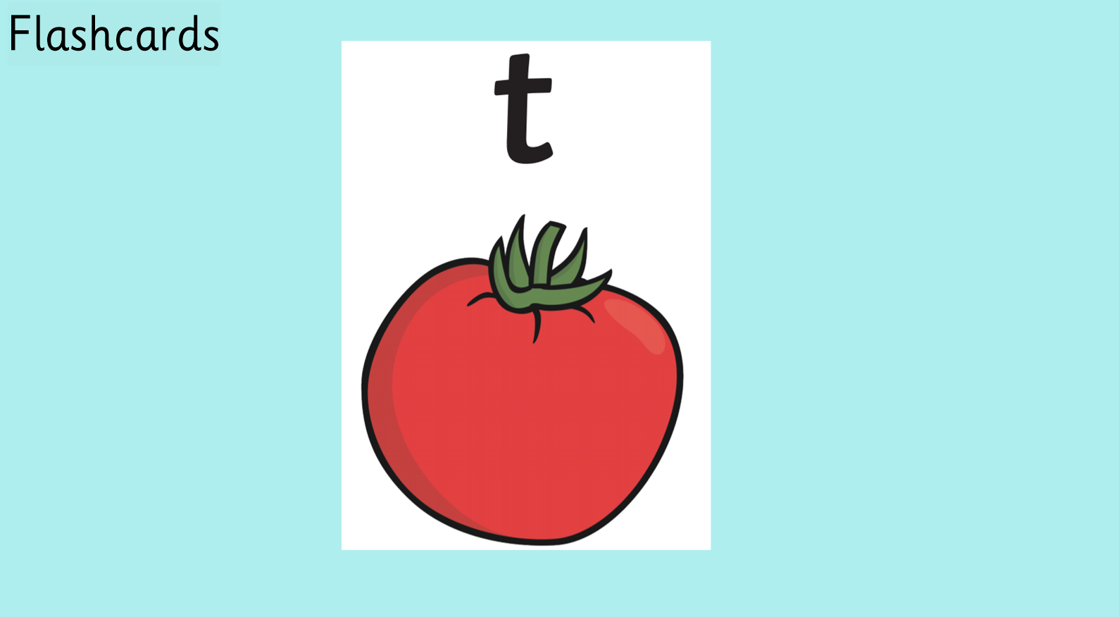

Slide 5
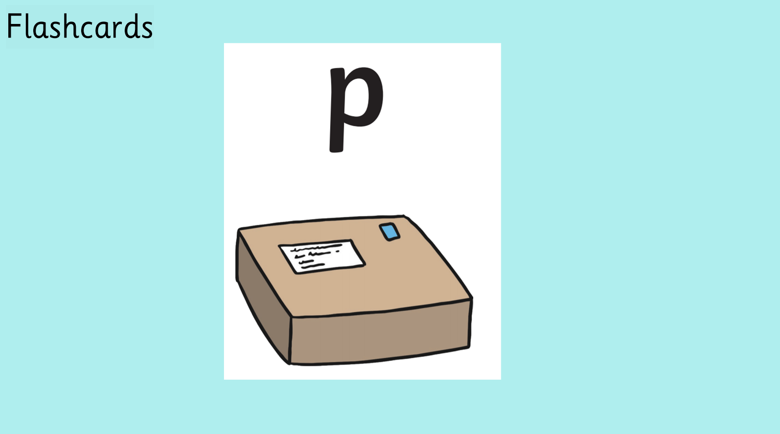

Slide 6
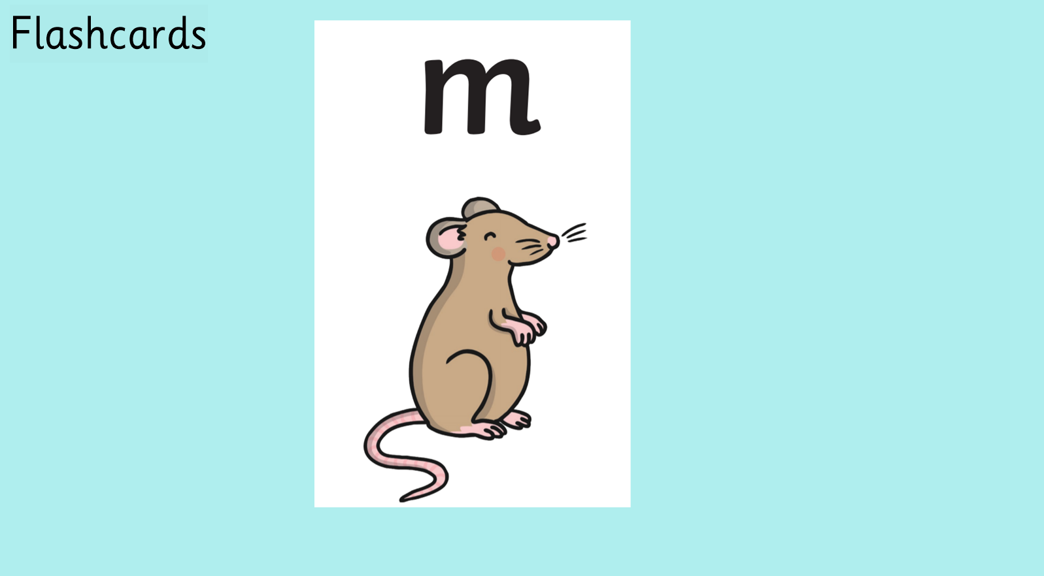

Slide 7
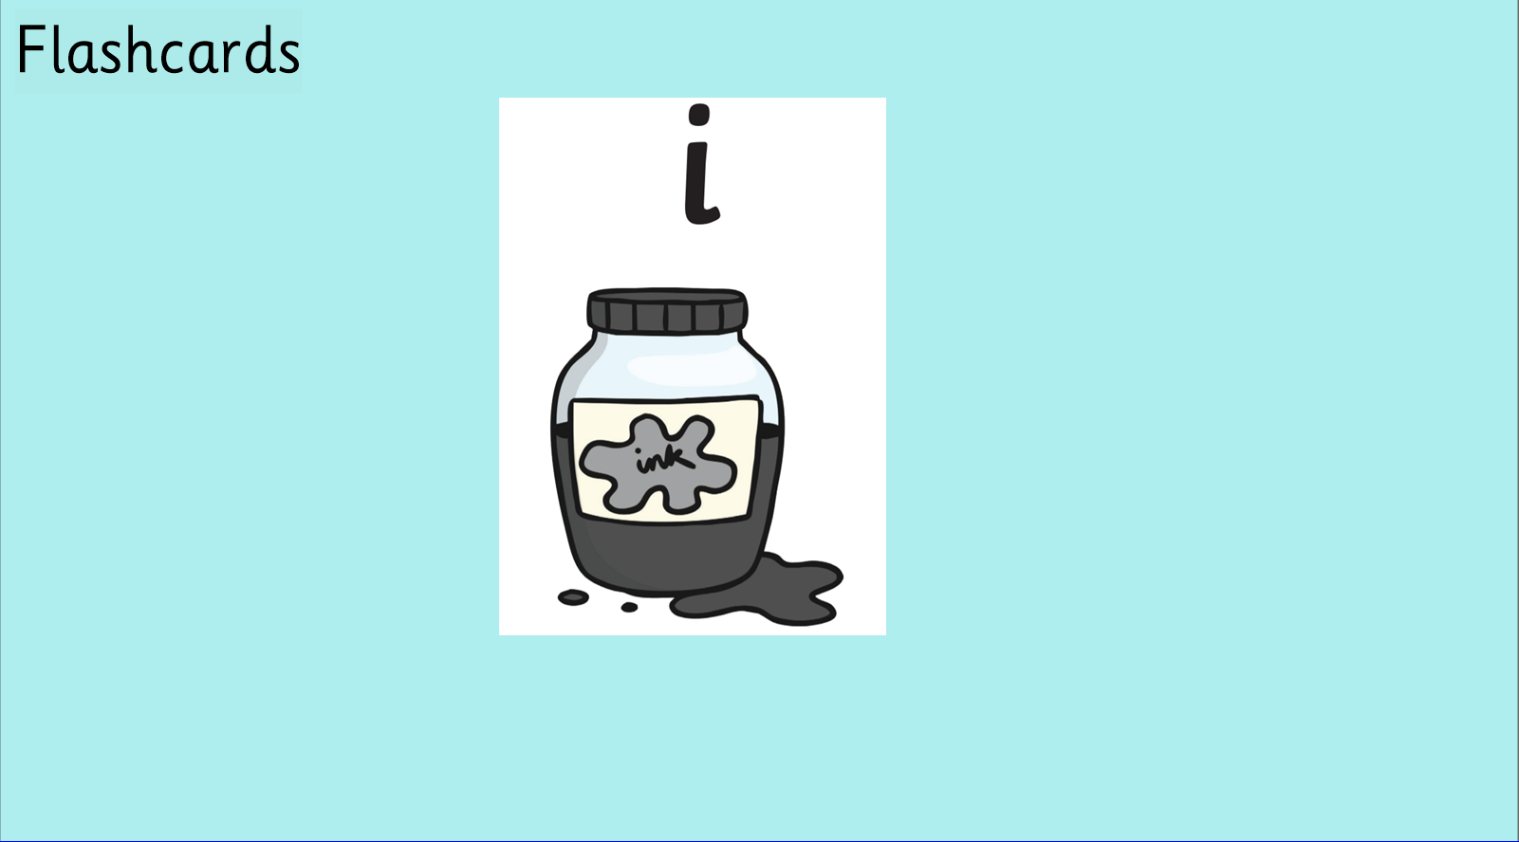

Slide 8
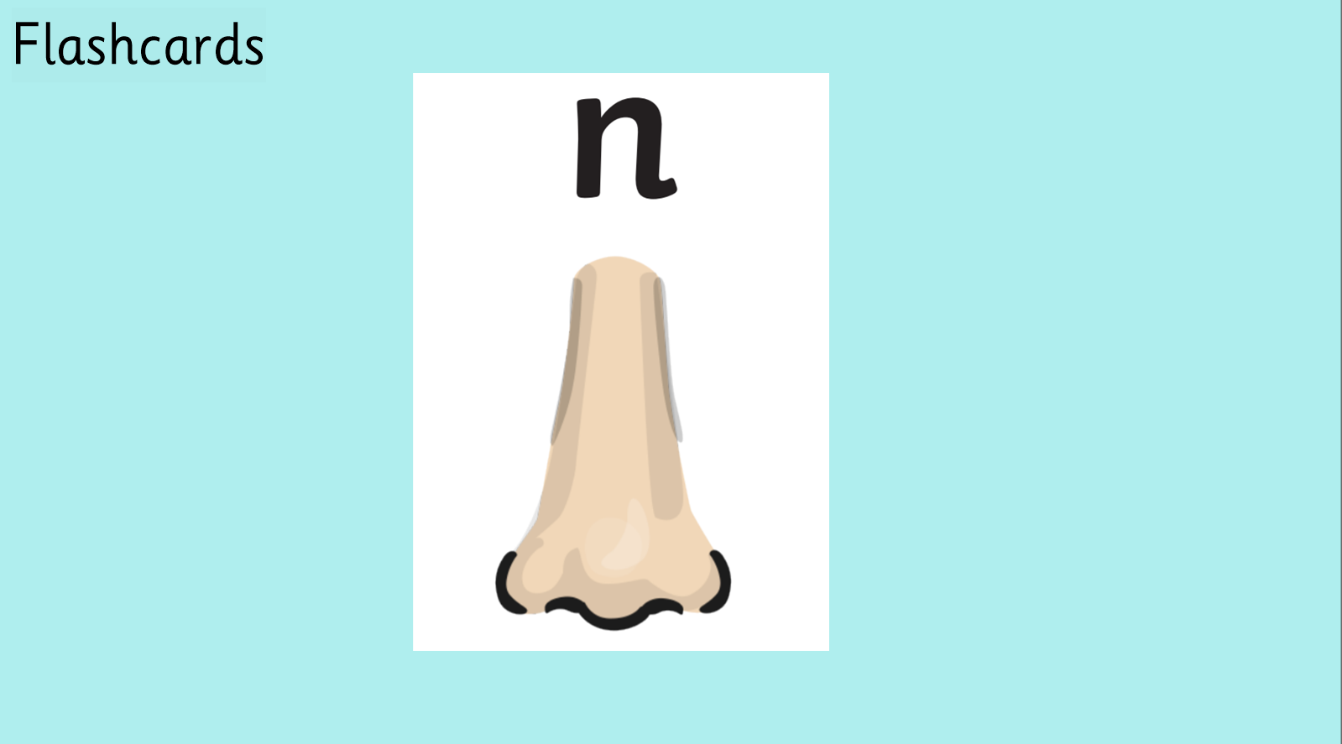

Slide 9
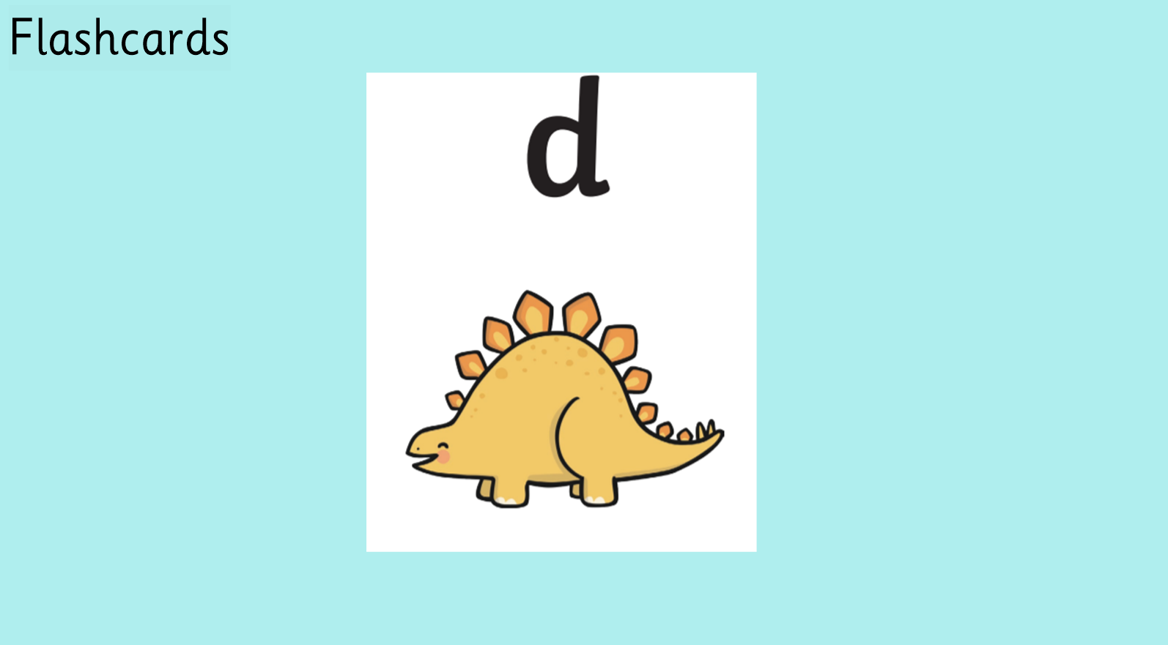

Slide 10
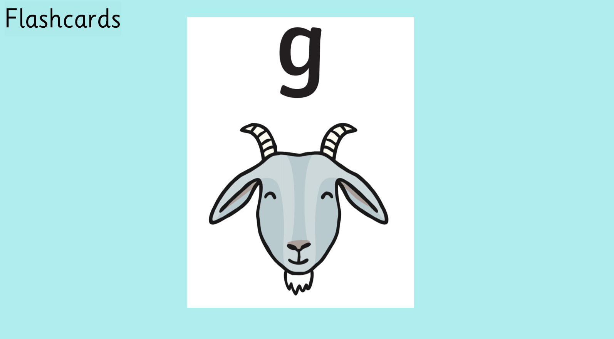

Slide 11
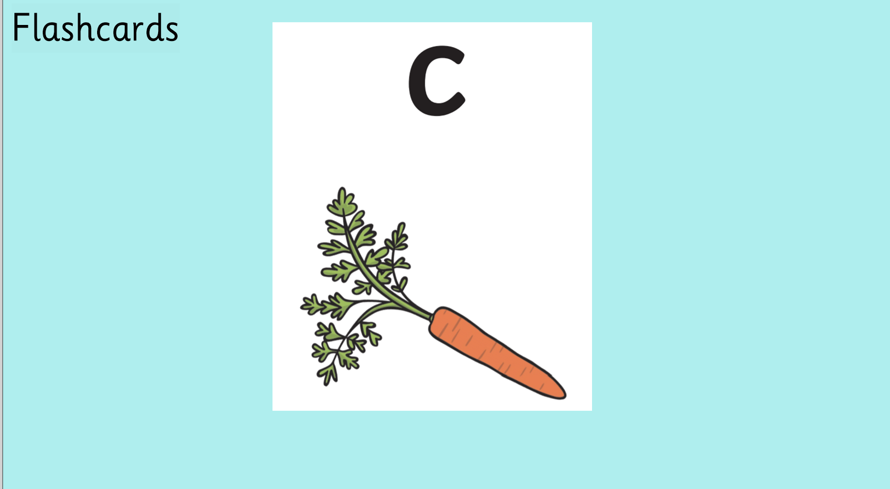

Slide 12


Slide 13


Slide 14
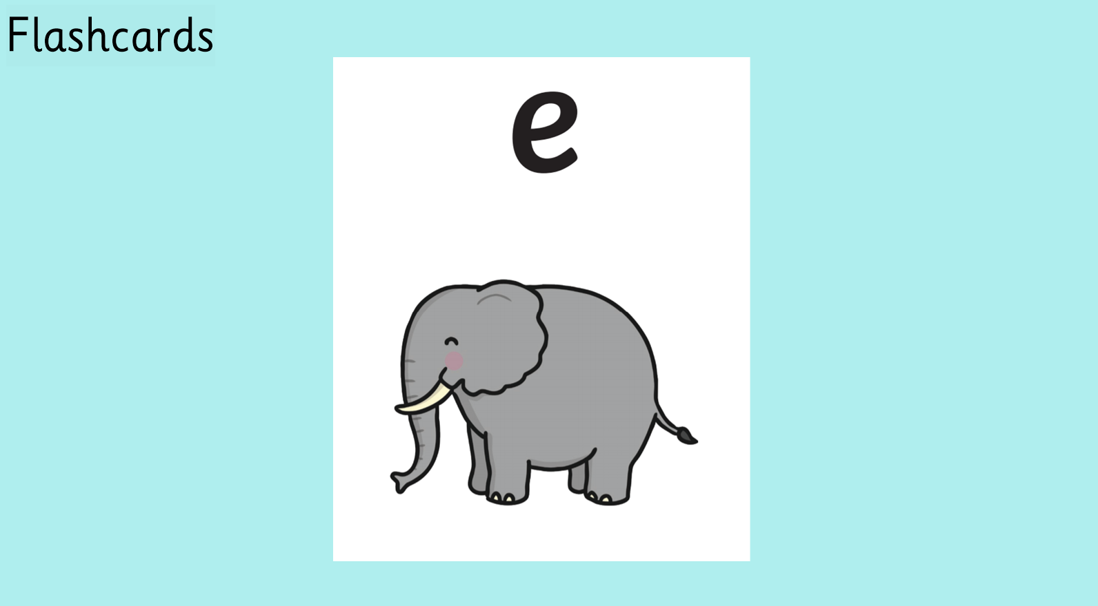

Slide 15


Slide 16
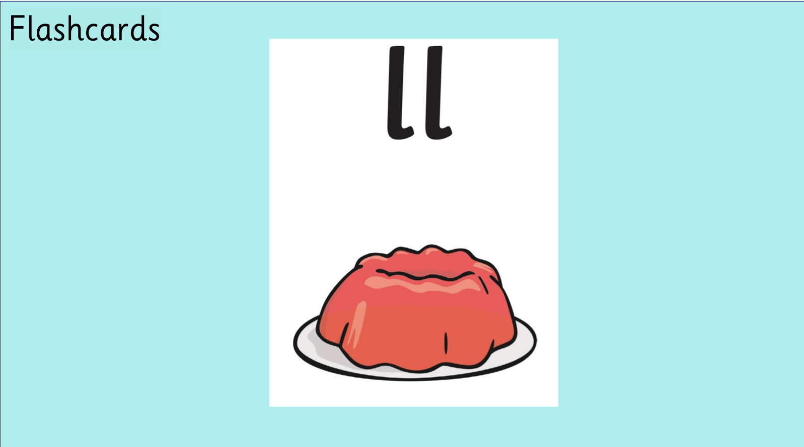

Slide 17


Slide 18


Slide 19
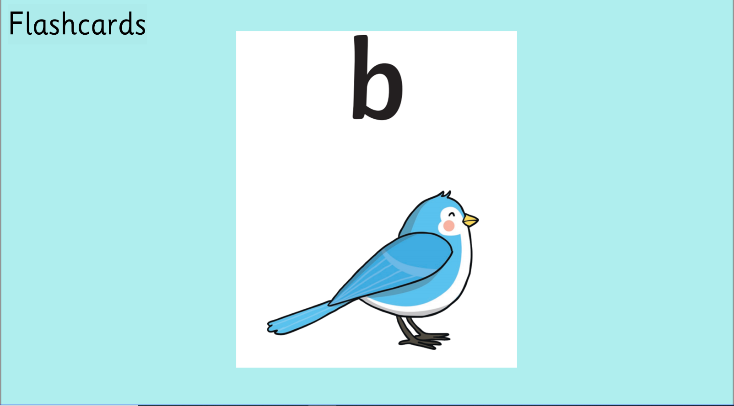

Slide 20


Slide 21


Slide 22


Slide 23


Slide 24


Slide 25


Slide 26
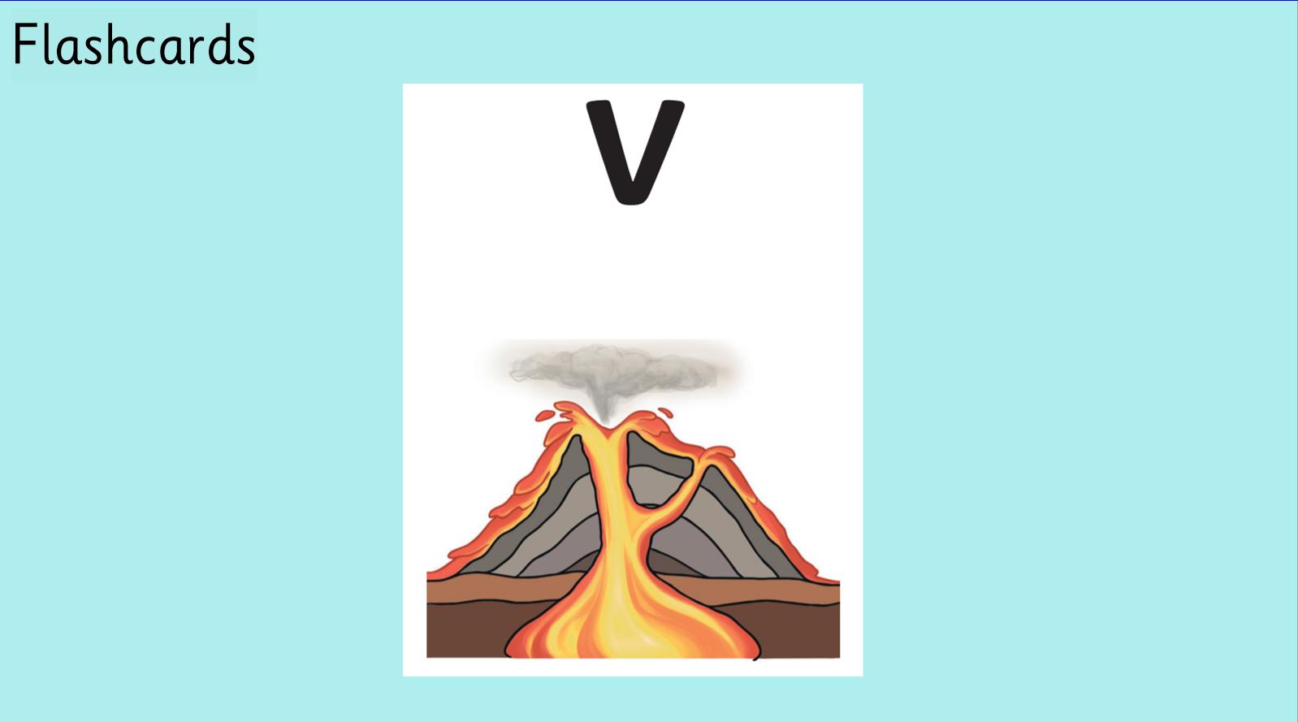

Slide 27
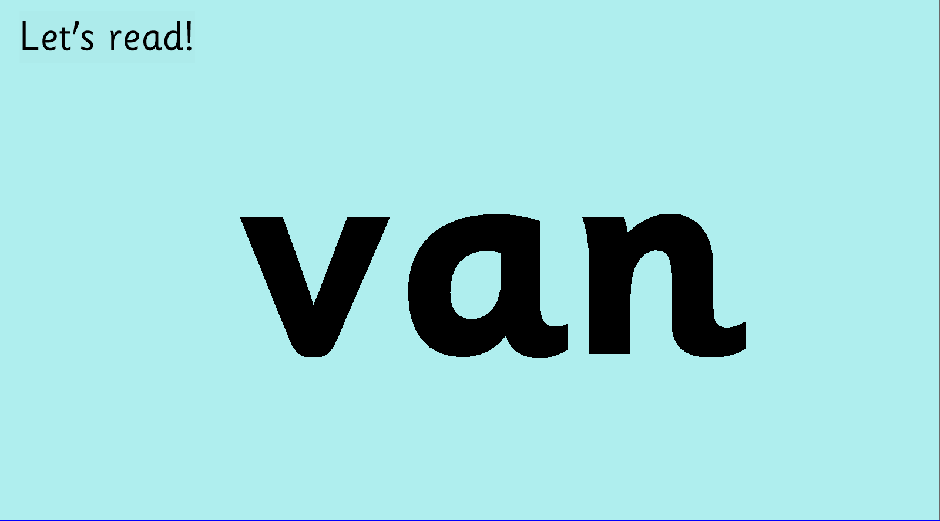


Slide 28



Slide 29



Slide 30


Slide 31


Slide 32


Slide 33


Slide 34
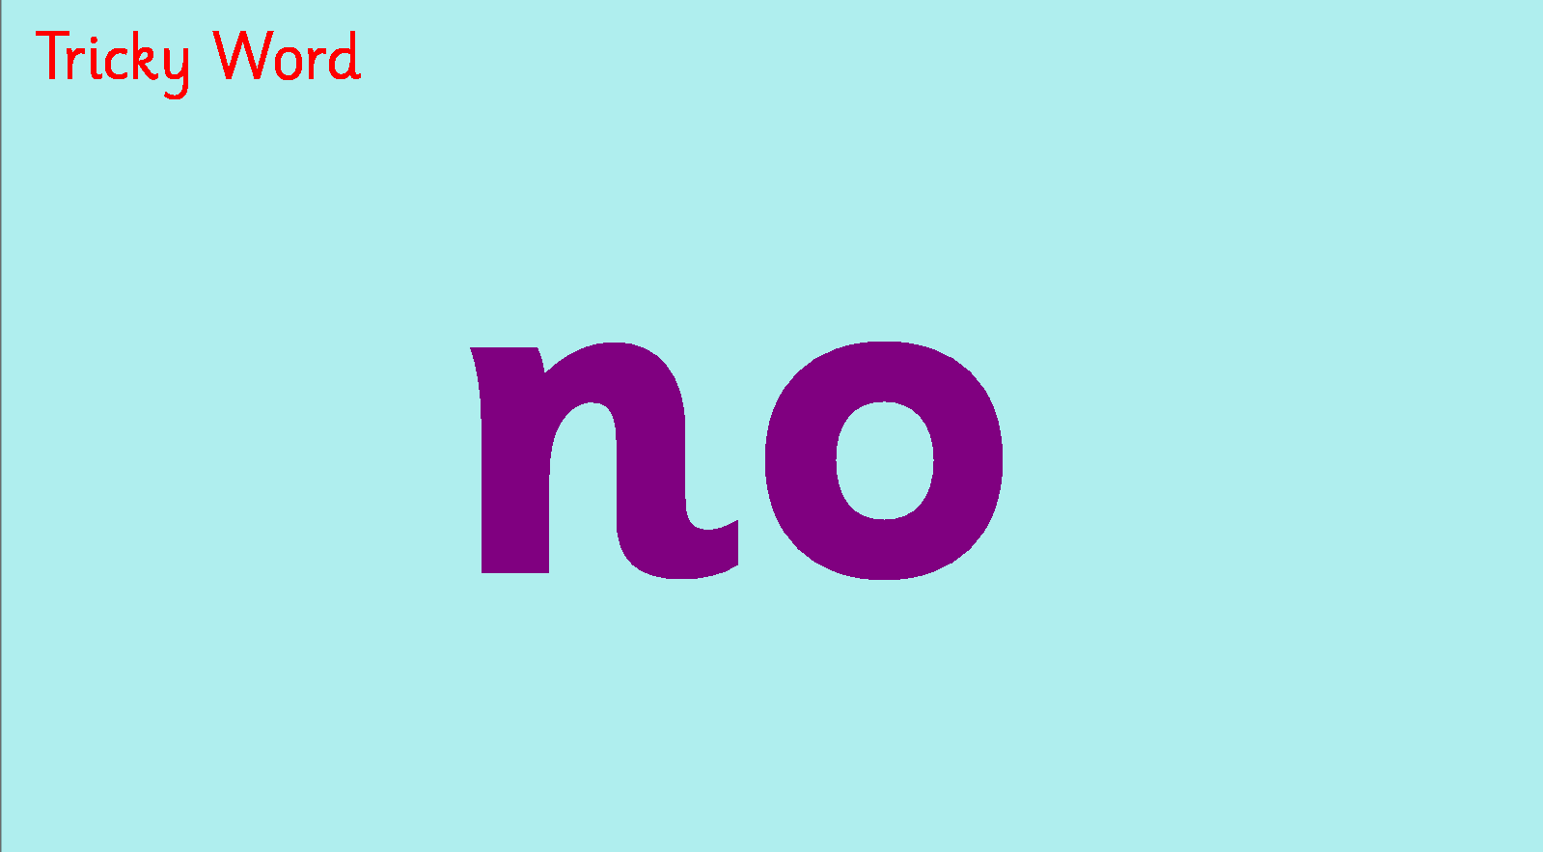

Slide 35


Slide 36
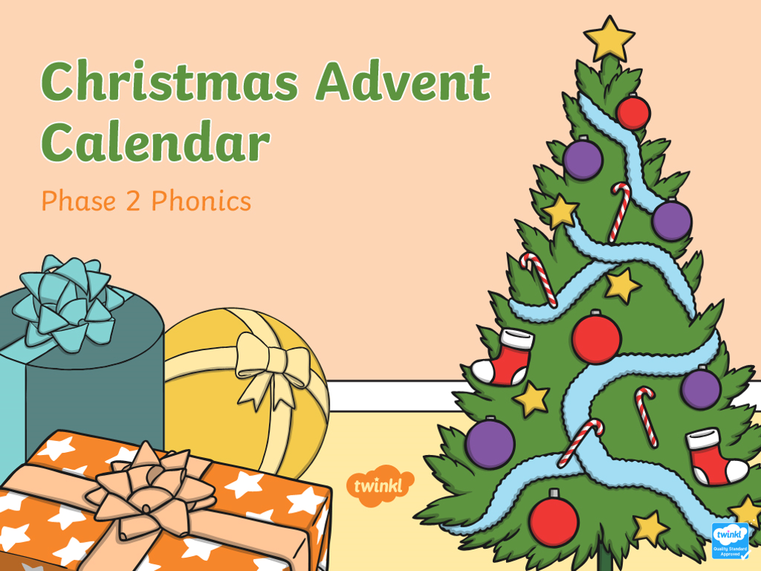

Slide 37




Decorate the Christmas Tree
Read the word on the bauble.
Click the bauble to put it on the tree.
in
big
I
no
is
go
him
it

Slide 38


Slide 39


Slide 40


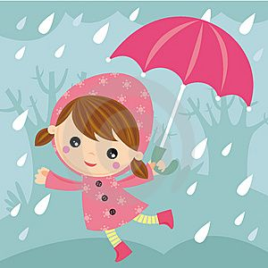

Read the word and find the matching picture
wet
wig
win

Slide 41
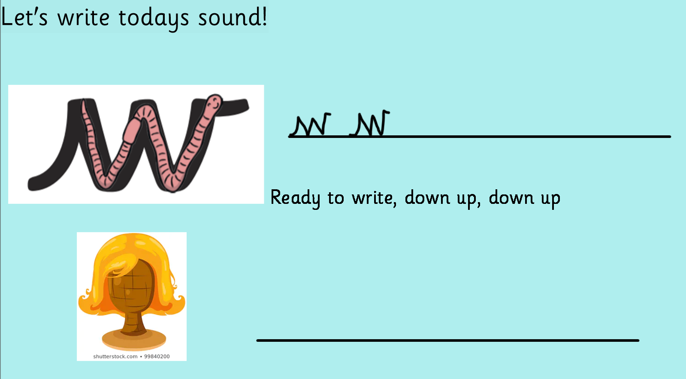
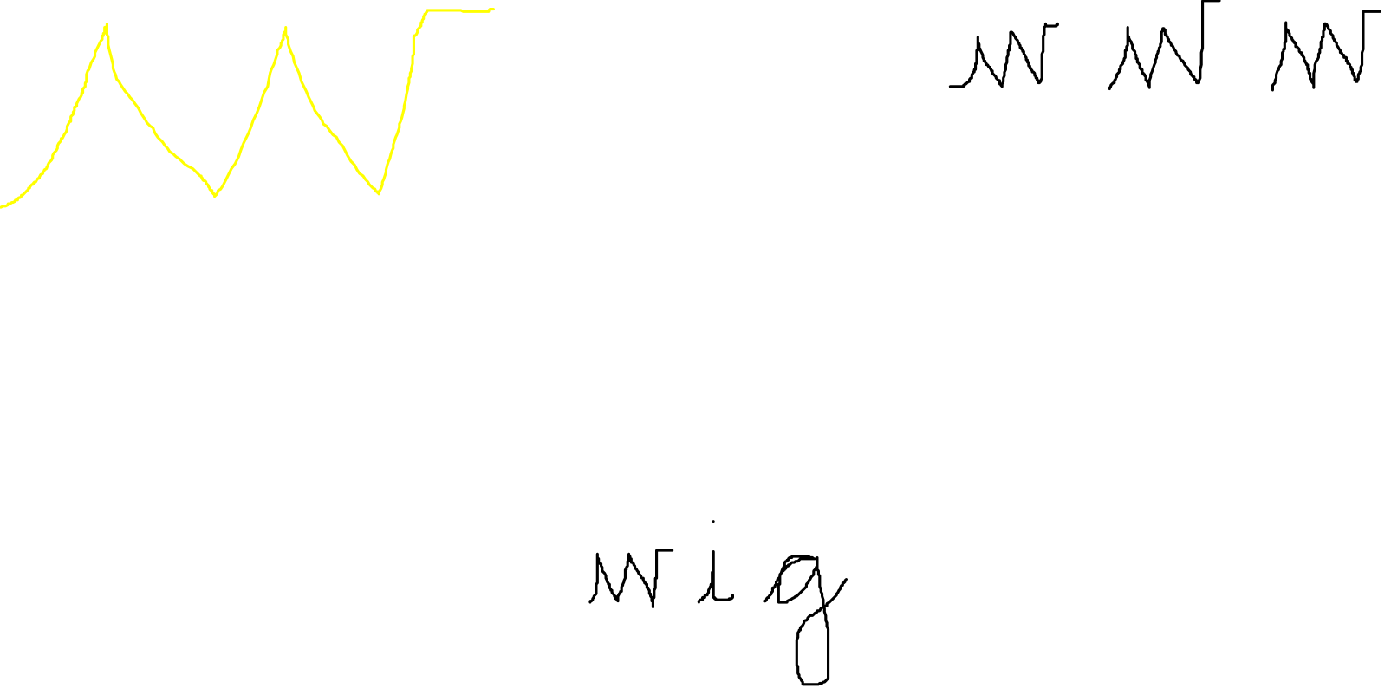

Slide 42


