Slide 1
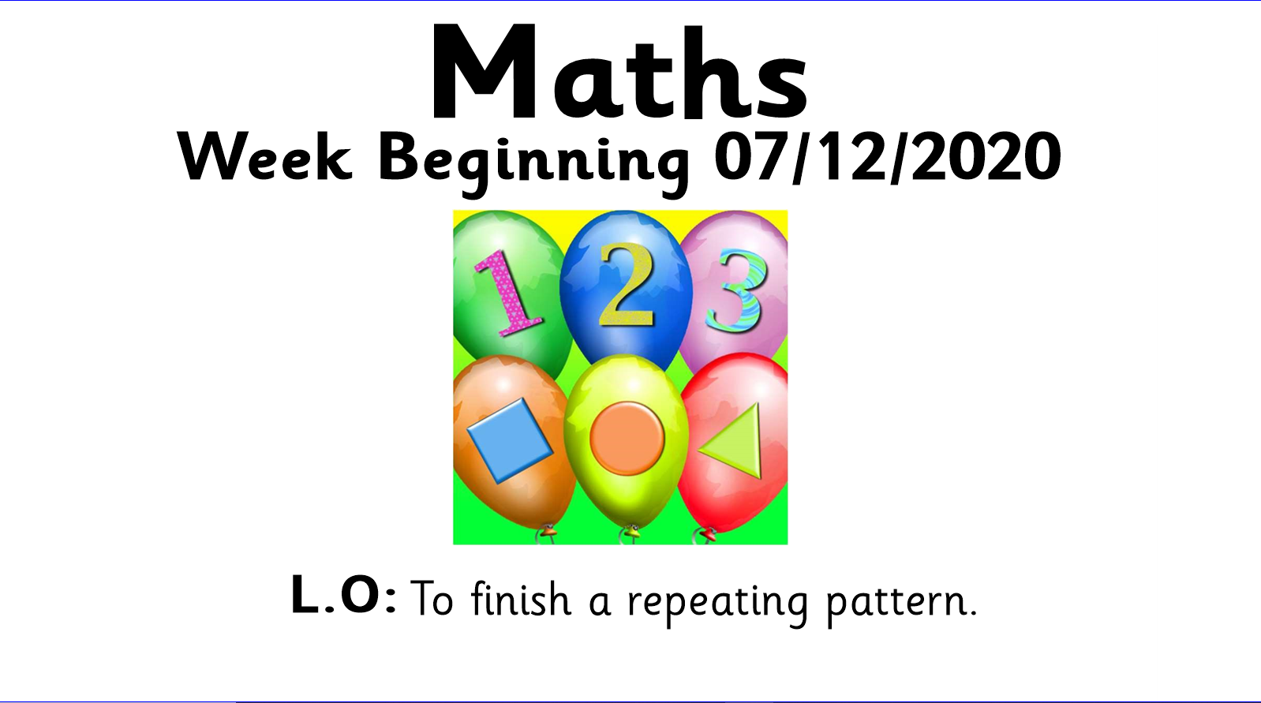


Slide 2
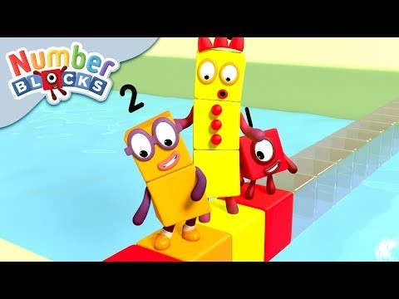

Slide 3
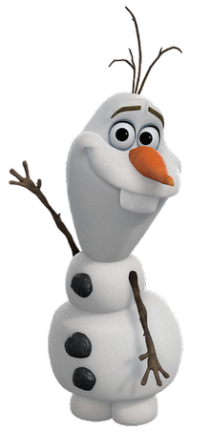
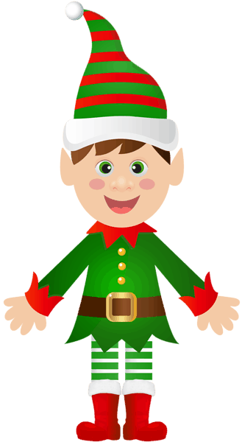
What comes next in this pattern?

Slide 4


What comes next in this pattern?

Slide 5

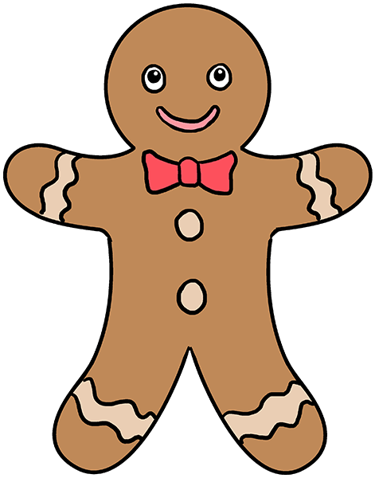

What comes next in this pattern?

Slide 6
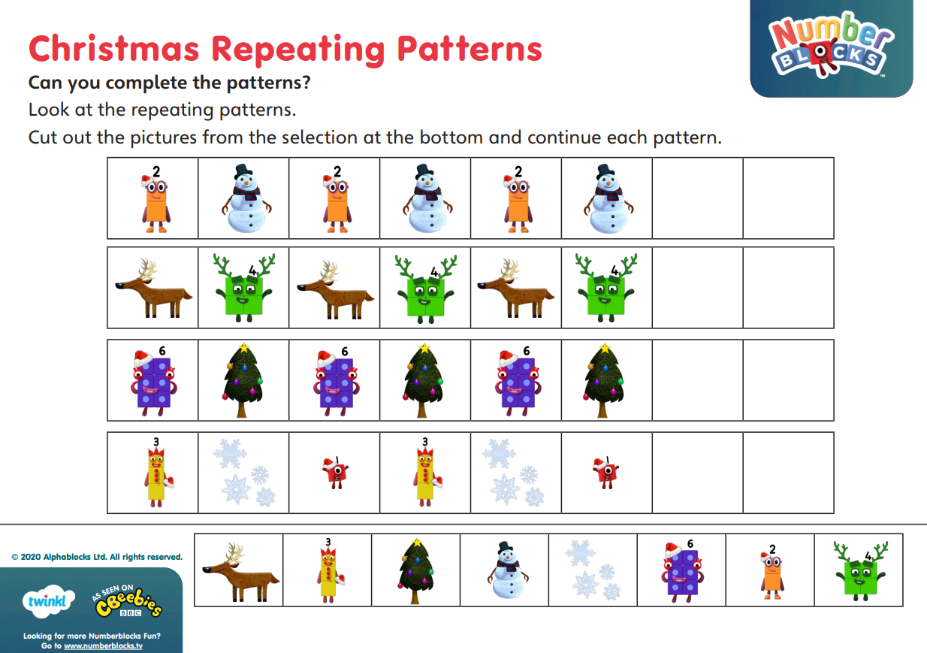
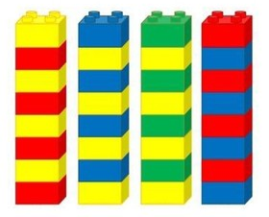
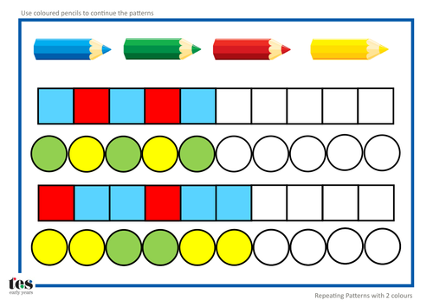
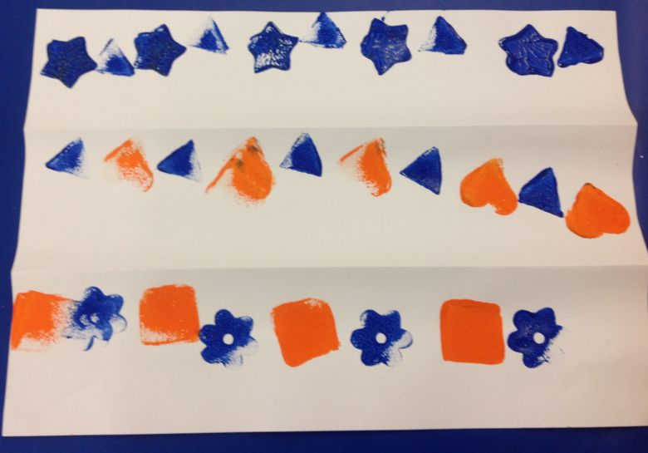

Activity
Can you finish the Christmas Repeating Patterns?
If you don’t have a printer you could make patterns using Lego, draw a pattern or paint a pattern.
Send a photo of your work to Miss Pitman

