Slide 1
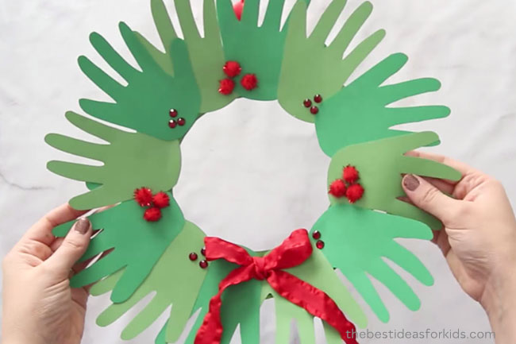

Handprint Wreath

Slide 2

Step 1
Make some green handprints
You could paint them, draw round your hand on green paper or draw round your hand and colour them green

Slide 3

Step 2
Stick your handprints into a circle shape with a hole in the middle.

Slide 4
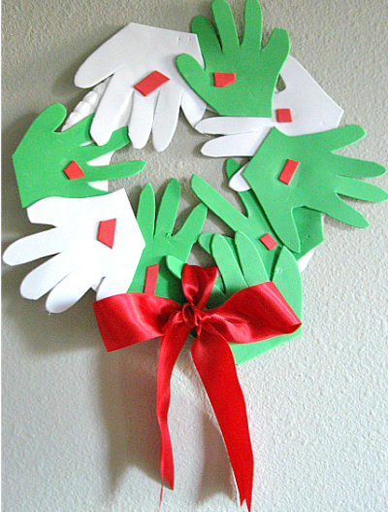
Step 3
Add some red berries- you could use pom poms, glitter or cut out some berries.

Slide 5
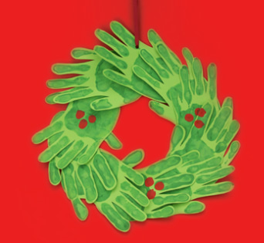
Step 4
Add some ribbon at the top and find a place to hang your wreath.

