Slide 1
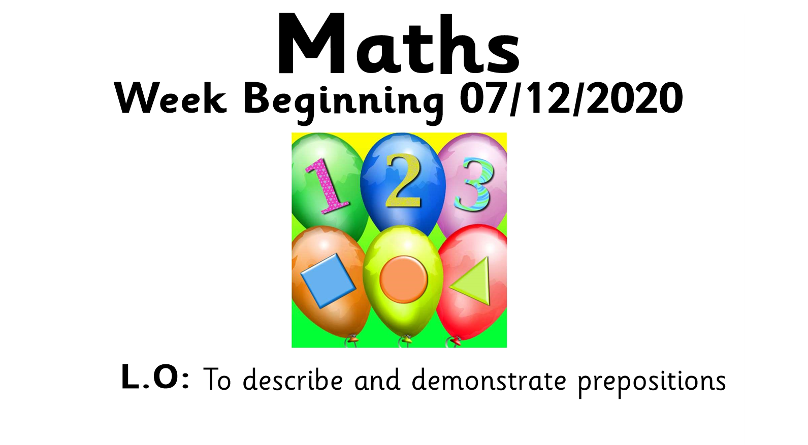


Slide 2
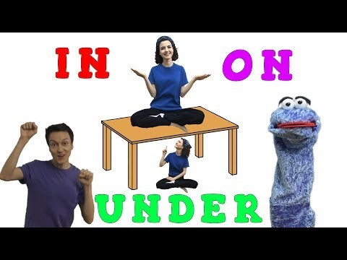

Slide 3
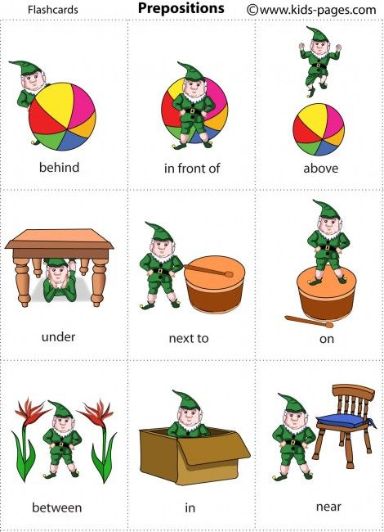

Today we are going to be talking about where things are.

Slide 4
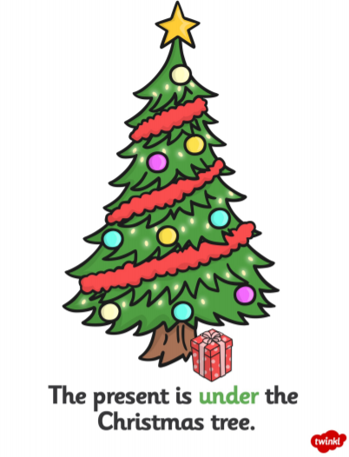

Slide 5
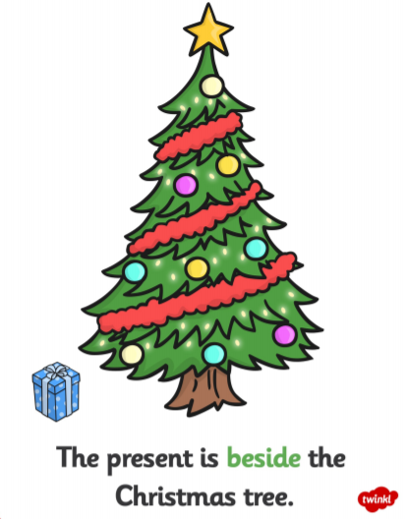

Slide 6
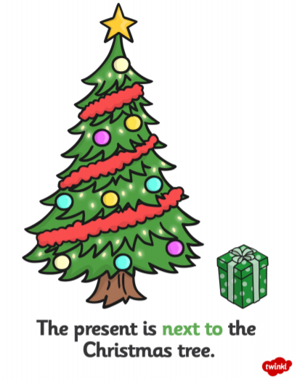

Slide 7
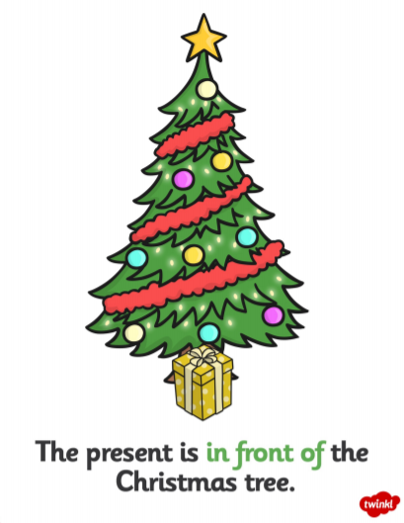

Slide 8
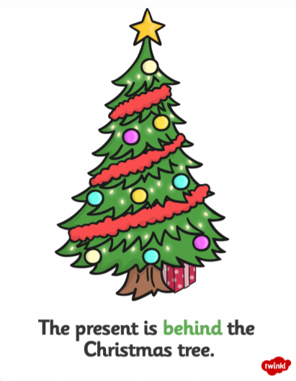

Slide 9
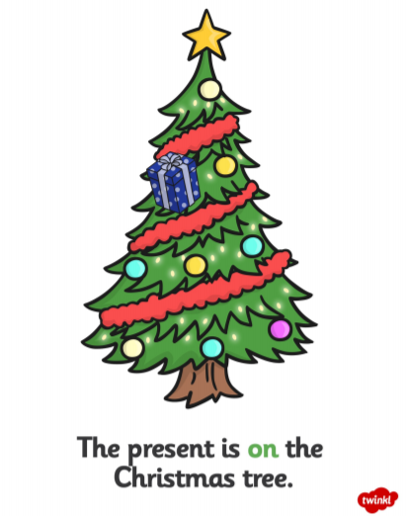

Slide 10
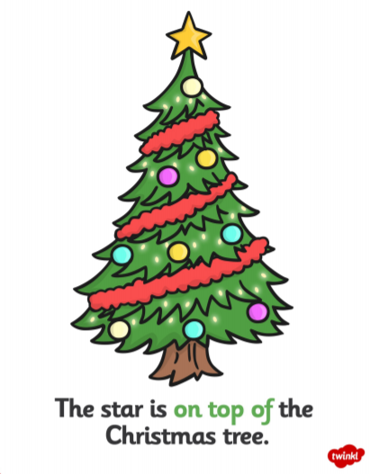

Slide 11
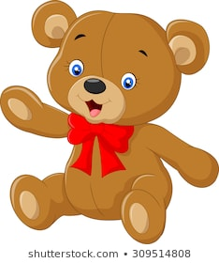


Activity
You will need:
  A toy
  A book
Sit on the floor with the book next to you. Listen for my instructions and place you toy in the matching place.

Slide 12
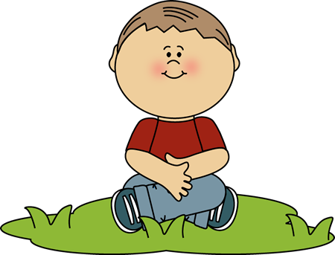
Put your toy behind your back

Slide 13
Put your toy near the book

Slide 14
Put your toy on your head

Slide 15
Put your toy in between you and the book

Slide 16
Put your toy in front of you

Slide 17
Put your toy under the book

Slide 18
Put your toy next to you

