Slide 1
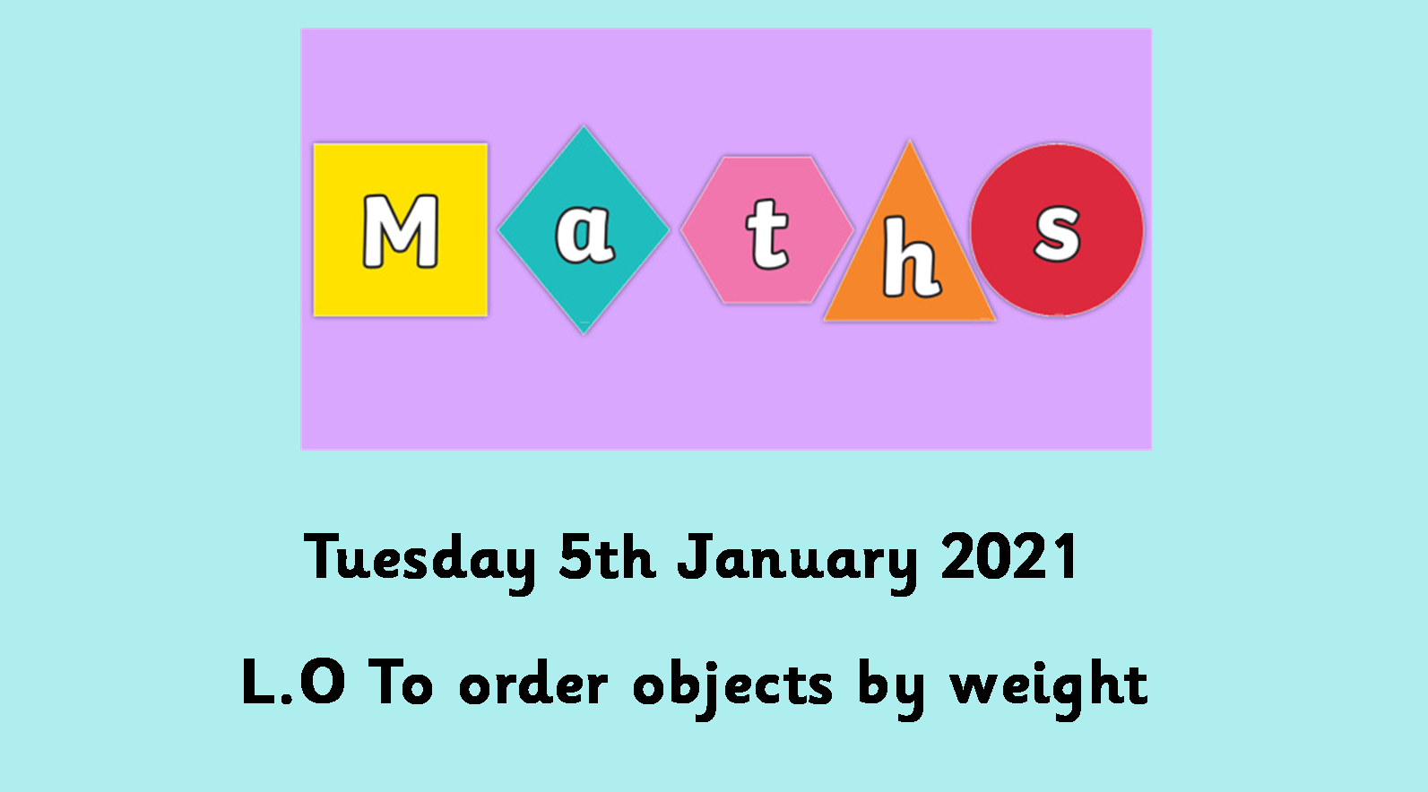

Slide 2

https://www.youtube.com/watch?v=QCPYaTx2v0w

Slide 3
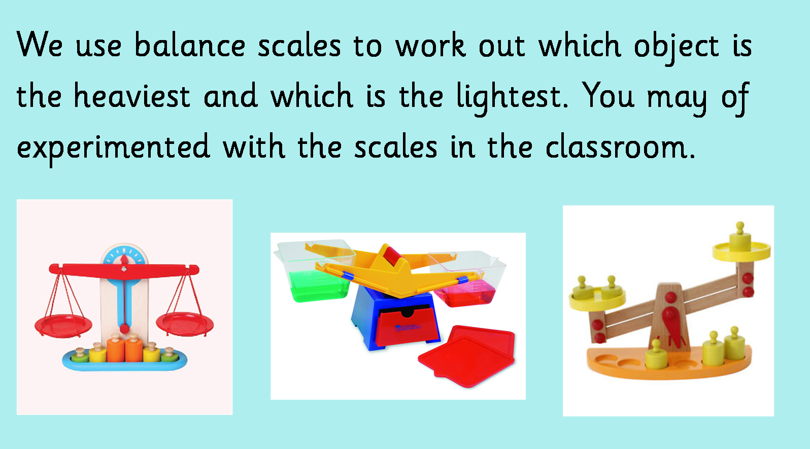

Slide 4
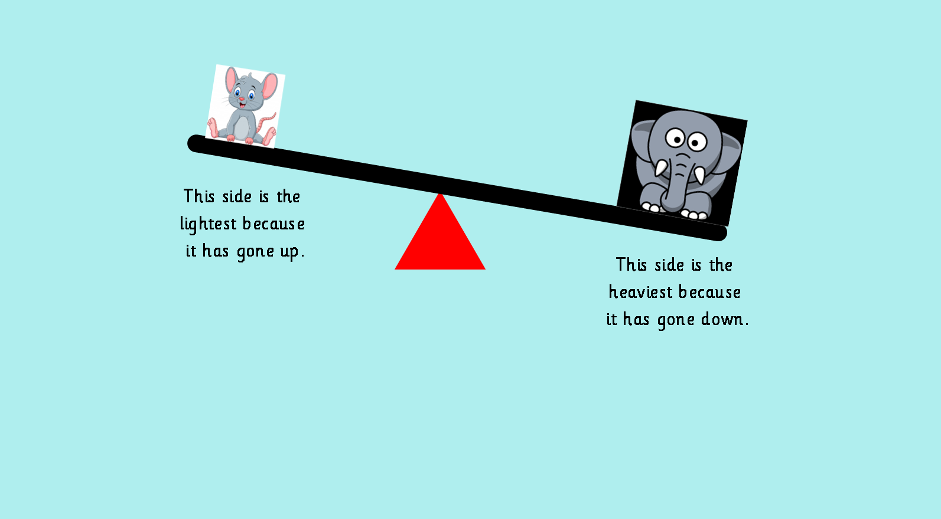

Slide 5
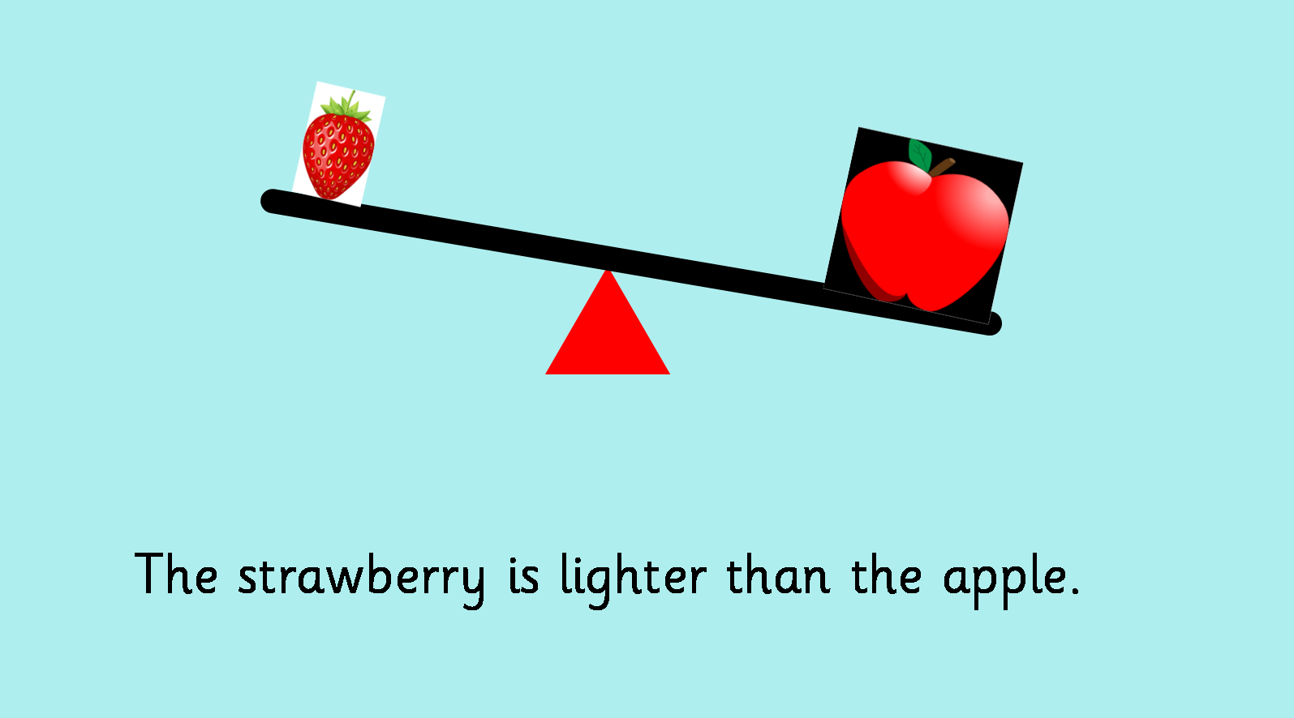

Slide 6
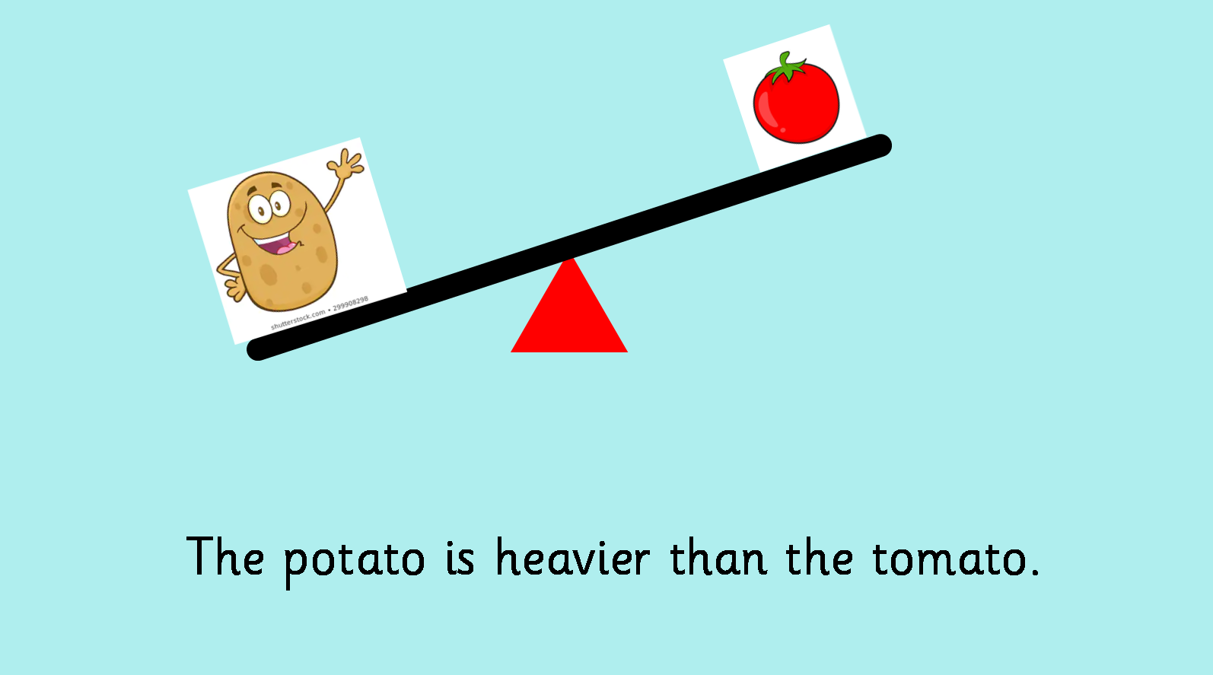

Slide 7
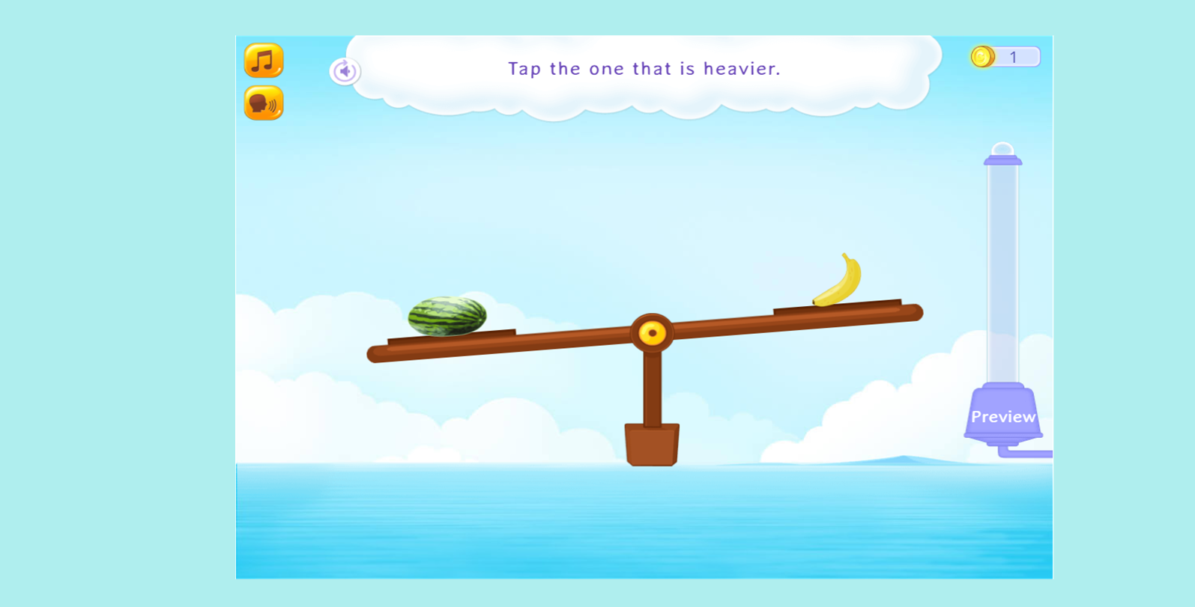
https://www.splashlearn.com/measurement-games

