Slide 1
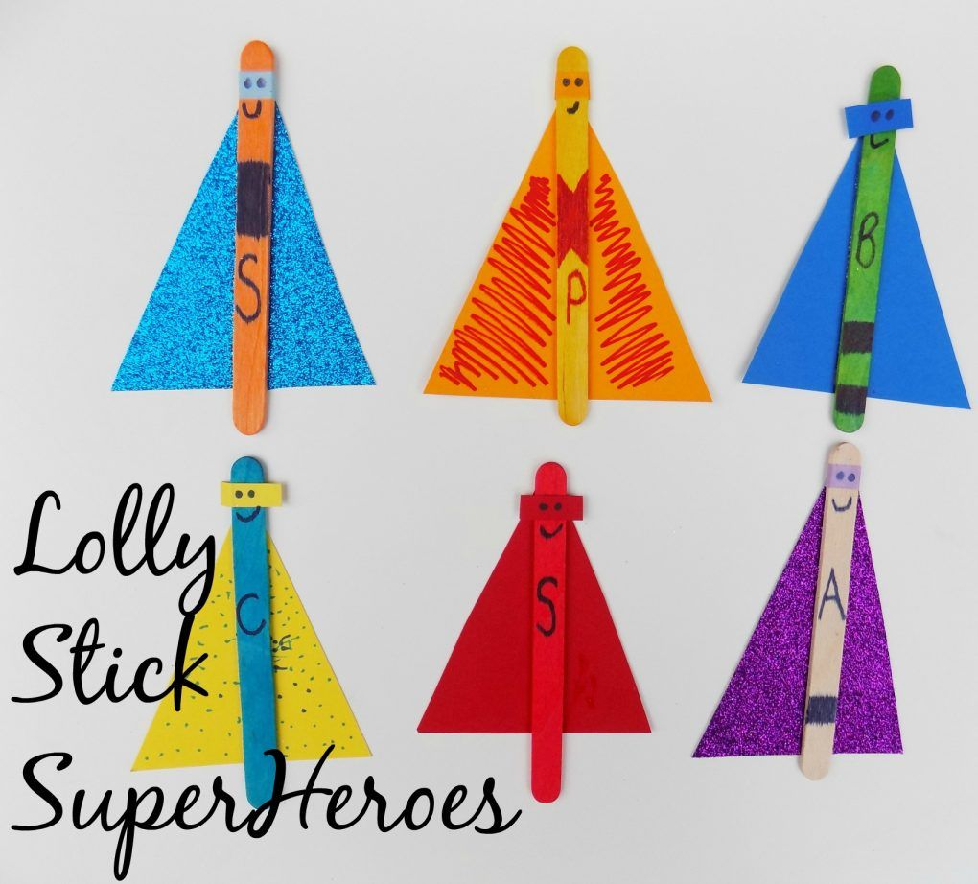

Slide 2
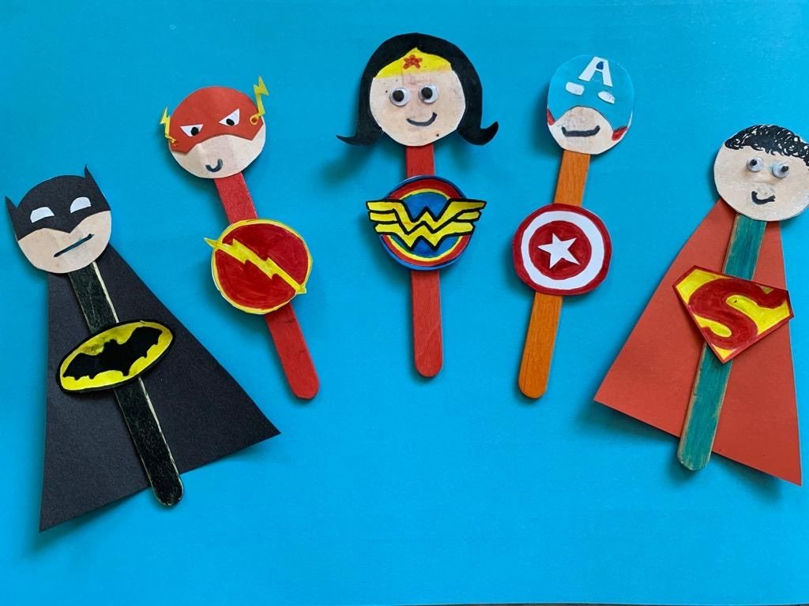
You will need
Card or paper
Felt tip pens
Scissors
Glue
Lolly stick- if you haven’t got any lolly sticks maybe use a tube or cut a strip of cardboard.

Slide 3
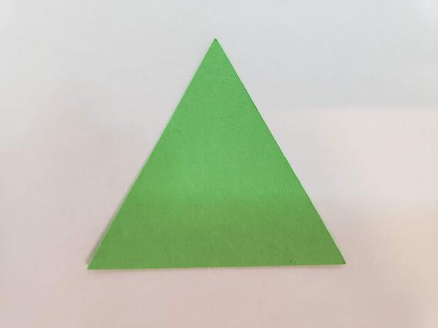
Step 1
Cut out a triangle shape from the card and decorate. This is going to be your cape.

Slide 4
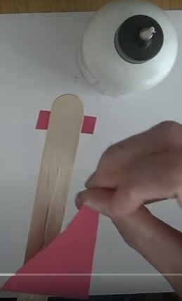
Step 2
Stick the cape to the lolly stick.

Slide 5
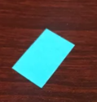
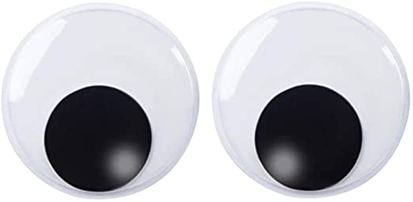
Step 3
Cut out a little rectangle and draw on some eyes. This is your mask.

Slide 6
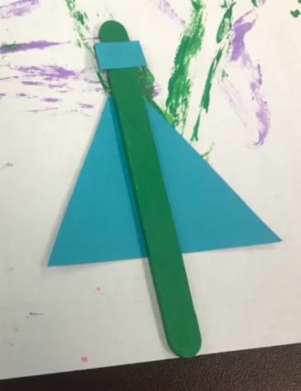
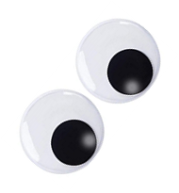
Step 4
Stick the mask onto the other side of your lolly stick, so your cape is at the back.

Slide 7

Step 5
Using the card, cut out any shape you wish and decorate. This is going to be your superhero badge. You may want to put a picture or letter on your superhero badge.

Slide 8
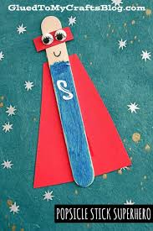

Step 6
Stick your superhero badge on the lolly stick. Stick it on the same side as the eyes.
Your superhero is now ready. Maybe you can make some more and act out a super hero scene.
What name will you give your super hero?

