Slide 2
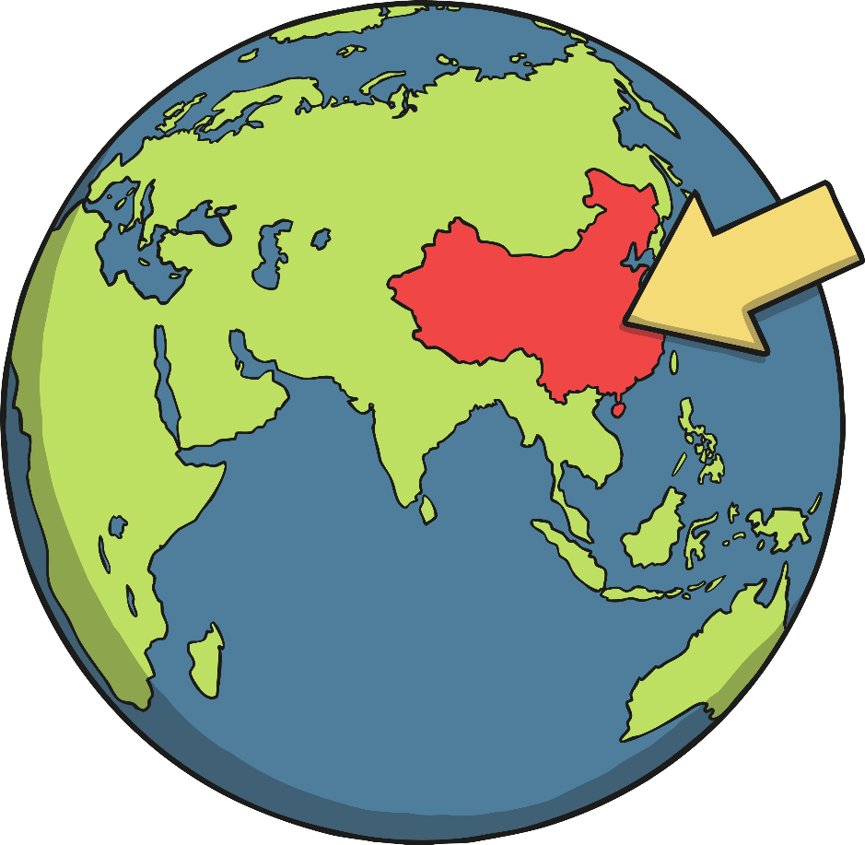
China
China is a country in Northeast Asia.
It has the largest population in the world, with over 1.3 billion people.

Slide 3
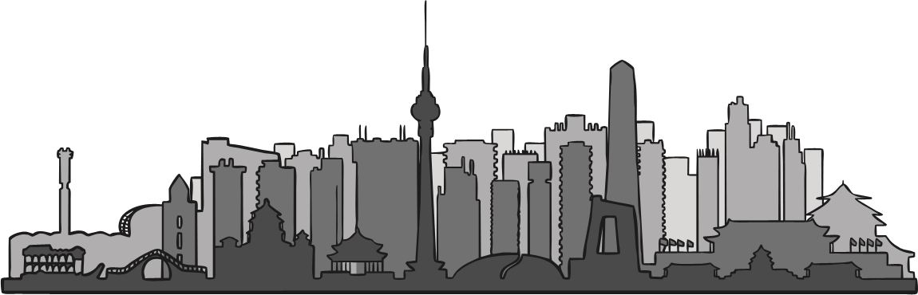
Beijing
The capital city of China is Beijing.

Slide 4
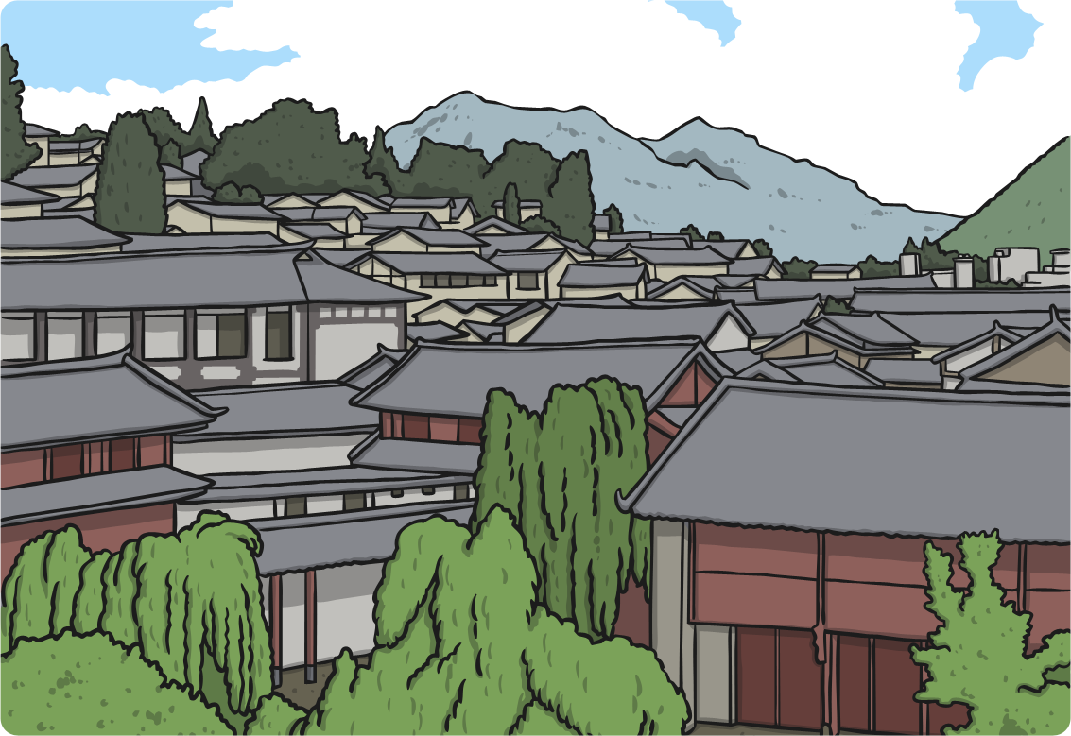
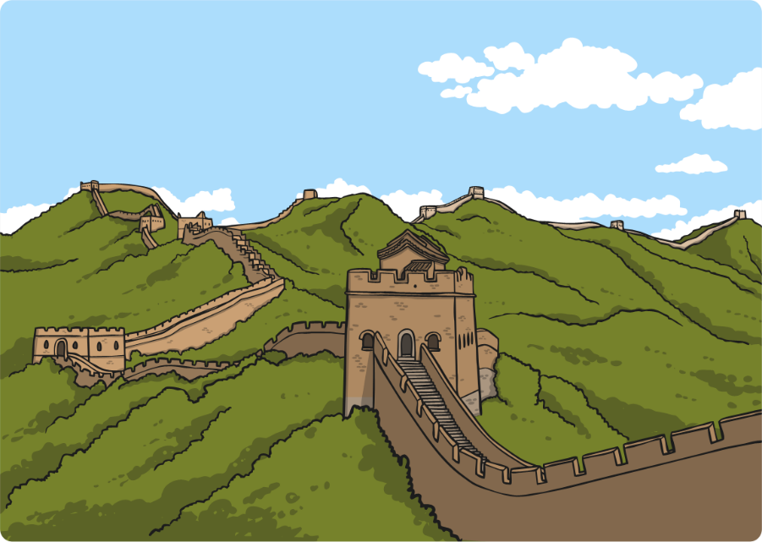
What Is China Like?
In the north of China, there are mountains, where it snows for much of the year.
The south of China is filled with jungles and it is very hot.

Slide 5
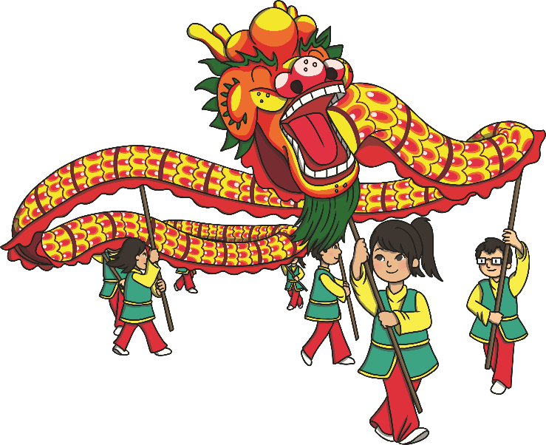
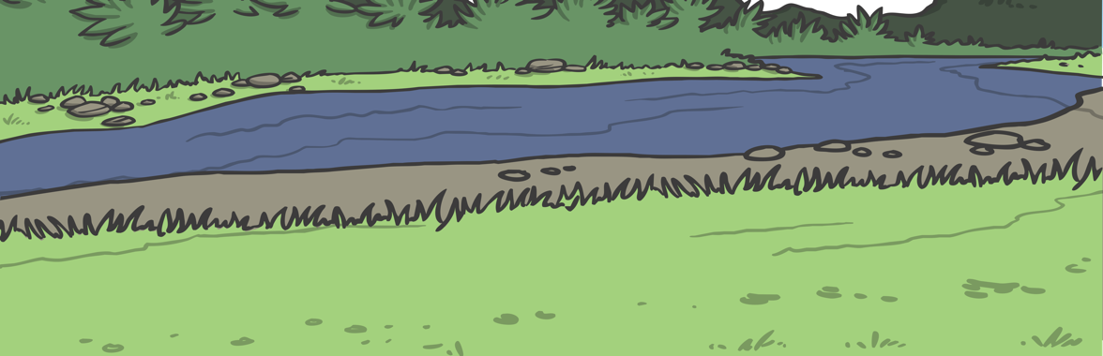
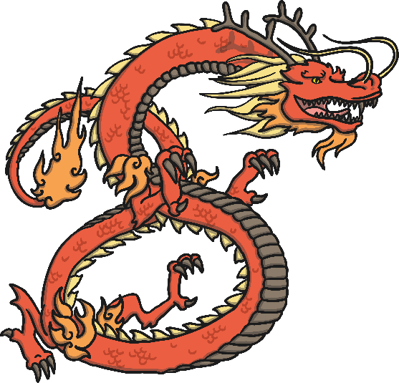
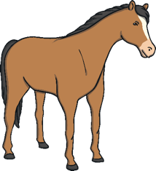
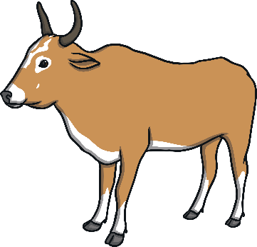
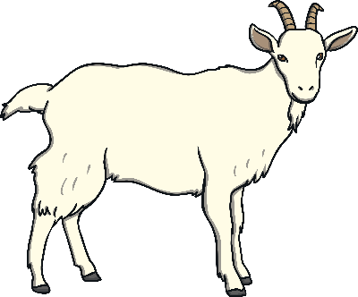
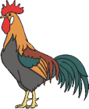
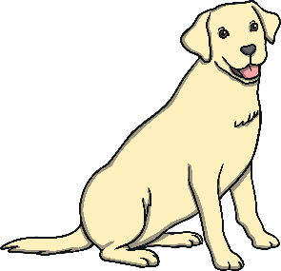
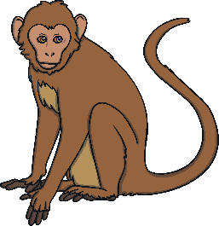
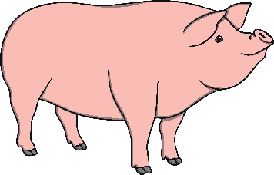
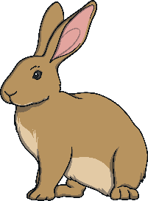
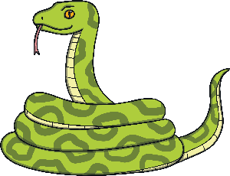
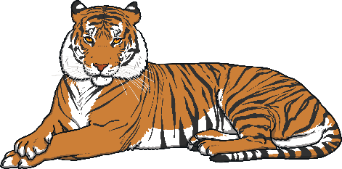
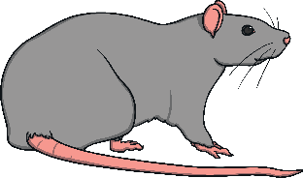
What is Chinese New Year?
Chinese New Year is a festival that celebrates the start of a new year in the Chinese calendar.
It is a bright and exciting festival that is celebrated in China and in other countries all around the world. People celebrate with gifts, fireworks and Chinese Dragon and Lion dances.
Did You Know…?
Each new year is named after an animal from the Chinese Zodiac.

Slide 6
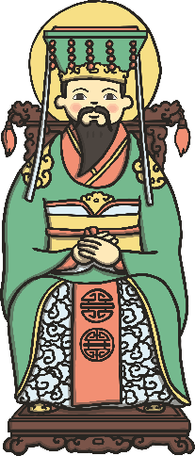
Chinese New Year
A long time ago, in China, the Jade Emperor decided that there should be a way to measure time. He invited all the animals to compete in a race across the river. The first 12 animals to cross the river would be rewarded by having a year named after them.
The position they came in the race would decide the order of the years. The rat won the race so the first year was named after him. The Ox came second so the second year was named after him.

Slide 7
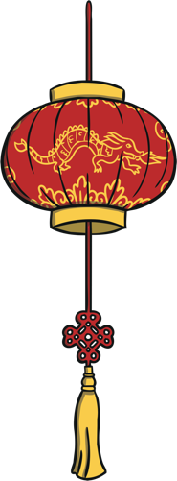



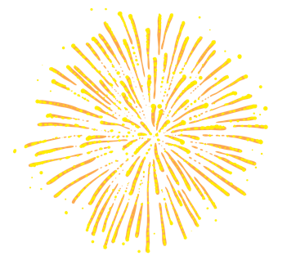
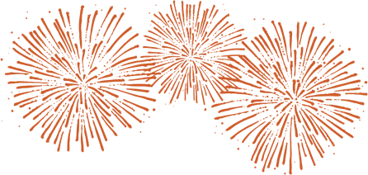
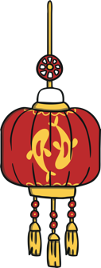

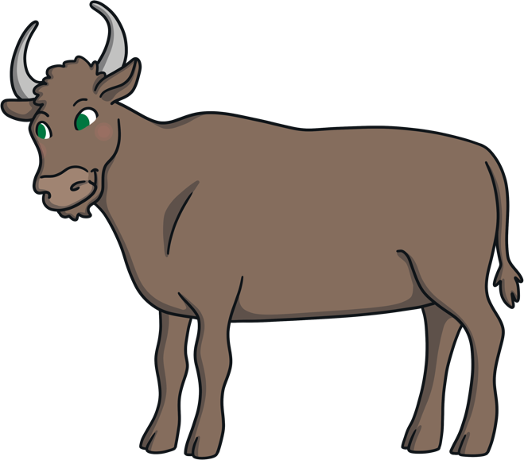
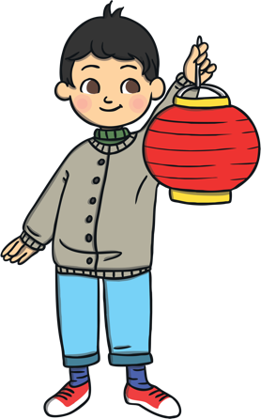
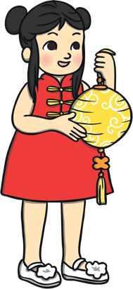
Did You Know…?
People born in the Year of the Ox are said
to be honest, hard-working and kind.

Slide 8
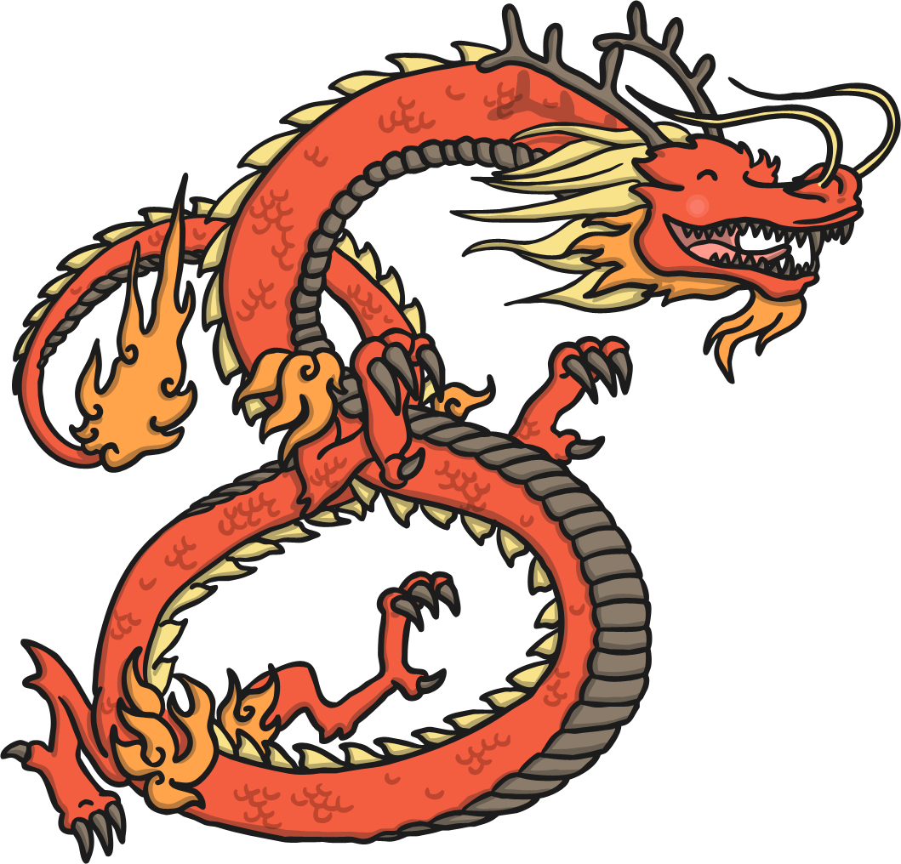
When Is Chinese New Year?
The date of Chinese New Year changes each year because it follows a very old calendar which is linked to the phases of the Moon.
Chinese New Year is always in January or February.

Slide 9
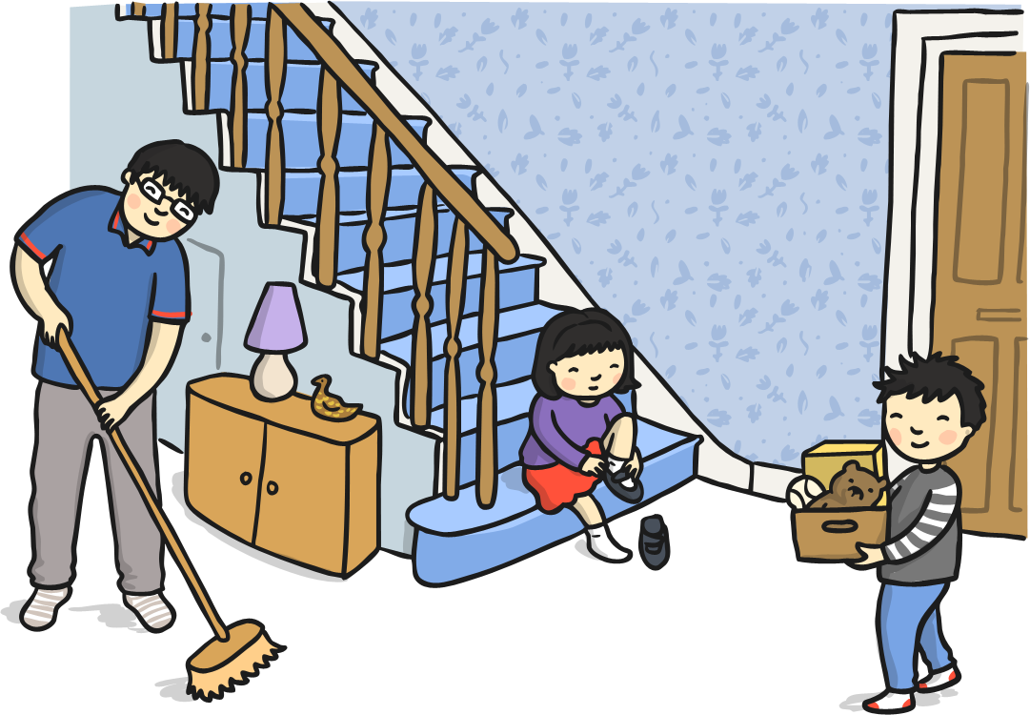
Preparing for the New Year
Chinese people spring clean their houses and gardens to sweep away any bad luck.
Houses are decorated with paper scrolls and lanterns, with good luck messages on them.

Slide 10
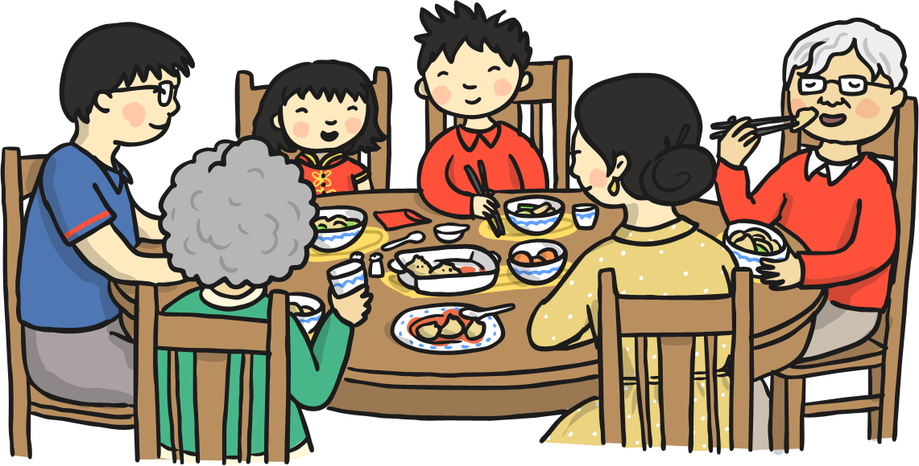
New Year's Eve
Families gather together and have a traditional meal of fish and chicken.
In the north of China people eat dijiaozi – a steamed dumpling.
In the south of China people eat nian gao – a sticky, sweet rice pudding.
People stay up until midnight setting off fireworks.

Slide 11
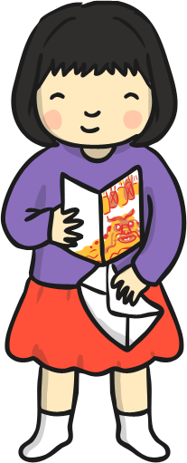
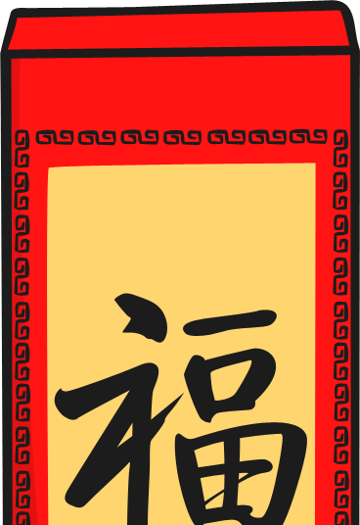
New Year's Day
Children wake up to find red envelopes filled with money and sweets under their pillow.
Every family member starts the day with brand new clothes from head to toe.
Red is a very popular colour for clothes, as it is thought to be lucky!

Slide 12
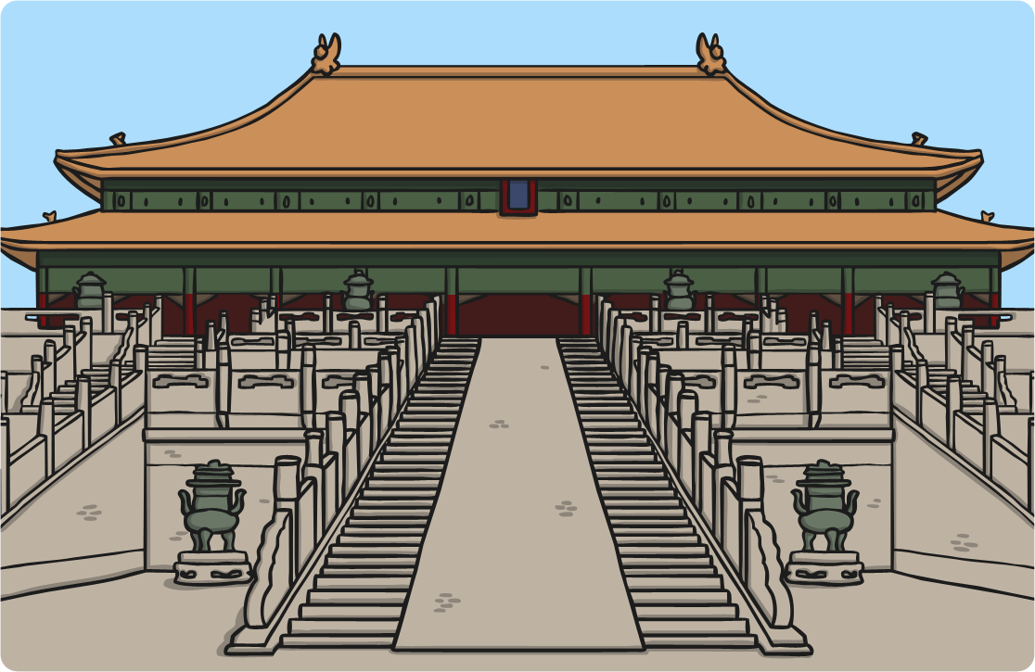
New Year's Day
The first stop of the day is the temple, to worship Gods and to welcome the New Year.
Each family has their own special dish which they prepare for the banquet.

Slide 13
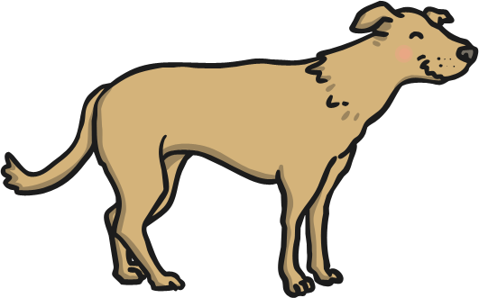
New Year Celebrations
The New Year Celebrations last for two weeks.
The 2nd day of the celebrations is also believed to be the birthday of all dogs, so dogs are treated with special foods.

Slide 14
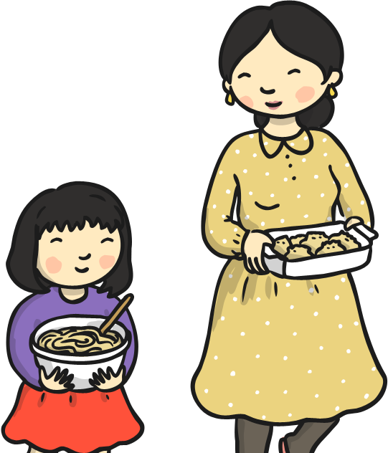
New Year Celebrations
During the celebrations, firecrackers are thrown.
Dumplings are eaten for good luck

Slide 15
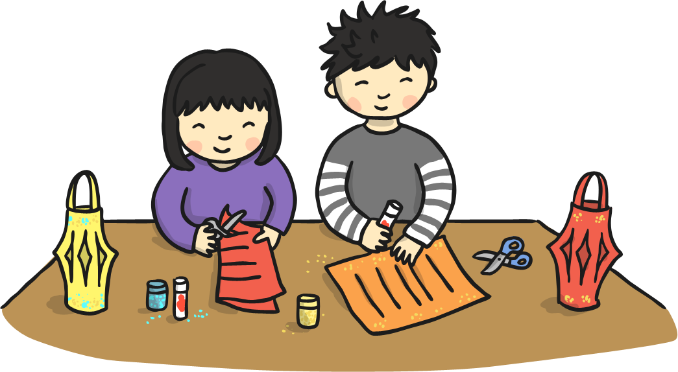
The Lantern Festival
The 15th day of celebrations is known as the Lantern Festival.

Slide 16
The Lantern Festival
Rice dumplings are eaten on this day.

Slide 17
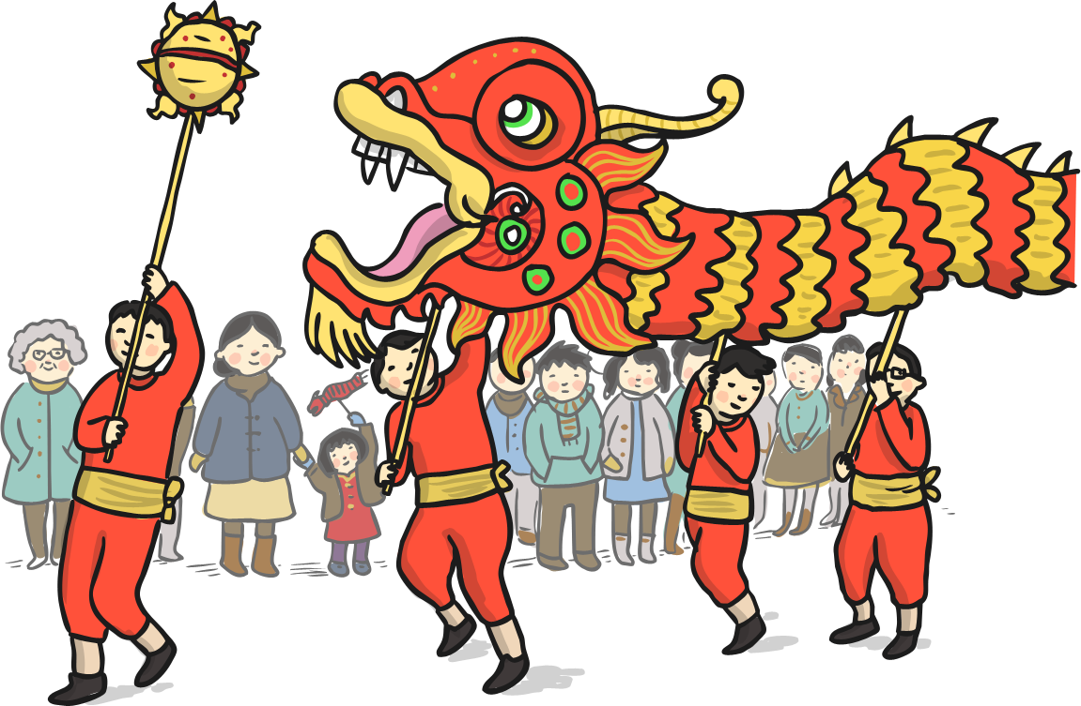
The Lantern Festival
There is dragon dancing and lion dancing parades in the streets.

Slide 18
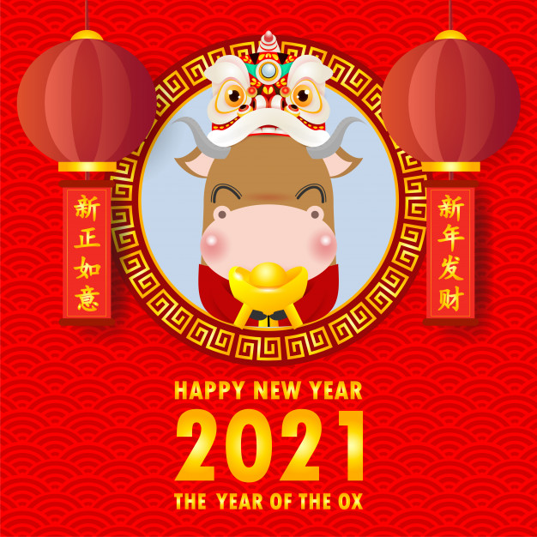
Today’s Activity
Let’s make a Chinese New Year Card!
You will need to fold a piece of paper in half and decorate. Can you write a message inside?

