Slide 1


Tuesday 9th February 2021
L.O To write a letter.

Slide 2
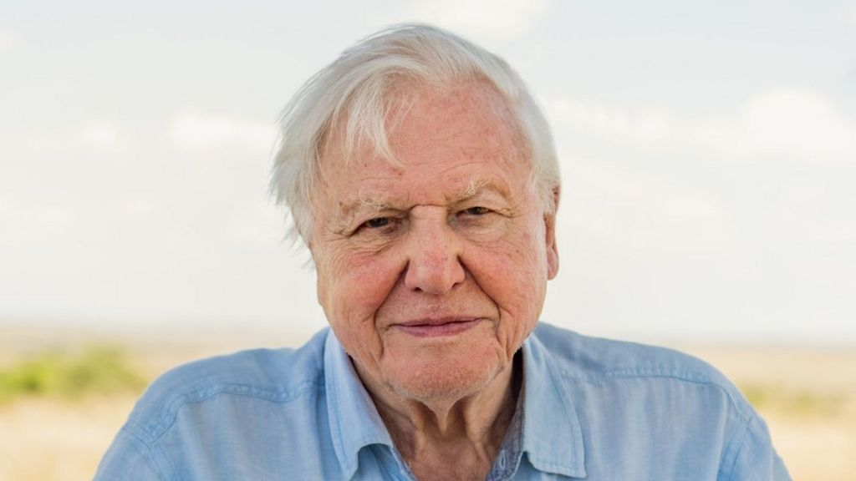
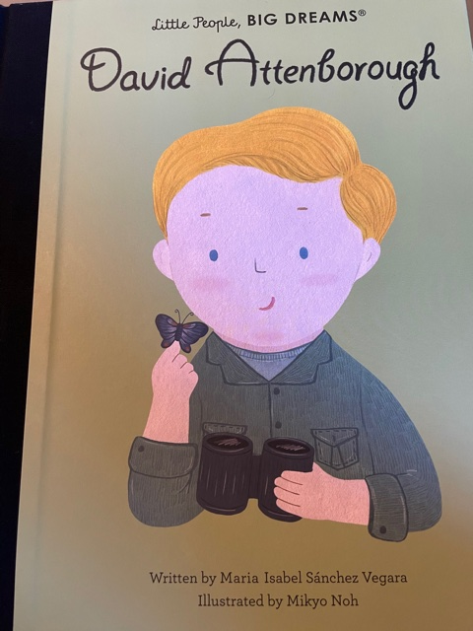
This week we are learning about a real life superhero called Sir David Attenborough. He has helped us to understand how to save after our planet and the animals on it. Today we are going to write a letter to Sir David Attenborough.

Slide 3
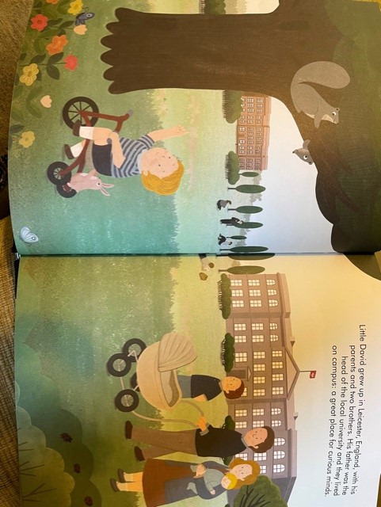

Slide 4
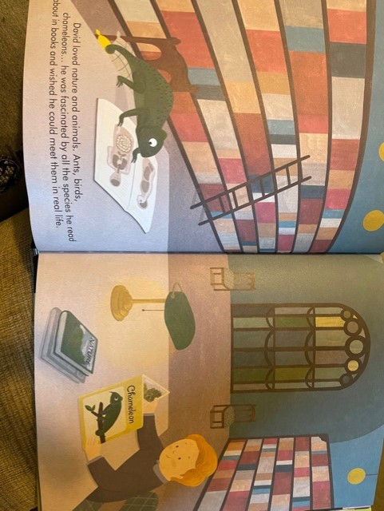

Slide 5
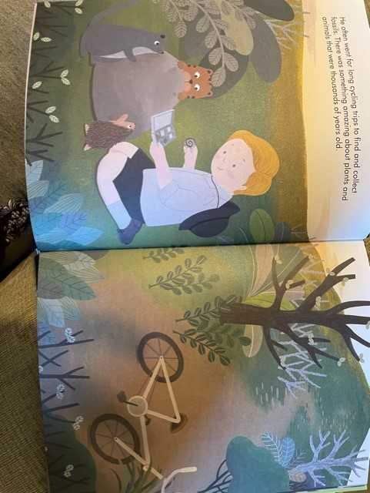

Slide 6
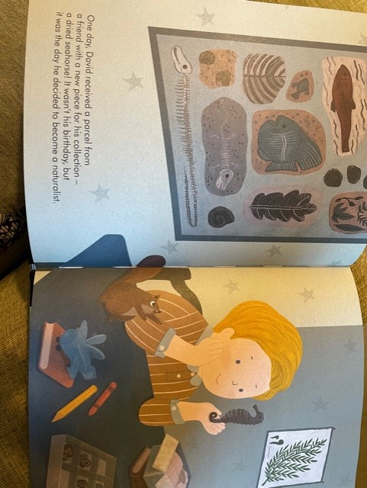

Slide 7
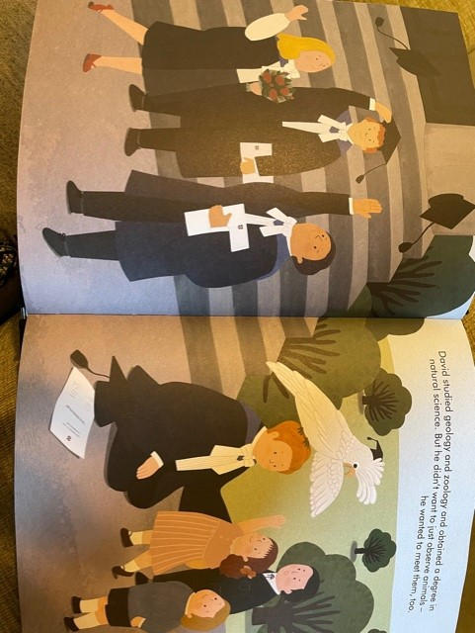

Slide 8
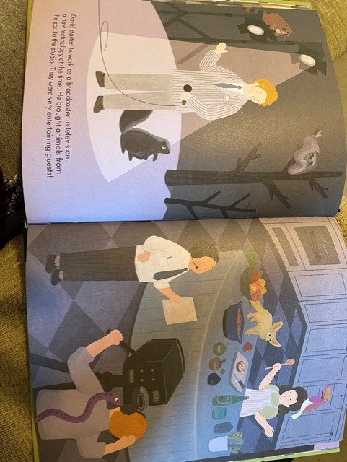

Slide 9
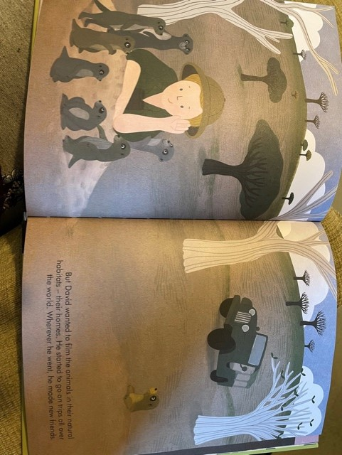

Slide 10
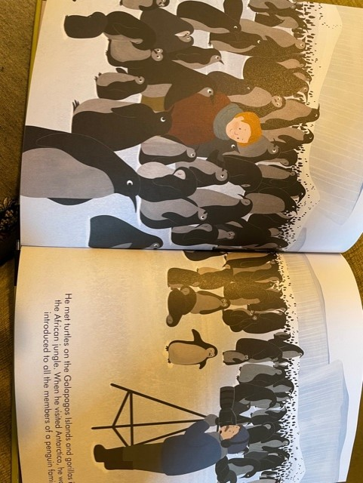

Slide 11
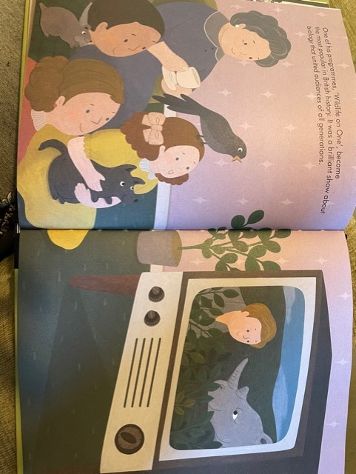

Slide 12
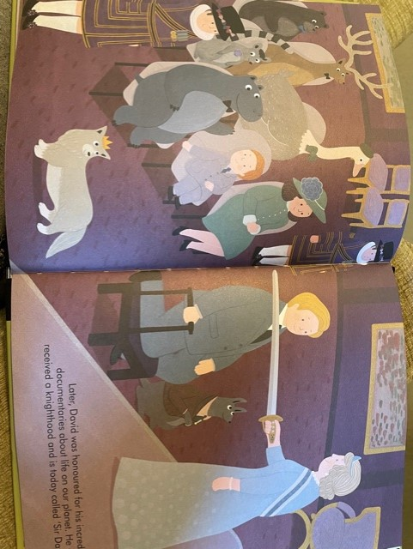

Slide 13
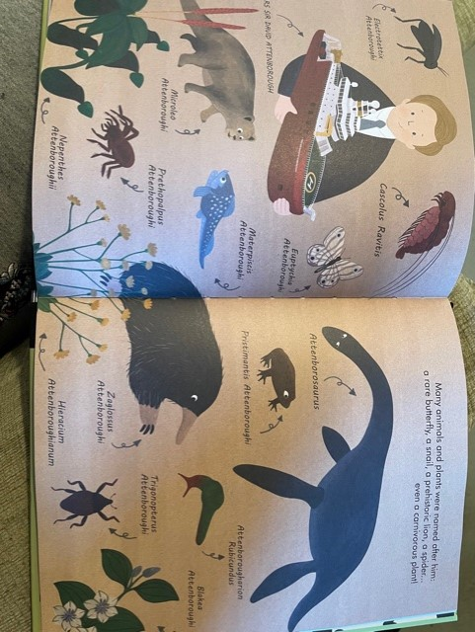

Slide 14
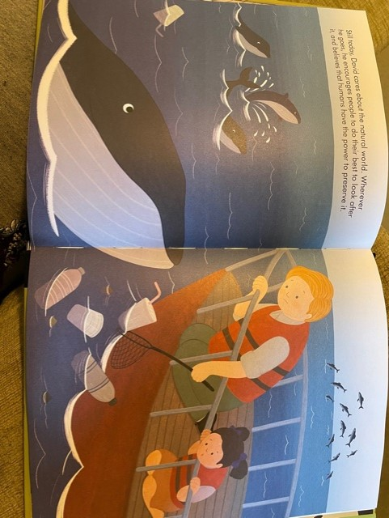

Slide 15
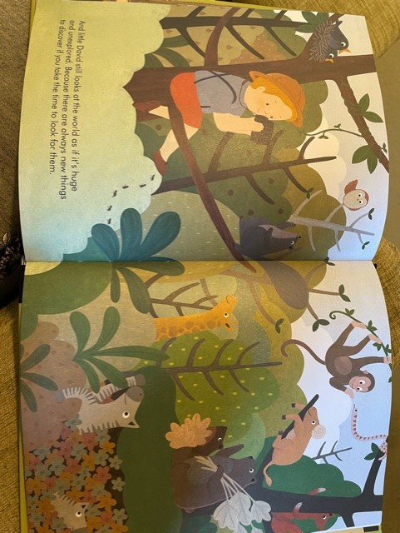

Slide 16
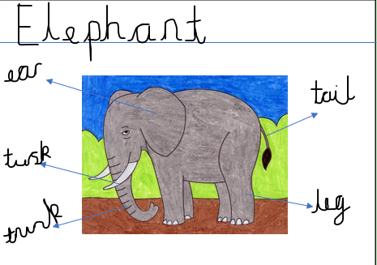
Writing a Letter
Who is the letter to?
To David,
Thank you for teaching us all about
animals and how to look after our
world. My favourite animal is an
elephant.
From
Miss Pitman
Your message
Who is the letter from?

Slide 17
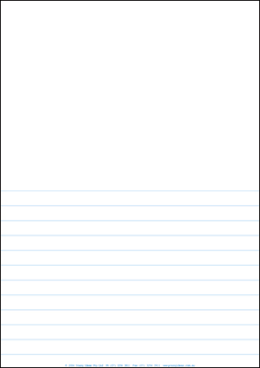
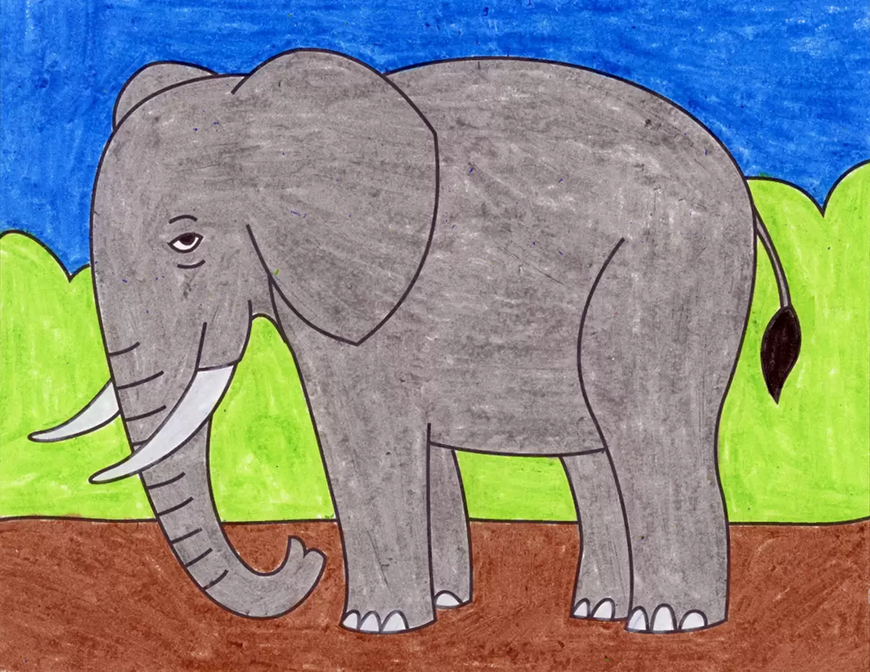





Today’s Activity
Under the picture you drew yesterday, write a letter to Sir David Attenborough.
Once you have finished take a picture and send it to your teacher. We will print them off and send them to Sir David Attenborough.
To David,

